Slide 1
Large-Scale Configurable Static Analysis
Mayur Naik
Georgia Tech
Joint work with:
Xin Zhang, Ravi Mangal
Georgia Tech
Hongseok Yang, Radu Grigore
Oxford University
Mooly Sagiv Tel-Aviv University
Percy Liang
Univ. of California at Berkeley
Notes:
Thank you.

Slide 2
What is Program Analysis?
Discovering useful facts about programs
For optimization, bug-finding, etc.
Broadly two kinds:
Dynamic analysis
program analysis using program runs
Static analysis
program analysis using program text
Primary focus of this talk: Static analysis
But we will also use dynamic analysis

Slide 3
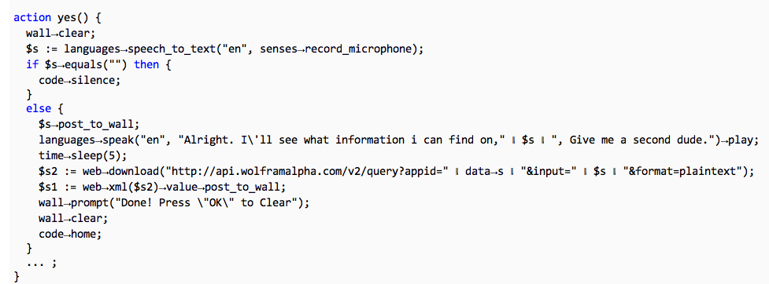





Example: Information-Flow Analysis
program p
information-flow analysis
query q₁
query q₂
X
X
p ² q₁?
p ² q₂?

Slide 4
Information-Flow Analysis
Information flow analysis
Pointer analysis
Type-state analysis
Call-graph analysis
program p
information-flow analysis
query q₁
query q₂
X
X
p ² q₁?
p ² q₂?

Slide 5
Static Analysis as Building Blocks
Information flow analysis
Pointer analysis
Type-state analysis
Call-graph analysis
Program slicing analysis
Pointer analysis
Dependence analysis
Call-graph analysis
Datarace detection analysis
Pointer analysis
Lockset analysis
Call-graph analysis
Thread-escape analysis
May-happen-in-parallel analysis

Slide 6
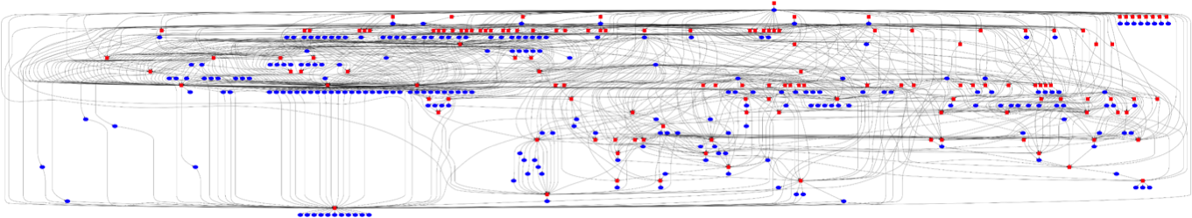
All Analyses in Chord
147 tasks (square nodes)
246 targets (oval nodes)
1050 dependencies (edges)

Slide 7
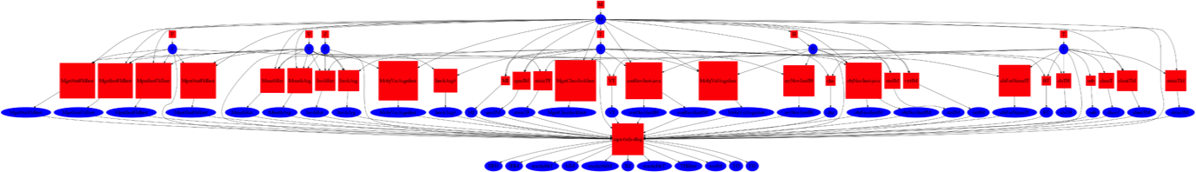
A Pointer Analysis (0-CFA) in Chord
37 tasks (square nodes)
49 targets (oval nodes)
154 dependencies (edges)

Slide 8
Pointer analysis example
f(){
v1 = new ...;
v2 = id1(v1);
v3 = id2(v2);
q2:assert(v3!= v1);
}
id1(v){return v;}
g(){
v4 = new ...;
v5 = id1(v4);
v6 = id2(v5);
q1:assert(v6!= v1);
}
id2(v){return v;}
Notes:
In the rest of the talk, I am going to use pointer analysis as an example to illustrate our approach. The example program allocates an object in each of methods f and g, and passes it to methods id1 and id2. The pointer analysis is asked to prove two queries: q1 says that v6 does not alias with v1 at the end of g, while q2 says that v3 does not alias with v1 at the end of f. Proving q1 requires a context sensitive analysis which can distinguish different calling contexts of id1 and id2. Otherwise, the confusion of calling contexts will cause a spurious flow shown on the slide, which will fail the proof of q1. Q2 on the other hand cannot be proven as v3 does alias with v1 .
A standard approach to distinguish between calling contexts is to clone, or inline the called method body at a call site. You might ask why not inline every method call? This is infeasible as it will grow the program size exponentially and make the analysis not terminating with the presence of recursion. To address this problem, our goal is to clone selectively.

Slide 9

Balancing Precision and Scalability
Precision
Scalability

Slide 10
Satic Analysis: 70’s to 90’s
client-oblivious
“Because clients have different precision and scalability needs, future work should identify the client they are addressing …” M. Hind, Pointer Analysis: Haven’t We Solved This Problem Yet?, 2001
program p
abstraction a
query q₁
query q₂
p ² q₁?
p ² q₂?

Slide 11
Static Analysis as Building Blocks
Information flow analysis
Pointer analysis
Type-state analysis
Call-graph analysis
Program slicing analysis
Pointer analysis
Dependence analysis
Call-graph analysis
Datarace detection analysis
Pointer analysis
Lockset analysis
Call-graph analysis
Thread-escape analysis
May-happen-in-parallel analysis

Slide 12
Static Analysis: 00’s to Present
client-driven
program p
abstraction a
query q₁
query q₂
p ² q₁?
p ² q₂?

Slide 13
Static Analysis: 00’s to Present
client-driven
modern pointer analyses
software model checkers
abstraction a₁
abstraction a₂
q₁
p
q₂
p ² q₁?
p ² q₂?

Slide 14
Our Static Analysis Setting
client-driven + parametric
new search algorithms: testing, machine learning, …
new analysis questions: optimality, impossibility, …
0 1 0 0 0
1 0 0 0 1
abstraction a₁
abstraction a₂
q₁
p
q₂
p ² q₁?
p ² q₂?

Slide 15
Example 1: Predicate Abstraction (CEGAR)
Predicates to use in predicate abstraction
0 1 0 0 0
1 0 0 0 1
abstraction a₁
abstraction a₂
q₁
p
q₂
p ² q₁?
p ² q₂?

Slide 16
Example 2: Shape Analysis (TVLA)
Predicates to use as abstraction predicates
0 1 0 0 0
1 0 0 0 1
abstraction a₁
abstraction a₂
q₁
p
q₂
p ² q₁?
p ² q₂?

Slide 17
Example 3: Cloning-based Pointer Analysis
K value to use for each call site and each allocation site
0 1 0 0 0
1 0 0 0 1
abstraction a₁
abstraction a₂
q₁
p
q₂
p ² q₁?
p ² q₂?

Slide 18
Problem Statement
An efficient algorithm with:
INPUTS:
program p and query q
abstractions A = { a₁, …, a_{n} }
boolean function S(p, q, a)
OUTPUT:
Impossibility: @ a 2 A: S(p, q, a) = true
Proof: a 2 A: S(p, q, a) = true
8 a’ 2 A: (a’ · a Æ S(p, q, a’) = true) ) a’ = a
a
p
_{S}
q
p ` q
p 0 q
AND
Optimal Abstraction

Slide 19
Problem Statement
An efficient algorithm with:
INPUTS:
program p and query q
abstractions A = { a₁, …, a_{n} }
boolean function S(p, q, a)
OUTPUT:
Impossibility: @ a 2 A: S(p, q, a) = true
Proof: a 2 A: S(p, q, a) = true
8 a’ 2 A: (a’ · a Æ S(p, q, a’) = true) ) a’ = a
1111 finest
S(p, q, a)
: S(p, q, a)
0100 optimal
0000 coarsest
AND
Optimal Abstraction

Slide 20
Orderings on A
Efficiency Partial Ordering
a₁ ·_{cost} a₂ , sum of a₁’s bits · sum of a₂’s bits
S(p, q, a₁) runs faster than S(p, q, a₂)
Precision Partial Ordering
a₁ ·_{prec} a₂ , a₁ is pointwise · a₂
S(p, q, a₁) = true ) S(p, q, a₂) = true

Slide 21
Why Optimality?
Empirical lower bounds for static analysis
Efficient to compute
Better for user consumption
analysis imprecision facts
assumptions about missing program parts
Better for machine learning

Slide 22
Why is this Hard in Practice?
|A| exponential in size of p, or even infinite
S(p, q, a) = false for most p, q, a
Different a is optimal for different p, q
A
S(p, q, a)
: S(p, q, a)

Slide 23
Talk Outline
Machine Learning [POPL’11]
Dynamic Analysis [POPL’12]
Static Refinement [PLDI’13]
Constraint Solving [PLDI’14]

Slide 24
Abstraction Coarsening [POPL’11]
For given p, q: start with finest a, incrementally replace 1’s with 0’s
Two algorithms:
deterministic vs. randomized
In practice, use combination of the algorithms
1111 finest
S(p, q, a)
: S(p, q, a)
0100 optimal
0000 coarsest

Slide 25
Randomized Coarsening Algorithm
a Ã (1, …, 1)
Loop:
Remove each component from a with probability (1 - ®)
Run S(p, q, a)
If :S(p, q, a) then add components back
Else remove components permanently

Slide 26
Performance of Randomized Coarsening
Let: n = total # components
s = # components in largest optimal abstraction
If set probability ® = e^{(-1/s)} then outputs optimal abstraction in O(s log n) expected time
Significance: s is small, only log dependence on total # components

Slide 27
Application: Pointer Analysis Abstractions
Client: static datarace detector [PLDI’06]
Pointer analysis using k-CFA with heap cloning
Uses call graph, may-alias, thread-escape, and may-happen-in-parallel analyses
 | # components (x 1000) |  | # unproven queries (dataraces) (x 1000)
 | alloc sites | call sites | 0-CFA | 1-CFA | diff | 1-obj | 2-obj | diff
hedc | 1.6 | 7.2 | 21.3 | 17.8 | 3.5 | 17.1 | 16.1 | 1.0
weblech | 2.6 | 12.4 | 27.9 | 8.2 | 19.7 | 8.1 | 5.5 | 2.5
lusearch | 2.9 | 13.9 | 37.6 | 31.9 | 5.7 | 31.4 | 20.9 | 10.5

Slide 28
Experimental Results: All Queries
K-CFA | # components (x 1000) | BasicRefine (x 1000) | ActiveCoarsen
hedc | 8.8 | 7.2 (83%) | 90 (1.0%)
weblech | 15.0 | 12.7 (85%) | 157 (1.0%)
lusearch | 16.8 | 14.9 (88%) | 250 (1.5%)
K-obj | # components (x 1000) | BasicRefine (x 1000) | ActiveCoarsen
hedc | 1.6 | 0.9 (57%) | 37 (2.3%)
weblech | 2.6 | 1.8 (68%) | 48 (1.9%)
lusearch | 2.9 | 2.1 (73%) | 56 (1.9%)

Slide 29
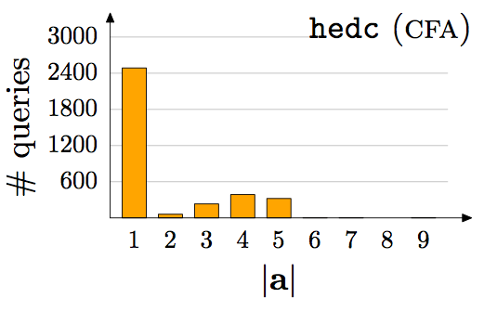
Empirical Results: Per Query

Slide 30
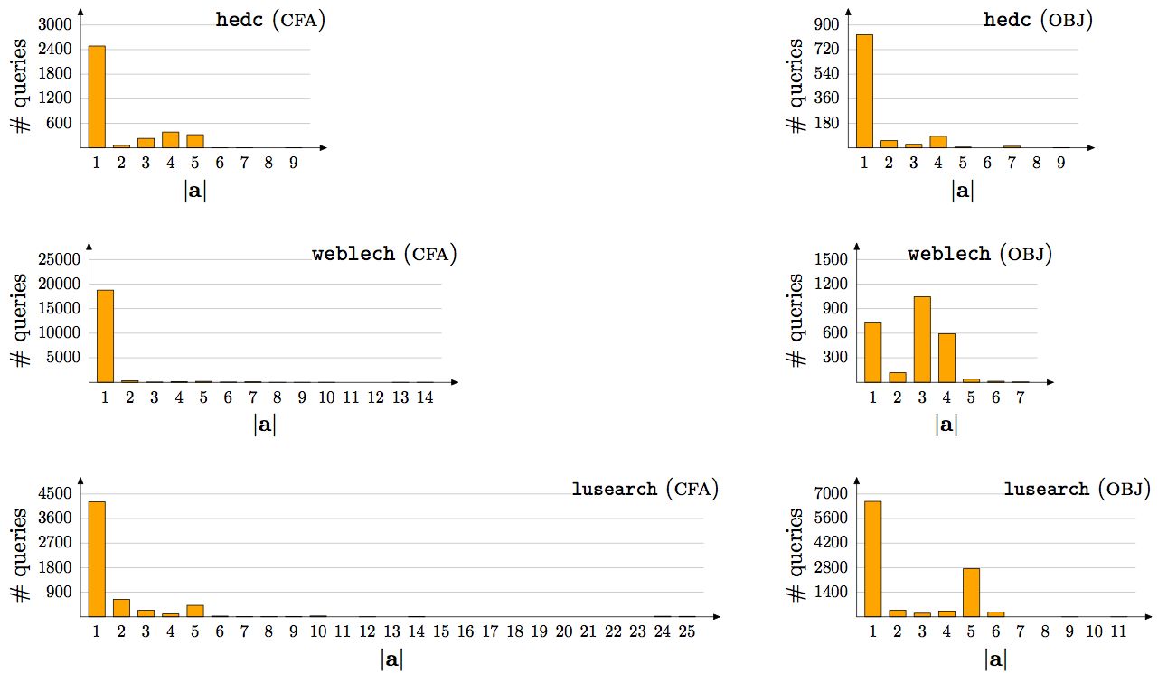
Empirical Results: Per Query, contd.

Slide 31
Talk Outline
Machine Learning [POPL’11]
Dynamic Analysis [POPL’12]
Static Refinement [PLDI’13]
Constraint Solving [PLDI’14]

Slide 32

Abstractions From Tests [POPL’12]
dynamic analysis
p, q
0 1 0 0 0
and optimal!
static analysis
p ² q?

Slide 33
Combining Dynamic and Static Analysis
Previous work:
Counterexamples: query is false on some input
suffices if most queries are expected to be false
Likely invariants: a query true on some inputs is likely true on all inputs [Ernst 2001]
Our approach:
Proofs: a query true on some inputs is likely true on all inputs and for likely the same reason!

Slide 34
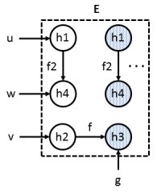

Example: Thread-Escape Analysis
// u, v, w are local variables
// g is a global variable
// start() spawns new thread
for (i = 0; i < N; i++) {
u = new h1;
v = new h2;
g = new h3;
v.f = g;
w = new h4;
u.f2 = w;
pc: w.id = i;
u.start();
}
h1 h2 h3 h4
L L L L
local(pc, w)?

Slide 35
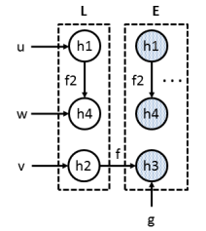
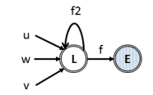
Example: Thread-Escape Analysis
// u, v, w are local variables
// g is a global variable
// start() spawns new thread
for (i = 0; i < N; i++) {
u = new h1;
v = new h2;
g = new h3;
v.f = g;
w = new h4;
u.f2 = w;
pc: w.id = i;
u.start();
}
h1 h2 h3 h4
L L E L
local(pc, w)?
but not optimal

Slide 36
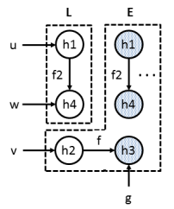
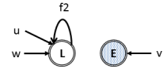
Example: Thread-Escape Analysis
// u, v, w are local variables
// g is a global variable
// start() spawns new thread
for (i = 0; i < N; i++) {
u = new h1;
v = new h2;
g = new h3;
v.f = g;
w = new h4;
u.f2 = w;
pc: w.id = i;
u.start();
}
h1 h2 h3 h4
L E E L
local(pc, w)?
and optimal!

Slide 37
Benchmarks
 | classes |  | bytecodes (x 1000) |  | alloc. sites (x 1000)
 | app | total | app | total
hedc | 44 | 355 | 16 | 161 | 1.6
weblech | 57 | 579 | 20 | 237 | 2.6
lusearch | 229 | 648 | 100 | 273 | 2.9
sunflow | 164 | 1,018 | 117 | 480 | 5.2
avrora | 1,159 | 1,525 | 223 | 316 | 4.9
hsqldb | 199 | 837 | 221 | 491 | 4.6

Slide 38
Precision: Thread-Escape Analysis

Slide 39
Running Time (seconds) CDFs

Slide 40
Running Time (seconds) CDFs

Slide 41
Talk Outline
Machine Learning [POPL’11]
Dynamic Analysis [POPL’12]
Static Refinement [PLDI’13]
Constraint Solving [PLDI’14]

Slide 42
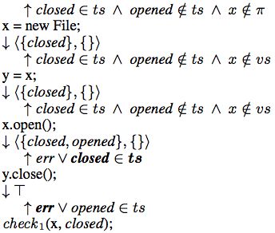
Example: Type-State Analysis
x = new File;
y = x;
if (*) z = x;
x.open();
y.close();
if (*)
check1(x, closed);
else
check2(x, opened);
Query | Abstraction
check1 | Any >= { x, y }
check2 | None
Query | Abstraction
check1 | { }
check2

Slide 43
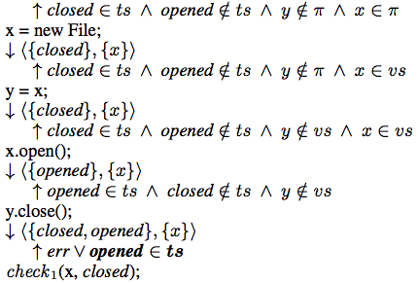
Example: Type-State Analysis
x = new File;
y = x;
if (*) z = x;
x.open();
y.close();
if (*)
check1(x, closed);
else
check2(x, opened);
Query | Abstraction
check1 | Any >= { x, y }
check2 | None
Query | Abstraction
check1 | { }
check2
{ x }
{ x, y }

Slide 44
test

Slide 45
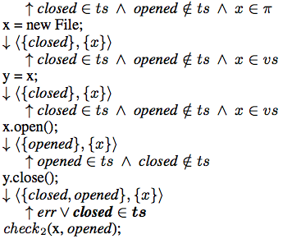
Example: Type-State Analysis
x = new File;
y = x;
if (*) z = x;
x.open();
y.close();
if (*)
check1(x, closed);
else
check2(x, opened);
Query | Abstraction
check1 | Any >= { x, y }
check2 | None
Query | Abstraction
check1 | { }
check2 | { }
{ x }
{ x, y }
{ x }

Slide 46
Precision: Thread-Escape Analysis

Slide 47
Comparison with Abstractions from Tests

Slide 48
Number of Iterations
 | proven queries |  |  | impossible queries
 | min | max | avg | min | max | avg
hsqldb | 2 | 27 | 3 | 1 | 13 | 2
antlr | 2 | 18 | 9 | 1 | 47 | 8
avrora | 2 | 82 | 48 | 1 | 30 | 4
lusearch | 2 | 32 | 2 | 1 | 23 | 2

Slide 49
Running Time
 | proven queries |  |  | impossible queries
 | min | max | avg | min | max | avg
hsqldb | 20s | 25m | 94s | 4s | 50m | 55s
antlr | 18s | 77m | 98s | 6s | 21m | 64s
avrora | 16s | 28m | 67s | 5s | 3h | 41s
lusearch | 14s | 13m | 112s | 6s | 45m | 131s

Slide 50
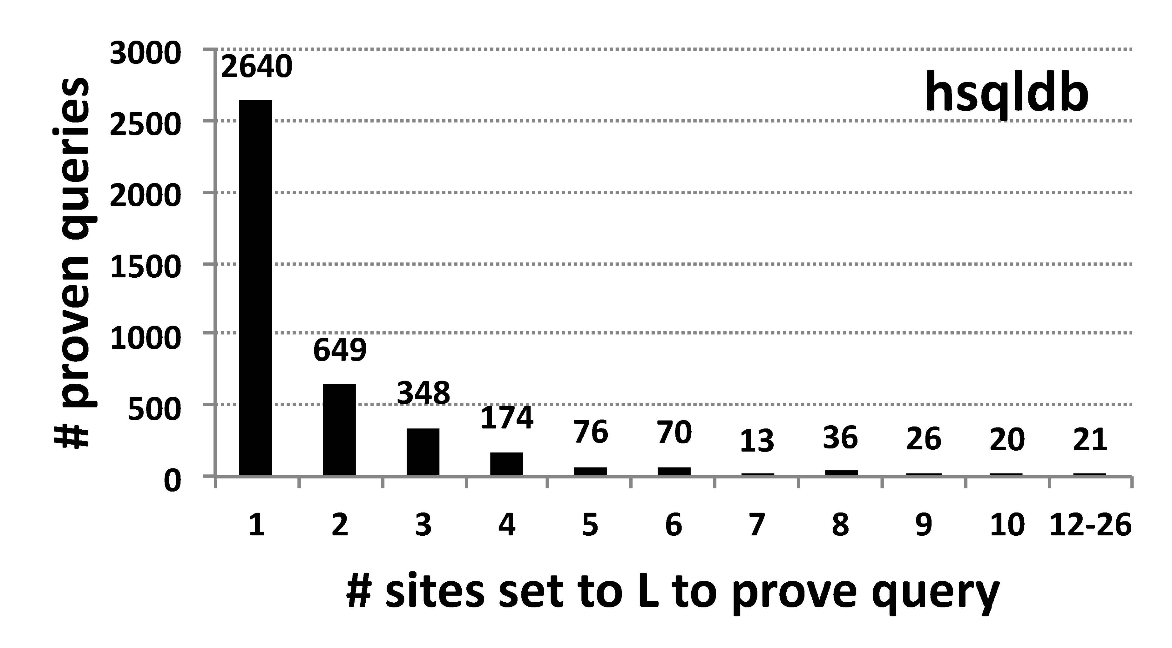
Size of Optimal Abstraction

Slide 51
Size of Optimal Abstraction

Slide 52
Talk Outline
Machine Learning [POPL’11]
Dynamic Analysis [POPL’12]
Static Refinement [PLDI’13]
Constraint Solving [PLDI’14]

Slide 53





Datalog for Program Analysis
Datalog
Notes:
Datalog has become popular in recent years for implementing program analysis. Program analysis tools like Soot, JChord and Doop, all have analyses implemented in Datalog and they also provide Datalog as part of the generic framework for writing program analysis. Recently, there are also researchers trying to implement program analysis in Datalog for LLVM.

Slide 54
What is Datalog?
Datalog

Slide 55
What is Datalog?
Input relations:
Output relations:
Rules:
edge(i, j).
path(i, j).
(1) path(i, i).
(2) path(i, k) :- path(i, j), edge(j, k).
Least fixpoint computation:
Input: edge(0, 1), edge(1, 2).
path(0, 0).
path(1, 1).
path(2, 2).
path(0, 1) :- path(0, 0), edge(0, 1).
path(0, 2) :- path(0, 1), edge(1, 2).
Datalog
Notes:
What is Datalog? Datalog is a logic programming language. A typical Datalog program consists of three parts: input relations, output relations, and rules. By defining the Datalog program and providing input tuples, the underlying Datalog engine conducts a least fixpoint computation and produces the output tuples. For example, we can define a Datalog program shown on the slide for the graph reachability problem, which many program analyses can be encoded into. The only input relation is the edge relation, while the only output relation is the path relation. There are two rules: the first rule says there is a path between each node itself., the second rule says we can extend a path from node i to j to a path from node i to k, if an edge from j to k exists. If we provide edge(0, 1) and edge (0, 2) as the input tuples which defines a graph with three nodes, the datalog engine will compute as follows: the first three path tuples come from Rule 1, while the last two path tuples come from Rule 2.

Slide 56






Why Datalog?
If there exists a path from a to b, and there is an edge from b to c, then there exists a path from a to c:
path(a, c) :- path(a, b), edge(b, c).
Datalog
Notes:
Why to use Datalog to implement program analysis? First of all, Datalog is declarative and easy to use. For example, if the user wants to state that a path exists from a to c if there exists a path from a to b and a edge from b to c, he can just write one single datalog rule shown in the textbox. Secondly, the underlying datalog engine hides the low-level implementation details like data structures and least fixpoint algorithms, allowing users to focus on high-level analysis design.

Slide 57

Why Datalog?
k-object-sensitivity,
k = 2, ~100KLOC
Notes:
Remember to introduce k-obj as “a popular kind of pointer analysis for object-oriented programs”
After years of development, the datalog engines have gained significant success in developing smart symbolic representations like Binary decision diagram, which allows many analyses scaling to a reasonable size of programs. For example, k-object-sensitivity is a popular kind of pointer analysis for object-oriented programs. The k value controls the cloning depth of context sensitivity and object sensitivity. K-object-sensitivity on current Datalog engines can scale to around 100 thousand lines of code with k equaled to 2.

Slide 58
Limitation
k-object-sensitivity,
k = 10, ~500KLOC
k-object-sensitivity,
k = 2, ~100KLOC
Notes:
However, to make these analyses really practical, we need to scale them to even larger programs with better precisions. For example, in k-object-sensitivity, how do we go from 100 thousands lines of code with k equaled to 2 to half million lines of code with k equaled to 10? While advances in Datalog solvers will likely continue, we propose a complementary approach to this problem that leverages those advances.

Slide 59
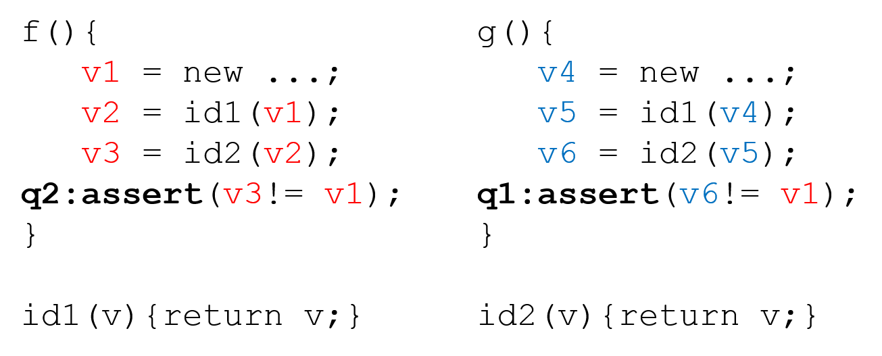
Pointer Analysis as Graph Reachability
a₁
0
a₀
b₀
3
b₁
6’
6
6’’
a₁
a₀
b₀
b₁
1
4
c₁
c₀
d₀
d₁
7’
7
7’’
c₁
c₀
d₀
d₁
2
5
Notes:
For exposition, we recast this problem as a graph reachability problem. Nodes 0, 1, 2 represent the basic blocks of f, while nodes 3, 4 and 5 represent the basic blocks of g. 6 and 7 represent the bodies of id1 and id2, while node 6’, 6’’, 7’, 7’’ are their clones at different call sites. Edges with the same label represents matching calls and returns. For an edge pair a0 and a1, a valid abstraction will either choose a0, which means no clone for id1 in f, or a1, which means cloning id1 in f.
Then, proving q1 becomes to show node 5 is not reachable from 0, while q2 becomes to show that node 2 is not reachable from node 0.

Slide 60
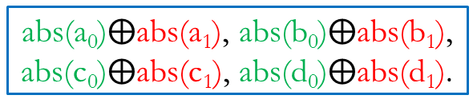
Graph Reachability in Datalog
a₁
0
a₀
b₀
3
b₁
Input relations:
edge(i, j, n), abs(n)
Output relations:
path(i, j)
Rules:
(1) path(i, i).
(2) path(i, j) :- path(i, k), edge(k, j, n), abs(n).
6’
6
6’’
a₁
a₀
b₀
b₁
1
4
c₁
c₀
d₀
d₁
7’
7
7’’
c₁
c₀
d₀
d₁
2
5
Input tuples:
edge(0, 6, a₀), edge(0, 6’, a₁), edge(3, 6, b₀),
…
Query Tuple | Original Query
q₁: path(0, 5) | assert(v6!= v1)
q₂: path(0, 2) | assert(v3!= v1)
abs(a₀)$⨁$abs(a₁), abs(b₀)$⨁$abs(b₁),
abs(c₀)$⨁$abs(c₁), abs(d₀)$⨁$abs(d₁).
16 possible abstractions in total
Notes:
We express the graph reachability problem in Datalog. Input relation edge represents the possible edges in the graph. The correspondent input tuples are fixed.
Relation abs is the program abstraction. It specifies what edges may be used in computing graph reachability. The correspondent input tuples are configurable. For any edge pair like a0 or a1, we can either choose a0 or a1. Choosing a1 over a0 will produce a more precise but more expensive abstraction. There’re 16 possible such abstractions in total.
The only output relation is the path relation, which represents graph reachability. Proving q1 becomes to show path(0, 5) is not derived under certain abstraction while q2 becomes to show path(0, 2) is not derived under certain abstraction.
There’re two rules. Rule 1 states that each node is reachable from itself. Rule 2 states that Node j is reachable from Node i if node k is reachable from Node i and edge(k, j) is allowed in the abstraction.

Slide 61


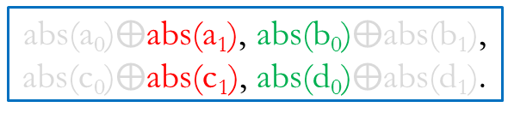
Desired Result
a₁
0
a₀
b₀
3
b₁
Input relations:
edge(i, j, n), abs(n)
Output relations:
path(i, j)
Rules:
(1) path(i, i).
(2) path(i, j) :- path(i, k), edge(k, j, n), abs(n).
6’
6
6’’
a₁
a₀
b₀
b₁
1
4
c₁
c₀
d₀
d₁
7’
7
7’’
c₁
c₀
d₀
d₁
2
5
Input tuples:
edge(0, 6, a₀), edge(0, 6’, a₁), edge(3, 6, b₀),
…
Query | Answer
q₁: path(0, 5) | a₁b₀c₁d₀
q₂: path(0, 2) | Impossibility
abs(a₀)$⨁$abs(a₁), abs(b₀)$⨁$abs(b₁),
abs(c₀)$⨁$abs(c₁), abs(d₀)$⨁$abs(d₁).
Notes:
It turns out that q1 is provable with the cheapest abstraction a1b0c1d0, while q2 is impossible to prove. Our goal is to find such cheapest abstraction for q1 and conclude q2 is impossible to prove.

Slide 62
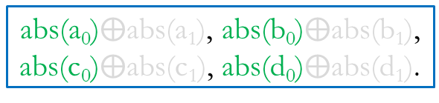
Iteration 1
a₁
0
a₀
b₀
3
b₁
path(0, 0).
path(0, 6) :- path(0, 0), edge(0, 6, a₀), abs(a₀).
path(0, 1) :- path(0, 6), edge(6, 1, a₀), abs(a₀).
path(0, 7) :- path(0, 1), edge(1, 7, c₀), abs(c₀).
path(0, 2) :- path(0, 7), edge(7, 2, c₀), abs(c₀).
path(0, 4) :- path(0, 6), edge(6, 4, b₀), abs(b₀).
path(0, 7) :- path(0, 4), edge(4, 7, d₀), abs(d₀).
path(0, 5) :- path(0, 7), edge(7, 5, d₀), abs(d₀).
…
6’
6
6’’
a₁
a₀
b₀
b₁
1
4
c₁
c₀
d₀
d₁
7’
7
7’’
c₁
c₀
d₀
d₁
2
5
Query | Eliminated Abstractions
q₁: path(0, 5)
q₂: path(0, 2)
abs(a₀)$⨁$abs(a₁), abs(b₀)$⨁$abs(b₁),
abs(c₀)$⨁$abs(c₁), abs(d₀)$⨁$abs(d₁).
Notes:
Same as a standard CEGAR approach, our approach starts with the cheapest abstraction in the space, which is a0b0c0d0, meaning no cloning at all. We fail to prove both queries as both tuples are derived.
We try to learn from counterexamples and avoid similar failures in the future. But what is a counterexample for Datalog programs?

Slide 63
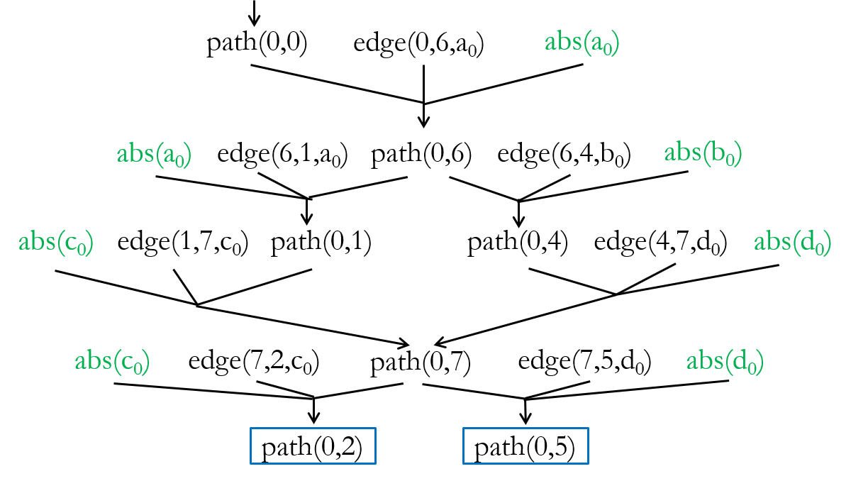
Iteration 1 - Derivation Graph
a₁
0
a₀
b₀
3
b₁
6’
6
6’’
a₁
a₀
b₀
b₁
1
4
c₁
c₀
d₀
d₁
7’
7
7’’
c₁
c₀
d₀
d₁
2
5
Query | Eliminated Abstractions
q₁: path(0, 5)
q₂: path(0, 2)
abs(a₀)$⨁$abs(a₁), abs(b₀)$⨁$abs(b₁),
abs(c₀)$⨁$abs(c₁), abs(d₀)$⨁$abs(d₁).
Notes:
It is a derivation graph for the query tuples.

Slide 64
Iteration 1 - Derivation Graph
path(0,0)
edge(0,6,a₀)
abs(a₀)
abs(a₀)
edge(6,1,a₀)
path(0,6)
edge(6,4,b₀)
abs(b₀)
abs(c₀)
edge(1,7,c₀)
path(0,1)
path(0,4)
edge(4,7,d₀)
abs(d₀)
abs(c₀)
edge(7,2,c₀)
path(0,7)
edge(7,5,d₀)
abs(d₀)
path(0,2)
path(0,5)
Notes:
Let us take a closer look at the derivation graph.

Slide 65
Iteration 1 - Derivation Graph
path(0,0)
edge(0,6,a₀)
abs(a₀)
abs(a₀)
edge(6,1,a₀)
path(0,6)
edge(6,4,b₀)
abs(b₀)
abs(c₀)
edge(1,7,c₀)
path(0,1)
path(0,4)
edge(4,7,d₀)
abs(d₀)
abs(c₀)
edge(7,2,c₀)
path(0,7)
edge(7,5,d₀)
abs(d₀)
path(0,2)
path(0,5)
Notes:
We can observe that, as long as we have a0 and c0 in the abstraction, path(0, 2) will be derived.

Slide 66
Iteration 1 - Derivation Graph
path(0,0)
edge(0,6,a₀)
abs(a₀)
abs(a₀)
edge(6,1,a₀)
path(0,6)
edge(6,4,b₀)
abs(b₀)
abs(c₀)
edge(1,7,c₀)
path(0,1)
path(0,4)
edge(4,7,d₀)
abs(d₀)
abs(c₀)
edge(7,2,c₀)
path(0,7)
edge(7,5,d₀)
abs(d₀)
path(0,2)
path(0,5)
Notes:
For path(0, 5), as long as we have a0c0d0

Slide 67
Iteration 1 - Derivation Graph
path(0,0)
edge(0,6,a₀)
abs(a₀)
abs(a₀)
edge(6,1,a₀)
path(0,6)
edge(6,4,b₀)
abs(b₀)
abs(c₀)
edge(1,7,c₀)
path(0,1)
path(0,4)
edge(4,7,d₀)
abs(d₀)
abs(c₀)
edge(7,2,c₀)
path(0,7)
edge(7,5,d₀)
abs(d₀)
path(0,2)
path(0,5)
Notes:
Or a0b0d0, it will be derived.

Slide 68
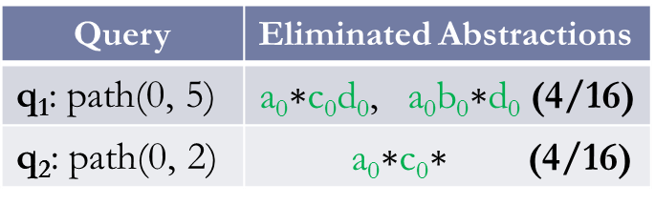
Iteration 1 - Derivation Graph
a₁
0
a₀
b₀
3
b₁
6’
6
6’’
a₁
a₀
b₀
b₁
1
4
c₁
c₀
d₀
d₁
7’
7
7’’
c₁
c₀
d₀
d₁
2
5
Query | Eliminated Abstractions
q₁: path(0, 5) | a₀c₀d₀, a₀b₀d₀ (4/16)
q₂: path(0, 2) | a₀c₀ (4/16)
abs(a₀)$⨁$abs(a₁), abs(b₀)$⨁$abs(b₁),
abs(c₀)$⨁$abs(c₁), abs(d₀)$⨁$abs(d₁).
Notes:
Therefore, we eliminate four abstractions for each queries.
Our next step should be find the cheapest viable abstraction. How do we do this?

Slide 69
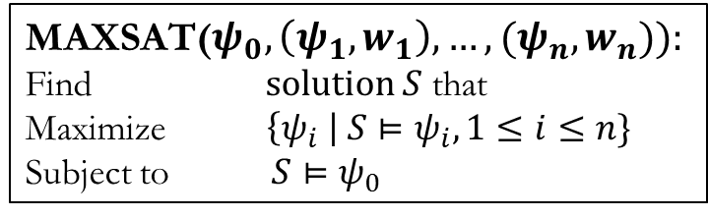
Encoded as MAXSAT
Hard Constraints
Soft Constraints
MAXSAT($ψ_{0},\left(ψ_{1},w_{1}\right),…,(ψ_{n},w_{n})):$
Find $solution S$ that
Maximize $\left\{ψ_{i} \right| S⊨ψ_{i}, 1≤i≤n\}$
Subject to $S⊨ψ_{0}$
Notes:
Our answer is to use MAXSAT. What is MAXSAT? MAXSAT is very similar with standard SAT, except that it is for optimization. There are two kinds of constraints in a MAXSAT problem: hard constraints are standard SAT constraints, while soft constraints are constraints with weights. MAXSAT solver will find a solution that maximizes the weights of satisfied soft constraints while satisfying all the hard constraints.

Slide 70
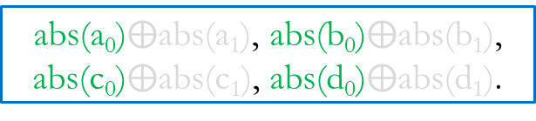
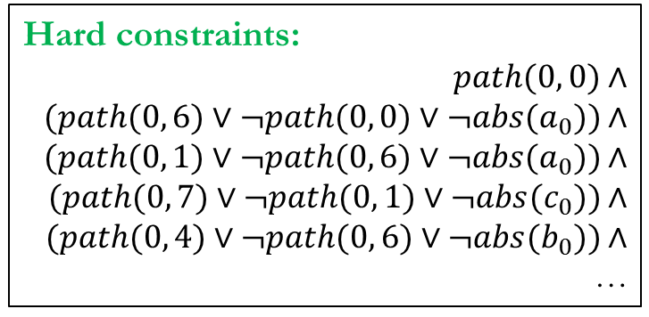
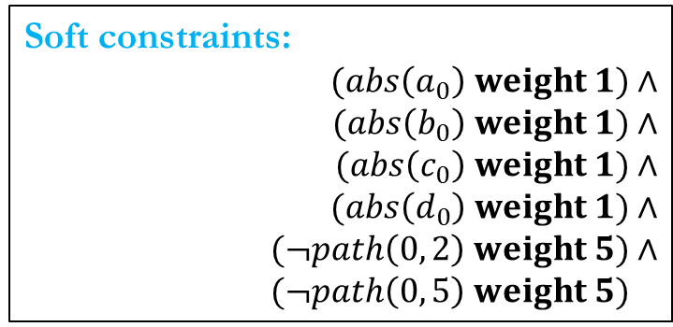
Encoded as MAXSAT
Avoid all the counterexamples
Hard constraints:
$$path(0, 0\text{)}∧$$
$$(path(0, \text{6}\text{)}∨¬path(0, \text{0)}∨¬abs(a_{0})\text{)}∧$$
$$(path(0, \text{1}\text{)}∨¬path(0, \text{6)}∨¬abs(a_{0})\text{)}∧$$
$$(path(0, \text{7}\text{)}∨¬path(0, \text{1}\text{)}∨¬abs(c_{0})\text{)}∧$$
$$(path(0, \text{4}\text{)}∨¬path(0, \text{6}\text{)}∨¬abs(b_{0})\text{)}∧$$
…
Minimize the abstraction cost
Soft constraints:
$$(abs\left(a_{0}\right) weight 1)∧$$
$$(abs\left(b_{0}\right) weight 1)∧$$
$$(abs\left(c_{0}\right) weight 1)∧$$
$$(abs\left(d_{0}\right) weight 1)∧$$
$$(¬path\left(0, 2\right) weight 5)∧$$
$$(¬path\left(0, 5\right) weight 5)∧$$
abs(a₀)$⨁$abs(a₁), abs(b₀)$⨁$abs(b₁),
abs(c₀)$⨁$abs(c₁), abs(d₀)$⨁$abs(d₁).
Notes:
We encode the derivation graph as the hard constraints. Each grounded Datalog rules is translated into a Horn clause. We use the tuple itself as the boolean variable, representing the existence of the tuple in the derivation. The constraints regarding derivation graph have to be hard as they explain why each tuple is derived. This is related with the soundness of the Datalog analysis.
There are two kinds of soft constraints. The first kind of soft constraints encodes the cost of abstraction. The higher weight, the cheaper the abstraction is. For example, we assign weight 1 to a0, which means if we have a0 in the abstraction, we gain a Score 1. If we have abs(a0) = false, which means we don’t have a0 but a1 in the abstraction. In this case, we get a score of 0, explicitly.
The second kind of soft constraints are about queries. We use the negation of the query tuple to express that we want to get rid of them. You might wonder why we encode query tuples as soft constraints rather than hard constraints. This is because no matter what abstraction we choose, q2 cannot be proven. If we encode it as a hard constraint, it will make the whole formula unsatisfiable, preventing the proof of the other query.
You may further wonder why we use 5 as the weight for the queries. We use 5, which is greater than the highest weight sum of all abstractions, that is 4. Therefore, when this constraint is violated, it means no abstraction in the space can prove this query, even with the most expensive abstraction.

Slide 71
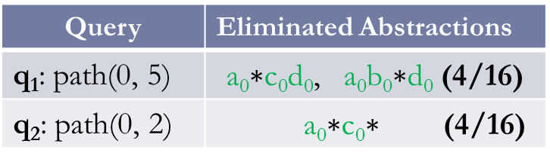
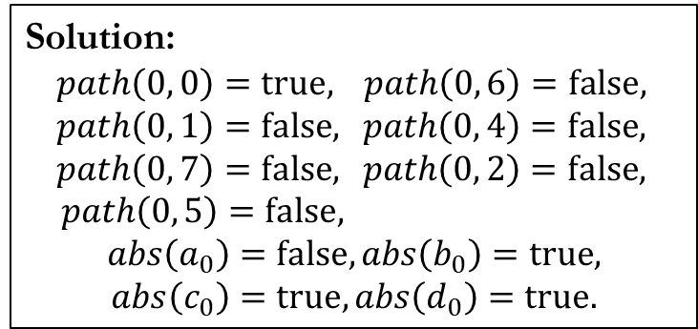
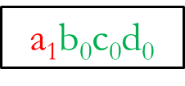
Encoded as MAXSAT
Solution:
$path\left(0, 0\right)=true,$ $path\left(0, 6\right)=false,$
$path\left(0, 1\right)=false,$ $path\left(0, 4\right)=false,$
$path\left(0, 7\right)=false,$ $path\left(0, 2\right)=false,$
$path\left(0, 5\right)=false, p,ath\left(0, 6\right)=0,$
$$abs\left(a_{0}\right)=false,abs\left(b_{0}\right)=true,$$
$$abs\left(c_{0}\right)=true,abs\left(d_{0}\right)=true.$$
Hard constraints:
$$path(0, 0\text{)}∧$$
$$(path(0, \text{6}\text{)}∨¬path(0, \text{0)}∨¬abs(a_{0}\text{)}\text{)}∧$$
$$(path(0, \text{1}\text{)}∨¬path(0, \text{6)}∨¬abs(a_{0}\text{))}∧$$
$$(path(0, \text{7}\text{)}∨¬path(0, \text{1}\text{)}∨¬abs(c_{0}\text{))}∧$$
$$(path(0, \text{4}\text{)}∨¬path(0, \text{6}\text{)}∨¬abs(b_{0}\text{))}∧$$
…
Soft constraints:
$$(abs\left(a_{0}\right) weight 1)∧$$
$$(abs\left(b_{0}\right) weight 1)∧$$
$$(abs\left(c_{0}\right) weight 1)∧$$
$$(abs\left(d_{0}\right) weight 1)∧$$
$$(¬path\left(0, 2\right) weight 5)∧$$
$$(¬path\left(0, 5\right) weight 5)∧$$
a₁$\text{b}\text{0}$c₀d₀
Query | Eliminated Abstractions
q₁: path(0, 5) | a₀c₀d₀, a₀b₀d₀ (4/16)
q₂: path(0, 2) | a₀c₀ (4/16)
Notes:
MAXST solve produces the solution shown on the slides. The solutions suggests flipping a0 to a1 while keeping all the other abstraction tuples.. This yields a1b0c0d0 to be the next abstraction to try. This abstraction is the cheapest abstraction among the viable abstractions left.

Slide 72
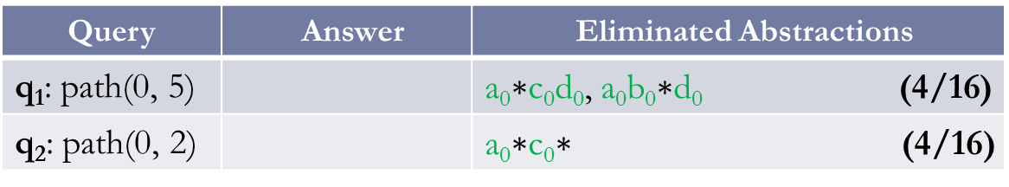





Iteration 2 and Beyond
Iteration 1
Derivation${ D}_{1}$
MAXSAT solver
Datalog solver
$$\text{Constraint}\text{s}$$
$$C_{1}$$
$$C_{1}∧$$
a₁$\text{b}\text{0}$c₀d₀
Query | Answer | Eliminated Abstractions
q₁: path(0, 5) |  | a₀c₀d₀, a₀b₀d₀, a₁d₀ (4/16)
q₂: path(0, 2) |  | a₀c₀, a₁c₀ (4/16)
Notes:
After the first iteration, we eliminate 4 abstractions for each query, and use a1b0c0d0 as the next abstraction to try.

Slide 73

Iteration 2 and Beyond
Iteration 2
Derivation${ D}_{2}$
MAXSAT solver
Datalog solver
$$\text{Constraint}\text{s}$$
$$C_{1}$$
$$C_{1}∧$$
a₁$\text{b}\text{0}$c₀d₀
Query | Answer | Eliminated Abstractions
q₁: path(0, 5) |  | a₀c₀d₀, a₀b₀d₀, a₁d₀ (4/16)
q₂: path(0, 2) |  | a₀c₀, a₁c₀ (4/16)
Notes:
In the second iteration, q1 and q2 are still unproven as both tuples are derived. We get another derivation D2 and pass it to the MAXSAT solver.

Slide 74


Iteration 2 and Beyond
Iteration 2
Derivation${ D}_{2}$
MAXSAT solver
Datalog solver
$$\text{Constraint}\text{s}$$
$$C_{1}$$
$$C_{1}∧$$
$$C_{2}∧$$
a₁$\text{b}\text{0}$c₀d₀
Query | Answer | Eliminated Abstractions
q₁: path(0, 5) |  | a₀c₀d₀, a₀b₀d₀, a₁d₀ (4/16)
q₂: path(0, 2) |  | a₀c₀ (4/16)
Notes:
MAXSAT encodes D2 as constraints C2

Slide 75
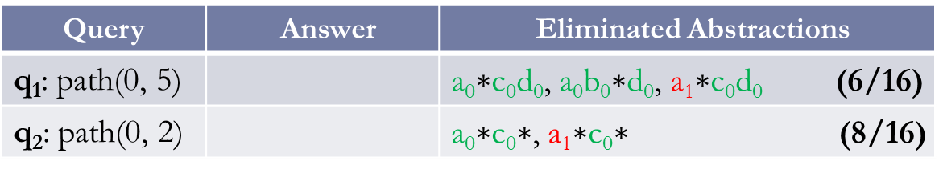

Iteration 2 and Beyond
Iteration 2
Derivation${ D}_{2}$
MAXSAT solver
Datalog solver
$$\text{Constraint}\text{s}$$
$$C_{1}$$
$$C_{1}∧$$
$$C_{2}∧$$
a₁$\text{b}\text{0}$c₁d₀
Query | Answer | Eliminated Abstractions
q₁: path(0, 5) |  | a₀c₀d₀, a₀b₀d₀, a₁c₀d₀ (6/16)
q₂: path(0, 2) |  | a₀c₀, a₁c₀ (8/16)
Notes:
By taking the conjunction of C2 and C1 coming from the first iteration, the MAXSAT eliminates 6 abstractions for q1, and 8 abstractions for q2. It produces a1b0c1d0 as the abstraction for the third iteration.

Slide 76


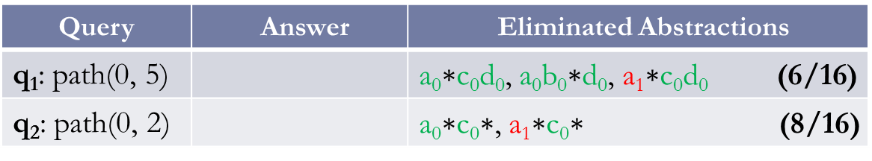
Iteration 2 and Beyond
Iteration 3
Derivation${ D}_{3}$
MAXSAT solver
Datalog solver
$$\text{Constraint}\text{s}$$
$$C_{1}$$
$$C_{1}∧$$
$$C_{2}∧$$
q₁ is proven.
a₁$\text{b}\text{0}$c₁d₀
Query | Answer | Eliminated Abstractions
q₁: path(0, 5) |  | a₀c₀d₀, a₀b₀d₀, a₁c₀d₀ (6/16)
q₂: path(0, 2) |  | a₀c₀, a₁c₀ (8/16)
a₁$\text{b}\text{0}$c₁d₀
Notes:
In the third iteration, q1 is proven as path(0, 5) is no longer derived. Therefore we find the cheapest abstraction to prove q1, which is a1b0c1d0.

Slide 77
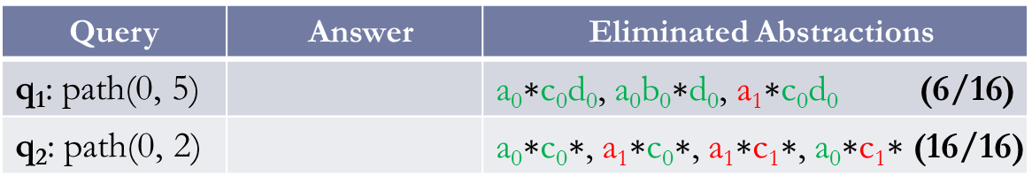

Iteration 2 and Beyond
Iteration 3
Derivation${ D}_{3}$
MAXSAT solver
Datalog solver
$$\text{Constraint}\text{s}$$
$$C_{1}$$
$$C_{1}∧$$
$$C_{2}∧$$
$$C_{3}∧$$
q₁ is proven.
q₂ is impossible to prove.
a₁$\text{b}\text{0}$c₁d₀
Query | Answer | Eliminated Abstractions
q₁: path(0, 5) |  | a₀c₀d₀, a₀b₀d₀, a₁c₀d₀ (6/16)
q₂: path(0, 2) |  | a₀c₀, a₁c₀, a₁c₁, a₀c₁ (16/16)
a₁$\text{b}\text{0}$c₁d₀
Impossibility
Notes:
Q2 is still derived. We encode the derivation D3 as constraint C3 and pass it to the MAXSAT solver. By taking the conjunction of all the constraints across iterations, MAXSAT eliminates all the 16 abstractions for q2, and conclude q2 is impossible to prove.

Slide 78
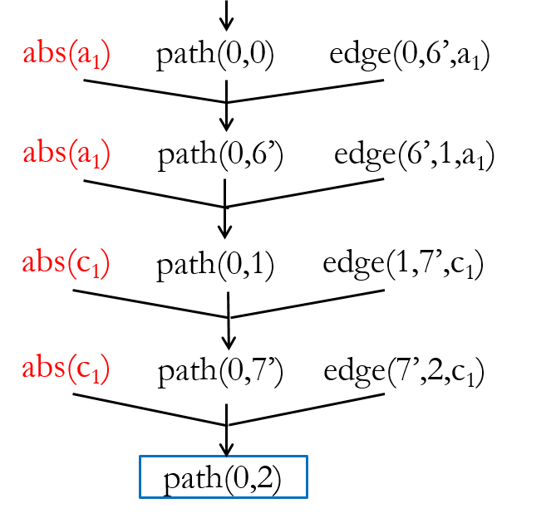


Mixing Counterexamples
Iteration 1
Iteration 3
Eliminated
Abstractions:
a₀$∗$c₀$∗$
a₁$∗$c₁$∗$
Notes:
If we take a closer look at the progress of resolving q2. Iteration 1 eliminates 4 abstractions while Iteration 3 eliminates 4 different abstractions. We notice that the two derivations share the same intermediate tuple path(0, 1). When MAXSAT solver takes the conjunction of two derivations, something interesting happens.

Slide 79
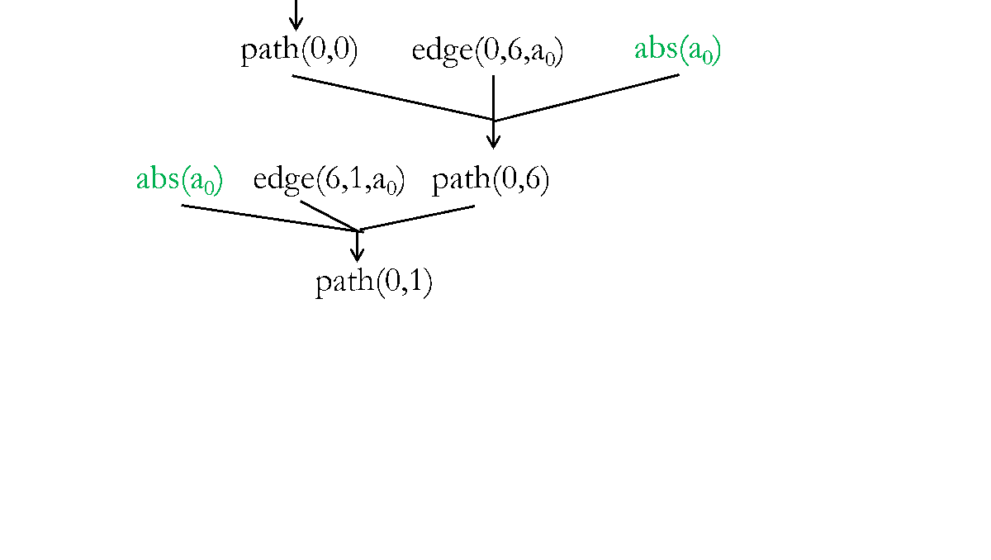
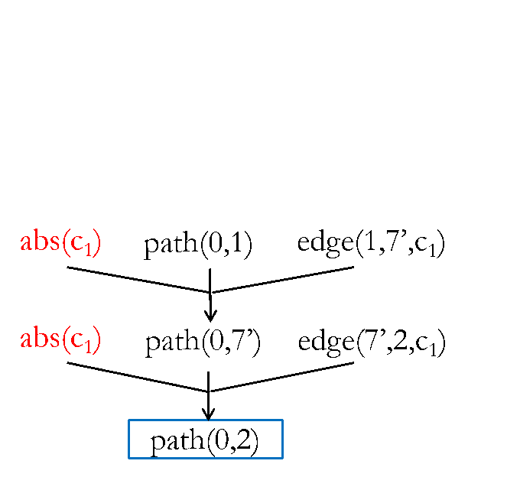

Mixing Counterexamples
Iteration 1
Mixed!
Iteration 3
Eliminated
Abstractions:
a₀$∗$c₀$∗$
a₀$∗$c₁$∗$
a₁$∗$c₁$∗$
Notes:
It turns out that we get a new counterexample for free by mixing the constraints of these two derivations. This counterexample eliminates 4 new abstractions, which neither of the previous derivations eliminate. By mixing counterexamples across iterations, our approach converges faster in practice.

Slide 80
Experimental Setup
Implemented in JChord using off-the-shelf solvers:
Datalog: bddbddb
MAXSAT: MiFuMaX
Applied to two analyses that are challenging to scale:
k-object-sensitivity pointer analysis:
flow-insensitive, weak updates, cloning-based
typestate analysis:
flow-sensitive, strong updates, summary-based
Evaluated on 8 Java programs from DaCapo and Ashes.
Notes:
We have implemented our approach in the Jchord program analysis framework for Java. Our implementation uses unmodified, off-the-shelf Datalog and MAXSAT solvers. We applied the approach to two client analyses that are challenging to scale: one is a k-obj pointer analysis and the other is a typestate analysis.
These two analyses differ in many aspects such as flow sensitivity, heap updates, and context sensitivity.
These differences highlight the generality of our approach.
We applied these two analyses to 8 real-world Java programs, mostly from DaCapo suite and Ashes Suite.

Slide 81
Benchmark Characteristics
 | classes | methods | bytecode(KB) | KLOC
toba-s | 1K | 6K | 423 | 258
javasrc-p | 1K | 6.5K | 434 | 265
weblech | 1.2K | 8K | 504 | 326
hedc | 1K | 7K | 442 | 283
antlr | 1.1K | 7.7K | 532 | 303
luindex | 1.3K | 7.9K | 508 | 295
lusearch | 1.2K | 8K | 511 | 314
schroeder-m | 1.9k | 12K | 708 | 460
Notes:
This table shows the statistics of the benchmarks. All the numbers include both application code and library code. We can see the size of the programs range from ~200KLOC to 0.5MLOC.
In the rest of the talk, I will focus on the pointer analysis results.

Slide 82
Results: Pointer Analysis
4-object-sensitivity
< 50%
 | queries |  |  | abstraction size |  | iterations
 | total | resolved
 |  | current | baseline | final | max
toba-s | 7 | 7 | 0 | 170 | 18K | 10
javasrc-p | 46 | 46 | 0 | 470 | 18K | 13
weblech | 5 | 5 | 2 | 140 | 31K | 10
hedc | 47 | 47 | 6 | 730 | 29K | 18
antlr | 143 | 143 | 5 | 970 | 29K | 15
luindex | 138 | 138 | 67 | 1K | 40K | 26
lusearch | 322 | 322 | 29 | 1K | 39K | 17
schroeder-m | 51 | 51 | 25 | 450 | 58K | 15
< 3% of max
Notes:
The “resolved” column shows the number of queries either proven or found to be impossible to prove. Our approach resolves all the queries while, the baseline, the 4-object-sensitivity analysis, only resolves up to 50% of the queries.
The “final” column shows the sizes of abstractions our approach uses in the last iteration. One way to view the size of the abstraction is to view it as the number of 1s in the abstraction bitvector. “max” shows the size of the most expensive abstraction. As shown on the slide, the size of the final abstraction our approach uses is less than 3% of that of the most expensive abstraction.
Animation on click 1: baseline resolves only upto X% queries
Animation on click 2 for final vs. max abstraction size (pop up)

Slide 83
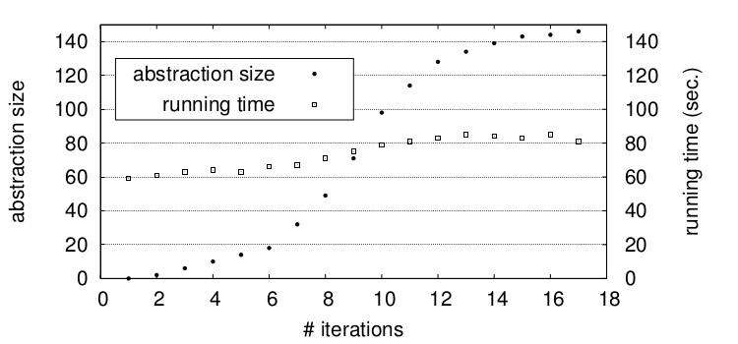
Performance of Datalog: Pointer Analysis
k = 4, 3h28m
Baseline
k = 3, 590s
k = 2, 214s
lusearch
k = 1, 153s
Notes:
This slide shows how the abstraction size and the datalog solver running time change across iterations on benchmark lusearch, The rest benchmarks look similar.
(Remove the following paragraph?)
The x axis is the number of iterations. This curve (use pointer) shows the abstraction size corresponding to the y axis on the left, while this curve (use pointer) shows the datalog running time corresponding to the y axis on the right.
Although the abstraction size grows linearly across iterations, the running time of the datalog solver remains almost constant. This is because by selectively cloning the call sites and allocation sites, our approach increases the abstraction cost by minimum amount required to prove the queries. On the other hand, the baseline, which uses a uniform k value, increases the Datalog running time exponentially.

Slide 84
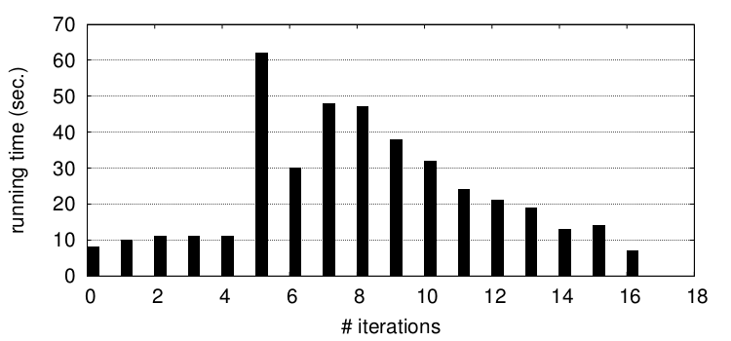
Performance of MAXSAT: Pointer Analysis
lusearch
Notes:
This slide shows the running time of the maxsat solver in each iteration for the lusearch benchmark.
[Animation on click: Blue Up Arrow] We see that in the initial iterations, the running time steadily increases -> constraints harder to solve -> abstraction size gets larger and larger.
[Animation on click: Blue Down Arrow] But in the later iterations, the running time steadily decreases -> constraints easier to solve -> fewer and fewer queries remain

Slide 85
Statistics of MAXSAT Formulae
 | pointer analysis
 | variables | clauses
toba-s | 0.7M | 1.5M
javasrc-p | 0.5M | 0.9M
weblech | 1.6M | 3.3M
hedc | 1.2M | 2.7M
antlr | 3.6M | 6.9M
luindex | 2.4M | 5.6M
lusearch | 2.1M | 5M
schroeder-m | 6.7M | 23.7M
Notes:
Here are statistics of the formulae fed to the maxsat solver in the last iteration for the pointer analysis on all benchmarks. The number of variables in these formulas ranges from 1M to 7M, and the number of clauses ranges from 1M to 24M. The statistics look similar for typestate analysis. These numbers highlight two strengths of our technique: the richness of the abstraction search space it explores, and the benefit of leveraging off-the-shelf maxsat solvers.

Slide 86
Conclusion
Datalog
MAXSAT
Abstraction
Notes:
In summary, Datalog has become a popular language to implement program analysis. However, there lacks a automatic way to search for efficient abstraction for analyses in Datalog. Our work show that MAXSAT is perfect fit for program abstraction search in Datalog analysis.

Slide 87


Conclusion
Datalog
MAXSAT
A(x, y):- B(x, z), C(z, y)
Soundness
Hard Constraints
$$A\left(x, y\right)∨¬B\left(x, z\right)∨¬C(z, y)$$
Tradeoffs
1 | 0 | 1 | 1 | 0
Precise vs. Scalable
Soft Constraints
Sound vs. Complete
$$abs\left(a_{0}\right) weight 1$$
…
Notes:
By encoding datalog derivations into hard constriants, MAXSAT captures the soundness of the analysis.
Soft constraints are used to balance different tradeoffs in the analysis. Our current approach encodes abstraction costs as soft constraints, which seeks to balance the tradeoff between scalability and precision. Soft constraints can be used to balance different tradeoffs, like the tradeoff between soundness and completeness. This would be an interesting direction to explore in the future. Thanks for you attention, and I’m ready to take questions.

Slide 88

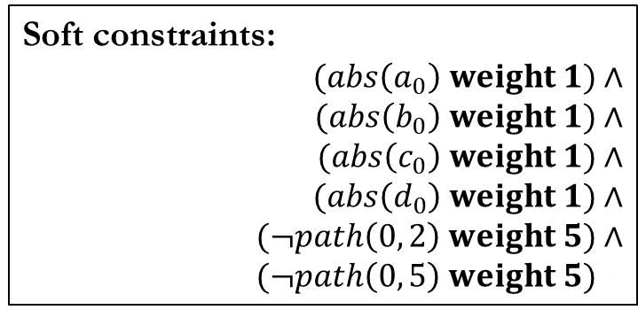
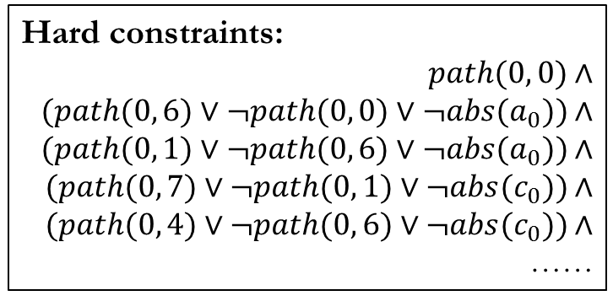
Future Directions
Hard constraints:
$$path(0, 0\text{)}∧$$
$$(path(0, \text{6}\text{)}∨¬path(0, \text{0)}∨¬abs(a_{0})\text{)}∧$$
$$(path(0, \text{1}\text{)}∨¬path(0, \text{6)}∨¬abs(a_{0})\text{)}∧$$
$$(path(0, \text{7}\text{)}∨¬path(0, \text{1}\text{)}∨¬abs(c_{0})\text{)}∧$$
$$(path(0, \text{4}\text{)}∨¬path(0, \text{6}\text{)}∨¬abs(c_{0})\text{)}∧$$
……
Optimum
Abstraction
Cost
Soft constraints:
$$(abs\left(a_{0}\right) weight 1)∧$$
$$(abs\left(b_{0}\right) weight 1)∧$$
$$(abs\left(c_{0}\right) weight 1)∧$$
$$(abs\left(d_{0}\right) weight 1)∧$$
$$(¬path\left(0, 2\right) weight 5)∧$$
$$(¬path\left(0, 5\right) weight 5)∧$$
Early
Convergence

Slide 89
Future Directions
Hard constraints:
$$path(0, 0\text{)}∧$$
$$(path(0, \text{6}\text{)}∨¬path(0, \text{0)}∨¬abs(a_{0})\text{)}∧$$
$$(path(0, \text{1}\text{)}∨¬path(0, \text{6)}∨¬abs(a_{0})\text{)}∧$$
$$(path(0, \text{7}\text{)}∨¬path(0, \text{1}\text{)}∨¬abs(c_{0})\text{)}∧$$
$$(path(0, \text{4}\text{)}∨¬path(0, \text{6}\text{)}∨¬abs(c_{0})\text{)}∧$$
……
Precise vs. Scalable
Sound vs. Complete
Soft constraints:
$$(abs\left(a_{0}\right) weight 1)∧$$
$$(abs\left(b_{0}\right) weight 1)∧$$
$$(abs\left(c_{0}\right) weight 1)∧$$
$$(abs\left(d_{0}\right) weight 1)∧$$
$$(¬path\left(0, 2\right) weight 5)∧$$
$$(¬path\left(0, 5\right) weight 5)∧$$

Slide 90
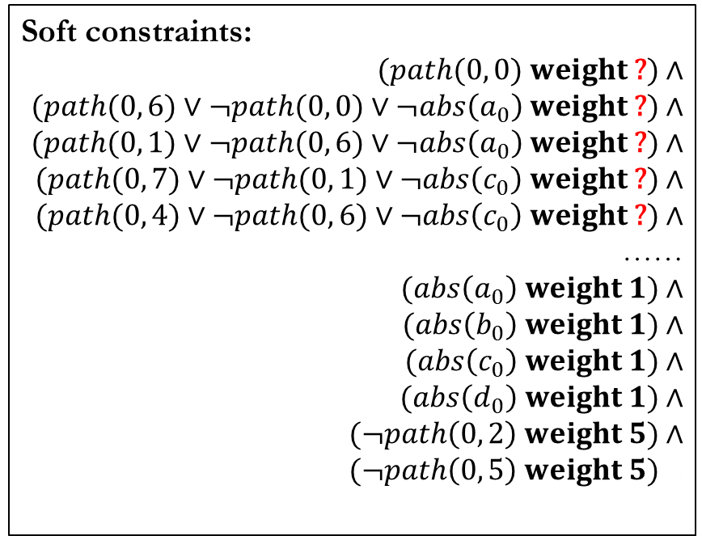
Future Directions
Soft constraints:
$$(path(0, 0\text{)} weight \text{?}\text{)}∧$$
$$(path(0, \text{6}\text{)}∨¬path(0, \text{0)}∨¬abs\left(a_{0}\right) weight \text{?}\text{)}∧$$
$$(path(0, \text{1}\text{)}∨¬path(0, \text{6)}∨¬abs\left(a_{0}\right) weight \text{?}\text{)}∧$$
$$(path(0, \text{7}\text{)}∨¬path(0, \text{1}\text{)}∨¬abs\left(c_{0}\right) weight \text{?}\text{)}∧$$
$$(path(0, \text{4}\text{)}∨¬path(0, \text{6}\text{)}∨¬abs\left(c_{0}\right) weight \text{?}\text{)}∧$$
……
$$(abs\left(a_{0}\right) weight 1)∧$$
$$(abs\left(b_{0}\right) weight 1)∧$$
$$(abs\left(c_{0}\right) weight 1)∧$$
$$(abs\left(d_{0}\right) weight 1)∧$$
$$(¬path\left(0, 2\right) weight 5)∧$$
$$(¬path\left(0, 5\right) weight 5)∧$$
Precision vs. Scalability
Soundness vs. Completeness

Slide 91
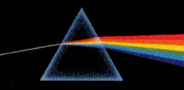
Thank You!
http://pag.gatech.edu/prism

