Slide 1
Effective Static Race Detection for Java
Mayur Naik
Alex Aiken
Stanford University

Slide 2
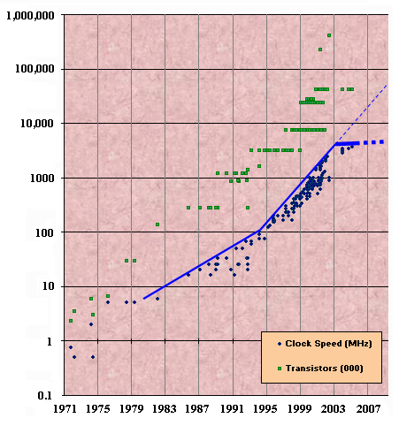
The Hardware Concurrency Revolution
Clock speeds have peaked
But #transistors continues to grow exponentially
Vendors are shipping multi-core processors
Intel CPU Introductions

Slide 3
The Software Concurrency Revolution
Until now:
Increasing clock speeds =>
even sequential programs ran faster
Henceforth:
Increasing #CPU cores =>
only concurrent programs will run faster

Slide 4
Reasoning about Concurrent Programs is Hard
t2 = x;
t2 = t2 + 1;
x = t2;
t1 = x;
t1 = t1 + 1;
x = t1;
x==k
x==k
x==k
t1=x
t2=x
t1=x
t1++
t2++
t2=x
x=t1
x=t2
t2++
. . .
t2=x
t1=x
x=t2
(20 total)
t2++
t1++
t1++
x=t2
x=t1
x=t1
x==k+2 ✓
x==k+2 ✓
x==k+1 ✗

Slide 5
Race Conditions
The same location may be accessed by different threads simultaneously.
(And at least one access is a write.)

Slide 6
Race Conditions
Particularly insidious concurrency bug
  Triggered non-deterministically
  No fail-stop behavior even in safe languages like Java
Fundamental in concurrency theory and practice
  Lies at heart of many concurrency problems
    atomicity checking, deadlock detection, ...
  Today’s concurrent programs riddled with races
    “… most Java programs are so rife with concurrency bugs that they work only ‘by accident’.” – Brian Goetz, Java Concurrency in Practice, Addison-Wesley, 2006

Slide 7
Example
Locking for Race Freedom
sync (l) {
sync (l) {
The same location may be accessed by different threads simultaneously without holding a common lock.
(And at least one access is a write.)
The same location may be accessed by different threads simultaneously.
(And at least one access is a write.)
t1 = x;
t1 = t1 + 1;
x = t1;
t2 = x;
t2 = t2 + 1;
x = t2;
}
}
x==k
x==k
x==k
t1=x
t2=x
t1=x
t1++
t2++
t2=x
x=t1
x=t2
t2++
. . .
t2=x
t1=x
x=t2
(20 total)
t2++
t1++
t1++
x=t2
x=t1
x=t1
x==k+2 ✓
x==k+2 ✓
x==k+1 ✗

Slide 8
Previous Work
Allen & Padua 1987; Miller & Choi 1988; Balasundaram & Kennedy 1989; Karam et al. 1989; Emrath et al. 1989; Schonberg 1989; …
Dinning & Schonberg 1990; Hood et al. 1990; Choi & Min 1991; Choi et al. 1991; Netzer & Miller 1991; Netzer & Miller 1992; Sterling 1993; Mellor-Crummey 1993; Bishop & Dilger 1996; Netzer et al. 1996; Savage et al. 1997; Cheng et al. 1998; Richards & Larus 1998; Ronsse & De Bosschere 1999; Flanagan & Abadi 1999; …
Aiken et al. 2000; Flanagan & Freund 2000; Christiaens & Bosschere 2001; Flanagan & Freund 2001; von Praun & Gross 2001; Choi et al. 2002; Engler & Ashcraft 2003; Grossman 2003; O’Callahan & Choi 2003; Pozniansky & Schuster 2003; von Praun & Gross 2003; Agarwal & Stoller 2004; Flanagan & Freund 2004; Henzinger et al. 2004; Nishiyama 2004; Qadeer & Wu 2004; Yu et al. 2005; Sasturkar et al. 2005; Elmas et al. 2006; Pratikakis et al. 2006; Sen & Agha 2006; Zhou et al. 2007; ...
Observation: Existing techniques and tools find
relatively few bugs

Slide 9
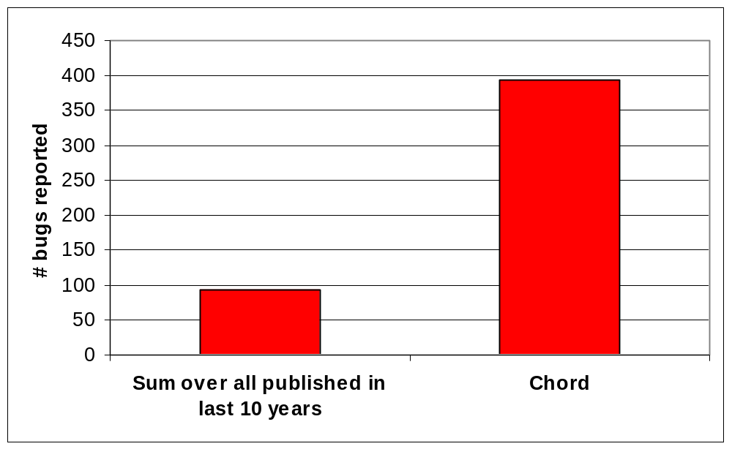
Our Results
392 bugs in mature Java programs comprising 1.5 MLOC
  Many fixed within a week by developers
Notes:
Remember to make distinction b/w race and bug

Slide 10
Our Race Detection Approach
all pairs
racing pairs

Slide 11
Challenges
Same location accessed
by different threads
simultaneously
without common lock held
Handle multiple aspects
  Same location accessed
  … by different threads
  … simultaneously
Correlate locks with locations they guard
  … without common lock held
Precision
  Showed precise may alias analysis is central (PLDI’06)
  low false-positive rate (20%)
Soundness
  Devised conditional must not alias analysis (POPL’07)
  Circumvents must alias analysis

Slide 12
Our Race Detection Approach
all pairs
aliasing pairs
shared pairs
parallel pairs
unlocked pairs
racing pairs
False Pos. Rate: 20%
Same location accessed
by different threads
simultaneously
without common lock held

Slide 13
Alias Analysis for Race Detection
// Thread 1: // Thread 2:
sync (l1) { sync (l2) {
… e1.f … … e2.f …
} }
Field f is race-free if:
e1 and e2 never refer to the same value
¬ MAY-ALIAS(e1, e2)
MUST-NOT-ALIAS(e1, e2)

Slide 14
May Alias Analysis
k-Object-Sensitive May Alias Analysis
Large body of work
Idea #1: Context-insensitive analysis
  Abstract value = set of allocation sites
foo() { bar() {
… e1.f … … e2.f …
} }
¬ MAY-ALIAS(e1, e2) if Sites(e1) ∩ Sites(e2) = ∅
Idea #2: Context-sensitive analysis (k-CFA)
  Context (k=1) = call site
foo() { bar() {
e1.baz(); e2.baz();
} }
Analyze function baz in two contexts
Recent may alias analysis [Milanova et al. ISSTA’03]
Solution:
Problem: Too few abstract values!
  Abstract value = set of strings of ≤ k allocation sites
Problem: Too few or too many contexts!
Solution:
  Context (k=1) = allocation site of this parameter

Slide 15
k-Object-Sensitive Analysis: Our Contributions
No scalable implementations for even k = 1
Insights:
  Symbolic representation of relations
    BDDs [Whaley-Lam PLDI’04, Lhotak-Hendren PLDI’04]
  Demand-driven race detection algorithm
    Begin with k = 1 for all allocation sites
    Increment k only for those involved in races
Allow scalability to k = 5

Slide 16
Our Race Detection Approach
all pairs
aliasing pairs
shared pairs
parallel pairs
unlocked pairs
racing pairs
Same location accessed
by different threads
simultaneously
without common lock held

Slide 17
Alias Analysis for Race Detection
// Thread 1: // Thread 2:
sync (l1) { sync (l2) {
… e1.f … … e2.f …
} }
Field f is race-free if:
e1 and e2 never refer to the same value
¬ MAY-ALIAS(e1, e2)
OR
l1 and l2 always refer to the same value
MUST-ALIAS(l1, l2)

Slide 18
Must Alias Analysis
Small body of work
  Much harder problem than may alias analysis
Impediment to many previous race detection approaches
  Folk wisdom: Static race detection is intractable
Insight: Must alias analysis not necessary for
race detection!

Slide 19
New Idea: Conditional Must Not Alias Analysis
// Thread 1: // Thread 2:
sync (l1) { sync (l2) {
… e1.f … … e2.f …
} }
Field f is race-free if:
Whenever l1 and l2 refer to different values, e1 and e2
also refer to different values
MUST-NOT-ALIAS(l1, l2) => MUST-NOT-ALIAS(e1, e2)

Slide 20
Example
a = new h0[N];
for (i = 0; i < N; i++) {
a[i] = new h1;
a[i].g = new h2;
}
h0
a[0]
a[N-1]
a[i]
h1
…
h1
…
h1
g
g
g
x1 = a[*];
sync (?) {
x1.g.f = …;
}
x2 = a[*];
sync (?) {
x2.g.f = …;
}
h2
…
h2
…
h2

Slide 21
Easy Case: Coarse-grained Locking
a = new h0[N];
for (i = 0; i < N; i++) {
a[i] = new h1;
a[i].g = new h2;
}
h0
a[0]
a[N-1]
a[i]
h1
…
h1
…
h1
g
g
g
x1 = a[*];
sync (a) {
x1.g.f = …;
}
x2 = a[*];
sync (a) {
x2.g.f = …;
}
h2
…
h2
…
h2
Field f is race-free if:
true
MUST-NOT-ALIAS(l1, l2) => MUST-NOT-ALIAS(e1, e2)
MUST-NOT-ALIAS(a, a) => MUST-NOT-ALIAS(x1.g, x2.g)

Slide 22
Example
a = new h0[N];
for (i = 0; i < N; i++) {
a[i] = new h1;
a[i].g = new h2;
}
h0
a[0]
a[N-1]
a[i]
h1
…
h1
…
h1
g
g
g
x1 = a[*];
sync (?) {
x1.g.f = …;
}
x2 = a[*];
sync (?) {
x2.g.f = …;
}
h2
…
h2
…
h2

Slide 23
Easy Case: Fine-grained Locking
a = new h0[N];
for (i = 0; i < N; i++) {
a[i] = new h1;
a[i].g = new h2;
}
h0
a[0]
a[N-1]
a[i]
h1
…
h1
…
h1
g
g
g
x1 = a[*];
sync (x1.g) {
x1.g.f = …;
}
x2 = a[*];
sync (x2.g) {
x2.g.f = …;
}
h2
…
h2
…
h2
Field f is race-free if:
true
MUST-NOT-ALIAS(l1, l2) => MUST-NOT-ALIAS(e1, e2)
MUST-NOT-ALIAS(x1.g, x2.g) => MUST-NOT-ALIAS(x1.g, x2.g)

Slide 24
Example
a = new h0[N];
for (i = 0; i < N; i++) {
a[i] = new h1;
a[i].g = new h2;
}
h0
a[0]
a[N-1]
a[i]
h1
…
h1
…
h1
g
g
g
x1 = a[*];
sync (?) {
x1.g.f = …;
}
x2 = a[*];
sync (?) {
x2.g.f = …;
}
h2
…
h2
…
h2

Slide 25
Hard Case: Medium-grained Locking
a = new h0[N];
for (i = 0; i < N; i++) {
a[i] = new h1;
a[i].g = new h2;
}
h0
a[0]
a[N-1]
a[i]
h1
…
h1
…
h1
g
g
g
x1 = a[*];
sync (x1) {
x1.g.f = …;
}
x2 = a[*];
sync (x2) {
x2.g.f = …;
}
h2
…
h2
…
h2
Field f is race-free if:
true (field g of distinct h1 values linked to distinct h2 values)
MUST-NOT-ALIAS(l1, l2) => MUST-NOT-ALIAS(e1, e2)
MUST-NOT-ALIAS(x1, x2) => MUST-NOT-ALIAS(x1.g, x2.g)

Slide 26
Disjoint Reachability
In every execution, if:
h0
h0
a[0]
a[N-1]
►
a[i]
►
►
  from distinct h1 values
  we can reach (via 1 or more fields)
  only distinct h2 values
…
…
…
h1
…
h1
h1
h1
h1
h1
g
g
g
►
►
►
…
…
…
h2
…
h2
h2
h2
h2
h2
then {h2} ⊆ DR({h1})
Note: Values abstracted by sets of allocation sites

Slide 27
Conditional Must Not Alias Analysis using
Disjoint Reachability
Sites(l1)
Sites(l2)
// Thread 1: // Thread 2:
sync (l1) { sync (l2) {
… e1.f … … e2.f …
} }
⊆ DR
Sites(e1)
Sites(e2)
Field f is race-free if:
  (Sites(e1) ∩ Sites(e2)) ⊆ DR(Sites(l1) ∪ Sites(l2))
  e1 reachable from l1 and e2 reachable from l2
MUST-NOT-ALIAS(l1, l2) => MUST-NOT-ALIAS(e1, e2)

Slide 28
Hard Case: Medium-grained Locking
a = new h0[N];
for (i = 0; i < N; i++) {
a[i] = new h1;
a[i].g = new h2;
}
h0
a[0]
a[N-1]
a[i]
h1
…
h1
…
h1
g
g
g
x1 = a[*];
sync (x1) {
x1.g.f = …;
}
x2 = a[*];
sync (x2) {
x2.g.f = …;
}
h2
…
h2
…
h2
Field f is race-free if:
  (Sites(e1) ∩ Sites(e2)) ⊆ DR(Sites(l1) ∪ Sites(l2))
  e1 reachable from l1 and e2 reachable from l2
  (Sites(x1.g) ∩ Sites(x2.g)) ⊆ DR(Sites(x1) ∪ Sites(x2))
  x1.g reachable from x1 and x2.g reachable from x2
  true
  true
  ({h2}) ⊆ DR({h1})
  x1.g reachable from x1 and x2.g reachable from x2

Slide 29
Experience with Chord
Experimented with 12 multi-threaded Java programs
  smaller programs used in previous work
  larger, mature and widely-used open-source programs
  whole programs and libraries
Tool output and developer discussions available at: http://www.cs.stanford.edu/~mhn/chord.html
Programs being used by other researchers in race detection

Slide 30
Benchmarks
classes
19
21
366
370
370
422
493
388
461
465
553
1746
KLOC
3
3
75
76
76
83
103
124
115
122
165
646
description
JDK 1.1 java.util.Vector
JDK 1.1 java.util.Hashtable
JDK 1.4 java.util.Hashtable
JDK 1.4 java.util.Vector
Traveling Salesman Problem
Web crawler
Apache FTP server
Apache object pooling library
Transaction manager
O/R mapping system
JDBC driver
Apache RDBMS
time
0m28s
0m27s
2m04s
2m02s
3m03s
9m10s
11m17s
10m29s
9m33s
9m42s
10m23s
36m03s
vect1.1
htbl1.1
htbl1.4
vect1.4
tsp
hedc
ftp
pool
jdbm
jdbf
jtds
derby

Slide 31
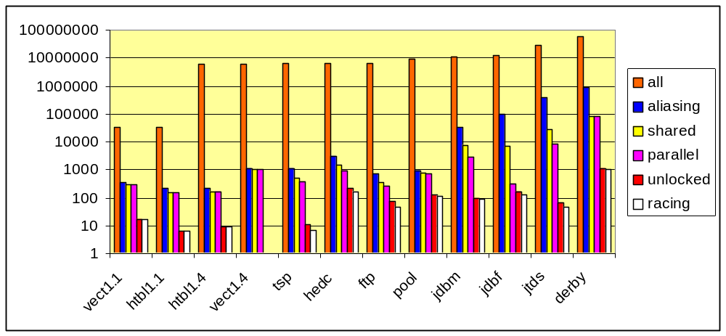
Pairs Retained After Each Stage (Log scale)

Slide 32
Classification of Unlocked Pairs
harmful
5
0
0
0
7
170
45
105
91
130
34
1018
benign
12
6
9
0
0
0
3
10
0
0
14
0
false
0
0
0
0
4
41
23
13
7
34
17
78
# bugs
1
0
0
0
1
6
12
17
2
18
16
319
vect1.1
htbl1.1
htbl1.4
vect1.4
tsp
hedc
ftp
pool
jdbm
jdbf
jtds
derby

Slide 33
Developer Feedback
16 bugs in jTDS
  Before: “As far as we know, there are no concurrency issues in jTDS …”
  After: “It is probably the case that the whole synchronization approach in jTDS should be revised from scratch ...”
17 bugs in Apache Commons Pool
  “Thanks to an audit by Mayur Naik many potential synchronization
  issues have been fixed” -- Release notes for Commons Pool 1.3
319 bugs in Apache Derby
  “This looks like *very* valuable information and I for one appreciate
  you using Derby … Could this tool be run on a regular basis? It is
  likely that new races could get introduced as new code is submitted ...”

Slide 34
Related Work
Static (compile-time) race detection
  Need to approximate multiple aspects
  Need to perform must alias analysis
  Sacrifice precision, soundness, scalability
Dynamic (run-time) race detection
  Current state of the art
  Inherently unsound
  Cannot analyze libraries
Shape Analysis
  much more expensive than disjoint reachability

Slide 35
Summary of Contributions
Precise race detection (PLDI’06)
  Key idea: k-object-sensitive may alias analysis
  Important client for may alias analyses
Sound race detection (POPL’07)
  Key idea: Conditional must not alias analysis
  Has applications besides race detection
Effective race detection
  392 bugs in mature Java programs comprising 1.5 MLOC
  Many fixed within a week by developers

Slide 36
Future Work
Analysis of higher-level concurrency properties
  transactions, atomicity, …
  Races fundamental but low-level
Language idioms for concurrent programming
  Facilitate program analysis for tools
  Facilitate program understanding for programmers

Slide 37
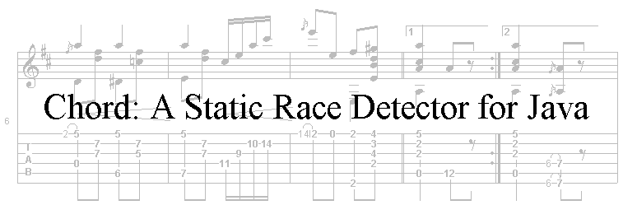
The End
http://www.cs.stanford.edu/~mhn/chord.html

