Slide 1
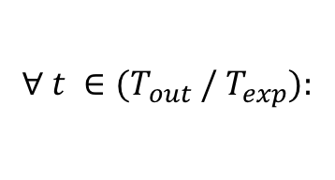




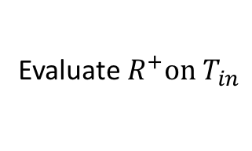






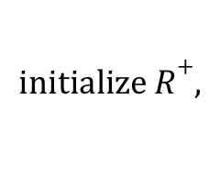




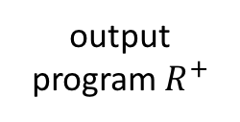
$$initialize R+,$$
$$R−$$
SAT Solver
$$φ≔true$$
Datalog Solver
Is $φ$ satisfiable?
output “no solution”
No
$$R+,$$
$$R−$$
Evaluate$R^{+}on{ T}_{in}$
$$T_{out}≔R^{+}(T_{in})$$
Is $T_{out}=T_{exp}?$
output program $R^{+}$
Yes
$$∀ t ∈{(T}_{out} /{ T}_{exp}):$$
$$why t?$$
“why” provenance
$$ψ≔prov(R^{+}, t)$$
$$φ≔φ∧ψ$$
$$∀ t ∈{(T}_{exp} /{ T}_{out}):$$
$$why not t?$$
“why not” provenance
$$ω≔\overline{prov}(R^{−}, t)$$
$φ≔φ∧$ $ω$

