Slide 1
Thyroid Detection

Slide 2
Objective:
Development of a classification model for detecting Thyroid and its type.
Benefits:
Detection of upcoming threats.
Gives better insight on customer health.
Helps in estimation .
Manual inspection if fraud is identified .

Slide 3
Data Sharing Agreement :
Sample file name (ex fraudDetection_20062021_101010)
Length of date stamp(8 digits)
Length of time stamp(6 digits)
Number of Columns
Column names
Column data type

Slide 4
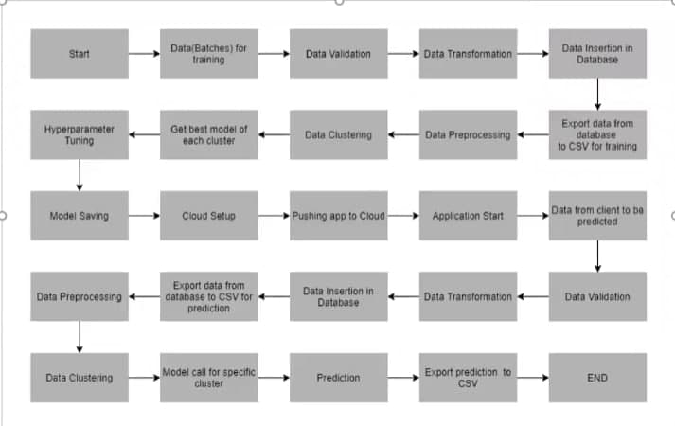
Architecture

Slide 5
Data Validation and Data Transformation :
Name Validation - Validation of files name as per the DSA. We have created a regex pattern for validation. After it checks for date format and time format if these requirements are satisfied, we move such files to "Good_Data_Folder" else "Bad_Data_Folder.“
Number of Columns – Validation of number of columns present in the files, and if it doesn't match then the file is moved to "Bad_Data_Folder.“
Name of Columns - The name of the columns is validated and should be the same as given in the schema file. If not, then the file is moved to "Bad_Data_Folder".
Data type of columns - The data type of columns is given in the schema file. It is validated when we insert the files into Database. If the datatype is wrong, then the file is moved to "Bad_Data_Folder".
Null values in columns - If any of the columns in a file have all the values as NULL or missing, we discard such a file and move it to "Bad_Data_Folder".

Slide 6
Model Training:
Data Export from Db : https://archive.ics.uci.edu/ml/datasets/thyroid+disease
The accumulated data from db is exported in csv format for model training
Data Preprocessing
Performing EDA to get insight of data like identifying distribution , outliers ,trend
among data etc.
Check for null values in the columns. If present impute the null values.
Encode the categorical values with numeric values.
Perform Standard Scalar to scale down the values.

Slide 7
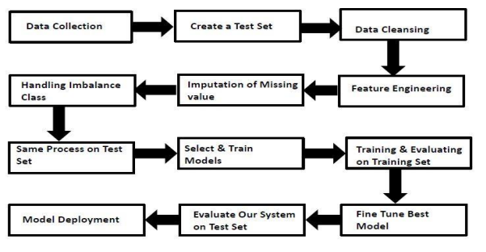

Slide 8
Data Pre-Processing
• Missing values handling by Simple imputation (Used KNN Imputer)
• Outliers' detection and removal by boxplot and percentile methods
• Categorical features handling by ordinal encoding and label encoding
• Feature scaling done by Standard Scalar method
• Imbalanced dataset handled by SMOTE -Over sampling
• Drop unnecessary columns

Slide 9
Model creation and evaluation
Various classification algorithms like Random Forest, XG Boost, KNN etc tested. • Random Forest, XGBoost and KNN all were given better results. XG Boost was chosen for the final model training and testing.
• Hyper parameter tuning was performed.
• Model performance evaluated based on accuracy, confusion matrix, classification report.

Slide 10
XG Boost Classifier Model
A decision-tree-based ensemble Machine Learning algorithm that uses a gradient boosting framework.
The XGBoost Classifier is a supervised learning algorithm which we can use for regression and classification problems. It is among the most popular machine learning algorithms comes under boosting ensemble technique.
XGBoost Classifier being ensemble algorithm tends to give more accurate result. This is because it works on the principle i.e. number of weak estimators when combined forms strong estimator. Even if one or few decision tree are prone to noise, overall results would tend to be correct.
Reason to use XGBoost Classifier model:
• It has high execution speed.
• It gives better model performance.

Slide 11
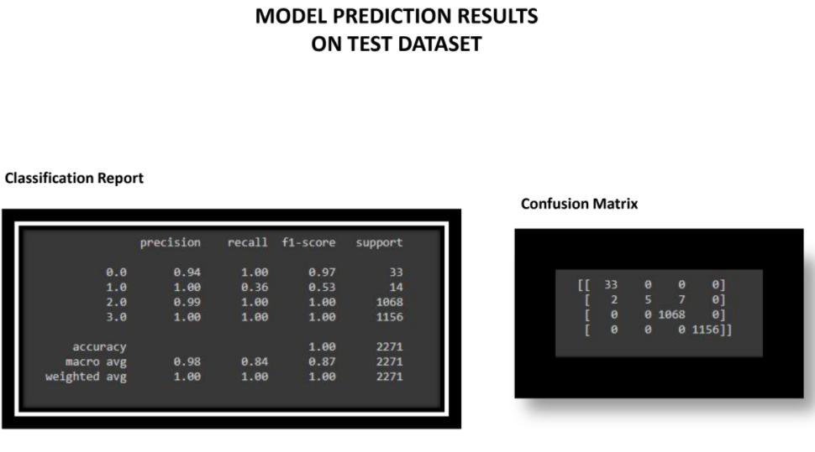

Slide 12
Database connection and deployment strategy
Database connection- Cassandra
Model Deployment – The model is deployed on Heroku using flask framework.

Slide 13
FREQUENTLY ASKED QUESTIONS
Q1) What is the source of data?
The data for training is obtained from famous machine learning repository.
UCI Machine Learning Repository: https://archive.ics.uci.edu/ml/datasets/thyroid+disease
Q2) What was the type of data?
The data was the combination of numerical and Categorical values.
Q3) After the File validation what you do with incompatible file or files which didn’t pass the validation?
Files like these are moved to the Achieve Folder and a list of these files has been shared with the client and we removed the bad data folder.
Q4) How logs are managed?
We are using different logs as per the steps that we follow in training and prediction like model training log and prediction log etc. And then sub log are inside those folder.

Slide 14
Q 6) What techniques were you using for data pre-processing?
• Removing unwanted attributes
• Visualizing relation of independent variables with each other and output variables
• Checking and changing Distribution of continuous values
• Removing outliers
• Cleaning data and imputing if null values are present.
• Converting categorical data into numeric values.
Q 7) How training was done or what models were used?
• First Data validation done on raw data and then good data insertion happen in DB.
• Then Data preprocessing done on final CSV file received from DB.
• We did clustering over the data to divide it on desired cluster based on elbow method.
• Various model such as Decision Tree, Random Forest and XGBoost models are trained on all clusters and based on performance, for each cluster different model is saved.

Slide 15
Q 8) How Prediction was done?
• The testing files are shared by the client .We Perform the same life cycle till the data is clustered .
• Then on the basis of cluster number model is loaded and perform prediction. In the end we get the accumulated data of predictions.
Q 9) What are the different stages of deployment?
• After model training and finalizing all models. We created required files for deployment. • Finally deployed our model over various cloud platforms such as Heroku and AWS.
Q 10) How is the User Interface present for this project?
• For this project I have made two types of UI.
• First is for bulk prediction.
• Second is for one user input prediction.
• Both UI are very user friendly and easy to use.

