Slide 1
Redux
Deekshith

Slide 2

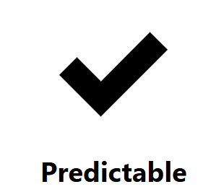
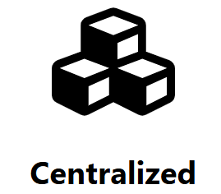
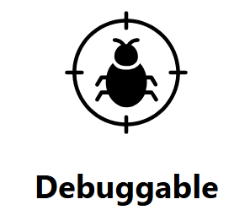
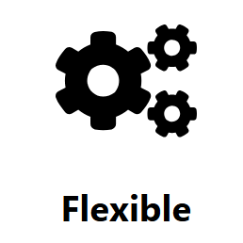
What is Redux?
Redux is a JS library for predictable and maintainable global state management.

Slide 3
Why Redux?
<App/>
<User/>
<Navbar/>
<Login/>
<DropDown/>
<Link/>
counter
<Email/>
<Password/>

Slide 4
Why Redux?
<App/>
<User/>
<Navbar/>
counter
<Login/>
<DropDown/>
<Link/>
counter
counter
<Email/>
<Password/>

Slide 5
Why Redux?
<App/>
counter
<User/>
<Navbar/>
counter
counter
<Login/>
<DropDown/>
<Link/>
counter
counter
<Email/>
<Password/>

Slide 6
Why Redux?
counter
<App/>
counter
counter
<User/>
<Navbar/>
counter
counter
<Login/>
<DropDown/>
<Link/>
counter
counter
<Email/>
<Password/>

Slide 7
Why Redux?
counter
<App/>
Redux
Store
<User/>
<Navbar/>
<Login/>
<DropDown/>
<Link/>
<Email/>
<Password/>

Slide 8
How Redux Works?
STORE
UI COMPONENT
Subscribe

Slide 9
How Redux Works?
ACTION
STORE
UI COMPONENT
Dispatch
Subscribe

Slide 10
How Redux Works?
REDUCER
ACTION
STORE
UI COMPONENT
Dispatch
Subscribe

Slide 11
Core Concepts of Redux:
Single Source of Truth: The state of your whole application is stored in a single object tree within a Redux store.
State is Read-Only: The only way to change the state is by dispatching an action, ensuring that state changes are explicit.
Changes are Made with Pure Functions: To specify how actions transform the state, you write pure reducer functions.
NOTE: Redux is not preferred for small applications because it introduces unnecessary complexity and boilerplate code when simpler state management solutions within React would suffice.

Slide 12
Let’s Code:
Install Redux Toolkit and React Redux.
Create a Redux Store.
Provide the Redux Store to React.
Create a Redux State Slice.
Add Slice Reducers to the Store.
Use Redux State in React Components.
Dispatch Actions to Update States.
npm install @reduxjs/toolkit react-redux
Reference: https://react-redux.js.org/tutorials/quick-start

