Slide 1

Telecom Churn
Case Study
Assignment by
Mayur Punamiya

Slide 2
Problem Statement
In the telecom industry, customers are able to choose from multiple service providers and actively switch from one operator to another. In this highly competitive market, the telecommunications industry experiences an average of 15-25% annual churn rate. Given the fact that it costs 5-10 times more to acquire a new customer than to retain an existing one, customer retention has now become even more important than customer acquisition.
For many incumbent operators, retaining high profitable customers is the number one business goal.
To reduce customer churn, telecom companies need to predict which customers are at high risk of churn.

Slide 3

Methodology USED TO derive conclusion
Step-1:
Data Importing, Inspecting, Cleaning & Manipulation
Filtering high-value customers
Tagging Churn Customers
Handling NA or Missing Values.
Dropping of Unnecessary Columns (i.e., which are not taken for in Analysis)
Dropping of Columns having large number of missing values.
Imputation of Values where required.
Step-2:
Data Analysis - Exploration
Univariate Analysis.
Bivariate data analysis:

Slide 4
Methodology USED TO derive conclusion
Step-3:
Model Building Preparation & Validation
Test-Train Split
Scaling
Step-4:
Model Evaluation
Creating a data frame with the actual conversion flag and predicted probabilities
Creating new column 'Predicted’
Finding the Optimal Cutoff
Step-5:
Making Predictions based on the Test Set
Step-6:
Deriving Conclusion & Recommendation based on Model.

Slide 5
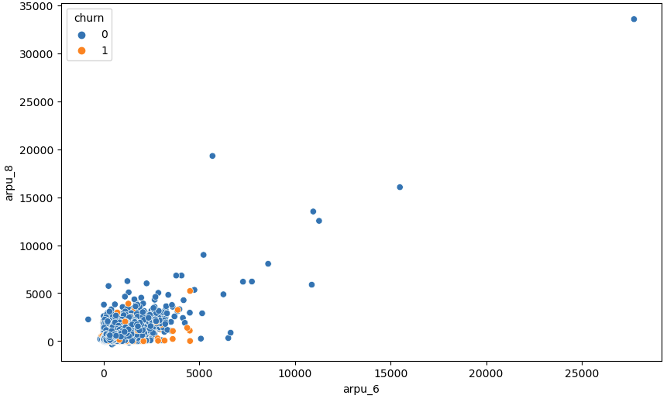
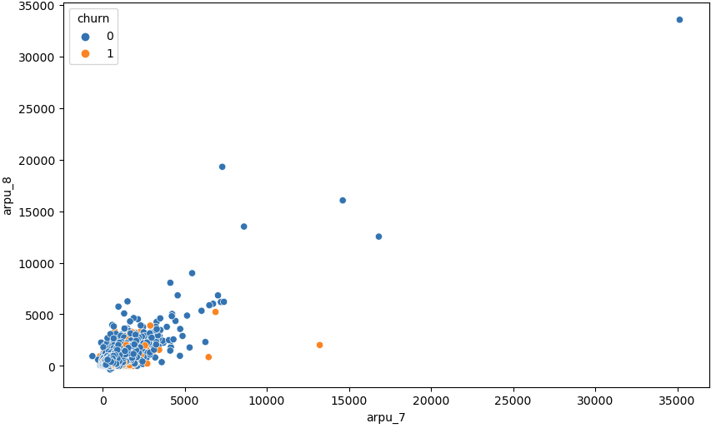
Data Cleaning and Preparation
Firstly, we dropped all the columns which had more than 30% values missing or NA.
We Checked the other remaining columns and drop columns which are not required for our analysis
Next the columns with null or missing values, we imputed them with 0.0
We Checked the other remaining columns and drop columns which are not required for our analysis
Data Exploration (EDA) Findings
What Chart Shows:
Customers with lesser "arpu" in 6,7 are more lickely to churn'

Slide 6


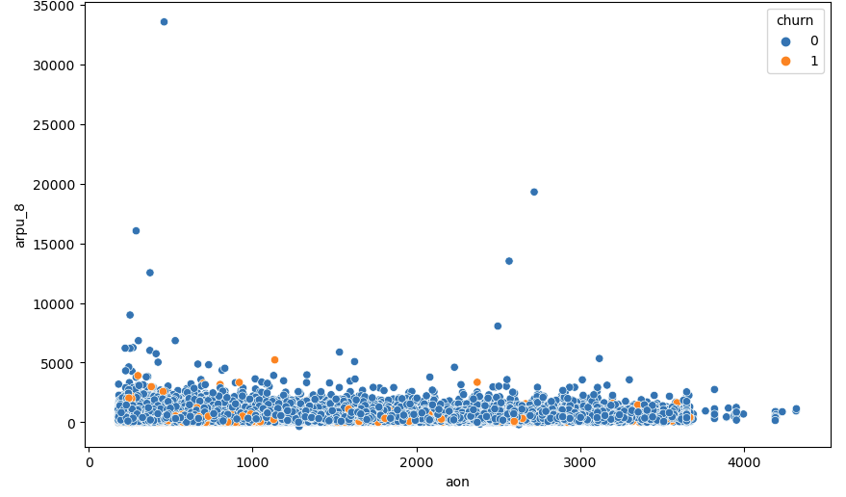
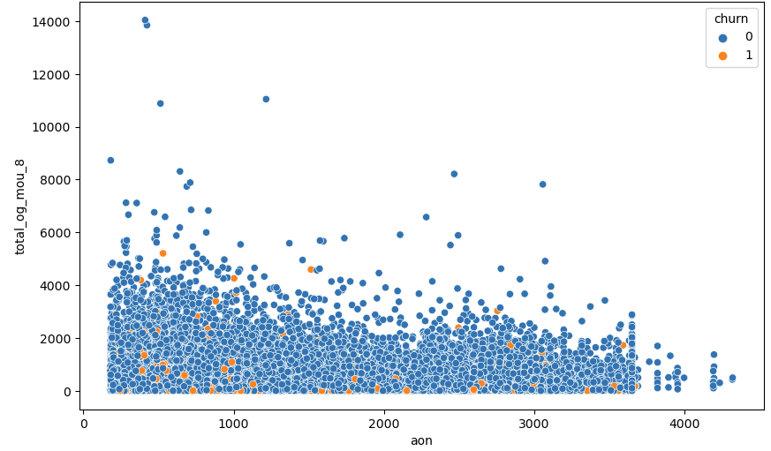
Data Exploration (EDA) Findings
What Chart Shows:
Customers with lesser "arpu_8" and "aon" are more likely to churn.'
What Chart Shows:
Customers with lesser "total_og_mou_8" and "aon" are more likely to churn.

Slide 7
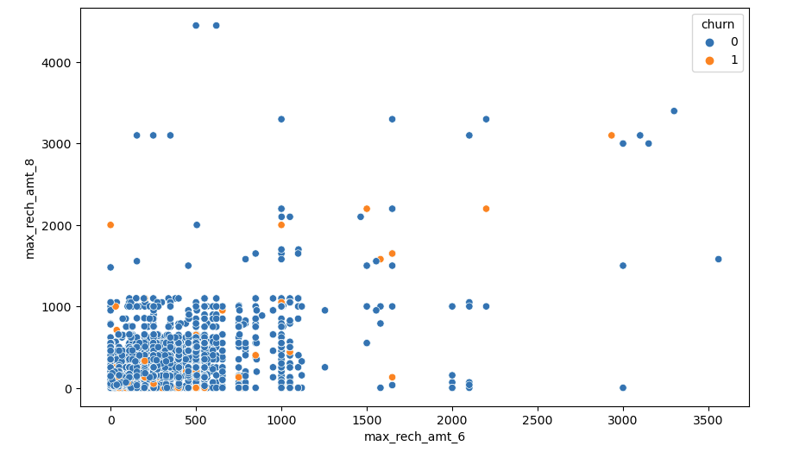
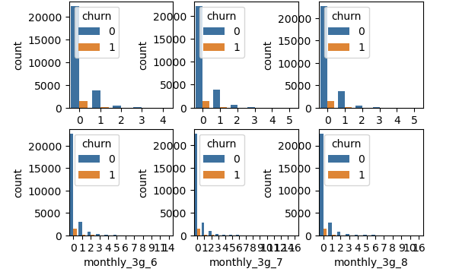
Data Exploration (EDA) Findings
What Chart Shows:
Lesser "max_rech_amt_6" and "max_rech_amt_8" indicates higher churn chances
What Chart Shows:
Higher use of 2g or 3g indicates lesser chances of churn

Slide 8
Model building
Splitting the Data into Training and Testing Sets.
The first basic step for regression is performing a train-test split, we have chosen 70:30 ratio.
Generalized Logistic Regression Results.
Feature Selection Using RFE.
Building Model.
Assessing the model.
Predictions made based on test data set.

Slide 9
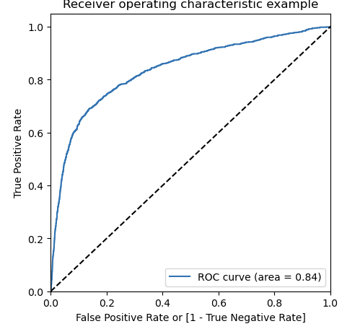
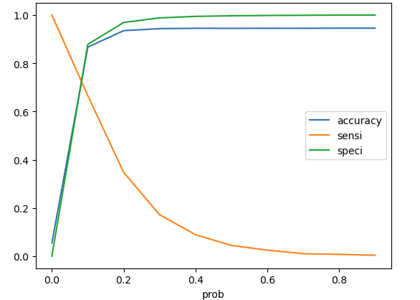
Plotting roc curve
Since we know that the perfect ROC Curve should be a value close to 1. We are getting a value of 0.84 indicating a good predictive model.
From the curve above, we see that 0.15 is the optimum point to take it as a cutoff probability.

Slide 10
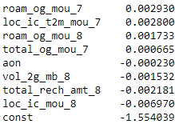
CONCLUSIONS & PREDICTIONS
So using Logistic regression we are getting an accuracy of 94% on train data and 92% on test data.
Roaming outgoing in month 7 and 8 are strong indicators, hence telecom company should reduce the costs for roaming. They need to provide good offers to the customers who are using services from a roaming zone.
MOU is one of the major factors.
Max recharge in the good phase are indicators of churn.
We can clearly see most of the critical features are form the action phase, which is inline with the business understanding that action phase needs more attention.
The image attached shows the important parameters for predicting churn.

