Slide 1
Call Centre Analysis
Project 3 – Final solution
Prepared by
Prajwal Nayak
Mayurkumar Rafaliya
Cathleen Mathew Mundat
Chaitanya Keesari
Anusha Asokan Palat
Jigeesha Kocher

Slide 2
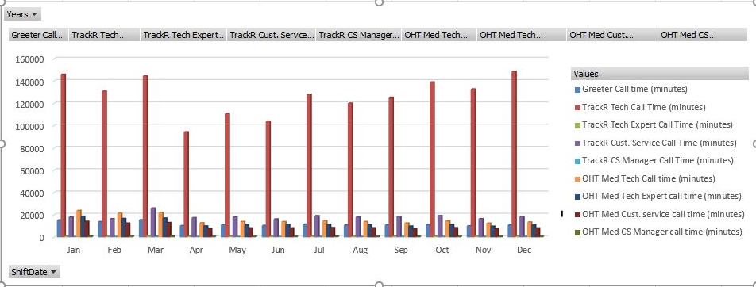
Call Centre Data Analysis

Slide 3
Infrastructure Upgrade1&2
Upgrade1
Suggestion
The work of greeter can be automated through an automating call centre software Genesys.
Advantages
Speech Enabled IVR
Voicebots
Chatbots
Enhanced customer experience
Improved customer satisfaction
Upgrade2
Suggestion
Customer in a waiting queue can be given an option through the Live Agent software to leave the mobile number if they are interested in receiving a call back.
Advantages
IVR
VOIP
Increased customer satisfaction
Reduced abandoned call rates
Increased agent productivity
Track and monitor call statistics

Slide 4
Project Plan for Upgrade1
Vision
Improve customer service
Reduce call wait time
Requirements
Genesys automated voice call software
Triage call to different departments
Action
Genesys Design, development, programming and testing
Deliverables
Genesys software
Genesys License
Benefits
Automated request and responses will reduce workload of agents
Managing busy call traffic
Greeter production time can be utilised to help other agents.

Slide 5
Project Plan for Upgrade2
Vision
Efficient call centre process
Reduce call wait time
Requirements
Customers should register for call back.
Live Agent software and licences must be purchased for callback system.
Action
Liveagent consulting, configuration, connecting phone number, uploading IVR message, testing
Deliverables
LiveAgent software
LiveAgent License
Benefits
Increased customer satisfaction
Reduced abandoned call rates
Increased agent productivity
Track and monitor call statistics

Slide 6
Website Tech Suggestions
Suggestions
Frequently Asked Questions (FAQ)
live chat with a virtual agent
Requirements
FAQs& Virtual agent must cover all the general queries
Queries enquired with the virtual agent must be stored and analysed to improve the communication
Benefits
Customer calling for general queries handled by FAQ
Reduce the pressure on the call agent.
Customer satisfaction
Resource Optimization

Slide 7
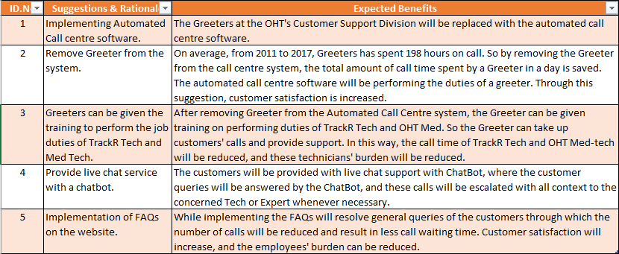
Excel projections Infrastructure Upgrade1&2

Slide 8
Risk & Risk Mitigation
Risk | Impact Rating | Risk Mitigation
Loss of confidentiality | High | Telephone system should be provided to authorized person only
Loss of important customer data | High | Daily backup should be made
Financial loss and loss of important customer data | High | A particular Software policy should be implemented
Loss of service overview | Moderate | Performance should be measure with the set benchmarks
Technical Issues | Moderate | The frequent software update should be made And frequent trouble should be made
Customers might not get a call-back | Low | Proper training should be given to the agent
A customer might not find FAQ and chat option on the | Low | The website design should be more intuitive and And A chat option should be pop up whenever the customer visits website.
Information is not correct on the website | Moderate | Information should be checked thoroughly and regularly

Slide 9
Conclusion
Better employee will
reduce the overall cost and effort
will also increase customer satisfaction
Multiple channels of information
Reduce the call rate
will reduce the number of minute problems
Infrastructure updates
increase the speed of the overall process
Reduce the customer waiting in a queue
increase overall customer satisfaction

Slide 10
References
EConestoga. (2022, February 23). Call Center Overview 21My05. EConestoga. Retrieved April 3, 2022, from https://conestoga.desire2learn.com/d2l/le/content/539481/viewContent/11890059/View
EConestoga. (2022, February 23). OHT Timeline Phase 2 210507. EConestoga. Retrieved April 3, 2022, from https://conestoga.desire2learn.com/d2l/le/content/539481/viewContent/11890066/View
EConestoga. (2022, February 23). P2 Call Center Needs 21May07. EConestoga. Retrieved April 3, 2022, from https://conestoga.desire2learn.com/d2l/le/content/539481/viewContent/11890061/View
EConestoga. (2022, February 23). OHT Call Center Processes 21May05. EConestoga. Retrieved April 3, 2022, from https://conestoga.desire2learn.com/d2l/le/content/539481/viewContent/11890069/View
EConestoga. (2022, February 23). Digital PBX Configuration 21May05. EConestoga. Retrieved April 3, 2022, from https://conestoga.desire2learn.com/d2l/le/content/539481/viewContent/11890060/View
EConestoga. (2022, February 23). PBX Sample Data Modes 1 to 49 190502. EConestoga. Retrieved April 3, 2022, from https://conestoga.desire2learn.com/d2l/le/content/539481/viewContent/11890052/View
EConestoga. (2022, February 23). OHT Timeline Phase 1 210507. EConestoga. Retrieved April 3, 2022, from https://conestoga.desire2learn.com/d2l/le/content/539481/viewContent/11890019/View
EConestoga. (2022, February 23). OHT Org Chart as of 2018July. EConestoga. Retrieved April 3, 2022, from https://conestoga.desire2learn.com/d2l/le/content/539481/viewContent/11890033/View
Genesys. (n.d.). Genesys Cloud CX platform - experience as a service. Genesys. Retrieved April 14, 2022, from https://www.genesys.com/genesys-cloud

Slide 11
Genesys. (n.d.). Fair use API on-demand charges. Genesys Cloud Resource Center. (n.d.). Retrieved April 14, 2022, from https://help.mypurecloud.com/articles/api-on-demand-charge/
Smartsheet. (n.d.). Make the most of the RFQ process. Smartsheet. Retrieved April 14, 2022, from https://www.smartsheet.com/rfq-process
Tech.co. 2022. VoIP Pricing: How Much Does VoIP Cost? | Tech.co. [online] Available at: <https://tech.co/business-phone-systems/voip-cost-price-breakdown> [Accessed 15 April 2022].
2022. [online] Available at: <https://www.liveagent.com/features/automatic-callback/> [Accessed 15 April 2022].
AVOXI. 2022. How Much Does IVR Cost? | AVOXI Cloud Communications. [online] Available at: <https://www.avoxi.com/blog/how-much-does-ivr-cost/> [Accessed 15 April 2022].
2022. [online] Available at: <https://www.liveagent.com/costs-calOculator/> [Accessed 15 April 2022].
Ringcentral.com. 2022. What is IVR (Interactive Voice Response)? [Meaning & Benefits]. [online] Available at: <https://www.ringcentral.com/contact-center/interactive-voice-response.html#ring-cc> [Accessed 15 April 2022].
Quality Unit, LLC. (2022, January 20). Callback software For Your Customers. LiveAgent. https://www.liveagent.com/callback-software/
IVR Implementation | Interactive Voice Response Applications. (n.d.). Call-Center-Tech. Retrieved April 15, 2022, from http://www.call-center-tech.com/ivr-implementation.html

Slide 12

Thank you

