Slide 1
DATA QUALITY - ISO/IEC 25012
Quality of information is the key factor for success of an organisation.
However many organisation lack the means to access quality of their data
Therefore AQClabs has developed a framework for evaluting and improving the data quality.
ISO/IEC 25012 identifies and provides a classification for the characteristics
that define data quality
Characterstics of Data Quality
ACCURACY
COMPLETENESS
CONSISTENCY
CREDIBILITY
CURRENTNESS

Slide 2
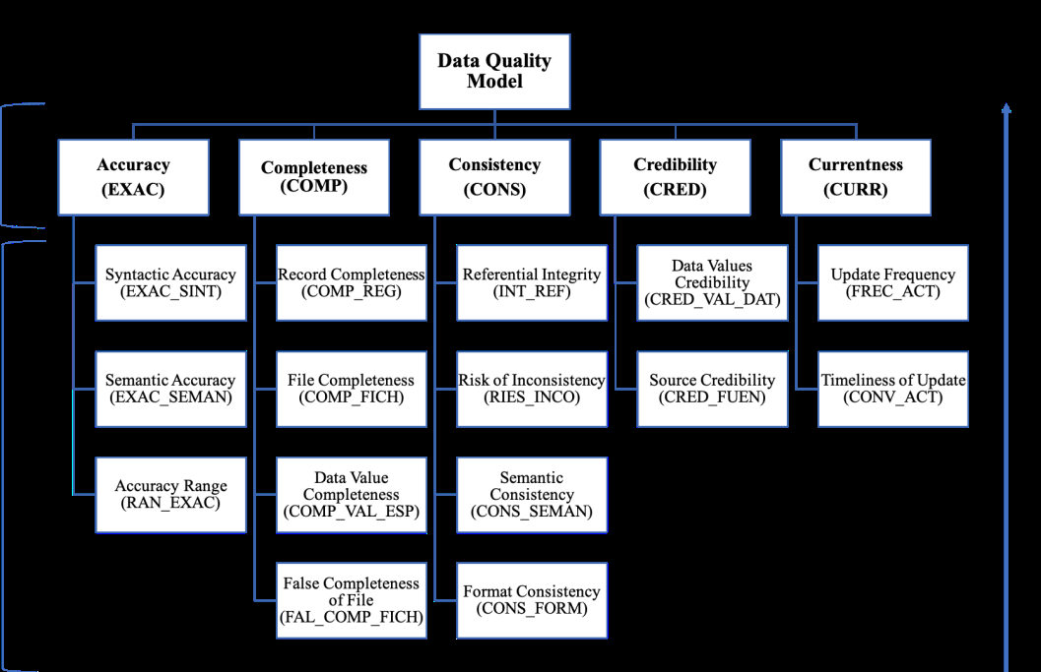
Data Quality Model

Slide 3
DQ Property Described in ISO/IEC 25024
Data quality characteristic | Accuracy
Data quality property | Data Accuracy Range
Measurement description | Data Accuracy Range focuses on checking if data values are included in the required intervals. Its value is obtained as the ratio of records in a data file whose values for their fields are within the specified intervals.
Calculation for-mula | X=A/B A= number of data items having a value included in a specified interval (i.e., range from minimum to maximum) B= number of data items for which can be defined a required interval of values
Scale | Ratio
Value range | [0.0, 1.0]

Slide 4
Data Quality Evaluation Environment
Defines data quality masurements quantitatively masuring data quality in terms of characterstics defined in ISO/IEC 25012.
Activity 1: Establish the data quality evaluation requirements
Business rule ID | Business rule example
1 | person.id must be represented with 9 characters, in which the first eight must be digits in the range [0-9], and the last one must be an alphabetic character in the range [A-Z].
2 | person.ipaddress must be expressed as four numbers in the range [0, 255] separated by a period, such as 126.12.4.89.

Slide 5
Data Quality Evaluation Environment
Activity 2: Specify the data quality evaluation.
The quality levels and measurement methods have been defined by the accredited laboratory as part of the tailoring of the data quality model
Understanding of the specific details of the data quality evaluation process by the organization.
Activity 3: Design the data quality evaluation
The scope of the evaluation is refined and completely defined in detail.
Activity 4: Execute the data quality evaluation
The quality level for the selected data quality characteristics are obtained by following the evaluation plan defined during activities 1 to 3.

Slide 6
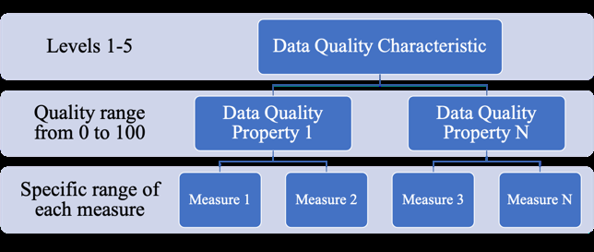
Data Quality Evaluation Environment
1.Design the evaluation scripts: The evaluation team develops a set of evaluation scripts
EXAMPLE: SELECT COUNT(*) FROM exampleDB.person p1
WHERE p1.id IS NOT NULL AND p1.id REGEXP '^[0-9]{8}[A-Za-z]{1}$'
UNION
SELECT COUNT(*) FROM exampleDB.person p2;

Slide 7
`
2.Execution of the evaluation scripts:
Based on the results of this execution, the weaknesses and strengths for each data quality property can be outlined
3.Production of the quality value for the data quality properties:
calculation of quality value for each data quality property is done
4.Derivation of the quality level for the data quality properties from their quality value
Level | Quality value
1 | 0 – 20
2 | 20 – 40
3 | 40 – 70
4 | 70 – 85
5 | 85-100

Slide 8
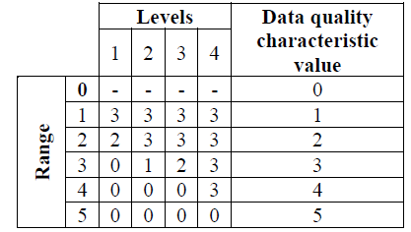
5.Determination of the quality level for the selected data quality characteristics.
Let us suppose that in the previous step 4, we have obtained the following quality levels for the properties: 4 for “Syntactic Accuracy”, 4 for “Semantic Accuracy”, and 3 for “Accuracy Range”).
These values give the profile <0, 0, 1, 2, 0> for this characteristic
When comparing this profile to the ranges defined in Table
range 5 allows no properties with a quality level lower than 5
range 4 allow no properties with a quality level lower than 4
range 3 allows a maximum of 2 data quality properties
at level 3, one at level 2 and none at level 1

Slide 9
Activity 5: Conclude the data quality evaluation
A detailed evaluation report is produced
Evaluation report, detailing the results of the evaluation.
Improvement report, if necessary.
Feedback from the organization.

Slide 10
Data Quality Certification
The data quality evalution is carried out by accredited laboratory for the evalution process.
Improvement actions are taken on the weaknesses detected in first evaluation.
Then second evaluation takes place on complete data
Finally the organisation reaches the necessary levels to certify the quality of their data repositories
The certification body provides the certificate of data quality for their repositories.
FIRST DQ EVALUATION
IMPROVEMENT ACTION
SECOND DQ EVALUTION
DQ CERTIFICATION

Slide 11
CASE STUDY ORGANISATION 1
A clone of the repository was created and deployed in a server by the organization
It contained 14 tables and 10 million records
Business rules involved in the evaluation
Accuracy 89
Completeness 78
Consistency 91
Credibility 54
Currentness 63
Total business rules involved 375

Slide 12
EVALUTION AND RESULT
60 days in collaboration with Org.1 for the identification of the business rules
13 days to execute the evaluation scripts,
3 days to produce the evaluation report,

Slide 13
Improvement Process and Second Evalution
Considering the strengths and weaknesses identified
Org.1 planned a meeting to discuss the details for the improvement process
Org. 1 agreed to address all the proposed improvements to reach required quality level (3 or higher) for the certification of all the data quality characteristics.
It took 8 weeks approximately to resolve all the weaknesses found as a result of
the first data quality evaluation.
Second Evalution
This second evaluation was carried out in 17 days:
3 days to review,modify and create the necessary evaluation scripts
13 days to execute the evaluation
1 day to create the evaluation report.

Slide 14
Result Of Second Evalution

Slide 15
CASE STUDY ORGANISATION 2
Number of Tables 36
Number of records 750 million
Business rules involved in the evaluation for each Characterstics:
Accuracy 189
Completeness 131
Consistency 340
Credibility 72
Currentness 81
Total business rules 813

Slide 16
Result Of First and Second Evalution

Slide 17
CASE STUDY ORGANISATION 3
Number of entities 10
Number of records 20 million
Business rules involved in the evaluation
Accuracy 94
Completeness 100
Consistency 176
Credibility 48
Currentness 70
Total business rules 488

Slide 18
Result of First and Second Evalution

Slide 19
How we can Implement It
-Acquirer (an individual acquires data from a supplier).
- Evaluator (an individual that performs an evaluation)
- Developer (an individual that performs development activities)
- Maintainer (an individual that performs operation and maintenance activities of data).
- Supplier (an individual that enters into a contract with the acquirer for the supply of data or service under the terms of the contract).
- User (an individual or organization that uses data to perform a specific function).
- Quality manager (an individual or organization that performs a systematic examination of the data).

