Slide 1
Retail Sales Dashboard
An Interactive Dashboard using Power BI
Made by: Mayur Sapkal

Slide 2
Objective of the Dashboard:
• Track overall performance through key sales metrics
• Analyze time-based trends for sales and profit
• Understand product category performance
• Use slicers for filtering by demographics and date
• Provide business-ready insights with interactivity

Slide 3
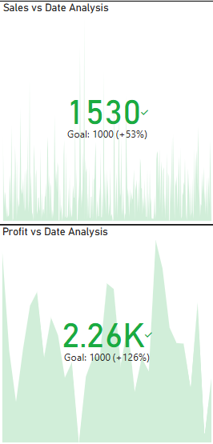

Key Performance Indicators:
• Total Sales: ₹456K
• Total Profit: ₹91.20K
• Total Transactions: 1,530 (vs. goal 1,000 → +53%)
• Profit Goal Achieved: 2.26K vs. 1,000 → +126%
• Visuals: KPI cards from Power BI dashboard

Slide 4
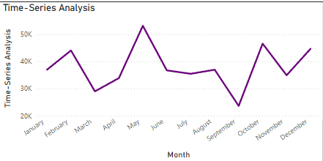
Sales and Profit Trends Over Time:
• Monthly trend of sales and profit
• Visualized using Line Charts
• Helps identify seasonal trends or monthly spikes
• Provides clear time-based performance overview

Slide 5
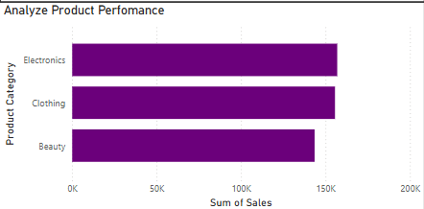
Sales by Product Category:
• Bar chart showing revenue by product category
• Electronics: Top performing
• Clothing and Beauty categories follow behind
• Helps prioritize product line decisions

Slide 6
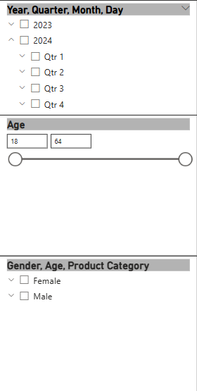
Filters and Interactive Controls:
• Slicers included for dynamic filtering:
- Year, Quarter, Month, Day
- Gender
- Age Range
- Product Category
• Enables demographic and time-based deep-dive

Slide 7
Tools Used & Workflow:
• Data Source: retail_sales_dataset_with_sales.csv
• Data Prep: Python script used to create Sales column
• Visualization Tool: Power BI Desktop
• Visual Types: KPI Cards, Line Charts, Bar Charts, Slicers

