Slide 1
Movies Dataset - EDA

Slide 2
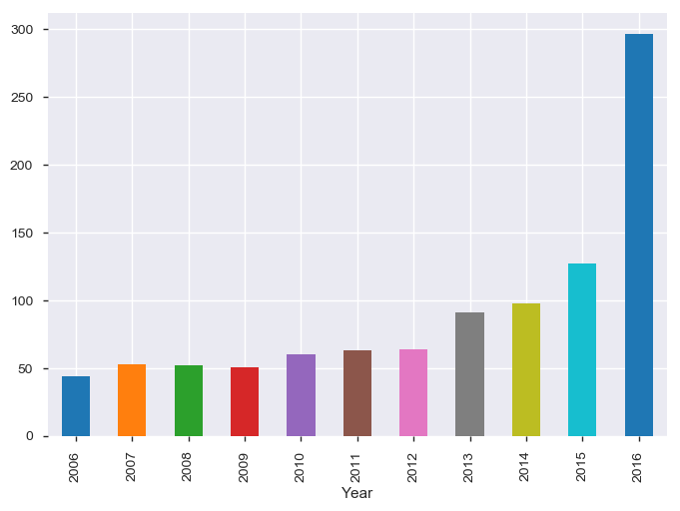
Movies release trend from 2006
The trend is upward moving from 2006. 2009 onwards there is continuous upward trend We can see an exponential growth in movies released since 2012, 2016 being the year of highest number of movies released which is multifold of movies released in 2006.

Slide 3
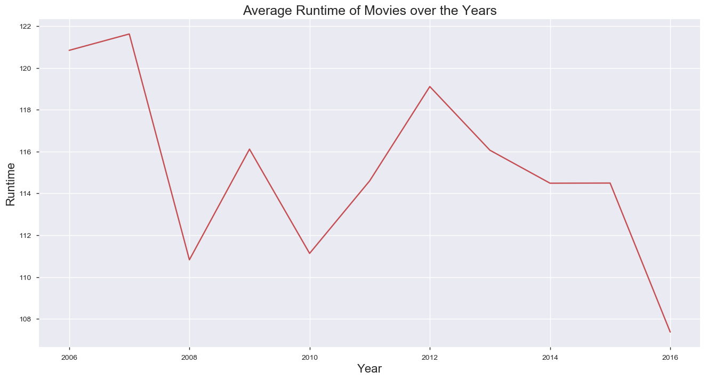
Trend of Movie runtime over years
The mean time of movies has reduced from 2006 to 2016. However there is no strong relation found between movie runtime and revenue.
# Find relation between runtime and metascore , runtime and rating and runtime and votes

Slide 4
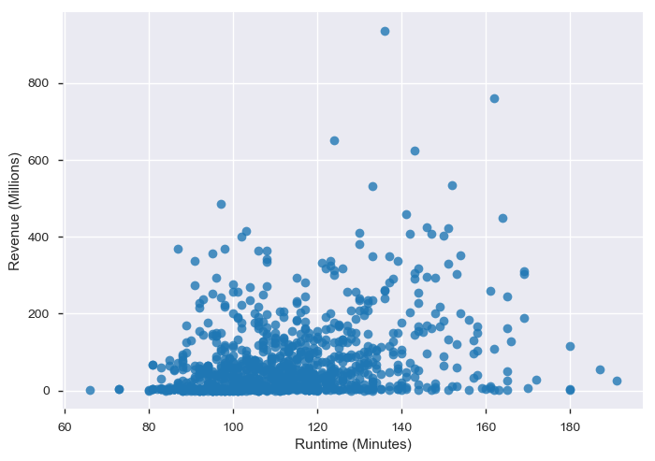
Correlation between Movie runtime and revenue

Slide 5
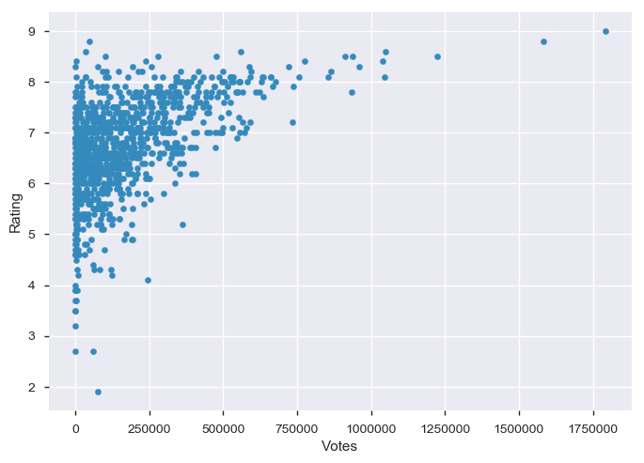
Correlation between Votes and Rating
Rating and votes show a positive correlation. With increased number of votes Rating is improved.

Slide 6
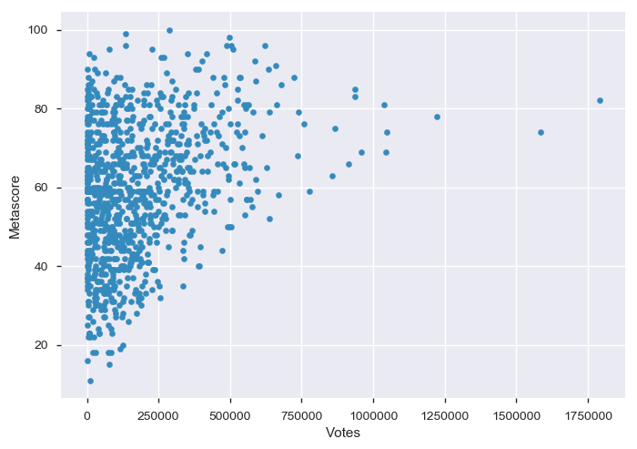
Correlation between votes and Metascore
Correlation between votes and Metascore is positive.With increased votes, Metascore also increasing.

Slide 7
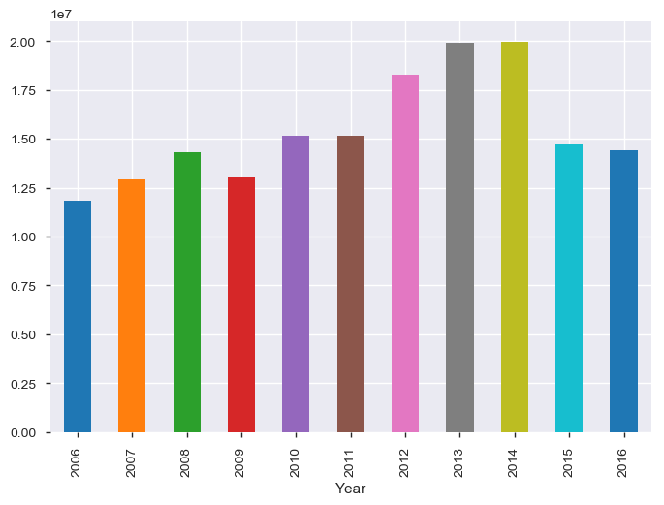
Trend of voting year on year
Though the number of movies released went on increasing from 2006, viewers voting has not increased in that proportion. 2015 and 2016 the trend is reversed. Despite of highest number of movies released, viewers refrained from voting for the movies.

Slide 8
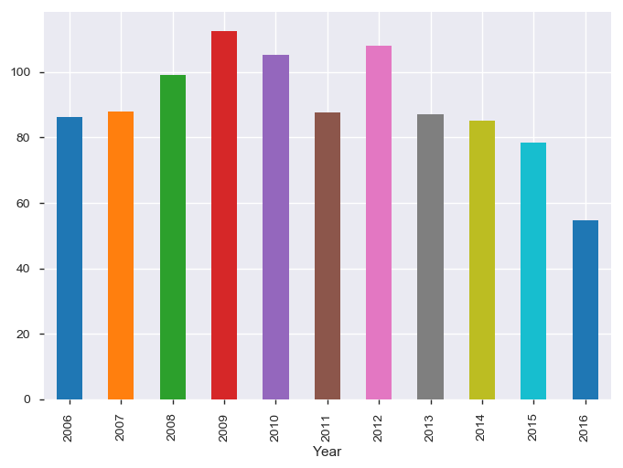
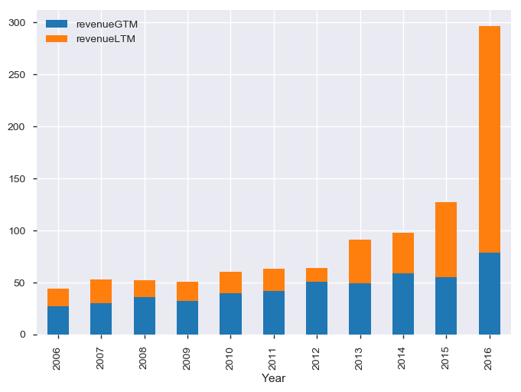
Average revenue per year
Interestingly, Average revenue per movie has reduced since 2012. In 2009 the average revenue per movie was the highest.
The above graph means, ratio of successful to unsuccessful movies went on decreasing.

Slide 9
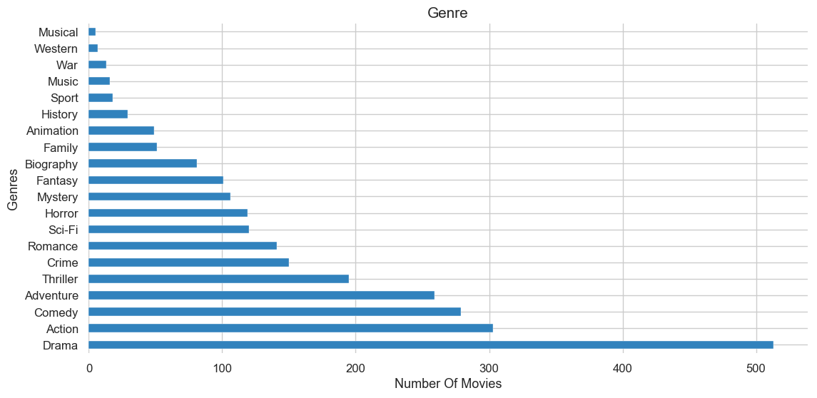
Which Genre is popular amongst producers

Slide 10
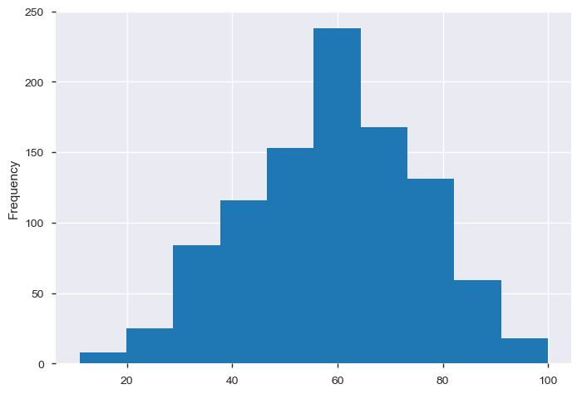
Metascore range
~50% movies got metascore in the range 50 to 70. The 4th quartile(75 to 100) can be considered as movies appreciated by critics.~20% movies were appreciated by critics.

Slide 11
Directors appreciated by critics( metascore > 75)
 | Director | Total Movies | Crtic's choice | Ratio
4 | Wes Anderson | 3 | 3 | 100.0
6 | Damien Chazelle | 2 | 2 | 100.0
10 | Richard Linklater | 2 | 2 | 100.0
11 | George Miller | 2 | 2 | 100.0
13 | Pete Docter | 2 | 2 | 100.0
19 | Bong Joon Ho | 2 | 2 | 100.0
22 | Kathryn Bigelow | 2 | 2 | 100.0
26 | Jeff Nichols | 2 | 2 | 100.0
29 | Alfonso Cuarón | 2 | 2 | 100.0
All movies directed by these directors are appreciated by the critics and have received metascore > 75.

Slide 12
Summary
1.From 2006 to 2016 there is an upward trend in number of released movies. In 2016 highest number of moves were released.
There is a downward trend in movie runtime from 2006 to 2016 however there is no correlation found between movie runtime and revenue.
There is a positive correlation between Votes and Rating. Similarly metascore shows an upward trend with increasing votes.
Till 2014 viewers casted their votes and expressed their opinion in large numbers however in 2015 onwards despite of more number of movies released, viewers refrained from expressing their opinion.
2013 onwards the average revenue is decreasing. This could be because of the increased number of movies released increasing number of options for the viewers.
The trend shows that when the options were less , the movies performed better on box office. Considering the median of revenue for all movies (50%) as the criteria for success, number of unsuccessful movies are increasing against successful movies each year.

Slide 13
Summary
Popular Genres - Drama, action, comedy or adventure are the most popular genres amongst the producers. More than 5-% movies are of Genre Drama or combination of drama and other genres.
Metascore - Movies appreciated by critics
~50% movies got metascore in the range 50 to 70. The 4th quartile(75 to 100) can be considered as movies appreciated by critics.~20% movies were appreciated by critics.

