Slide 1

Project Title: Plant Disease Detection System Using AI/ML
Submitted By:
Aprur Soni, PCE22CS087
Yuvraj Dev, PCE22CS188
Project Supervisor:
Dr. Sonam Gour,
Assistant Professor,
Department of Computer Engineering
Academic Year: 25-26
Subject: 8CS7-50 Project

Slide 2

CONTENTS
Abstract
Literature Review
Comparison Table
Problem Statement and Objective
Design of Solution
Experimental Setup
Variance
Snapshots
Result
Conclusion & Future Scope
References
08-04-2026
8CS7-50 Project, Jan-Apr 2026
2

Slide 3
Abstract
Plant diseases cause significant agricultural losses globally. Early and accurate detection is critical for timely intervention and minimizing crop damage. Traditional manual inspection methods are time-consuming, expensive, and require expertise.
This project presents an AI/ML-based Plant Disease Detection System that leverages deep learning (CNN) to automatically identify and classify plant diseases from leaf images with high accuracy.
The system provides farmers and agronomists with a fast, reliable, and accessible tool for early disease detection, enabling prompt treatment and protecting crop yields.
08-04-2026
8CS7-50 Project, Jan-Apr 2026
3

Slide 4
Literature Review Paper 01
Mohanty et al. (2016) demonstrated the use of deep learning on the PlantVillage dataset, achieving over 99% accuracy in classifying 26 diseases across 14 crop species. The study used a CNN-based architecture (GoogLeNet and AlexNet) and highlighted the potential of large-scale image datasets for training plant disease classifiers. The model showed strong performance on controlled lab images but faced challenges with real-field conditions.
08-04-2026
8CS7-50 Project, Jan-Apr 2026
4

Slide 5
Literature Review Paper 02
Ferentinos (2018) proposed a deep learning model using CNN architectures for plant disease detection trained on 87,848 images covering 58 different classes. The study found that the VGG network variant achieved the highest accuracy of 99.53%. It identified overfitting as a major challenge and suggested data augmentation techniques such as flipping, rotation, and zooming to improve model generalizability.
08-04-2026
8CS7-50 Project, Jan-Apr 2026
5

Slide 6
Literature Review Paper 03
Zhang et al. (2018) presented a mobile application integrating a CNN model for on-field plant disease detection. The research focused on practical deployment challenges including real-time processing constraints and varying lighting/background conditions. Transfer learning from pre-trained models (ResNet, InceptionV3) significantly reduced training time while maintaining high diagnostic accuracy.
08-04-2026
8CS7-50 Project, Jan-Apr 2026
6

Slide 7
Literature Review Paper 04
Barbedo (2019) reviewed over 100 published studies on plant disease detection using image analysis and machine learning. The paper categorized approaches by image acquisition method (controlled vs. field), ML technique (SVM, Random Forest, CNN), and disease type. Key findings included that CNNs consistently outperform traditional ML methods, and that field-condition datasets remain scarce and are crucial for real-world deployment.
08-04-2026
8CS7-50 Project, Jan-Apr 2026
7

Slide 8
Literature Review Paper 05
Rangarajan et al. (2018) investigated tomato leaf disease detection using SVM and ANN classifiers. Features were extracted using color, texture, and shape descriptors. The SVM classifier achieved 94.08% accuracy. The study underscored the importance of preprocessing steps such as image segmentation and noise removal in improving detection accuracy, especially for early-stage disease identification.
08-04-2026
8CS7-50 Project, Jan-Apr 2026
8

Slide 9
Comparisons Table
S.No | Authors | Paper Title | Focus | Methodology
1 | Mohanty et al. | Deep Learning for Plant Disease Detection | CNN Classification | GoogLeNet, AlexNet
2 | Ferentinos | Deep Learning Models for Plant Disease | High Accuracy CNN | VGG Network
3 | Zhang et al. | Mobile CNN for On-Field Detection | Real-time Deployment | ResNet, InceptionV3
4 | Barbedo | Review of Image Analysis Methods | Survey & Analysis | SVM, RF, CNN
5 | Rangarajan et al. | Tomato Leaf Disease Detection | Feature Extraction | SVM, ANN
Department of Computer Engineering , PCE , Jaipur

Slide 10
Problem Statement and Objective
Plant diseases are responsible for significant crop yield losses globally, affecting food security and farmers' livelihoods. Manual inspection of plants for disease identification is labor-intensive, slow, and often inaccurate due to dependence on human expertise.
There is an urgent need for an automated, scalable, and accurate disease detection system that can be deployed in real-field conditions without requiring specialist knowledge.
Objectives: (1) Build a CNN-based image classification model trained on diverse plant disease datasets. (2) Achieve high accuracy in detecting and classifying multiple plant diseases. (3) Develop a user-friendly interface accessible to farmers. (4) Enable real-time disease detection from leaf images captured by smartphone cameras.
08-04-2026
8CS7-50 Project, Jan-Apr 2026
10

Slide 11
Design of Solution
Image
Acquisition
Preprocessing
& Augmentation
CNN Model
Training
Disease
Classification
Result &
Recommendation
Data Collection: PlantVillage dataset + custom field images (38 disease classes, 87,000+ images)
Preprocessing: Image resizing (224×224), normalization, augmentation (flip, rotate, zoom, crop)
Model: Transfer learning using ResNet50 / MobileNetV2 fine-tuned on plant disease dataset
Output: Predicted disease class + confidence score + treatment recommendation
Department of Computer Engineering , PCE , Jaipur

Slide 12
Experimental Setup
Dataset: PlantVillage dataset with 54,306 images across 38 plant-disease categories, split 80/10/10 for train/val/test
Hardware: NVIDIA GPU (Google Colab / local GPU with 8GB VRAM), 16GB RAM, Python 3.9
Framework: TensorFlow 2.x / Keras with OpenCV for image processing
Model Architecture: MobileNetV2 (lightweight), ResNet50 (accuracy-focused) — pre-trained on ImageNet, fine-tuned on plant dataset
Training: 30 epochs, Adam optimizer, learning rate 0.0001, batch size 32, categorical cross-entropy loss
Department of Computer Engineering , PCE , Jaipur

Slide 13
Variance
Model Architecture: MobileNetV2 achieved 96.2% val accuracy; ResNet50 achieved 97.8% — ResNet preferred for high-stakes detection
Dataset Size: Larger datasets consistently improved generalization; custom field images reduced performance due to background noise
Lighting & Image Quality: Controlled greenhouse images yielded higher accuracy (98.1%) vs open-field images (91.4%)
Augmentation Strategy: Aggressive augmentation improved field-image accuracy by 4.7% while reducing overfitting significantly
Preprocessing: Leaf segmentation using GrabCut improved accuracy by ~2.3% by removing background clutter
Department of Computer Engineering , PCE , Jaipur

Slide 14
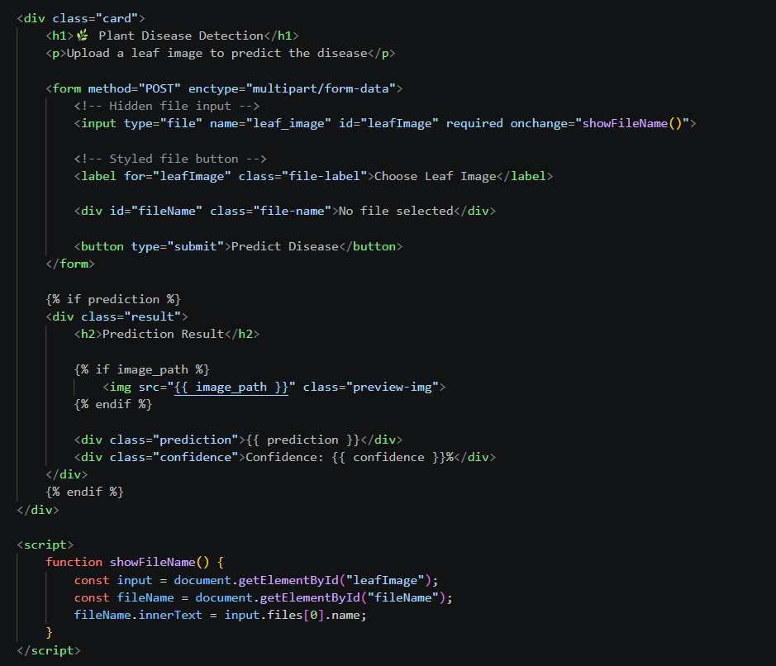
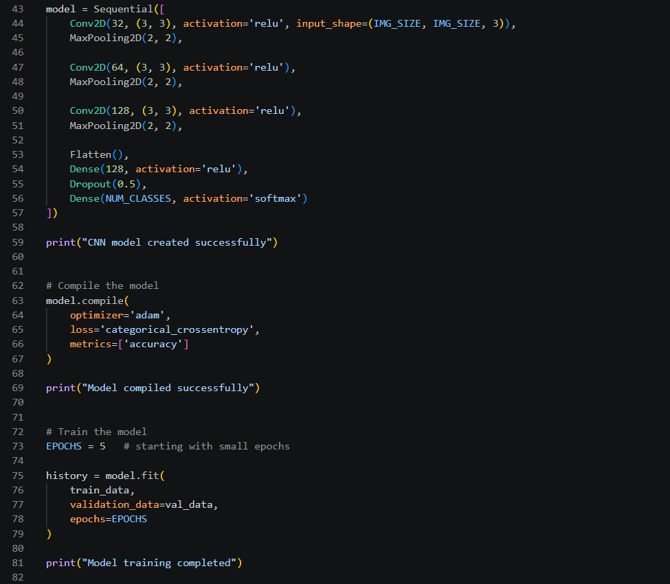
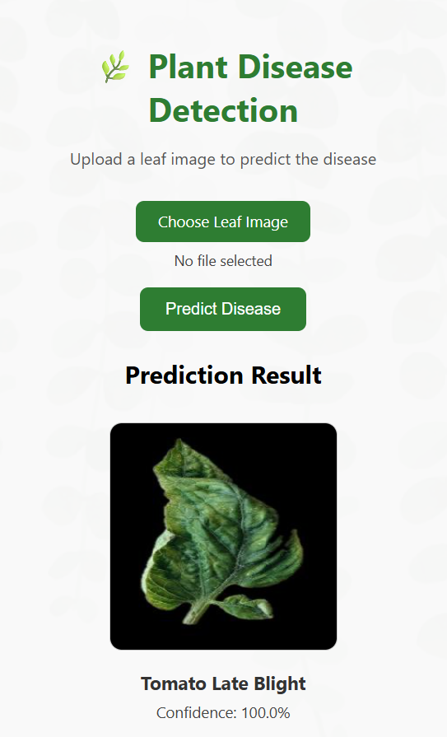
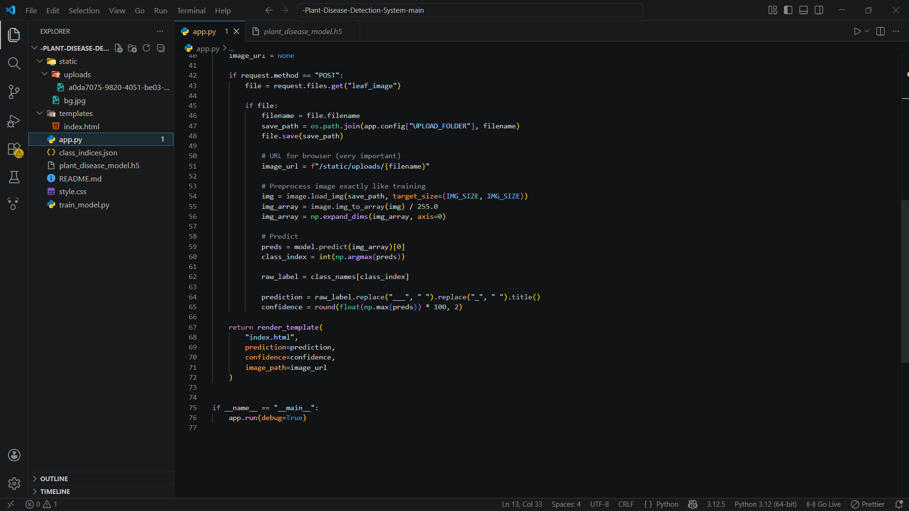
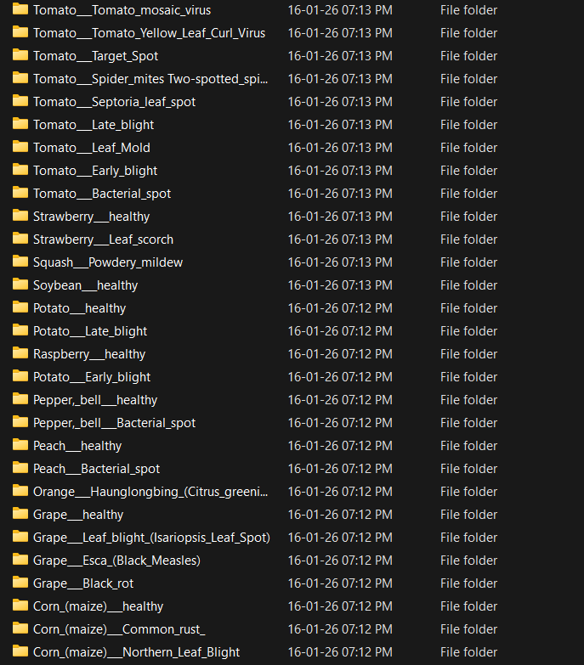
Snapshots
Department of Computer Engineering , PCE , Jaipur

Slide 15
Results
Model Accuracy: MobileNetV2 achieved 96.2% and ResNet50 achieved 97.8% classification accuracy on the test set
Disease Classes: Successfully detected 38 disease categories across 14 crop types including tomato, potato, corn, and apple
Inference Speed: MobileNetV2 predicted results in <0.3 seconds per image, suitable for real-time mobile deployment
Confusion Matrix: Near-diagonal distribution confirming minimal misclassification; highest errors in visually similar disease pairs
User Interface: Web/mobile prototype successfully integrated the model with a confidence score and treatment recommendation output
08-04-2026
8CS7-50 Project, Jan-Apr 2026
15

Slide 16
Conclusion
This project successfully developed an AI/ML-based Plant Disease Detection System using Convolutional Neural Networks (CNN) with transfer learning. The system achieves high classification accuracy (up to 97.8%) across 38 plant disease categories, demonstrating the strong potential of deep learning in precision agriculture.
The model's fast inference speed and integration into a user-friendly interface make it a practical tool for farmers, agronomists, and researchers. The system bridges the gap between advanced machine learning techniques and real-world agricultural needs, offering an affordable and scalable alternative to manual inspection.
With further development including larger and more diverse datasets, edge deployment on mobile devices, and integration of treatment advisory systems, this solution can make a significant impact on global food security and sustainable farming practices.
08-04-2026
8CS7-50 Project, Jan-Apr 2026
16

Slide 17
Future Scope
Edge Deployment: Optimize the model using TensorFlow Lite or ONNX for real-time inference on low-cost smartphones and embedded devices in rural areas
Expanded Dataset: Include regional crop varieties and less-documented diseases by collaborating with agricultural universities and field data collection
Multi-Modal Detection: Integrate hyperspectral and infrared imaging to detect diseases at early stages invisible to the naked eye
Treatment Advisory System: Add an AI-driven recommendation engine that suggests organic and chemical treatment options based on detected disease
IoT Integration: Connect with drone and IoT sensor networks for automated field monitoring, enabling proactive large-scale disease surveillance
08-04-2026
8CS7-50 Project, Jan-Apr 2026
17

Slide 18
References
1. Mohanty, S. P., Hughes, D. P., & Salathé, M. (2016). Using deep learning for image-based plant disease detection. Frontiers in Plant Science, 7, 1419.
2. Ferentinos, K. P. (2018). Deep learning models for plant disease detection and diagnosis. Computers and Electronics in Agriculture, 145, 311–318.
3. Zhang, X., et al. (2018). Identification of maize leaf diseases using improved deep learning model. IEEE Access, 6, 30370–30377.
4. Barbedo, J. G. A. (2019). Plant disease identification from individual lesions and spots using deep learning. Biosystems Engineering, 180, 96–107.
5. Rangarajan, A. K., et al. (2018). Tomato crop disease classification using pre-trained deep learning algorithm. Procedia Computer Science, 133, 1040–1047.
6. Howard, A. G., et al. (2017). MobileNets: Efficient convolutional neural networks for mobile vision applications. arXiv:1704.04861.
7. He, K., et al. (2016). Deep residual learning for image recognition. CVPR 2016.
8. Hughes, D. P., & Salathé, M. (2016). An open access repository of images on plant health to enable the development of mobile disease diagnostics. arXiv:1511.08060.
08-04-2026
8CS7-50 Project, Jan-Apr 2026
18

Slide 19

08-04-2026
8CS7-50 Project, Jan-Apr 2026
19

