Slide 1

An
Industrial Training Presentation
My SQL
Carried Out At
Azure Skynet Solutions PVT. LTD.
(Session 2024-25)
Submitted By:
Name: Mayur Soni
Roll. No: 22
Section: B
Registration No.: PCE22CS087
Submitted to:
Dr. Rajesh Bhatija
Department of Computer Engineering

Slide 2
Content of the Slides
Company’s description
Prerequisites of training
Training description
Introduction to python programming
Project description
Conclusion
References

Slide 3
Company’s Description
Azure Skynet Solutions Private Limited, an ISO 9001: 2015 certified company which is a leading Information Technology training & service provider of India.
The company’s diverse and talented employees are committed to help businesses, governments and educational institutions to plan and run successful security programs through the right combination of products, services and solutions related to security program strategy, enterprise risk and consulting, threat and vulnerability management and training in multiple technologies.
Founded in 2014, the company has served more than 120 clients of various sizes across multiple industries.
Azure Skynet Solutions is a process centered organization with its focus to promote innovation through training, implementation and research.

Slide 4
Prerequisites of the Training
The prerequisites of the training are:-
⇢Basic Computer Skills
⇢Familiarity with Databases
⇢Basic SQL Knowledge
⇢Understanding of RDBMS
⇢Basic Programming Knowledge

Slide 5
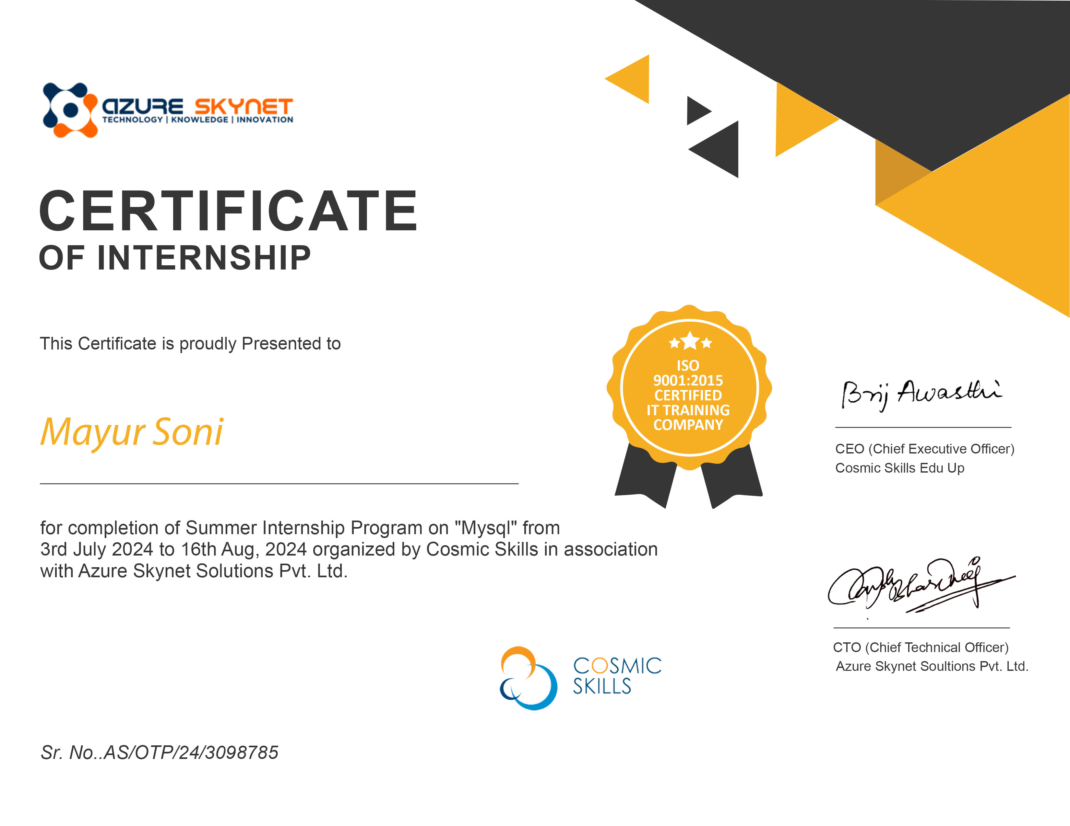
Certificate of Training

Slide 6
WHAT IS MYSQL?
MySQL is an open-source relational database management system (RDBMS) that uses Structured Query Language (SQL) for managing and organizing data.
It is used for:
1. Web Databases
2.Data Storage and Retrieval
3.E-commerce
4.Software Development

Slide 7
WHAT CAN MYSQL DO?
⇢Powering websites and web applications.
⇢Storing large volumes of data for analysis and reporting.
⇢Storing logs and tracking user activity or system events.
⇢Providing a database backend for software applications across industries.
⇢Serving as a database backend for cloud-based services and platforms

Slide 8
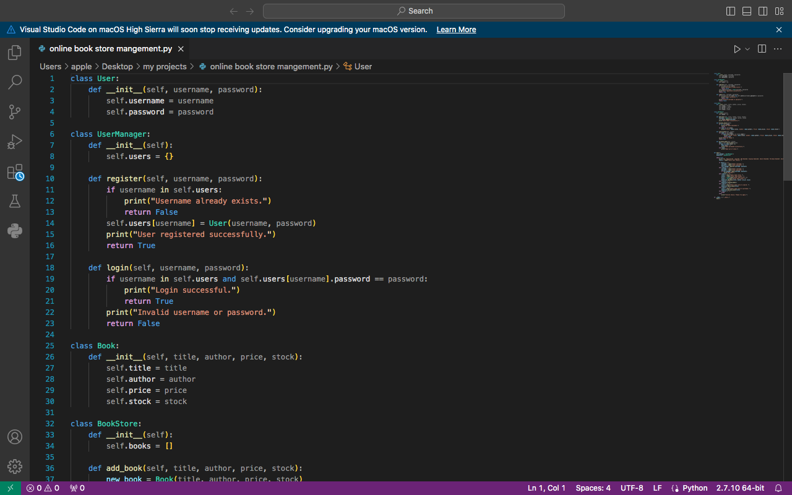
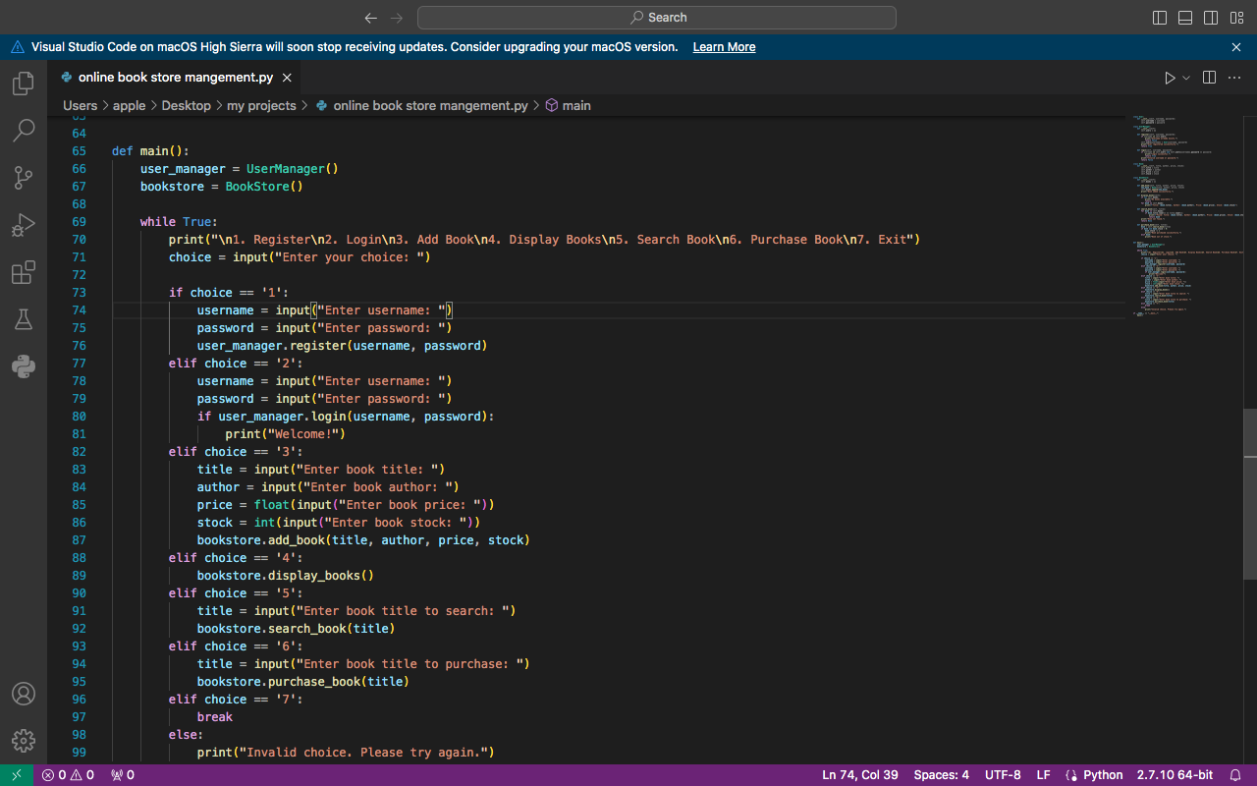
Projects

Slide 9
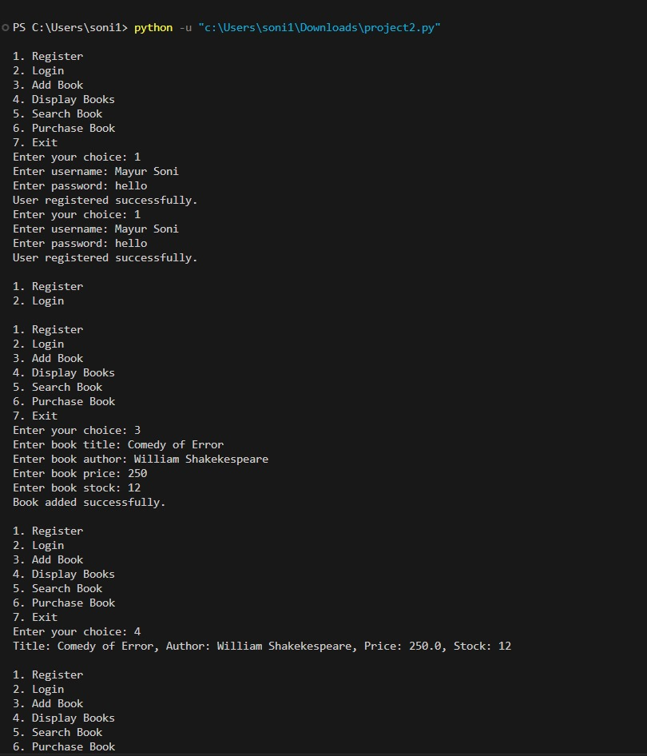
Project Output

Slide 10
References
https://www.w3schools.com/
https://jquery.com/
https://www.geeksforgeeks.org/
https://www.shiksha.com/
https://blog.hubspot.com/

Slide 11
Thank You

