Slide 1
IBM University Engagement Project Submission
“Exploring the Power of Agentic AI with IBM Granite and IBM Bob”

Slide 2


Project Tile – [AI Agent for Digital Financial Literacy]
Domain of Project – [Finance]
Student Name | Recent Passport Photo | Email ID | Mobile number [WhatsApp]
MAYUR SURESH NAIR
msnair101@gmail.com
9747155965
Recommended font style and size: Font Style: Arial Font Size (Heading): 28
Font Size (Content): 20

Slide 3
Problem Statement -
Problem Statement : AI Agent for Digital Financial Literacy
The Challenge
First-time digital financial users, rural populations, and non-English speakers face steep barriers when transitioning to modern banking, UPI, and digital transactions. As digital payments expand rapidly across India, many citizens lack the baseline digital literacy required to navigate complex user interfaces or understand financial terminology. This knowledge gap creates widespread anxiety and hesitation, leaving millions excluded from the speed, safety, and convenience of digital financial ecosystems.
Beyond accessibility barriers, low financial literacy exposes vulnerable demographics to significant online risks, including phishing scams, fraudulent UPI link requests, and predatory loan apps. Information on how to prevent these threats exists, but it remains scattered across dense government portals, RBI circulars, banking sites, and technical help pages that are difficult for everyday users to parse. Without a trusted, centralized channel offering clear guidance, users struggle to distinguish legitimate financial practices from deceptive schemes.
The Objective
The primary goal of this project is to build an agentic, RAG-powered AI system that delivers real-time, personalized, and multilingual financial literacy guidance to diverse user bases. By combining advanced natural language understanding with localized knowledge retrieval, the system aims to make essential financial advice approachable, actionable, and culturally relevant for non-expert users.
To tackle the safety gap, the assistant is designed to proactively educate users on fraud prevention, UPI transaction safety, and responsible credit practices. Rather than giving static advice, the system acts as an interactive coach—helping users verify whether a transaction process is safe, explaining interest rate calculations, and providing step-by-step guidance on using digital payment applications without fear of exploitation.

Slide 4
Proposed Solution -
Proposed Solution: AI Agent for Digital Financial Literacy
An AI Agent for Digital Financial Literacy, powered by RAG (Retrieval-Augmented Generation), helps users understand and navigate essential financial tools and practices. It retrieves reliable content on using UPI, avoiding online scams, understanding interest rates, budgeting, and personal finance management from government portals, banking websites, and educational platforms. With multilingual support, users from diverse backgrounds can interact in their preferred language and ask questions like “How do I send money via UPI?” or “What is a safe interest rate for a loan?” The agent ensures financial literacy is accessible, personalized, and culturally inclusive. This AI-driven assistant empowers users with knowledge, protects them from fraud, and builds confidence in digital finance.

Slide 5
Technology Used
IBM Bob platform -For designing and orchestrating multi-agent workflows visually
IBM Granite model - ibm-granite-4h-small
IBM Cloud – It provides the infrastructure to build, deploy, and scale the Nutrition Agent efficiently. IBM Cloud enables a reliable, secure, and scalable environment for deploying the Nutrition Agent.
RAG– RAG to fetch real data first, then generate intelligent answers, making the Nutrition Agent more trustworthy and effective.
IBM Watsonx.ai - For model deployment, embeddings, and AI governance

Slide 6
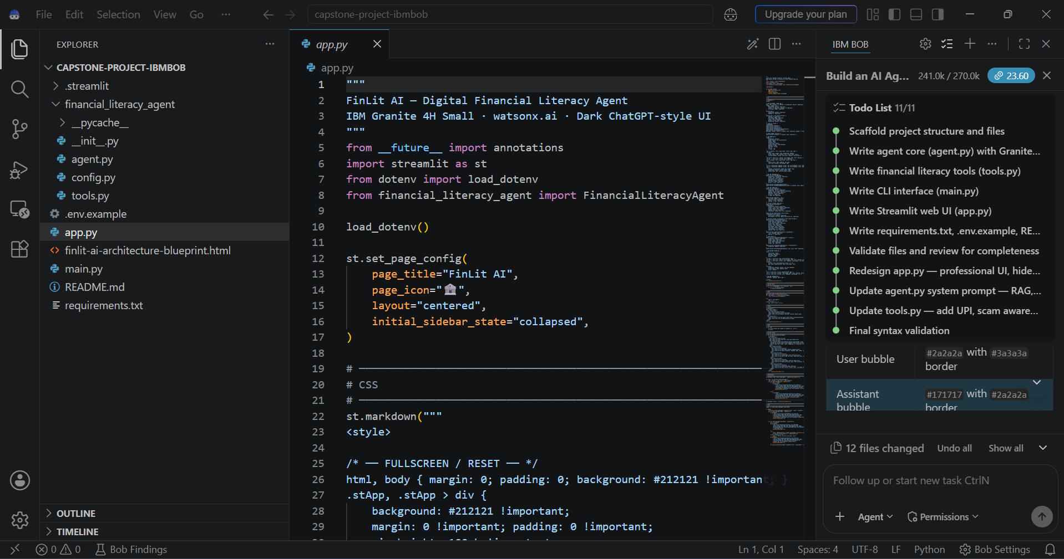
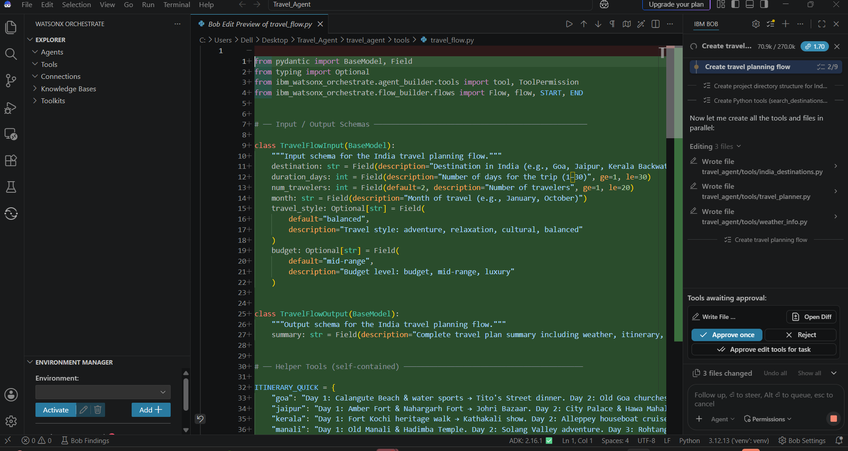
Required Files created using IBM bob -

Slide 7
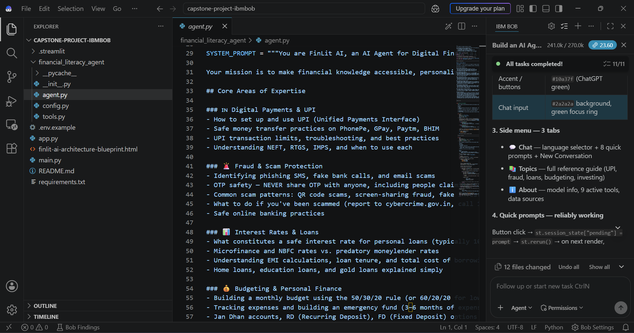
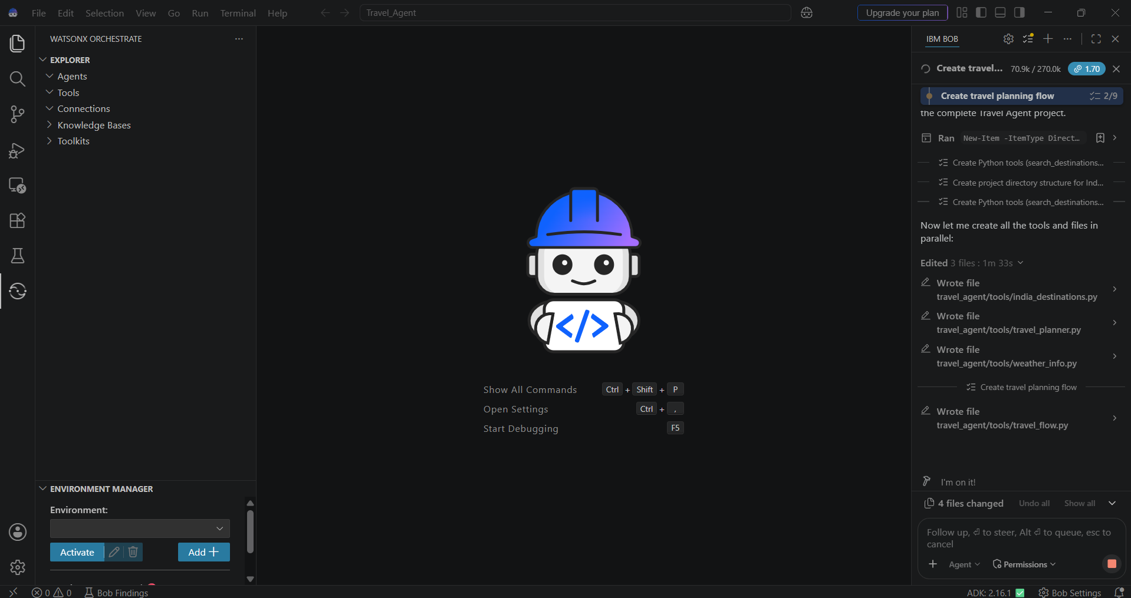
IBM Bob Screenshots:

Slide 8
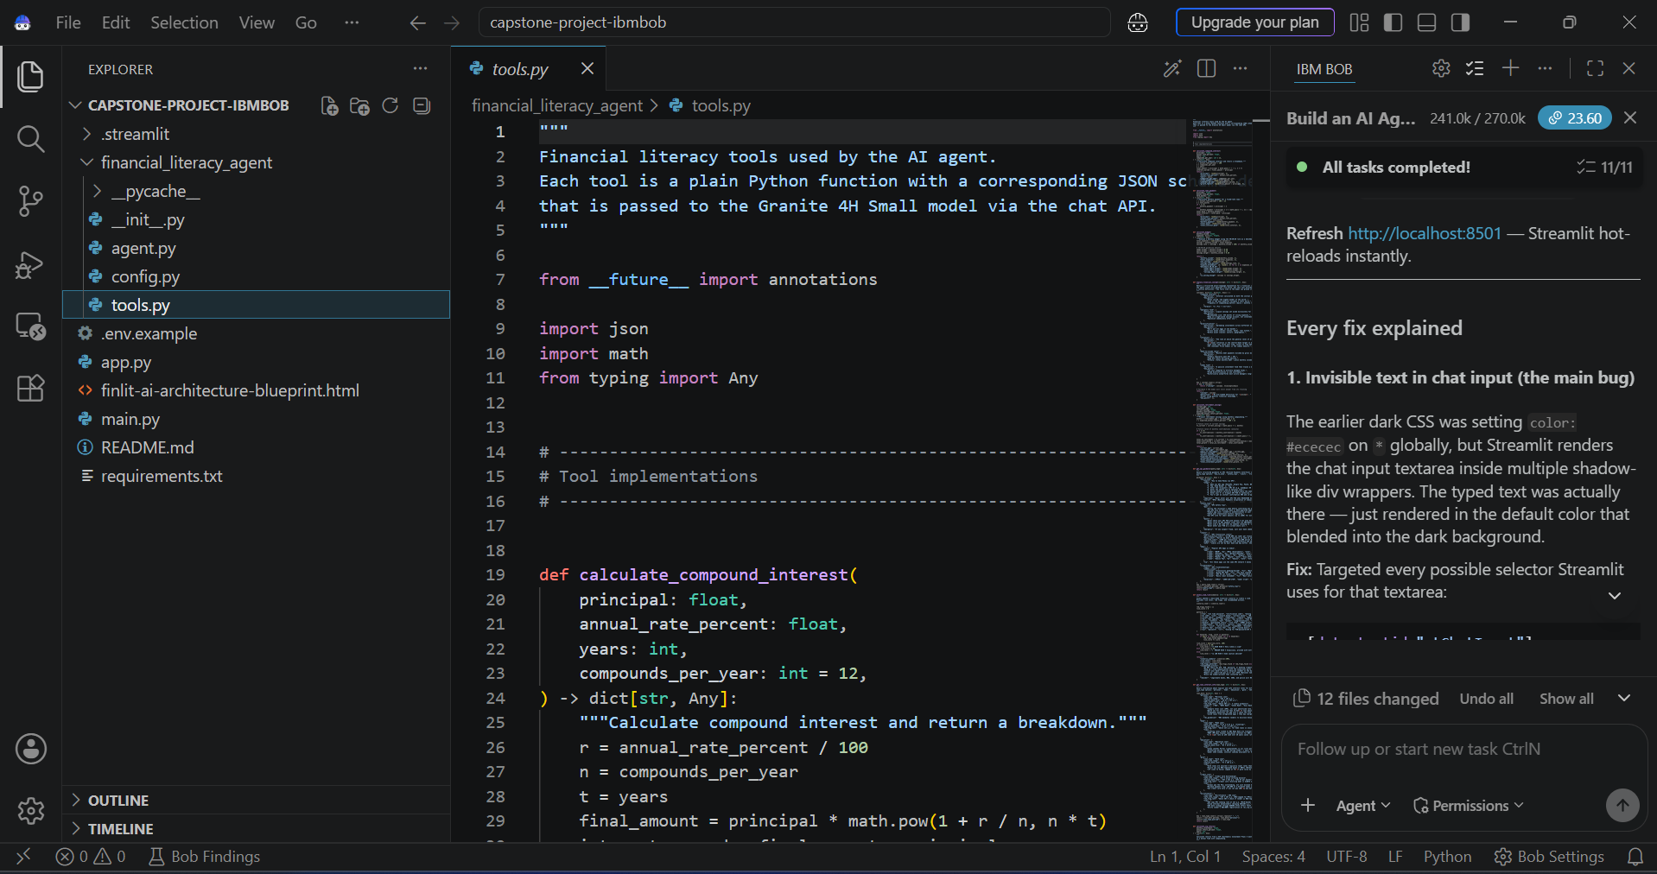

Slide 9
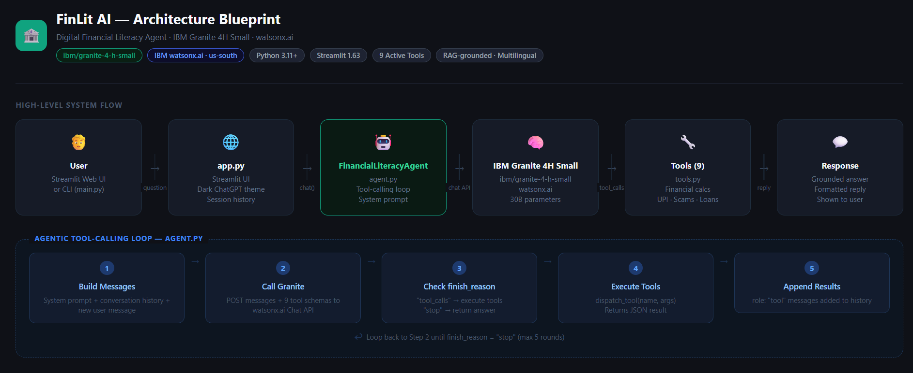
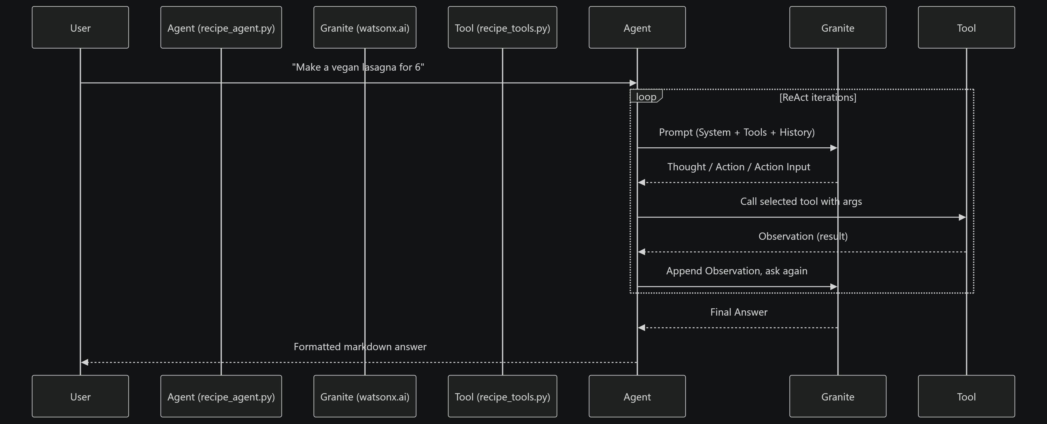
Architecture blueprint for IBM bob:

Slide 10

Role of Agentic AI in the solution
Role of Agentic AI in Finance Agent
Agentic AI shifts this solution from a basic text responder into an active financial guide capable of planning, executing, and adapting multi-step processes. Unlike traditional chatbots that output static paragraphs, an agentic framework breaks down complex financial tasks—such as setting up a UPI PIN, verifying a loan offer, or checking a bank statement—into sequential sub-goals. It evaluates the user's technical comfort level, provides step-by-step instructions, and waits for feedback at each phase to ensure the task is completed safely before moving to the next step.
Intelligent Tool Orchestration & Contextual Reasoning
Instead of performing simple keyword searches against a single database, the agent dynamically decides which external tool or dataset to query based on user intent. When queried about a suspicious offer, the agent can autonomously cross-reference official RBI guidelines, query government scam registries, and pull current interest rate standards from banking portals. If an initial search yields ambiguous results, the agent autonomously reformulates its search parameters and synthesizes data across multiple sources to provide a reliable, policy-compliant answer without human intervention.
Proactive Fraud Guardrails & Personalized Adaptation
Beyond responding to explicit user queries, an agentic system continuously monitors the context of interactions for subtle markers of financial scams, such as high urgency, requests for secret PINs, or unverified payment links. Upon detecting these indicators, the agent autonomously triggers protective interventions—flagging dangerous behavior and explaining the risk in the user's native language. Over time, the agent retains long-term contextual memory, gradually adjusting its explanations from simple concepts for beginners to advanced budgeting tools as the user's digital literacy improves.

Slide 11
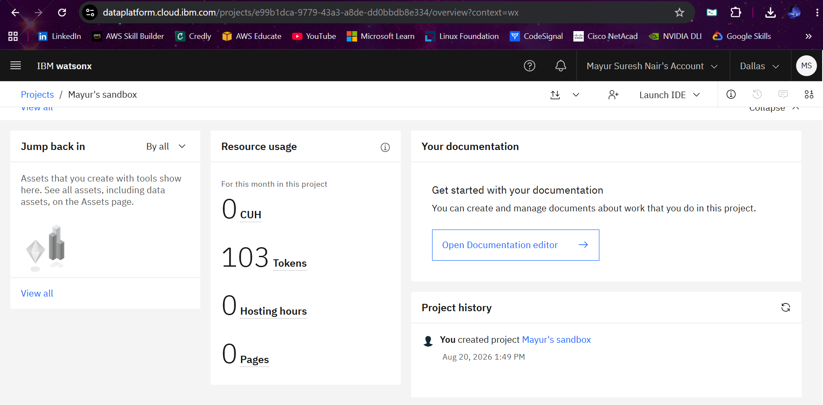
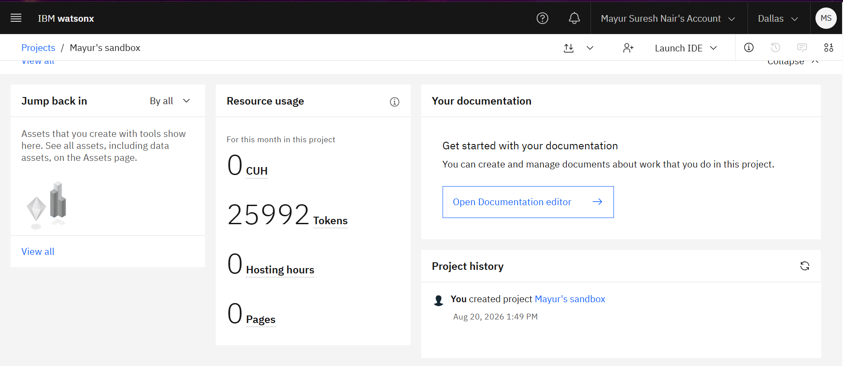


Token Usage
25889 token are used
Before Prompt
After the Prompt
·
·
·

Slide 12
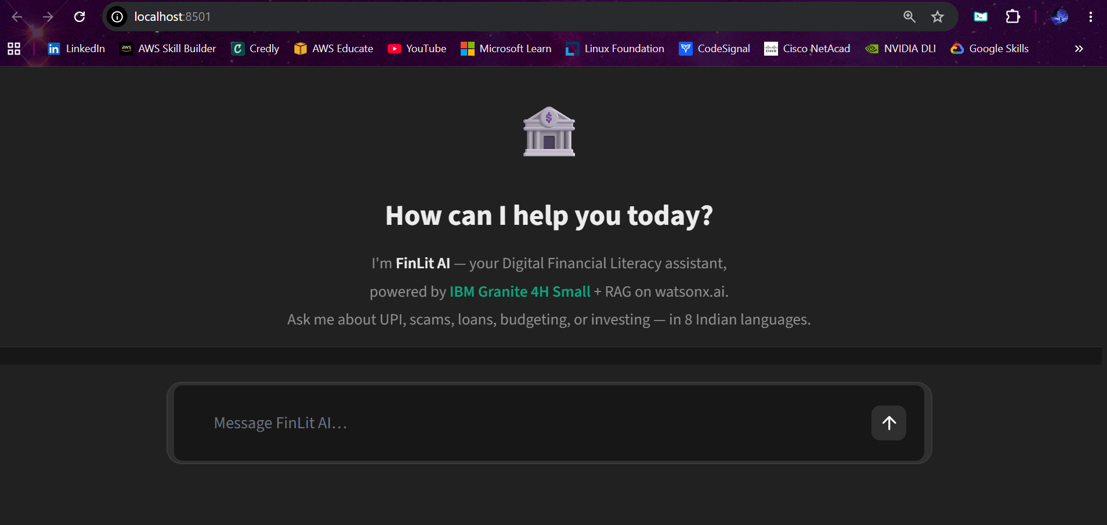
Project Output Screenshot
Please put IBM Bob output screenshots with 2-3 prompts.
You can take 2-3 more slides for each screenshot
·
·
·

Slide 13
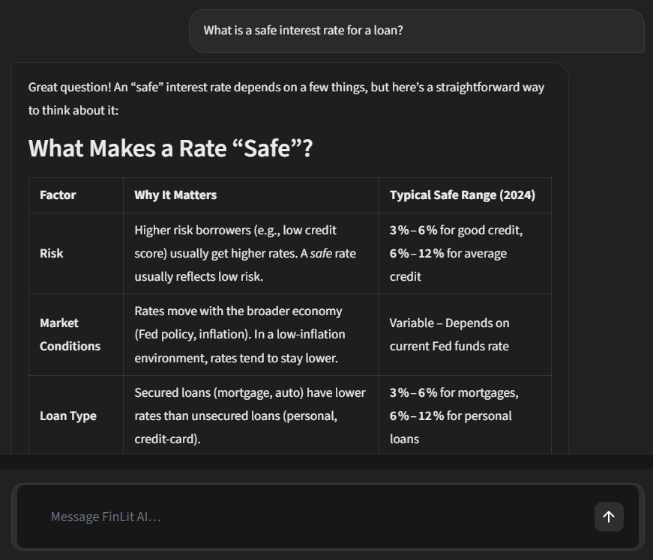
Project Output Screenshot
·
·
·

Slide 14
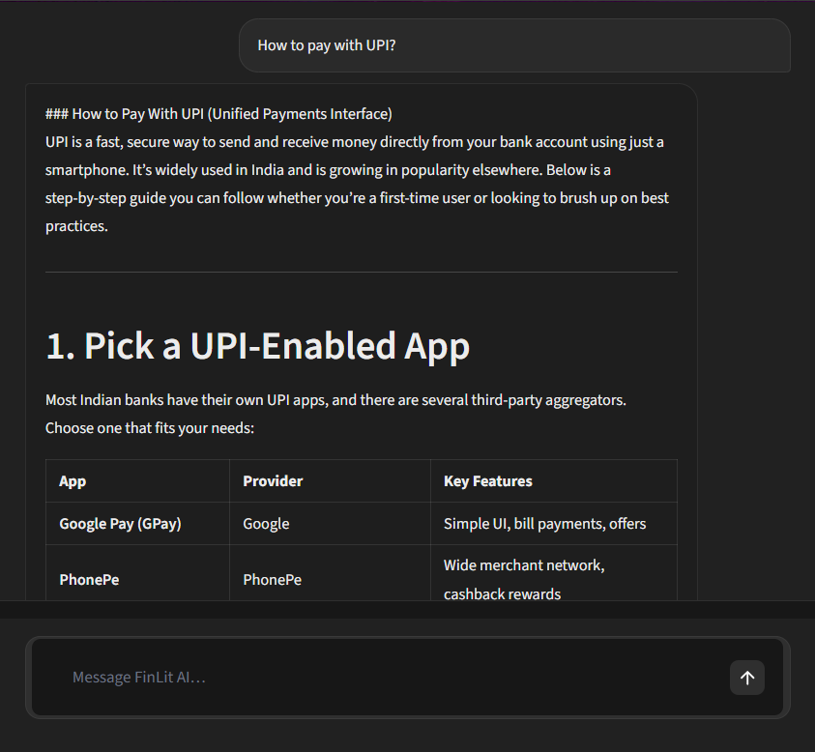
Project Output Screenshot
·
·
·

Slide 15
Novelty and Uniqueness
1. Dynamic, Multi-Turn Safety Guardrails vs. Static Advice
Traditional Approach: Existing banking apps and generic AI chatbots rely on passive FAQs or rigid keyword searches. They only present advice when explicitly asked and cannot detect immediate danger.
The Unique Edge: This solution uses Agentic AI to actively monitor conversation contexts for behavioral markers of financial fraud. If a user mentions a suspicious transfer, high urgency, or a request for a PIN, the agent immediately interrupts the workflow, flags potential phishing risks, and guides the user through safety checks.
2. Grounded Truth Engine via Policy-Grounded RAG
Traditional Approach: Standard Generative AI models frequently hallucinate financial figures, interest rates, or eligibility criteria, posing a severe liability for users.
The Unique Edge: The system embeds a Retrieval-Augmented Generation (RAG) pipeline strictly indexed against live, official regulatory sources (such as Reserve Bank of India circulars, government financial inclusion portals, and verified banking APIs). It cites specific regulatory frameworks to ensure zero misinformation.
3. Vernacular Contextualization & Multimodal Accessibility
Traditional Approach: Most financial tools translate content literally from English, missing regional nuances, colloquial financial terms, and local dialects.
The Unique Edge: It pairs voice-first, multimodal inputs (text, speech, and image processing for payment screenshots) with native regional language processing. Rather than running raw mechanical translations, the agent simplifies complex financial concepts (like compound interest or UPI handles) into relatable, culturally tailored analogies.
4. Autonomous Agentic Tool Orchestration with IBM Granite
Traditional Approach: Rule-based bots follow rigid linear decision trees that break when a user's query deviates from a template.
The Unique Edge: Leveraging IBM Granite's reasoning engine, the system dynamically decides which tool to deploy—whether querying an RBI scam registry, fetching a live government scheme database, or executing a localized voice pipeline—allowing it to handle unpredictable user interactions smoothly.

Slide 16
Git Hub Link
Github URL: https://github.com/mayursureshnair/IBM-Bob-Capstone-Project.git
·
·
·

Slide 17
Future Scope
Voice-First & Vernacular AI (IVR Integration): Expand from smartphone text/voice inputs to low-cost feature phone support via automated voice calls (IVR), bringing AI literacy to rural areas without internet access.
On-Device Offline AI Execution: Quantize and deploy lightweight IBM Granite models directly onto mobile devices for edge processing, enabling instant fraud detection and offline financial guidance in remote regions.
Direct Banking & Fintech API Partnerships: Integrate with official banking frameworks and open banking APIs to allow automated account balance checks, safe micro-loan applications, and real-time transaction flags with user permission.
Multimodal Visual Scanning: Enhance the vision capabilities so users can scan physical paper documents, loan agreements, or bank notices to receive instant, localized audio summaries and risk alerts.
·
·
·

Slide 18
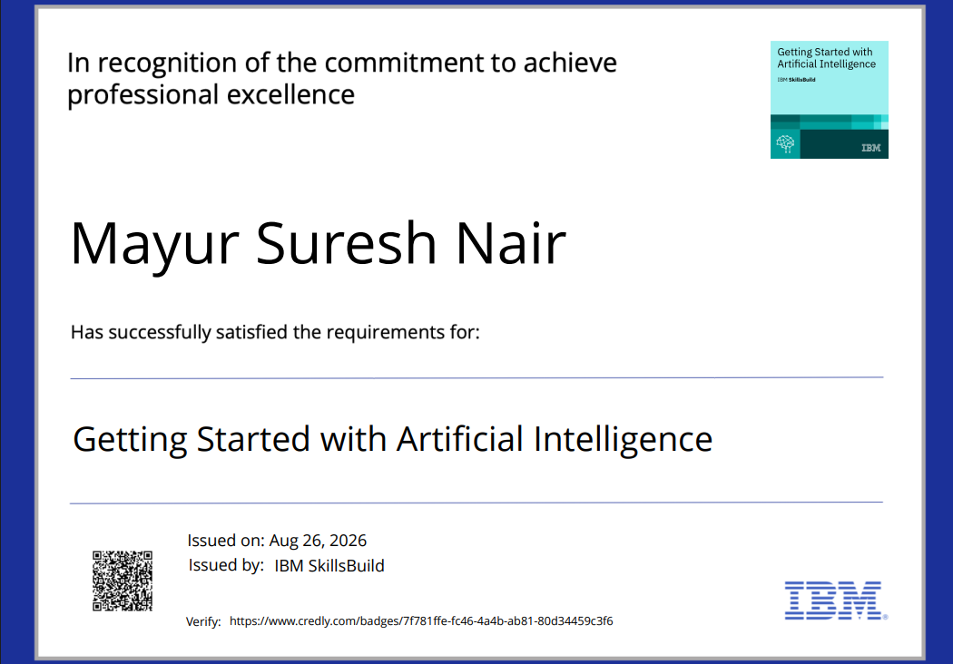
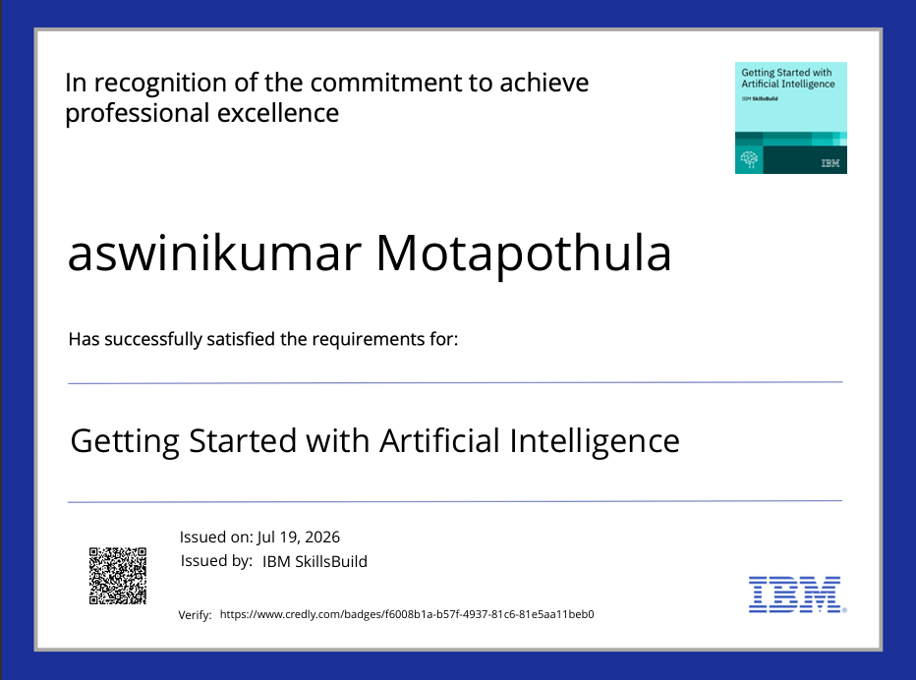
Certificates Earned:
IBM SkillsBuild: Getting Started with Artificial Intelligence

Slide 19
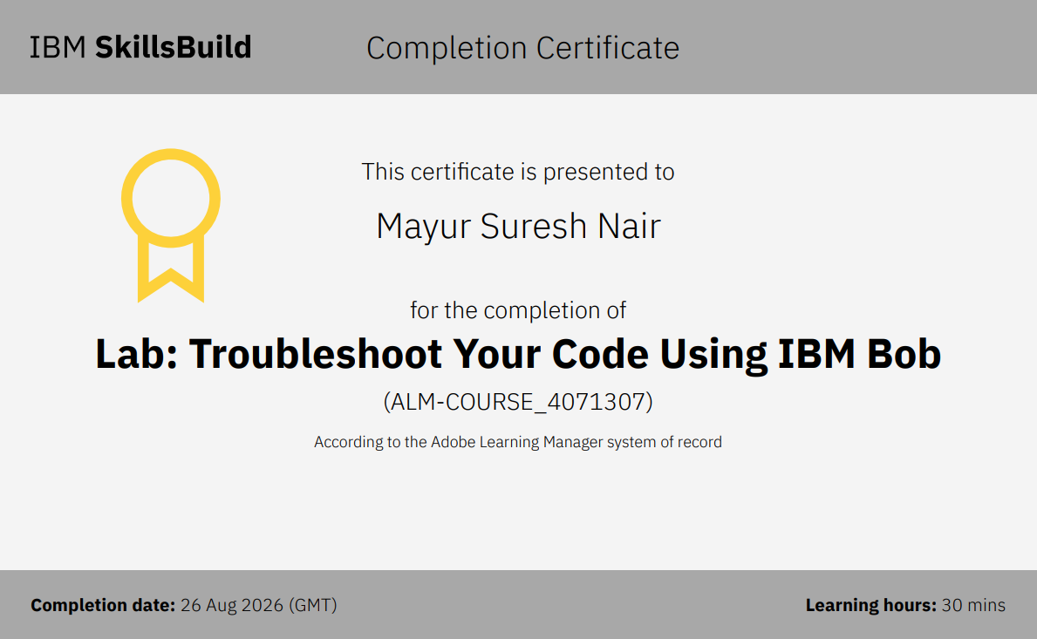
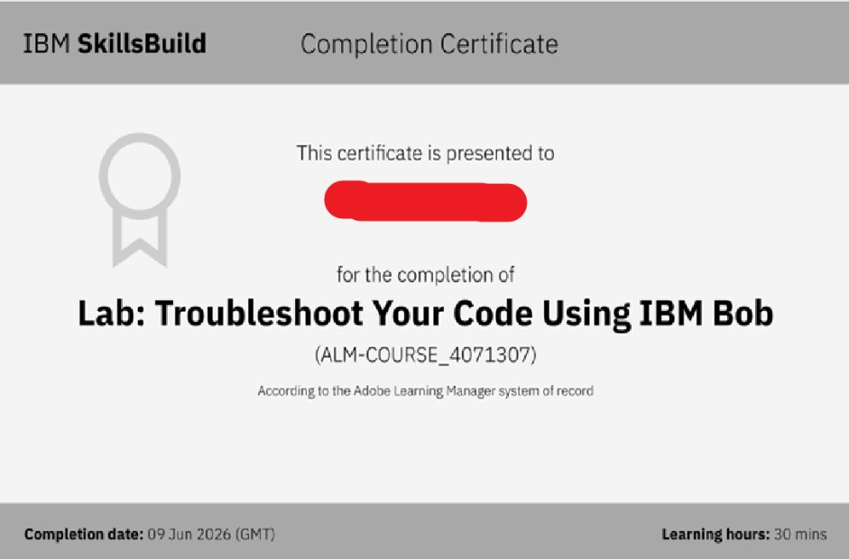
Certificates Earned:​
IBM BOB Certificate

Slide 20


