Slide 1
Sales dashboard presentation Insights from Jan 2024 to Feb 2024 Company Name: FoodCloud Presented by: Mayur Tambe

Slide 2
Overview
This analysis provides a comprehensive view of sales data over a specified period, utilizing various visualizations and insights generated from a Power BI dashboard.
The analysis covers key metrics such as total sales, customer and vendor trends, geographic distribution, vendor performance, category analysis, customer segmentation, and sales trends over time.
Each section of the presentation offers actionable insights to drive strategic decision-making and business growth.

Slide 3
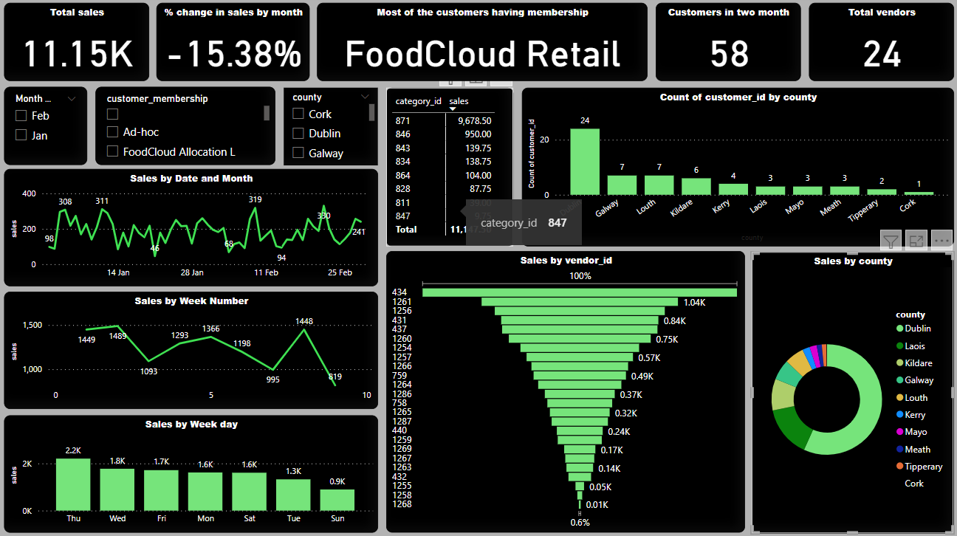
Sales Dashboard Overview

Slide 4
Total sales overview
Total sales: 11.15K
Sales in January: 6.04K
Sales in February: 5.11K
Variance in Sales
Percent Decrease: 15.38%
Summary:
Top Vendor ID in terms of sales: 434
Top Category ID in terms of sales: 871

Slide 5
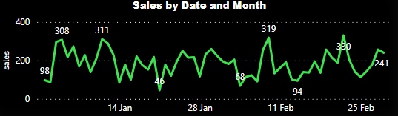
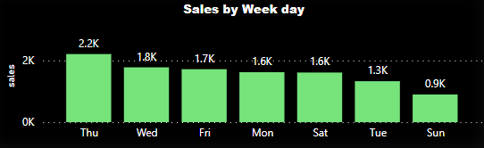
Sales trends
Additionally, the day-of-week bar chart enables us to understand sales patterns for each weekday. For example, we observe that Thursday consistently exhibits the highest sales compared to other days. This understanding will aid us in optimizing sales strategies and resource allocation based on weekday trends.

Slide 6
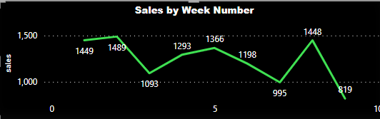
Sales trends
The weekly line chart allows us to zoom in on weekly sales trends, providing insights into weekly fluctuations and trends, notably the 3rd week of both months has lower sales.
Our top-performing weeks were the 2nd and 8th weeks during these two months, with sales reaching 1488 and 1448, respectively.

Slide 7
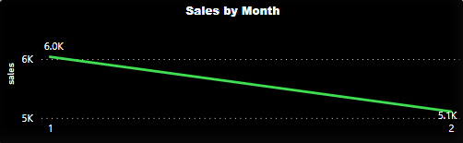
Sales trends
We can analyze sales trends for specific months, enabling us to identify seasonal patterns and track month-to-month performance variations. For instance, our January sales totaled 6.04K, while February sales amounted to 5.11K.

Slide 8
Customer & vendor analysis
In the past two months, we have acquired a total of 58 customers and engaged with 24 vendors.
This indicates the growth of our customer base and our network of vendors over the specified period.
Furthermore, we can identify trends among different customer segments. For instance, the majority of our customers are enrolled in the "FoodCloud Retail" membership, which has contributed significantly to our sales during these two months.
By utilizing the customer membership slicer, we can analyze sales performance across different customer segments.

Slide 9
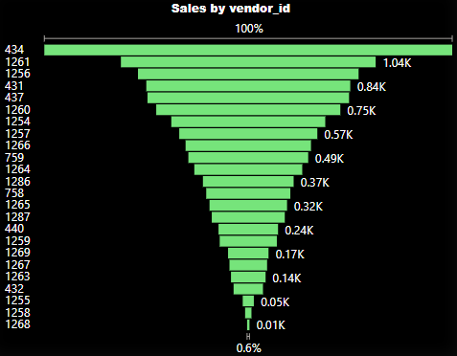
Vendor Performance
Vendor 434 and Vendor 1261 appear to be the top performers, contributing significantly to our overall sales.
Analyzing vendor-wise sales can help us identify key partnerships and optimize our vendor relationships for better sales outcomes.

Slide 10
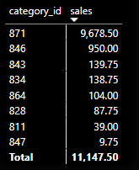
Category Analysis
We can identify 871 category_id driving the highest sales volume and revenue.
This analysis informs product inventory management, marketing strategies, and future product development initiatives, ensuring alignment with customer preferences and market demand.

Slide 11
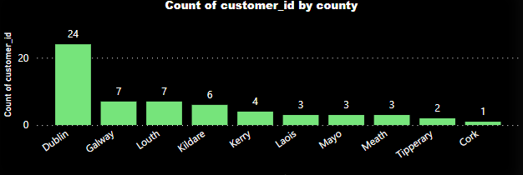
Geographic Analysis
Our customer base is distributed across various counties, as depicted in the column chart.
County Dublin has the highest number of customers and County Cork has the lowest.
This geographic insight can help us target specific regions for marketing and sales initiatives.

Slide 12
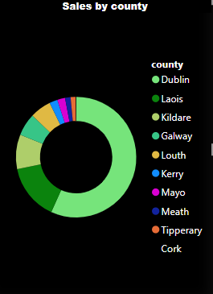
Geographic Analysis
The pie chart illustrates the distribution of sales across various counties, providing a geographical perspective on our sales performance.
By visualizing sales distribution by county, we can say that the Dublin region has the highest sales contribution, and other potential areas need to be targeted for marketing efforts.

Slide 13
THANK YOU

