Slide 1
TREKHUB
Unlock The World Of Trekking Adventure………

Slide 2
Agenda
Project Introduction
Project Architecture
Database Design
Technology platform used for project
User Roles and Responsibilities
Division of work within the team
Details of contribution of each team member
File and Directory structure for project
Use of Github for project
Future Extension
Conclusion

Slide 3
Project Introduction
Purpose of the project :
The project provides online platform for trekkers to plan their trekking events and provide services suitable for individuals seeking for adventures, thrilling, and memorable experiences.
Need :
In current situation peoples are searching for centralize platform to solve their trekking related issues like lack of information about trekking destination, best routes to reach, transportation, food, stay, local guidance, language barrier, health and safety problems. There are no facilities is present to tackle all these problems in one place.
Beneficiaries of project :
This project will be beneficial for the trekkers due to better choices available according to their interest as well as for the organizers due to increased in bookings due to better customer relationship. This project will be also beneficial for local entrepreneurs majorly.

Slide 4
Project Architecture
Used For Used For
User Interfacing 1. Server Side Validation, If Needed
Basic Data Validation 2. Response Handling
3. Business Logic Used For
4. Database Operations 1. Permanent Storage
2. Database Level Validations
3. Database Access and data
Integrity
Technology Used
HTML, CSS
JavaScript, jQuery Technology Used
React JS 1. Spring Boot
JSON 2. Hibernate Technology Used
3. .NET MVC 1. MySQL
Front End Layer
Server Layer
Database Layer

Slide 5
Database Design
Tables and Entities
Roles
role_id
role_name
Login
login_id
uid
pwd
role_id
Treks
trek_id
trek_name
duration
capacity
description
location
level
PlanTreks
plantreks_id
start_date
price
avail_seats
last_date_apply
trek_id
guide_id
status
Users
user_id
fname
lname
email
contact
adharno
gender
addressline
pincode
user_login_id
TrekImages
trek_image_id
trek_image
trek_id
Feedback
feedback_id
rating
comment
trekker_id
plantrek_id

Slide 6
Tables and Entities
TrekBooking
booking_id
booking_date
trekker_id
platrek_id
members
amount
Payment
payment_id
payment_mode
transaction_id
amount
payment_date
booking_id
plantrek_id
trekker_id

Slide 7
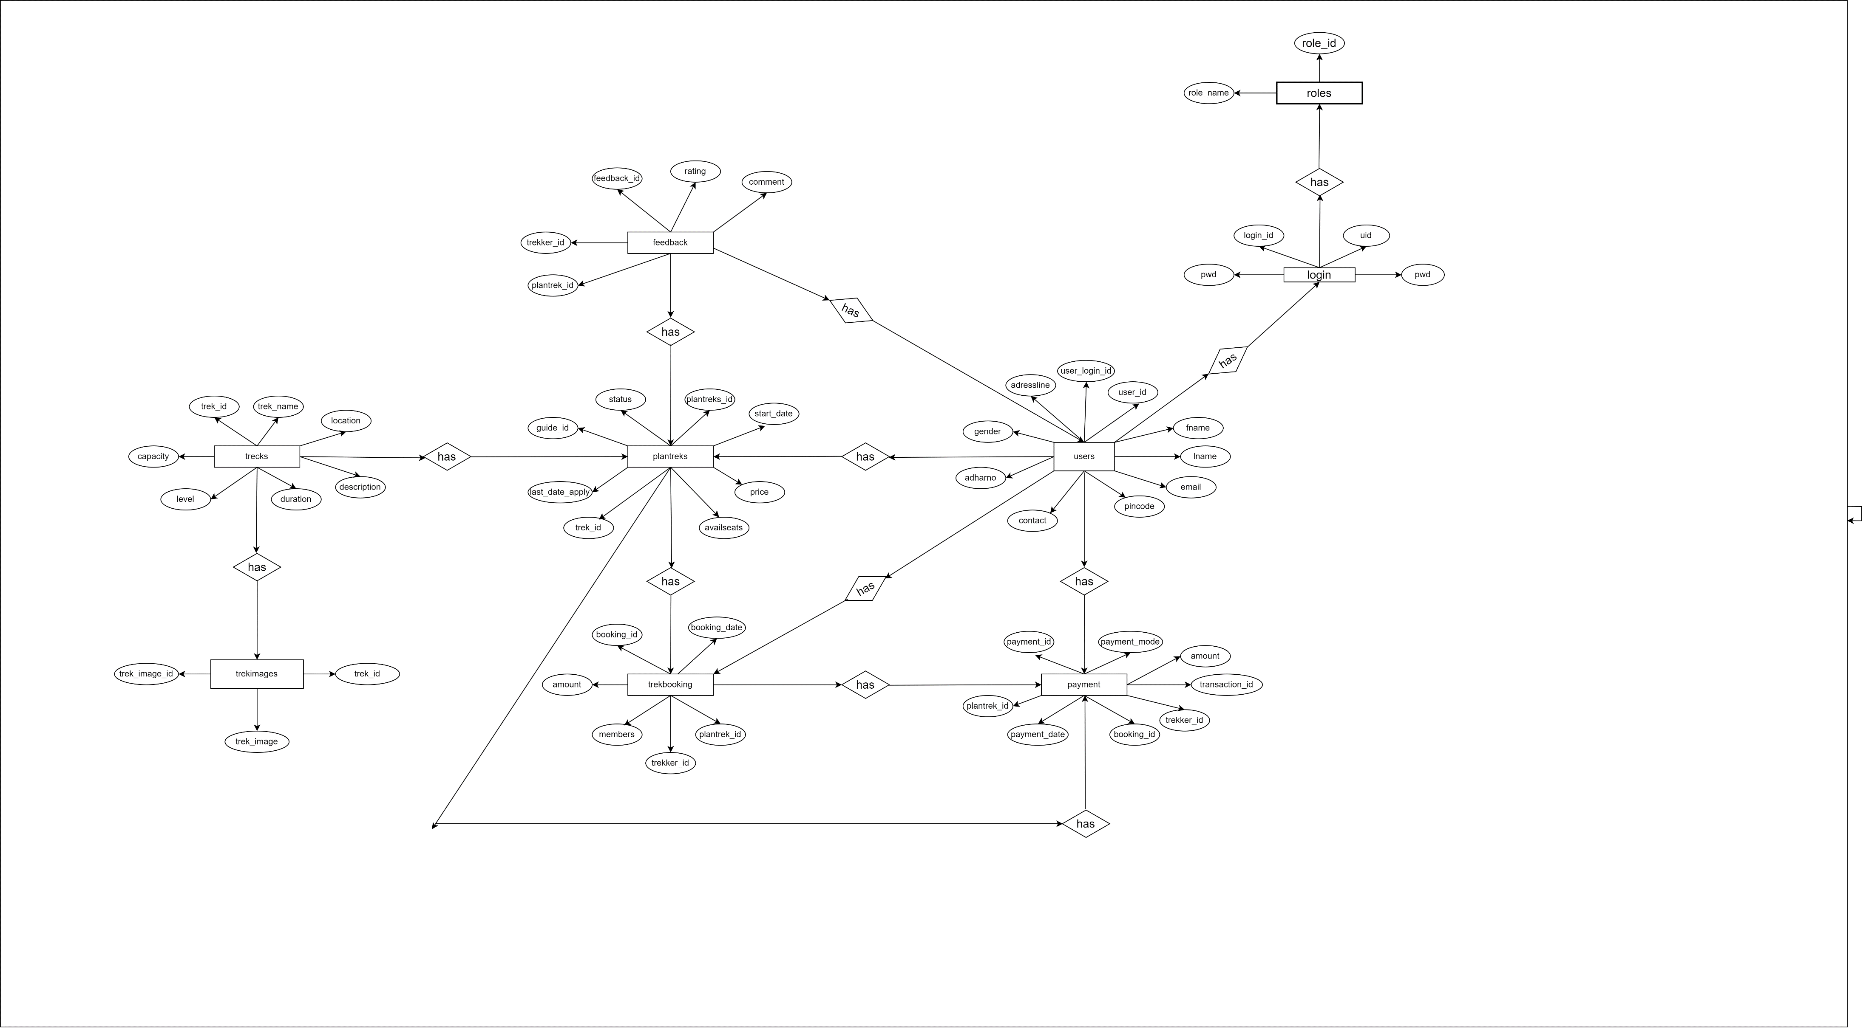
Entity Relationship Diagram

Slide 8
Technology platform used for project
Technology used
Java, .NET MVC, Spring Boot REST API, React JS, MySQL
Reasons for selecting specific technologies
Java 2. .NET MVC 3. Spring Boot Rest API
a. Platform Independent a. Separation of Concerns a. Rapid Development
b. Strong Ecosystem and libraries b. Modularity and reusability b. Microservices architecture
c. Object-oriented-programming c. Testability c. Embedded Services
d. Security d. Security d. Auto-configuration
e. Performance and Scalability e. Cross platform development e. Extensibility

Slide 9
4. React JS 5. MySQL
Component based architecture a. Relational data model
Component reusability b. Open source and cost-effective
Unidirectional data flow c. Cross-platform compatibility
Compatibility d. ACID Compliances
Developer tools e. Data Integrity

Slide 10
User Roles and Responsibilities
1.User Roles:
There are three most important roles assigned to the users. Like Admin user,
Trekker user, Guide user.
2.Responsibilies for each User :
Admin: Allowing access to guide creation, trek creation, plan trek, trek reports etc
Trekker : see the treks and book the treks etc
Guide : update the status of ongoing trek and see the assign treks

Slide 11
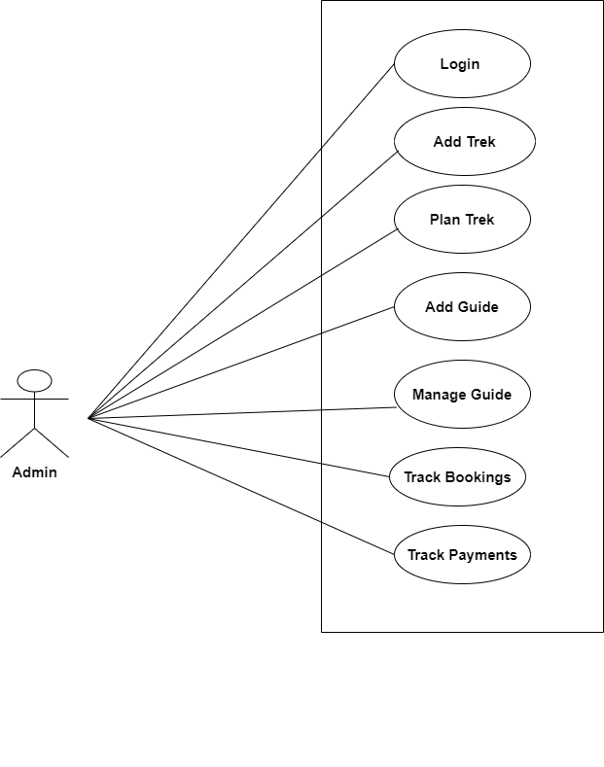
Use Case Diagram : Admin Module

Slide 12
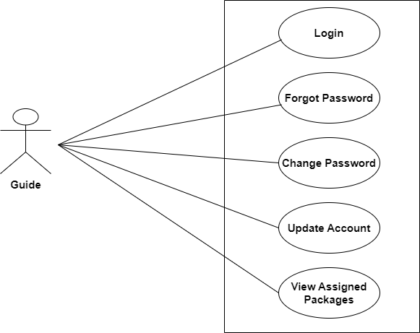
Use Case Diagram : Guide Module

Slide 13
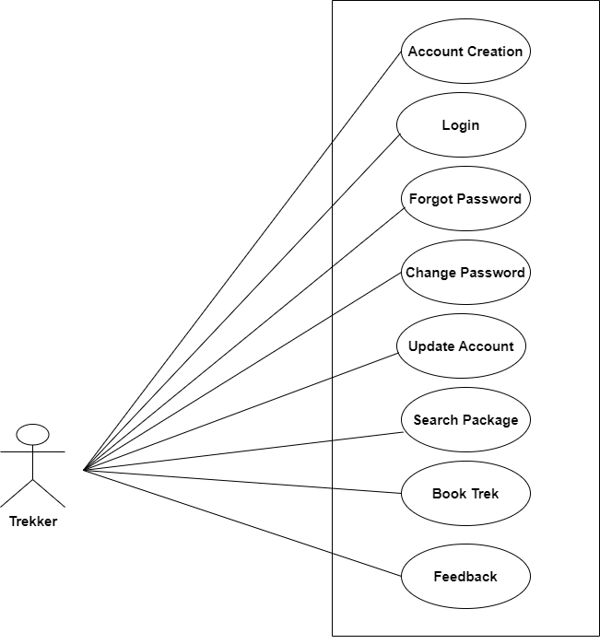
Use Case Diagram : Trekker Module

Slide 14
Division of work within the team
Kedar Jagtap : Implemented admin and trekker use cases
Tushar Gahiwal : Implemented Guide and Trekker use cases
Rushikesh Sapkal : Implemented Guide and Trekker use cases
Mayur Torawane : Implemented Admin and Trekker use cases
Stages at which co-ordination needed
mostly co-ordination was needed for completing the UI part of
Project by using react apart from that we are everyone worked together for
database design

Slide 15
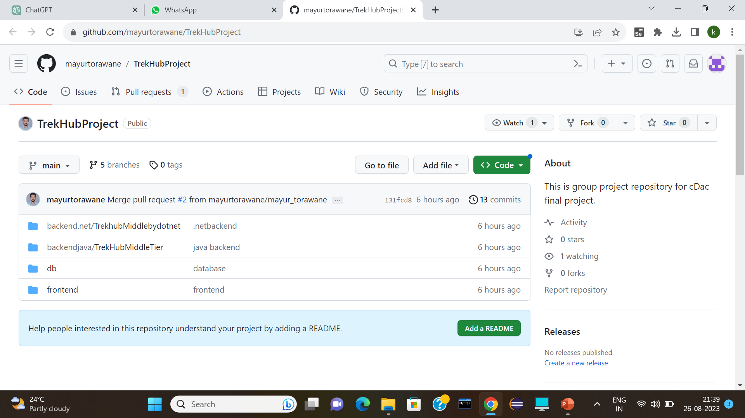
Use of GitHub in the project
Git URL : https://github.com/mayurtorawane/TrekHubProject.

Slide 16
Future Extension
Advanced Search Filters:
Implementing advanced search options like filtering by date, location, and price range
Payment Integration:
Integrating payment gateways for seamless rental transactions and secure online payments.
Personalized Recommendations:
Utilize user data to offer personalized trekking event recommendations based on the user's past bookings, preferences, and location.
In-App Communication:
Implement a messaging system that facilitates communication between participants, event organizers, and guides.
Rating and Reviews:
Adding a rating and review system for properties and tenants to build trust within the community.

Slide 17
Conclusion
Challenges you faced :
There were many challenges that we faced like finding a write path to start with, exploring the technologies beyond the horizon of our course Etc.
Things Learnt :
We have learnt to efficiently distribute the task within the team. We have learnt to combine all the dynamic stack of technologies together to create a fully functional software.
Overall Experience :
Overall experience was very practical oriented and highly knowledgeable

Slide 18
THANK YOU

