Slide 1
IronHack Data Analytics Bootcamp Mid Bootcamp Project on Customer base global retail bank By Md Abu Yusuf

Slide 2
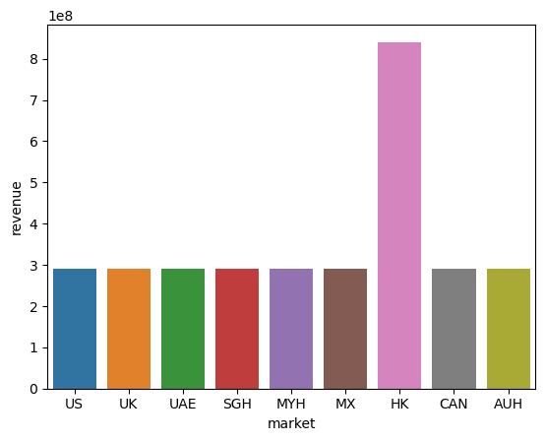
Which country is most profitable

Slide 3
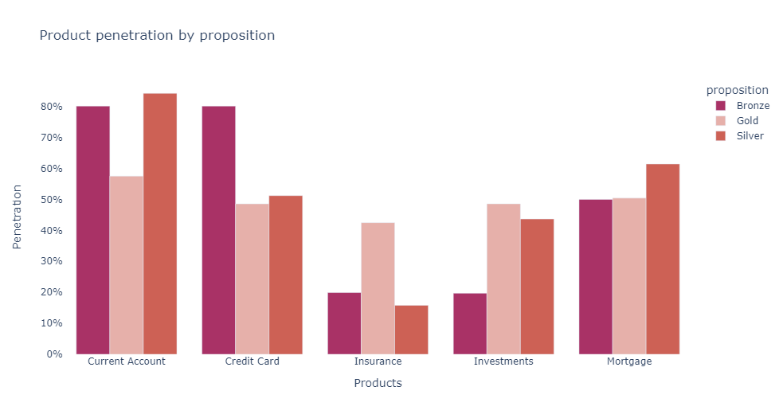
Which is most selling product

Slide 4
On what products should be emphasized for marketing

Slide 5
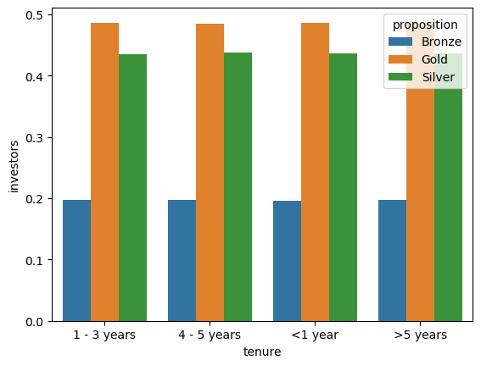
On which proposition/product customer has less interested in investment by Tenure

Slide 6
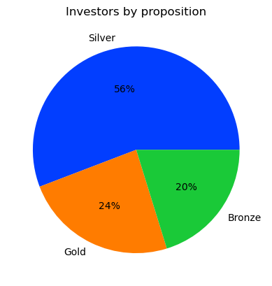
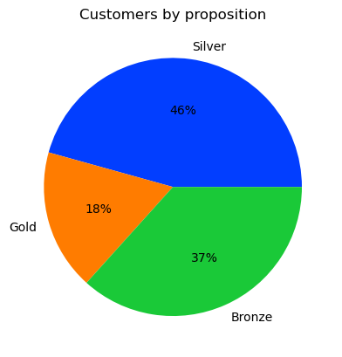
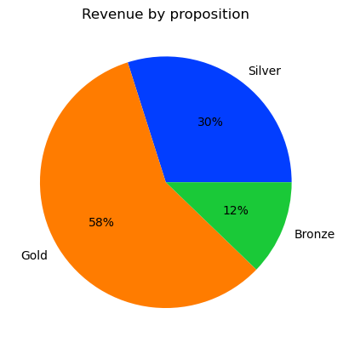
Proposition by Customers, Investors and Revenue

Slide 7
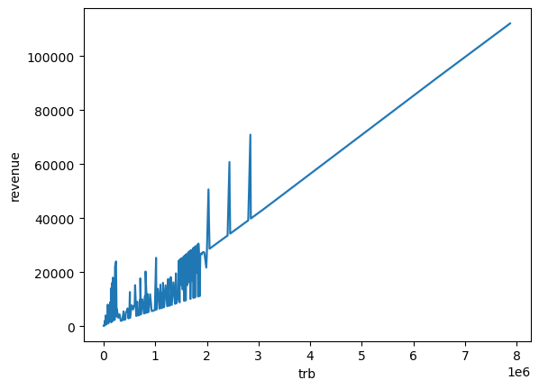
Is TRB has impact on revenue generation

Slide 8
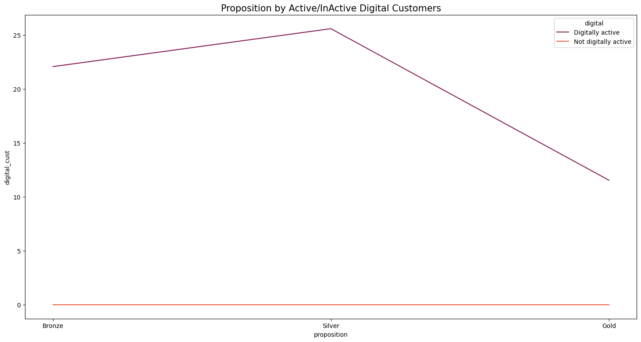
How customers are digitally active based on proposition/product

Slide 9
Thanks Questions

