Slide 1

 | Shri Shivaji Vidya Prasarak Sanstha’s Bapusaheb Shivajirao Deore Polytechnic, Dhule Academic Year : 2023 – 2024 Department of Computer Engineering
A seminar on Capstone Project Proposal (CPP-22058)
Topic |  | Dental Appointment Management System
Presented by |  | 1. Chitte Komal Sandeep
 |  | 2.Gavale Pratik Rajendra
 |  | 3. Lohar Kanishk Rajesh
 |  | 4. Mali Harshal Somnath
Guided by |  | Ms. Mansi Manikhedkar
Semester |  | Sixth (I Scheme) | Date :

Slide 2
Content
Abstract
Introduction (background of the industry or used based problem / task)
Literature Survey
Scope of the project
Methodology
Details of designs, working and processes
Results and applications
Conclusion and future scope
References and Bibliography

Slide 3
1. Abstract
The proposed system is an - Dental Appointment Management System(DAMS) it is a web application. Dental Appointment Management System, is a website design for dental clinic and their use.
This website makes managing much easier for dental patient, doctor, receptionist.
The website can maintain computerized records without loosing the records and entries.

Slide 4
2. Introduction
In Dental Clinic , Appointments as booked through manually going to the clinic or through the calls.
Records of patients are maintain in registers, which is very unorganized way and chances are high to loss the record.
The objective of our proposed system is to create appointment
system in which doctor, receptionist and patients can track the upcoming appointments and past records .
It would also consist of feature to upload an x-ray document from the patient.
The major objective of this application is to schedule the appointments according to the emergency.

Slide 5
3. Literature Survey
3.1 Study of existing system / Review of Research Papers
In clinic the appointments are book through call to the clinic or by directly going to the clinic,which is time consuming.
Patients details like P.name,P.age,P.address,P.medical history and whether He/She is old patient or not which make it hard to gather the details and managing the appointment through it.
The old patients records,old patients details and test plans of patients are filled up in register manually, which may consume time and also makes hard to access the records when needed .

Slide 6
3. Literature Survey
3.2 Limitations of existing system / Problems discussed in research papers
Challenges in booking, tracking and managing the appointment of patients manually may occurs a lot of errors.
Scattered patients related data across multiple systems and documents.
Rely on manual and paper-based processes.
No future appointments details and remainder about upcoming events.

Slide 7
3. Literature Survey
3.3 Problem Identification /need of a system:
Manual Appointment Scheduling: Dental clinics often rely on manual methods such as phone calls or paper-based systems to schedule appointments.
This can lead to errors, double bookings, and inefficiencies
Inefficient Patient Management: Handling patient records, treatment histories, and contact information manually can be time-consuming and error-prone
Missed Appointments: Patients may forget about their appointments or fail to show up .
In the current system, patients don't know their appointment time , cant emergency reschedule the appointments and know the upcoming appointments dates and treatments plan.

Slide 8
3. Literature Survey
3.4 Problem Definition:
The proposed system is a web application for the different phases of treatment planning, notification and remainder system and monitoring the computerized records detail of patient ; dental appointment web application enabling patients to easily schedule appointments, receive reminders, and provide feedback, while allowing dentists to manage their schedules efficiently and securely access patient records.
The application should integrate with existing systems, ensure robust authentication and data security, support mobile devices, streamline billing, and provide comprehensive analytics for practice performance insights.

Slide 9
4. Scope Of The Project
Appointment Management:
Record and track patient appointment and other activities.
Provide a calendar view for dentists and staff to manage appointments,
view availability, and block off time slots for specific procedures or breaks
Integration with Other Systems:
To synchronize patient data and treatment histories. Sync with
communication tools such as email clients and messaging platforms for
automated notifications and reminders.

Slide 10
4. Specifications
4.1 User Requirements
User of Systems
i. Requirement of Doctor:
Patients details
Status of patient
Previous Treatment history.
Appointments details and reschedule details.
Doctor
Patient
Receptionist

Slide 11
4. Specifications
ii. Requirement of Patient:
Clinic time schedule
Appointment Status
Treatment planned
Previous treatment history
Progress of treatment
Notification , Remainder
iii. Requirements of Receptionist:
Patients Details
Patients/Files/Records Entry
Previous treatment history
Progress tracking
Record management
Notification

Slide 12
4. Specifications
4.2 System requirement
Hardware Specification:
Windows 10 (64 bit)
Intel(R) Core(TM) i3-3220 CPU @3.30 GHz 3.30 GHz 4.00GB
Software Specification:
Server: XAMPP 8.0.28
Database: MySQL 5.2.1
Technology will use to develop project:
Structure: Html
Design: Css
Validation: JavaScript
Database: Php,

Slide 13
5.Methodology
5.1 Proposed work
Sr. | Receptionist | Patient | Doctor
1 | Modify appointment schedule | Register | Edit time slot
2 | Approved/Reject appointment | Fill appointment form | Check patient detail
3 | Can change appointment schedule | Can edit profile | Give consultancy
4 | Billing | Can change password | Give prescription
5 | Edit Information of patient | Can see own appointment history | Manage patient
6 | Can send notification | Can see test result | Can see appointment history
7 | Upload test result | Report feedback | Check feedback

Slide 14
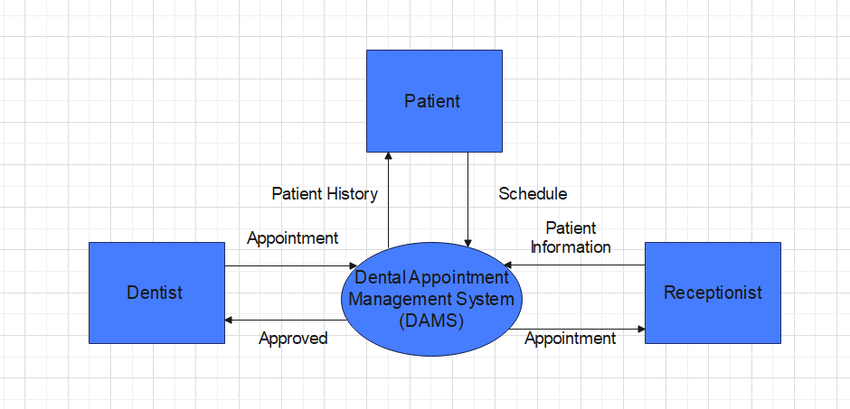
5.Proposed Detailed Methodology of solving identified problem
Data Flow Diagram

Slide 15
5. Proposed Detailed Methodology of solving identified problem
Patients
Receptionist
Doctor
Login as Dentist
Check Appointment Status
Give Schedule Availabity
Get Appointment Details
Get Appointment Details
Cancel Appointment
Cancel Appointment
Patient Arrives
View Patients’s Information
Patient Leaves
Manage Patients Information
Opperates Dental Procedure

Slide 16
5.Proposed Detailed Methodology
Patients
Register
Receptionist
Doctor
Login as Patient
Make new Appointment
Select Dental Procedure
Check Appointment Details
Get appointment Details
Cancel Appointment
Cancel Appointment
In case
View Patient Information
Patient Arrives
Patient Leaves
Manage Patients Information
Operates Dental Procedure

Slide 17
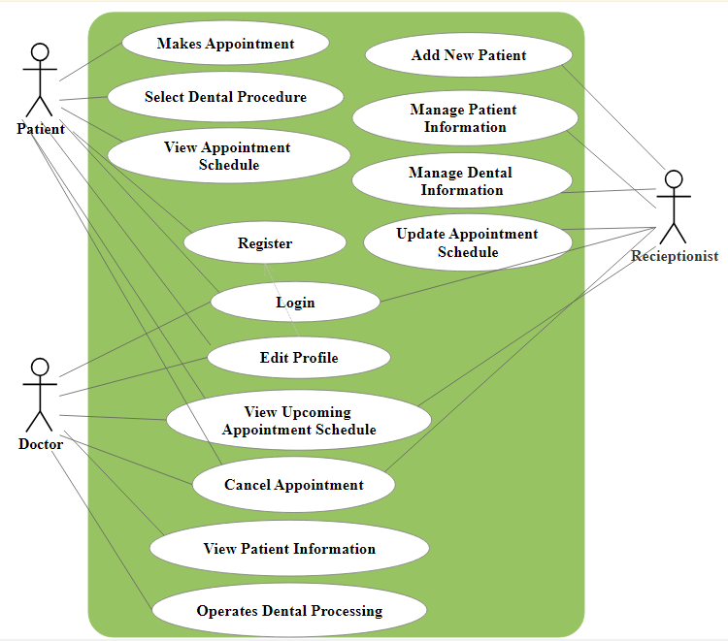
Use case diagram

Slide 18
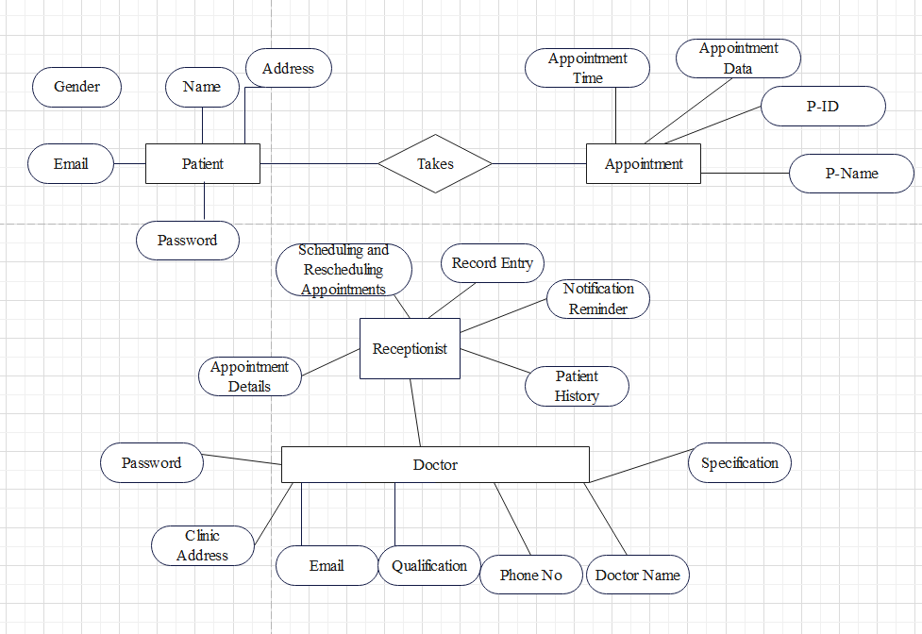
ER Diagram

Slide 19
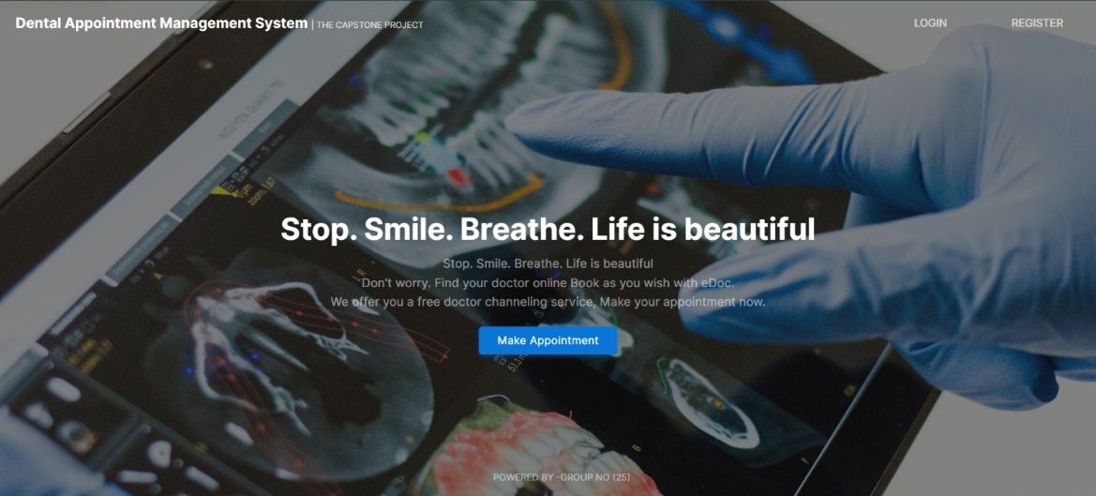
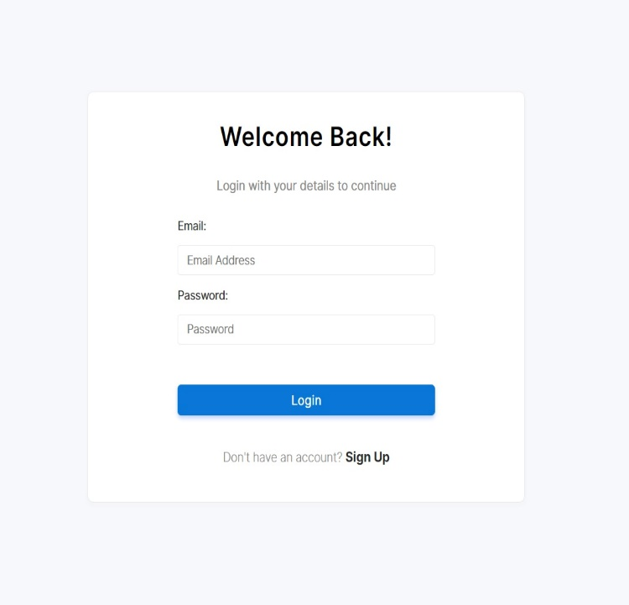
Working of Dental Appointment Management System
Outputs
Login Page
Home Page

Slide 20
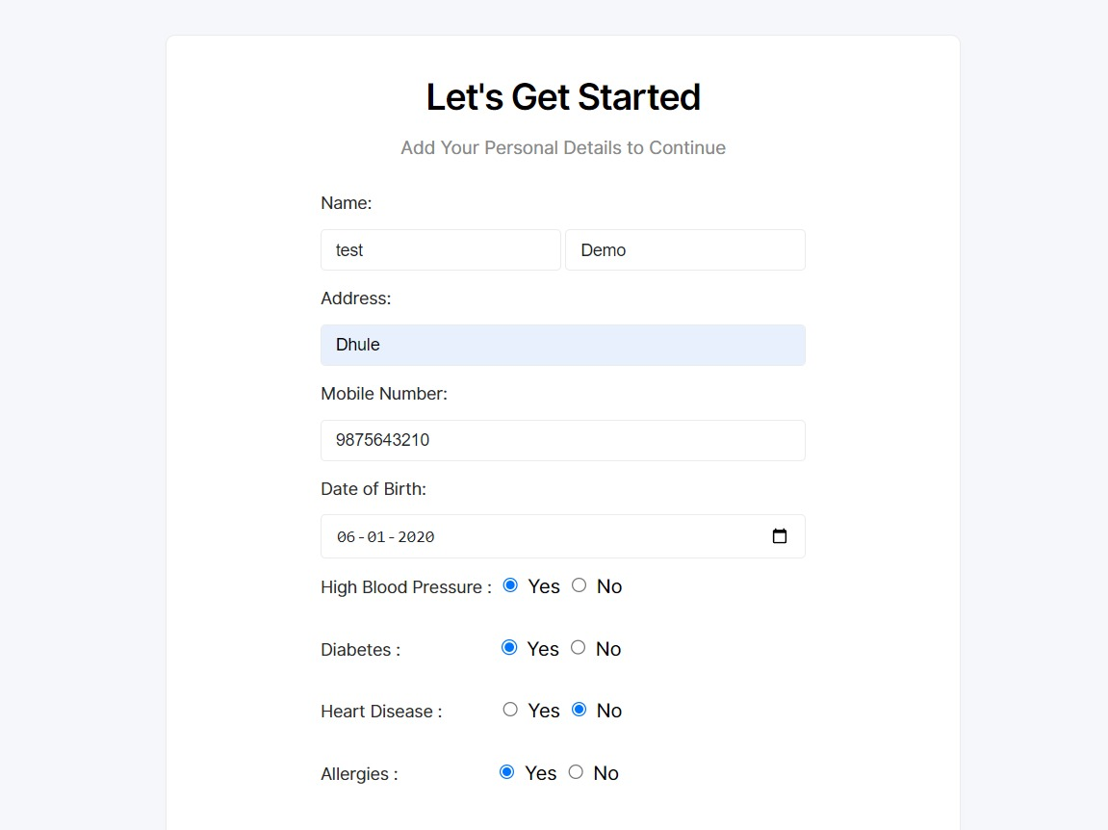
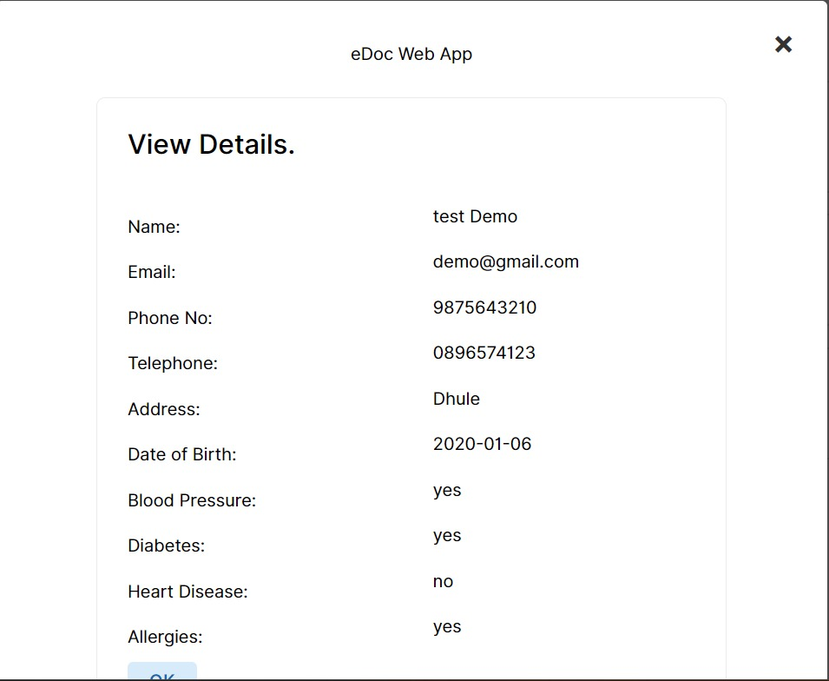
Working of Dental Appointment Management System
Patient Registration Patient Details

Slide 21
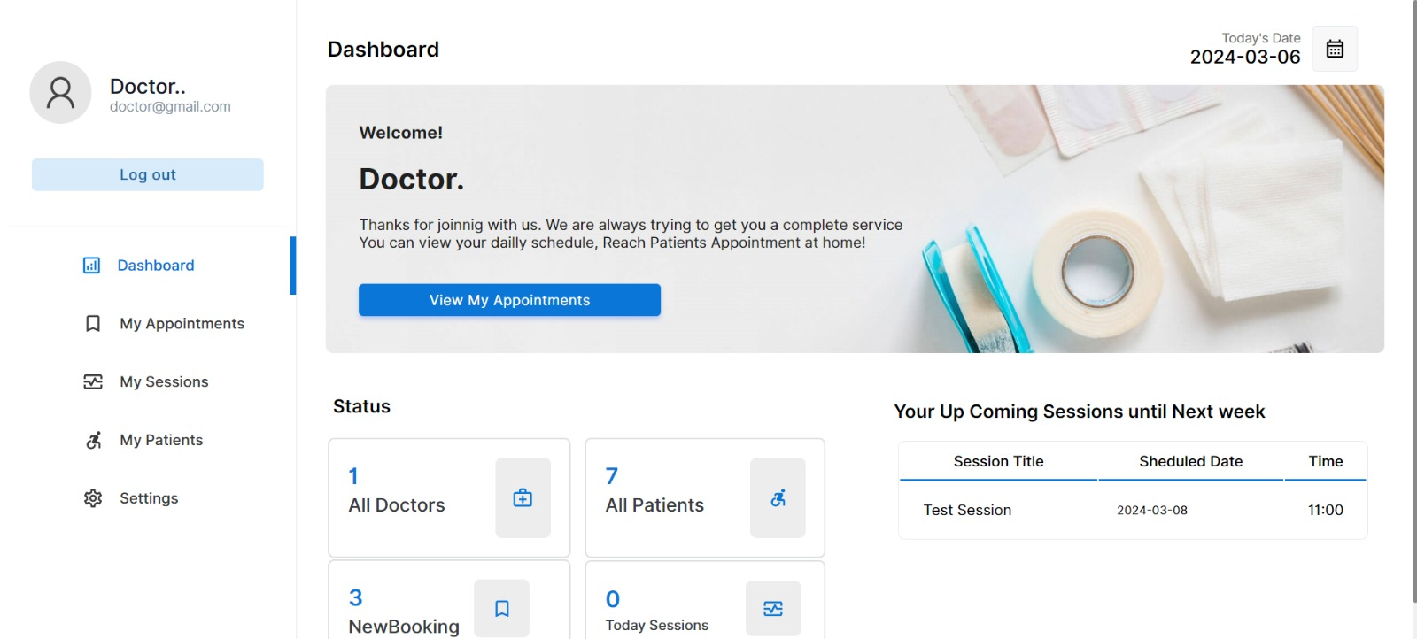
Working of Dental Appointment Management System
Doctor’s Dashboard

Slide 22
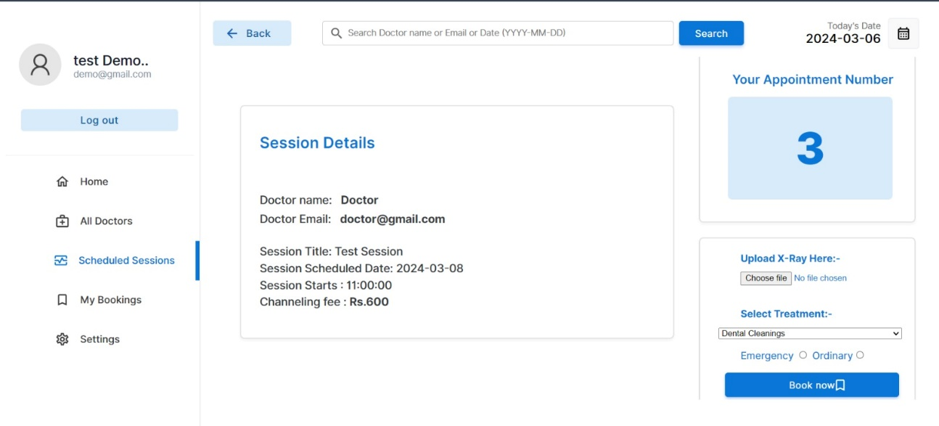
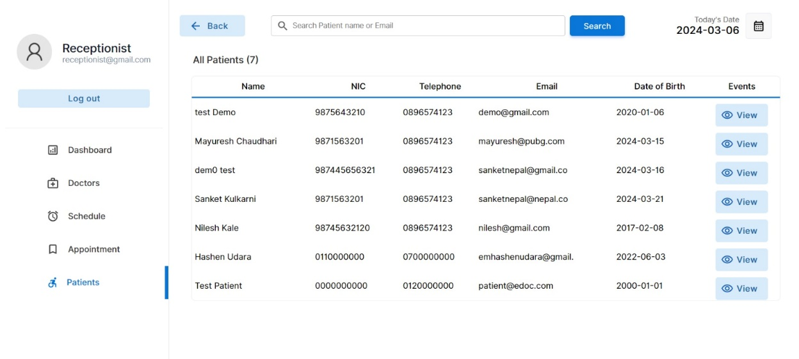
Working of Dental Appointment Management System
Scheduling
Session
Receptionist
Dashboard
(Patient List)

Slide 23
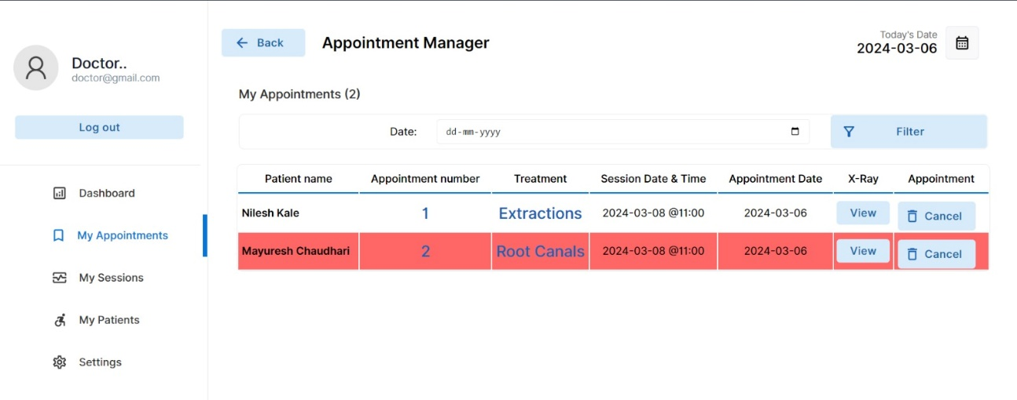
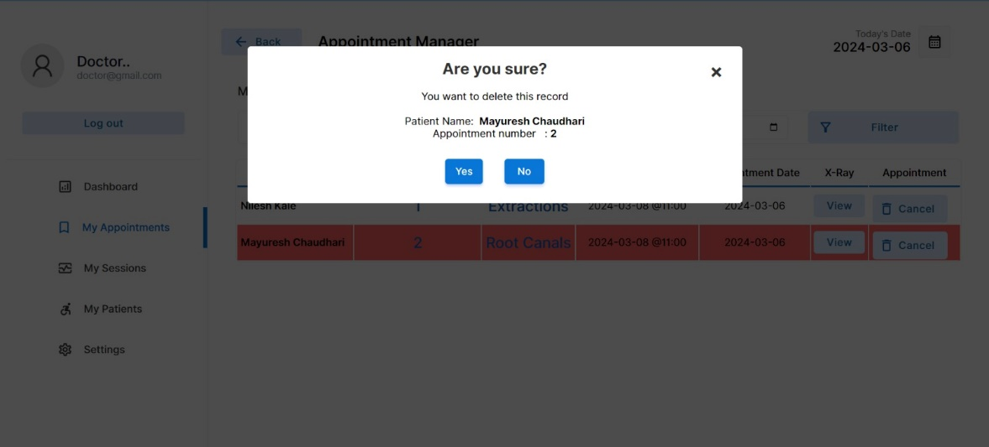
Working of Dental Appointment Management System
Appointment Manager

Slide 24
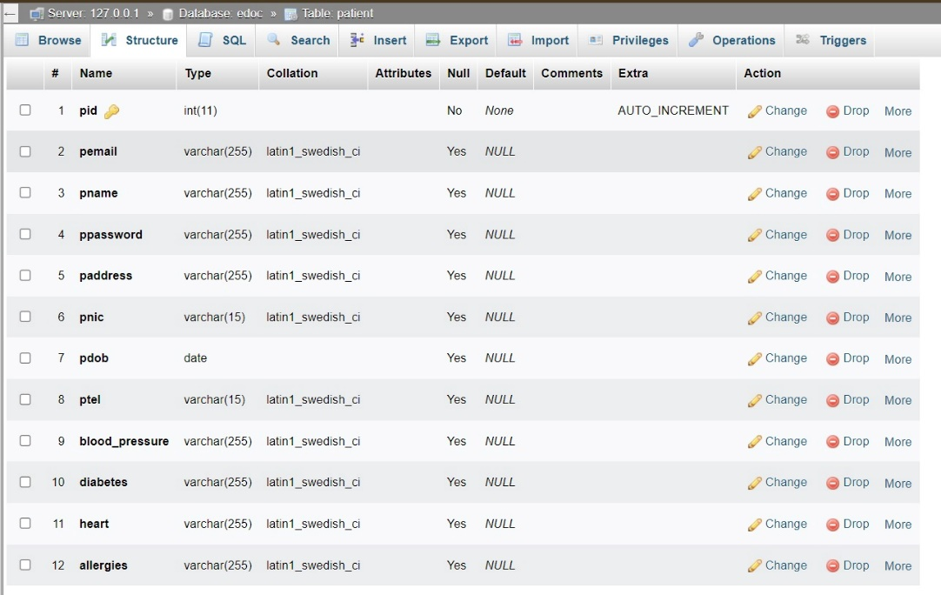
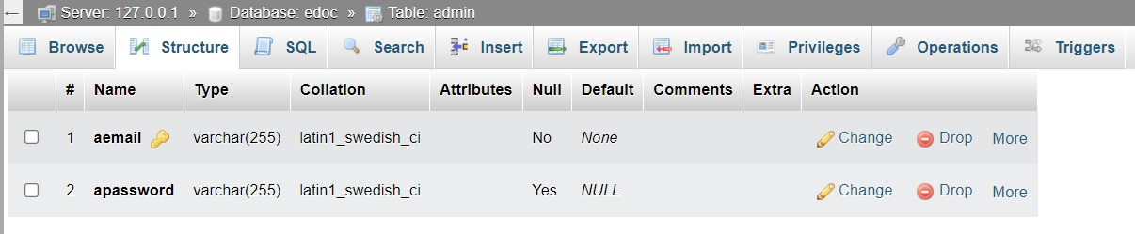
Working of Dental Appointment Management System
Database
Registration
Credentials

Slide 25
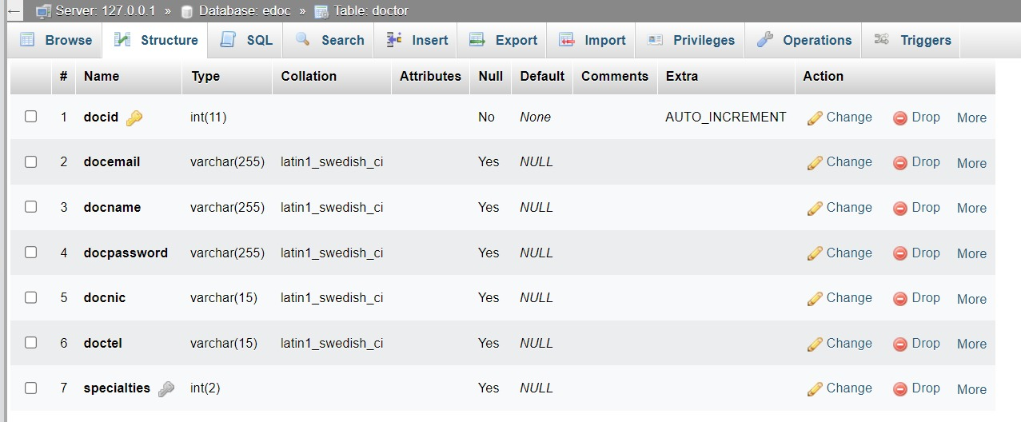
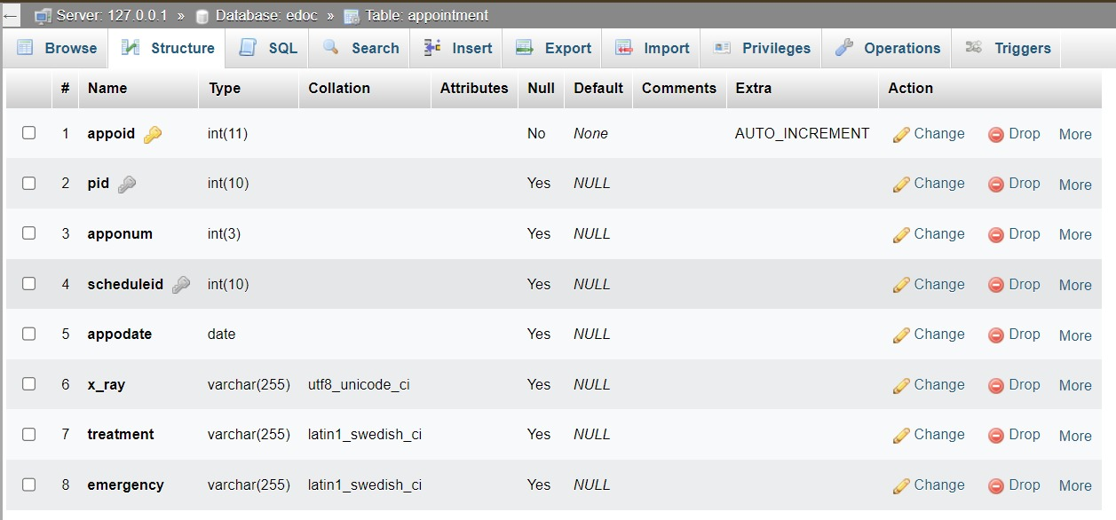
Working of Dental Appointment Management System
Doctor
Credentials
Patient Credentials

Slide 26
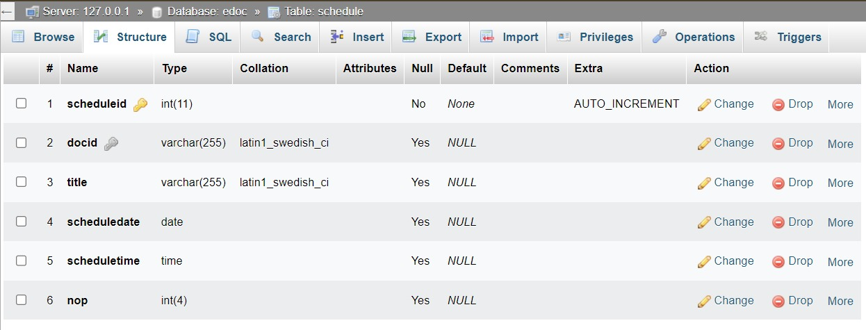
Working of Dental Appointment Management System
Patient Scheduling

Slide 27
8. Conclusion and future scope
8.1 Conclusion
In conclusion, a dental appointment system offers streamlined scheduling, enhanced patient experience, and optimized practice operations.
It ensures efficient appointment management, improves patient-provider communication, and complies with regulatory standards. With features like online scheduling, automated reminders, and comprehensive patient records, the system drives practice efficiency, patient satisfaction, and long-term growth.

Slide 28
8. Conclusion and future scope
8.2 Future Scope
In the future, dental appointment systems will use smart technology like AI to schedule appointments better.
People might even see their dentists through video calls! These systems will predict when appointments are needed .
They'll also keep everyone's information safe and be easy to use for everyone, making going to the dentist easier and more fun!

Slide 29
9. References and Bibliography
References:
Google for problem solving
https://www.lucidchart.com
https://www.dentee.com/dental-practice management-software/
https://practice.healcon.com/
https://www.twillio.com
Bibliography:
Pravin Shingane Dentists
Address: Chamunda Dental Clinic ,Datta Mandir Chowk ,Deopur Dhule,424005 Phone No: 273802
Email: chamundadental@rediffmail.com

Slide 30
THANK YOU !

