Slide 1
BAT 405 Lecture Compilations

Slide 2
Module 1: Intro to Python Data Analysis
AGENDA:
Introduction
Python for data analysis
Advantages of python

Slide 3

PYTHON FOR DATA ANALYSIS

Slide 4

PYTHON FOR DATA ANALYSIS
Python is a multi purpose programming language which has thousands of libraries dedicated to analytics
PANDAS makes it easy to work with structured and tabular data
Vast selection of analytical tools and algorithms with libraries such as SCIPY and SCIKIT LEARN
MATPLOTLIB helps create and customize data visualization
Environment such as GOOGLE COLAB provide us with an interactive tool to communicate our process and results with stakeholders

Slide 5
EASE OF ACCESS
Syntax is easy to understand
Platforms such as Google Colab allows users to run python programs from anywhere

Slide 6
OPEN SOURCE
Python is backed by a large open source community
State of the art algorithms or new research are quickly implemented and shared

Slide 7
SCALE
Python can run through on premise or cloud servers to process large amounts of data
It is capable of loading data in real time (streaming) and immediately generates insights which can be displayed to users

Slide 8
VERSATILITY
Python is not exclusively for Data Analysis, software, mobile, or web applications are also developed using this language
Python is useful for connecting different scripts together and it can interact with different systems

Slide 9
EXAMPLE SCENARIO
Daily transactions can be streamed by python then processed to determine customer segments
Personalized promotions can then be pushed to each customer automatically based on the identified segments

Slide 10
SUMMARY
With enough practice python allows data analyst to be comfortable with processing data from different sources across all industries

Slide 11
End of Module 1
THANK YOU!
Mr. Dean Charliemagne Ramos

Slide 12
LESSON OBJECTIVES
By the end of this lesson, you will:
Know how to run python programs using Google Colaboratory.
Know the basic functions in Google Colaboratory.
Learn about how mathematical and relational operations work in python.
Understand basic concepts in Python such as variables, conditional statements, loops and functions.
Be able to write python scripts and run them.
Learn about different data types in Python

Slide 13
Module 2: Intro to Google Colaboratory
AGENDA:
Google Colaboratory Interface Navigation
Mathematical Operations and Relational Operations
Data Types
Variables
Conditional Statements and Loops
Functions

Slide 14
What is Google Colab?
Google Colab is a free online tool for coding in Python. It's like a virtual science laboratory where you write and run code, analyze data, and perform repetitive tasks. Google Colab is also good for collaborating in real-time, saving on Google Drive, and accessing from any device.

Slide 15
Can I use Google Colab offline?
No, Google Colab requires an internet connection to function. Since Google Colab runs on Google's servers, it is not possible to use it offline or locally on your own computer.
However, you can download a copy of your Colab notebook and work on it offline using Jupyter Notebook, which is a similar tool that runs locally on your own computer. Here are the steps to download your Colab notebook:
Open your Colab notebook in your web browser.
Click on "File" in the menu bar, and then click "Download .ipynb" to download the notebook as a Jupyter Notebook file.
Once the download is complete, open the notebook file in Jupyter Notebook to continue working on it offline.

Slide 16
How is Google Colab different from pg Admin 4?
Google Colab runs Python, a general programming language that can do things such as software development, data analysis, scientific computing, and web development. PgAdmin4 is software that allows you to communicate with a database. They work hand-in-hand as you export your data through pgAdmin4 then import it to Google Colaboratory.

Slide 17
How can I access Google Colab?
Through Google Colab website
Open your web browser and go to the Google Colab website: https:// colab.research.google.com/
If prompted, log in to your Google account by clicking on the "Sign in" button in the top right corner of the screen and entering your email address and password.
Once you are signed in, you will be taken to the Colab welcome page where you can create a new Colab notebook or open an existing one.
To create a new notebook, click on the "New Notebook" button in the top left corner of the screen.
You can choose to create a new notebook from scratch or use one of the available templates by clicking on "File" and then "New notebook".
You can start coding in the notebook and save your work by clicking on "File" and then "Save" or "Save a copy in Drive".
To open an existing notebook, click on the "File" menu and select "Open notebook".
You can search for notebooks by title or by the folder they are located in. Once you find the notebook you want to open, click on it to open it.
You can then start working on the notebook and save your changes by clicking on "File" and then "Save" or "Save a copy in Drive".

Slide 18
What libraries can we use in Google Colab?
Google Colaboratory comes with a number of Python libraries pre-installed, which can be used for various tasks such as data analysis, machine learning, and scientific computing. Here are some of the most commonly used libraries that come pre-installed in Google Colaboratory:
NumPy: a library for working with arrays and matrices in Python.
Pandas: a library for working with tabular data in Python.
Matplotlib: a library for creating plots and visualizations in Python.
Seaborn: a library for creating visualizations in Python. Seaborn is built on top of Matplotlib and provides additional functions for creating more complex and aesthetically pleasing plots.
Statistics: a library for performing basic statistical analysis in Python.
Scikit learn: a library for machine learning tasks such as classification, regression, and clustering.
TensorFlow: a library for building and training machine learning models, particularly deep learning models.
Keras: a high-level neural networks API, which is built on top of TensorFlow and makes it easier to build and train deep learning models.
OpenCV: a library for computer vision tasks such as image and video processing.
SciPy: a library for scientific computing tasks such as optimization, linear algebra, and signal processing.
PyTorch: a library for building and training machine learning models, particularly deep learning models.

Slide 19
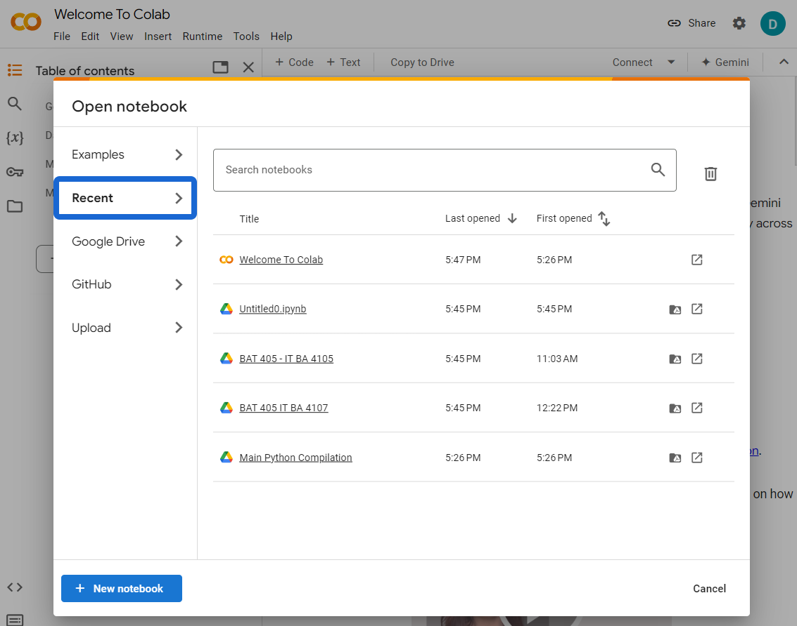
Lets Try Google Colab
Open Google Colab on your Google Chrome
You may use this link https://colab.research.google.com/

Slide 20
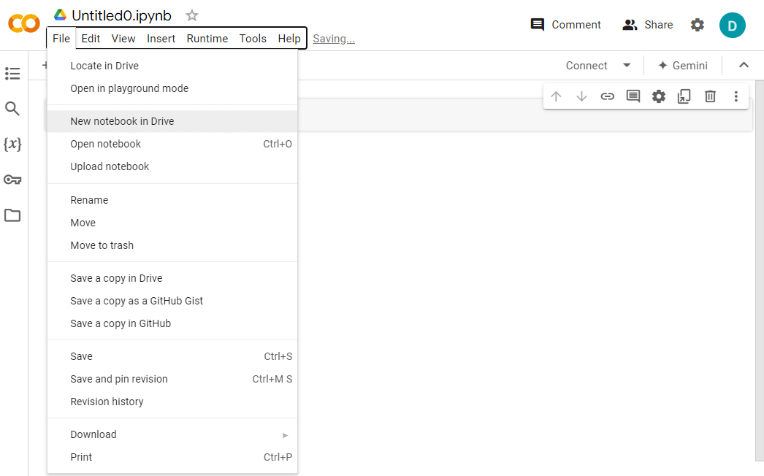
Lets Try Google Colab
You may save a copy in your Google Drive

Slide 21
Basic Things To learn
Opening a new Jupyter notebook
Loading an Existing Jupyter notebook
Sharing a Jupyter Notebook
Writing and running a code
Writing Texts through Markdown

Slide 22
End of topic!

Slide 23
Next Topic:
Mathematical Operations and Relations

Slide 24
Topic Outline
- How to use Google Colaboratory (aka Google Colab) to run Jupyter Notebooks
- Basics of Python Programming
- Understanding Python Data Types
**The following references were used to build this notebook's content:**
- *Lutz, M. (2013). Learning python: Powerful object-oriented programming. " O'Reilly Media, Inc.".*
- *Zelle, J. M. (2004). Python programming: an introduction to computer science. Franklin, Beedle & Associates, Inc..*

Slide 25
Mathematical Operations
PEM(MD)(AS) rule: order by which mathematical operations are performed
- Parenthesis
- Exponents
- Modulo, Multiplication and Division
- same order
- operations are performed whichever appears first from left to right
15 \div 5 \times 2 = 3 \times 2 = 6
- the **modulo** operation returns the remainder when a number is divided by another number
20 \ \% \ 8 = 4
- Addition and Subtraction
- same order
- operations are performed whichever appears first from left to right
15 - 20 + 30 = -5 + 30 = 25
TIP: Just use *parentheses* if you think a certain expression needs to be performed first.

Slide 26
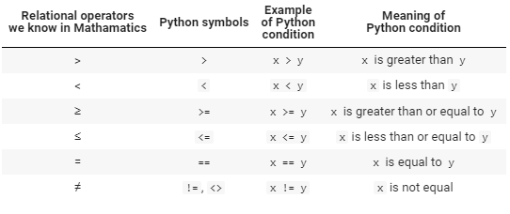
Relational Operators
These operators are crucial in decision-based algorithms. If a relation is true, the value `True` is returned. Otherwise, `False` is returned.

Slide 27
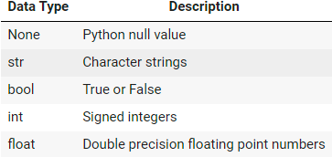
Understanding Data Types
Basic Data Types:
List
Len
Append
Extend
DEL
sorted
SET
Dictionary
Tuple
Typecasting

Slide 28
Variables

Slide 29
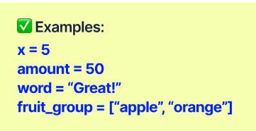
Variables: Definition
A variable is what stores a value such as an integer, a string, or other data types

Slide 30
Variables Naming Conventions

Slide 31
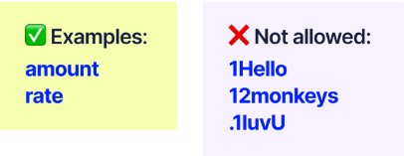
Variable naming conventions
Start only with either a letter or the underscore symbol “_”

Slide 32
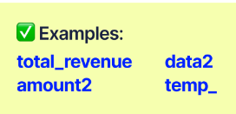
Variable naming conventions
Use only Alpha - numeric characters [a-z, A-Z, 0-9 or the underscore symbol.]

Slide 33
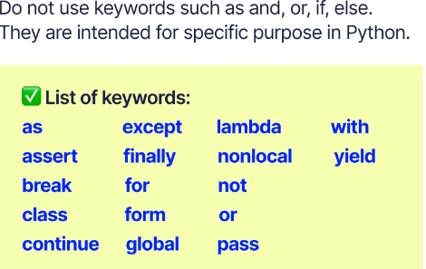
Variable naming conventions

Slide 34
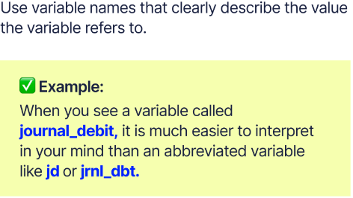
Variable naming conventions

Slide 35
RECAP
By now, You Already Know:
how to run python program using google Colaboratory
the basic functions in google Colaboratory
how mathematical and relational operations work in python
the basic concepts in python such as variables, conditional statements, loop and functions
how to write python scripts and correctly run them
the different types in python

Slide 36
Next Topic:
Data Science Life Cycle

Slide 37
Lesson Objectives
Understand the different components of a data science project lifecycle
learn about a specific scenario where the data science project life cycle is implemented in an actual project

Slide 38
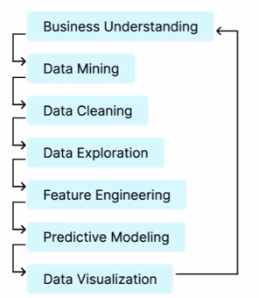
Data Science Life Cycle

Slide 39
Lesson Objectives
Understand the different components of a data science project lifecycle
learn about a specific scenario where the data science project life cycle is implemented in an actual project

