Slide 1
IoT communication protocol
CoAP
MQTT
RestFul HTTP

Slide 2
1. CoAP

Slide 3
1.1 Definition of CoAP
Constrained Application Protocol(CoAP) is a specialized Internet Application Protocol for constrained devices
In recent years experts have predicted that there will be more devices connected to each other than the number of human beings. Against this backdrop, the Internet of Things and M2M technologies have emerged. While for people, connecting to the internet appears convenient and easy, for those micro devices, accessing the internet is very difficult. In the current world of PCs, information is exchanged via TCP and the application layer protocol HTTP. But for small devices, implementing TCP and HTTP protocols is clearly an excessive requirement. To allow small devices to access the Internet, the CoAP protocol was devised.
CoAP is an application layer protocol that runs on top of UDP instead of TCP like HTTP, and is very small, with a minimum packet size of 4 bytes. 。

Slide 4
2.2 Features of CoAP
Meeting the needs of a resource-constrained network
Stateless HTTP mapping to access CoAP resources via HTTP proxies or build HTTP interfaces on top of CoAP
Reliable IP unicast and maximum effort IP multicast using UDP
asynchronous message exchange
Very small message header load and parsing complexity
Support for URIs and Content-type.
Proxy and cache support
Built-in resource discovery
DTLS can be used as a secure encryption layer
Low resource consumption, requiring less than 10KB of RAM and ROM.
Two-tier (transactional, request/response) processing supports asynchronous communication.
Support for observation mode
Block transfer support

Slide 5
2.3 Interaction model of CoAP
The interaction model of the CoAP protocol is similar to the client/server model of HTTP. A request in CoAP is the same as a request in HTTP, initiated by the client, requesting a resource (identified by a URI) located on the server and performing an action (identified by a Method Code). The server then sends back a response with a Response Code, which may also contain a representation of the resource (with response format).
Unlike the HTTP protocol, CoAP interactions are asynchronous and built on datagram-oriented transport protocols such as UDP. interactions are implemented via a message layer that provides optional reliability support (using exponential fallback). four types of messages are defined in the CoAP protocol: CON, NON, ACK and RST. these four types of messages contain The request and response identifier, which identifies whether these messages are requests or responses.

Slide 6
2.4 Message Types of CoAP
CON——The request needs to be acknowledged.If the CON request is sent, then the other party must respond.
NON——Requests that do not need to be acknowledged.If the NON request is sent, the other party does not have to respond.
ACK——Respond to a message that receives a CON message.
RST——Reset message. A reset message is sent when the receiver receives a message that contains an error, the receiver parses the message or no longer cares about what the sender sent.

Slide 7
2.4 Message Structure of CoAP
The CoAP message format is compact and runs on UDP by default (each CoAP message is a data part of a UDP packet). coAP can also run on the DTLS protocol and other transport protocols such as SMS, TCP, or SCTP, which are outside the scope of this document.
CoAP messages are encoded in a binary format. This message format begins with a fixed 4-byte header. The token value is followed by 0 or more options in Type-Length-Value (TLV) format. After that to the end of the entire datagram is the payload section, which can be empty.

Slide 8
2.4 Message Structure of CoAP

Slide 9
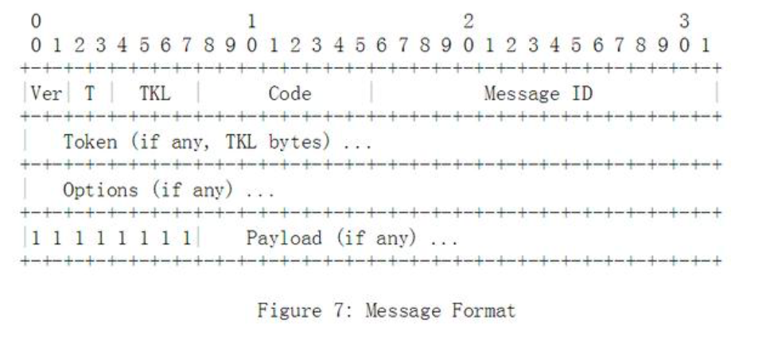
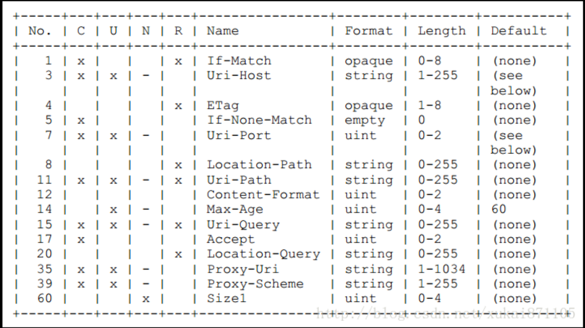
_{Head}
The first line is the header, which is compulsory and have a fixed number of four bytes.
Ver: 2bit, version information, currently must write 0x01.
T: 2bit, message type, including CON, NON. ACK, RST four kinds.
TKL: 4BIT, token length, currently supports 0~8B length, other lengths are reserved for future extension.
Code: 8bit, divided into the first 3bit (0~7) and the last 5bit (0~31), the first 3bit represents the type. 0 represents empty message or request code, and the beginning of 2 represents response code. The value is as follows:
1 0.00 Indicates an Empty message 2 0.01-0.31 Indicates a request. 3 1.00-1.31 Reserved
4 2.00-5.31 Indicates a response. 5 6.00-7.31 Reserved
Message ID: 16bit, representing the Message MID, each Message has an ID, and the resend Message MID remains unchanged

Slide 10
_{Token (optional)}
Is used to match a response to a request. Token values are a sequence of 0 to 8 bytes. Each message must carry a flag, even if its length is zero. Each request comes with a client-generated token that the server must respond to in any resulting response. Token is like a message ID to mark the uniqueness of a message. Token is also a setting for message security, using a random number of all 8 bytes, so that the forged message cannot be authenticated. Option (optional, 0 or more). Both the request message and the response message can be 0-multiple options. It is mainly used to describe the corresponding attributes of the request or response, such as parameters or characteristics, such as whether the proxy server is used, the port of the destination host, etc.
_{Payload (Optional)}
Payload identifier "0xFF" is placed in front of it. If there is no payload identifier, that means it is a payload of zero length. If there is a Payload identifier but it is followed by a payload of zero length, it must be treated as a message format error.

Slide 11
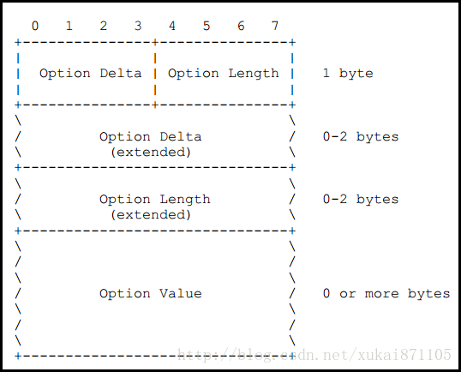
Options
In general, Option section contains Option Delta, Option Length and Option Value.
【Option Delta】 represents the increment of Option. The specific number of the current Option is equal to the sum of all previous Option deltas.
【Option Length】 represents the specific Length of the Option Value.
【Option Value】 represents the specific content of Option

Slide 12
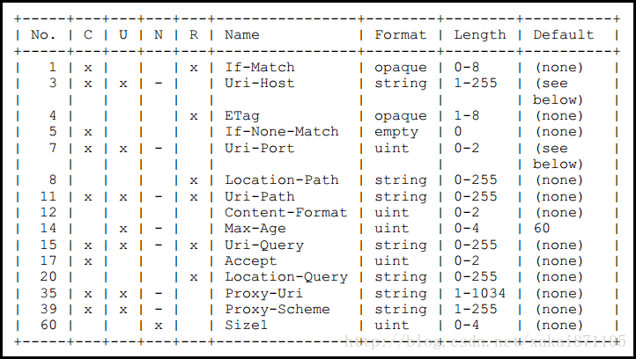
Options
In these options, uri-host, URi-port, URi-path, and uri-query are related to resource "locations" and parameters.
[3] URi-host :CoAP Host name, such as iot.eclipse.org
[7] URi-port :CoAP Port number, the default is 5683
[11] URi-path: Resource routing or Path, such as \temperature. The resource path takes the UTF8 string form, regardless of the length of the first "\".
[15] URi-query: Access resource parameters, such as? Value1 =1& Value2 =2, with "&" delimited between parameters and "? "between URi-Query and URi-path. Space.
In these options, content-Format and Accept are used to represent the media Format of the CoAP payload
[12] Content-format: Specifies CoAP complex media types, which are described by integers. For example, Application/JSON corresponds to an integer of 50, and Application /octet- Stream to an integer of 40.
[17] Accept: Specify the media type in the COMPLEX CoAP response, with the same definition as content-format.

Slide 13
Options
In these options, uri-host, URi-port, URi-path, and uri-query are related to resource "locations" and parameters.
[3] URi-host :CoAP Host name, such as iot.eclipse.org
[7] URi-port :CoAP Port number, the default is 5683
[11] URi-path: Resource routing or Path, such as \temperature. The resource path takes the UTF8 string form, regardless of the length of the first "\".
[15] URi-query: Access resource parameters, such as? Value1 =1& Value2 =2, with "&" delimited between parameters and "? "between URi-Query and URi-path. Space.
In these options, content-Format and Accept are used to represent the media Format of the CoAP payload
[12] Content-format: Specifies CoAP complex media types, which are described by integers. For example, Application/JSON corresponds to an integer of 50, and Application /octet- Stream to an integer of 40.
[17] Accept: Specify the media type in the COMPLEX CoAP response, with the same definition as content-format.

Slide 14
Options
Multiple options are supported in the CoAP protocol, for example
The first Option, Delta=11, means that Option means URi-path (11)
The second Option, Delta=1, means Option=1+11, meaning content-format (12)
The third Option, Delta=3, means Option=3+1+11, means URi-query (15)
CoAP represents multiple options in this way, and each Option can be found in the HTTP protocol.

Slide 15
2.4 The Response Code

Slide 16
In CoAP response, Code is defined as CoAP response Code
1. Success 2.xx
This type of status code indicates that the request has been successfully received, understood, and accepted by the server.
2.01 Created
2.02 Deleted
2.03 Valid
2.04 Changed
2.05 Content
2. Client Error 4.xx
This type of status code represents an error that appears to have occurred on the client side and is interfering with the server's processing.
4.00 Bad Request
4.01 Unauthorized
4.02 Bad Option
4.03 Forbidden
4.04 Not Found
4.05 Method Not Allowed
4.06 Not Acceptable
4.12 Precondition Failed
4.13 Request Entity Too Large
4.15 Unsupported Content-Format

Slide 17
3. Server Error 5.xx
This kind of status code represents that the server has errors or abnormal states in the process of processing the request, or it may be that the hardware and software resources of the server cannot complete the processing of the request.
5.00 Internal Server Error
5.01 Not Implemented
5.02 Bad Gateway
5.03 Service Unavailable

