Slide 2
why choose NB in sklearn?
make comparison with other models
almost no parameters can be adjust. convenient!

Slide 3
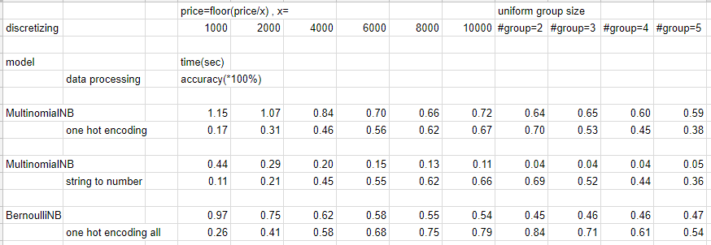
result
從結果來看，將所有 feature (若為實數則先分群)經過 one hot encoding 後效果最佳

