Slide 1

FAKE NEWS DETECTION BY MACHINE LEARNING
Bachelor of Technology
In
COMPUTER SCIENCE AND ENGINEERING
PRESENTATIVES:
Yash Gupta(1907830100113)
Mayank Tyagi(1907830100053)
Mayank Singh(1907830100052)
Gaurav (1907830100032)
UNDER THE SUPERVISION:
Dr. Nagresh Kumar
R.D. ENGINEERING COLLEGE, TECHNICAL CAMPUS, GHAZIABAD

Slide 3
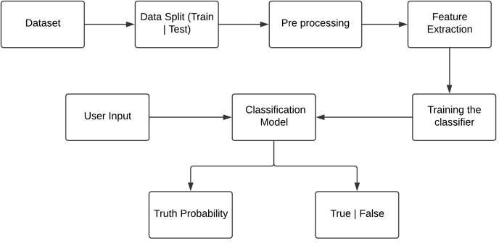






















Slide 4


Slide 5
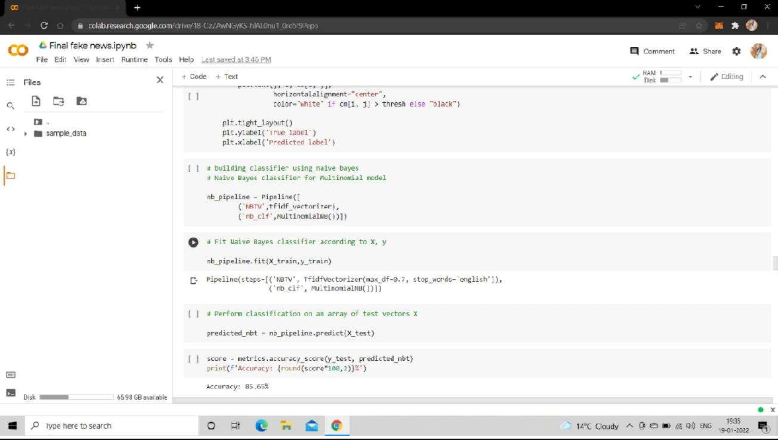
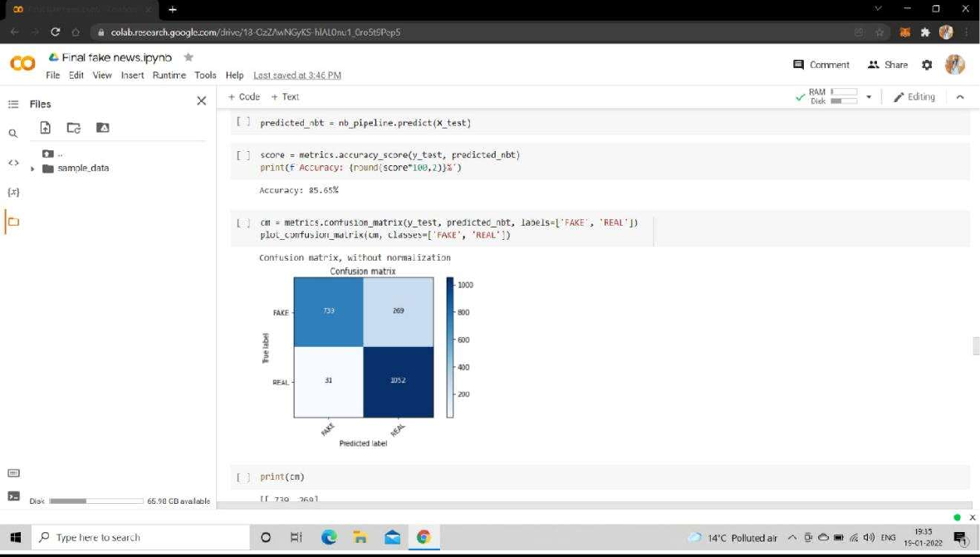

Slide 6
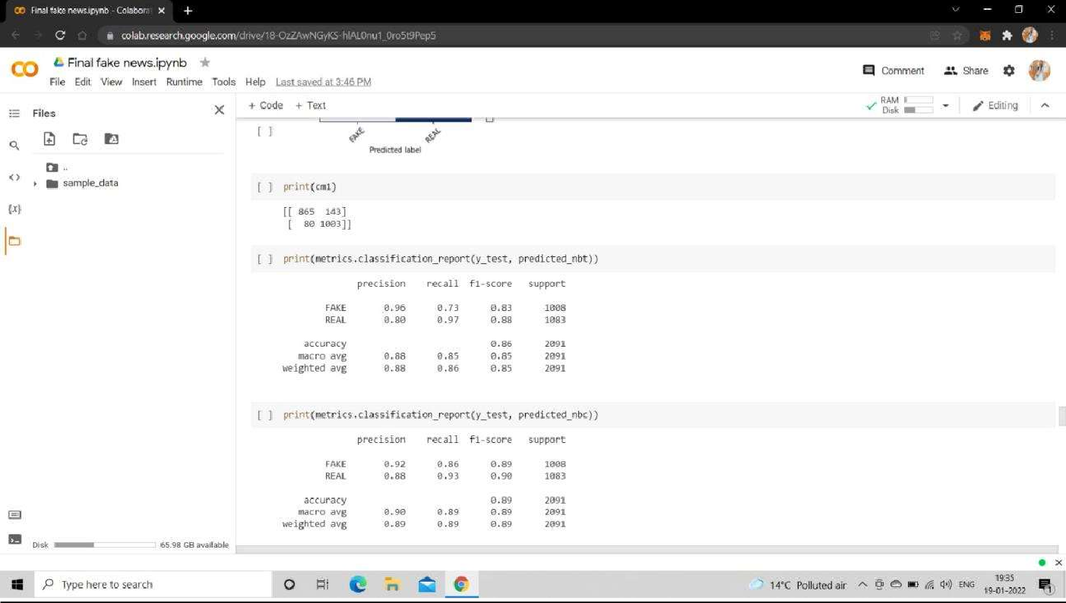

Slide 7
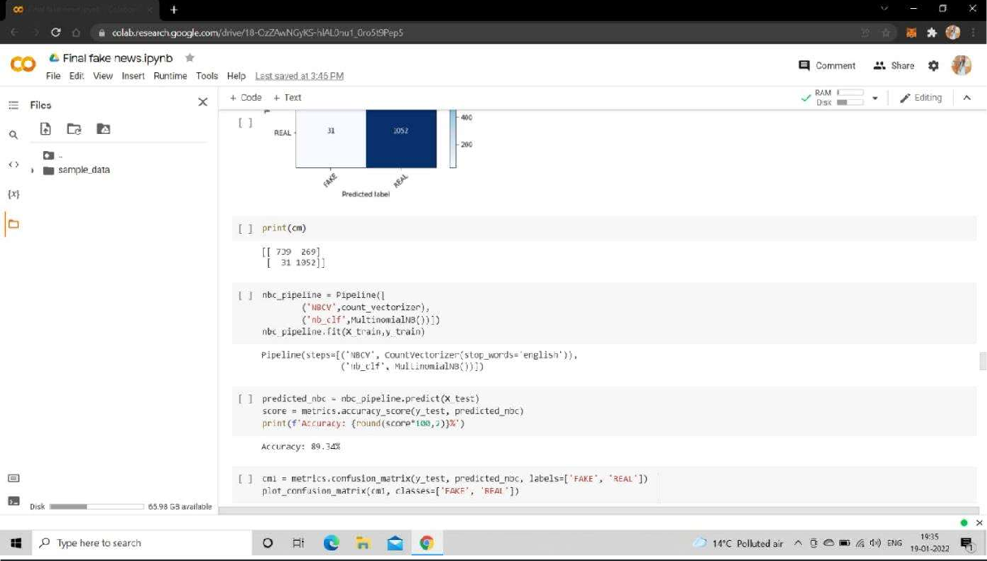
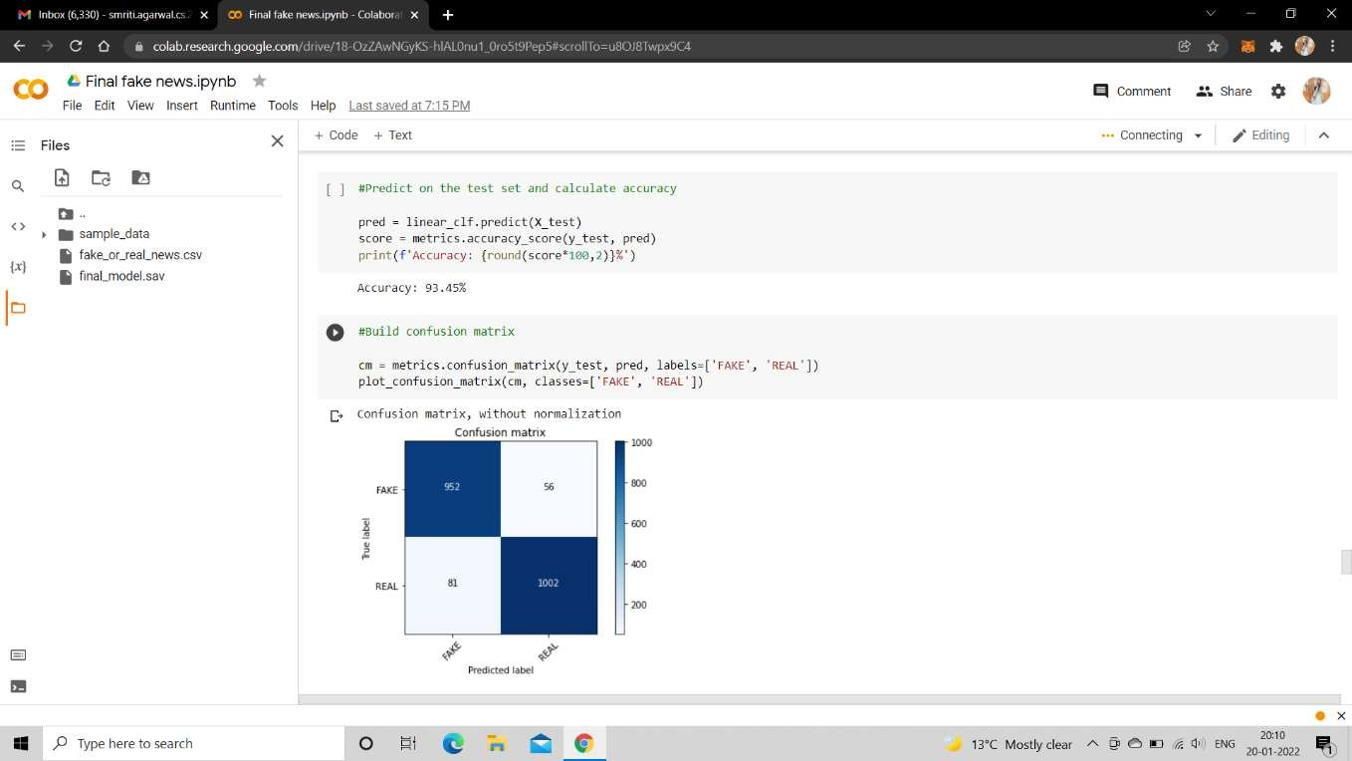

Slide 8
