Slide 1
Notes:
Ramen spectroscopy
Electrochemical sensor voltometry
Dr. Choo group
Constant pressure

Slide 3
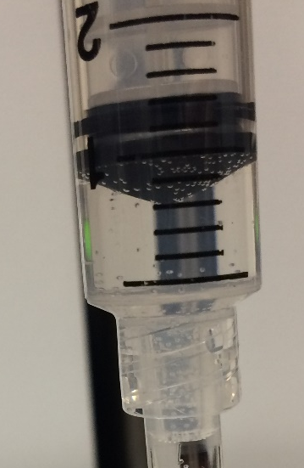
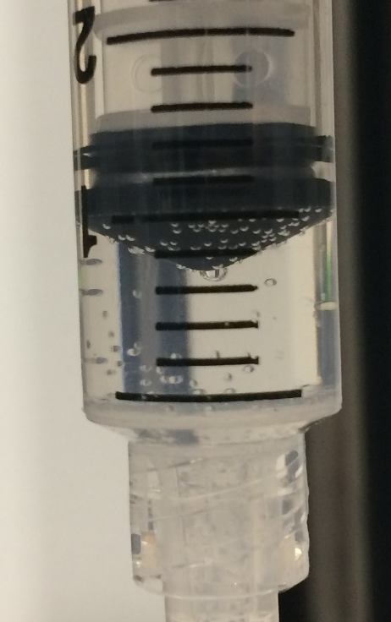
Same syringe
5 run continuously
After 3rd run

Slide 4
Same syringe
5 run continuously

