Slide 1
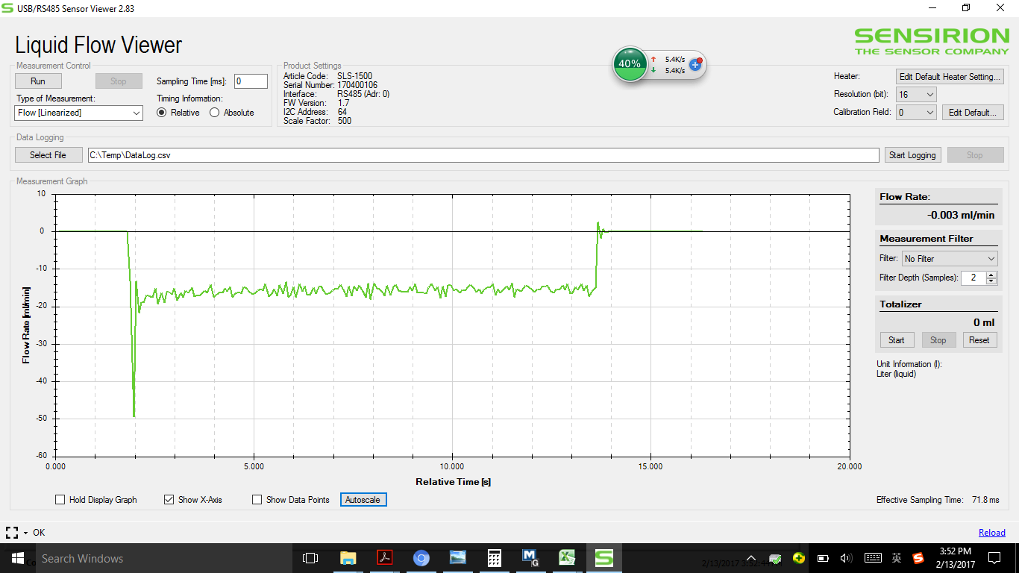

Slide 2
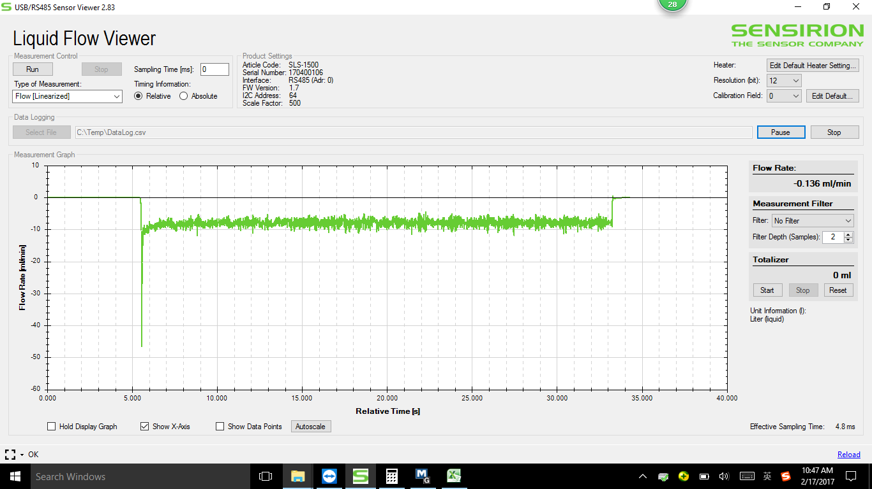
flow_20170217_5ml_70mm-min_0um_1st

Slide 3
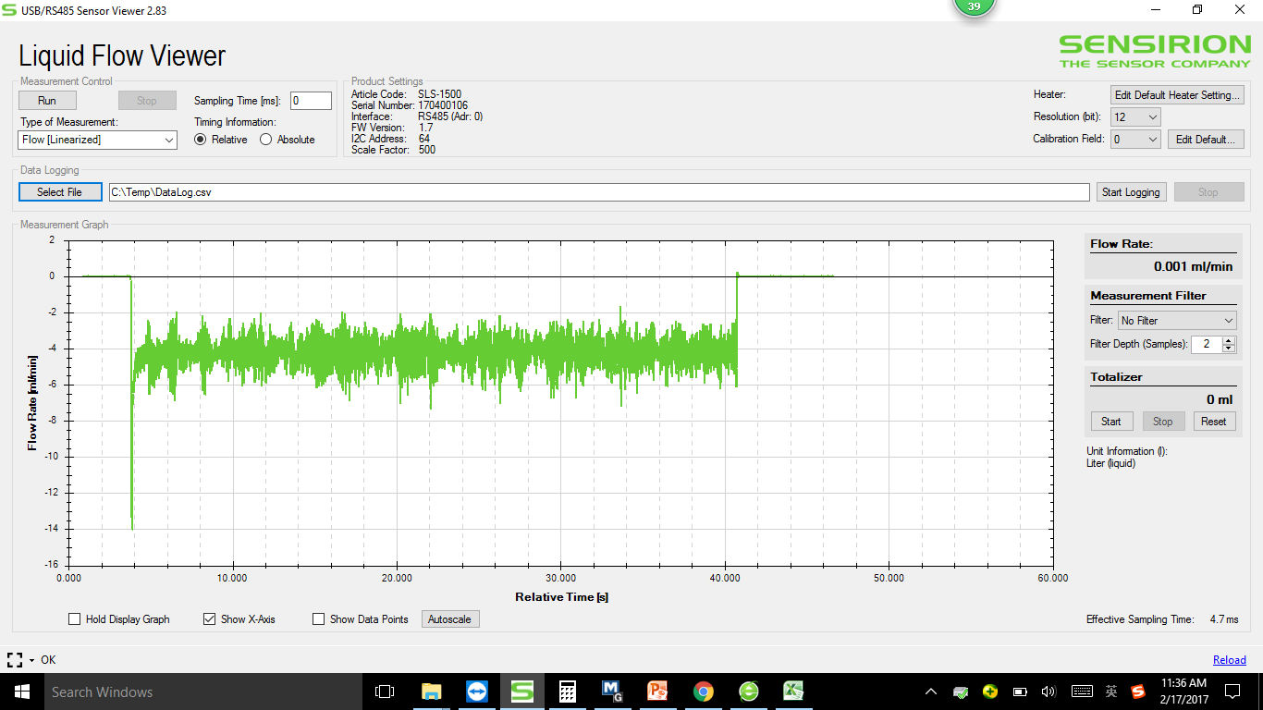
flow_20170217_3ml_70mm-min_0um_1st

