Slide 1
Notes:
Ramen spectroscopy
Electrochemical sensor voltometry
Dr. Choo group
Constant pressure

Slide 2
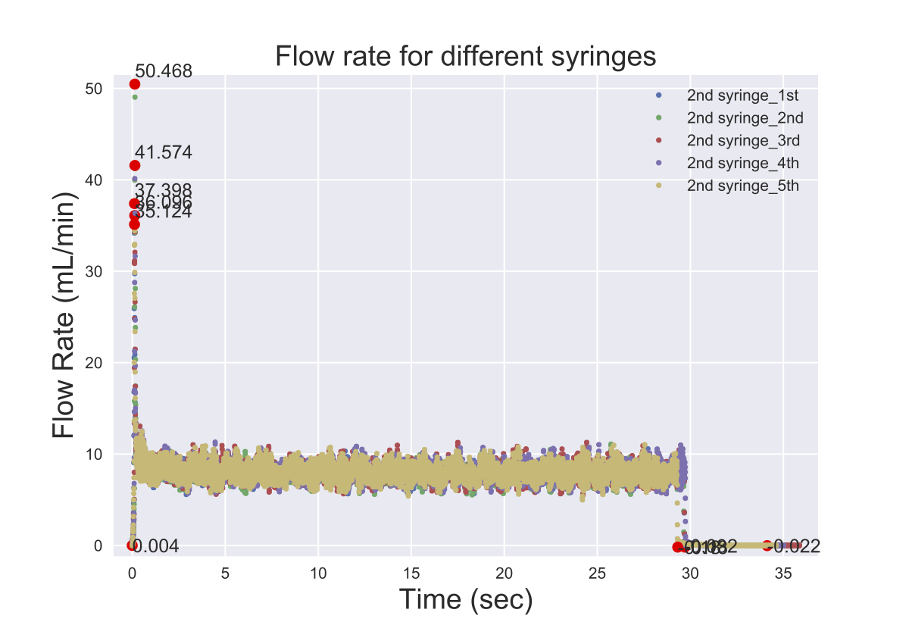
Same syringe (2nd)
5 continuous runs

Slide 3
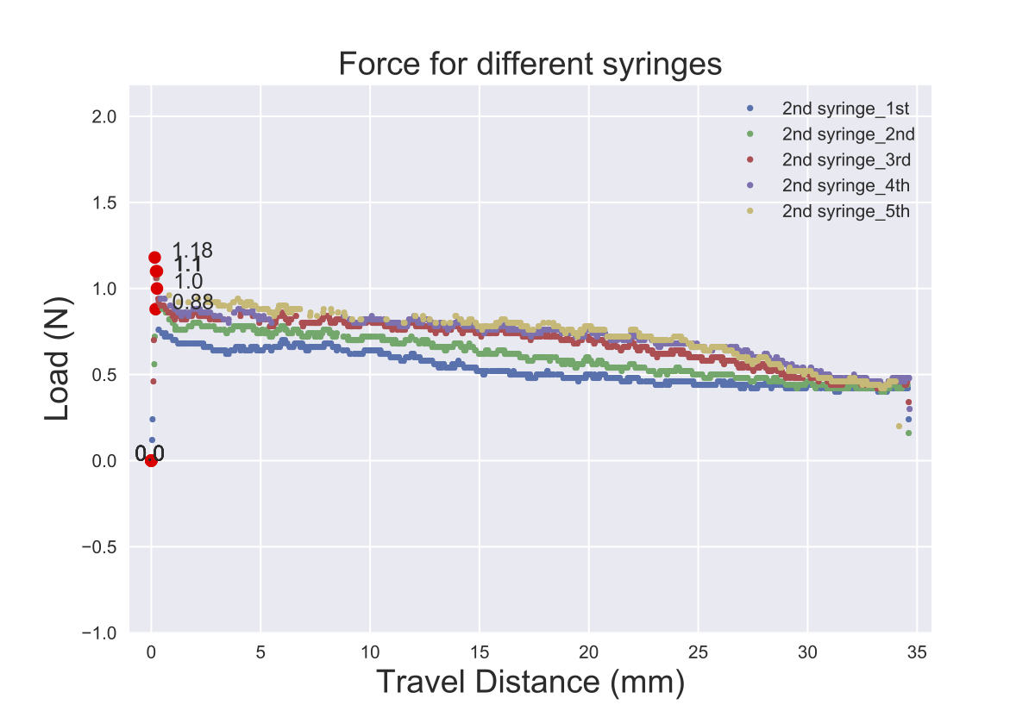
Same syringe (2nd)
5 continuous runs

Slide 4
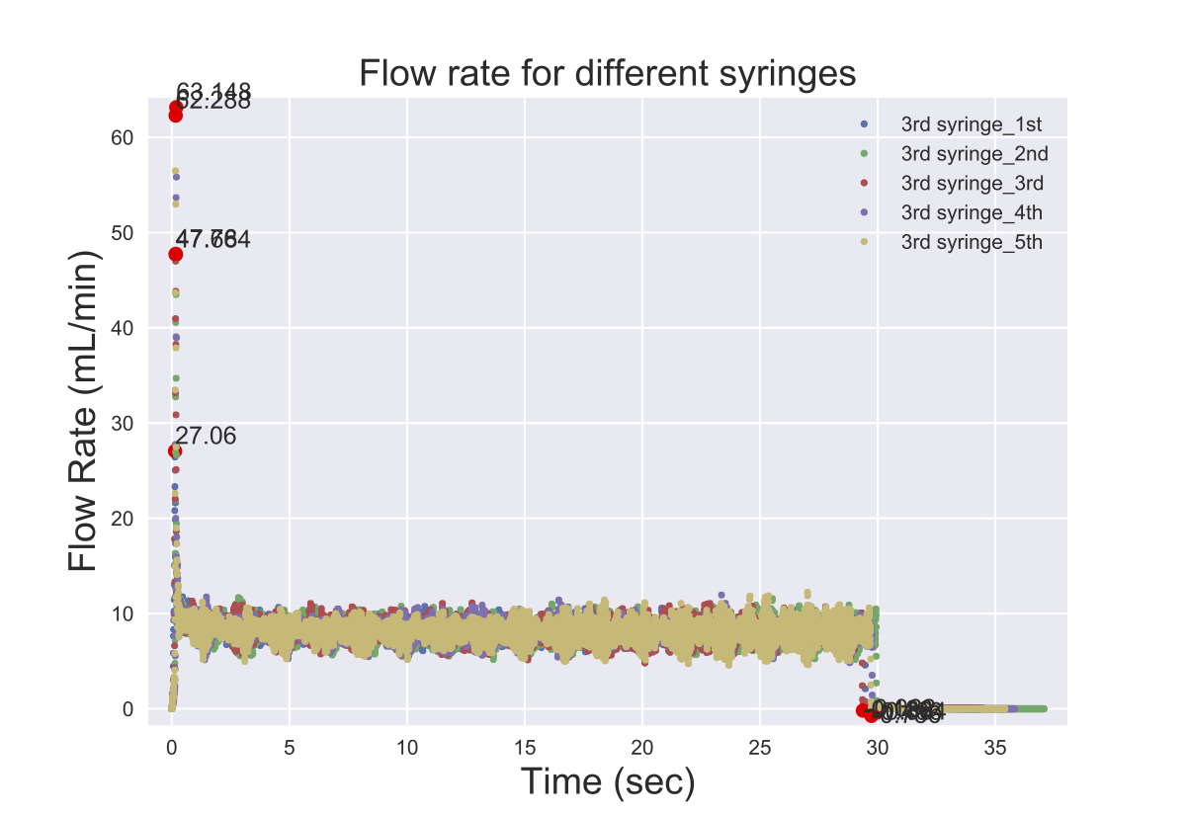
Same syringe (3rd)
2nd to 5th are continuous runs

Slide 5
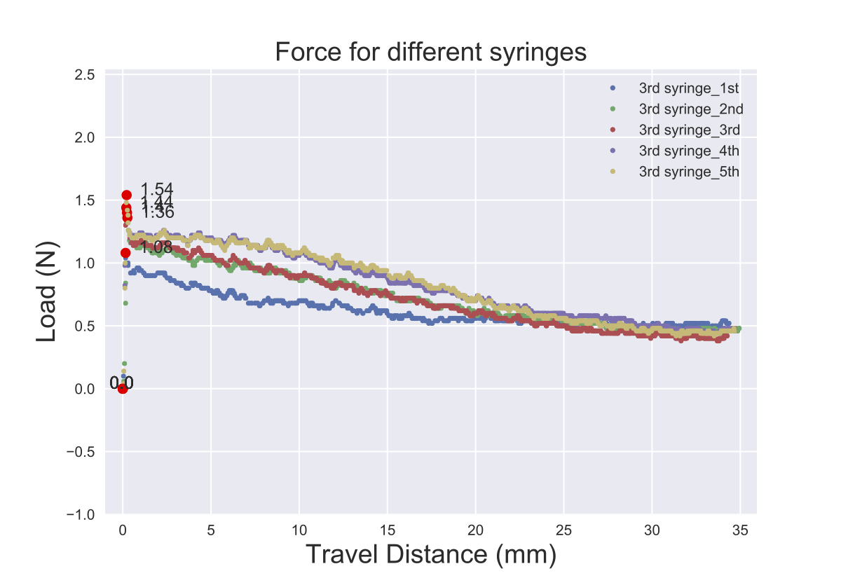
Same syringe (3rd)
2nd to 5th are continuous runs

Slide 6
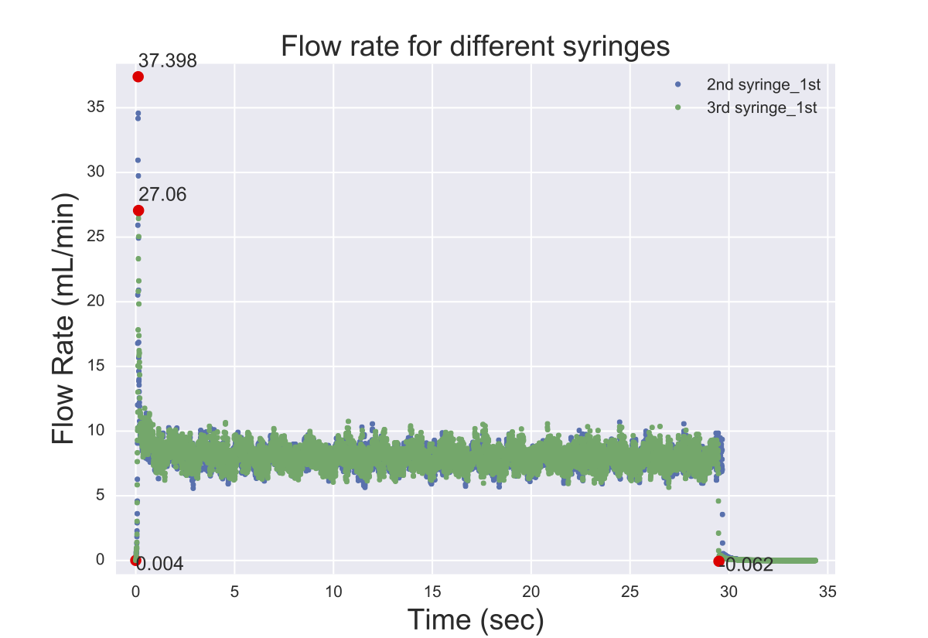
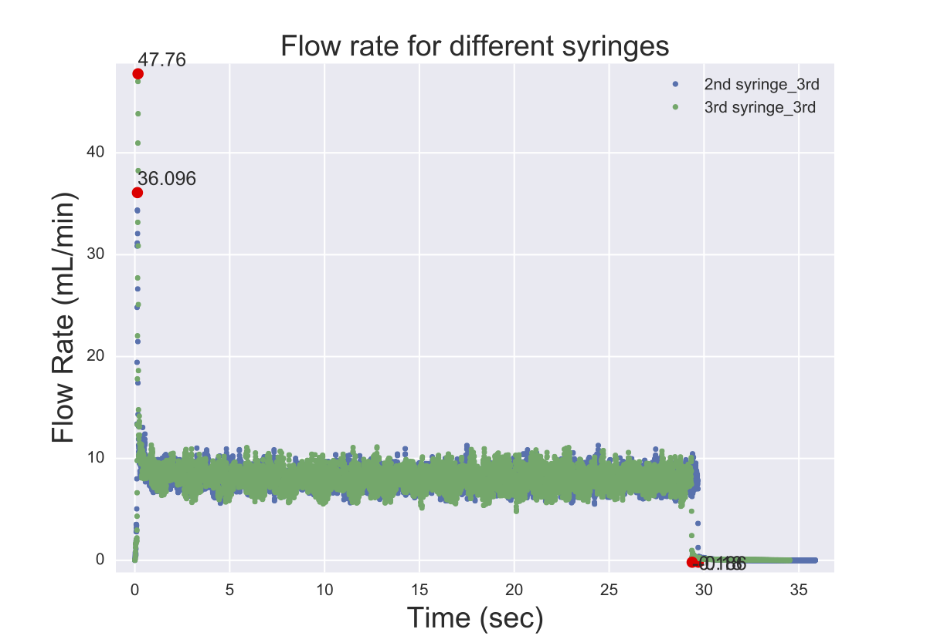
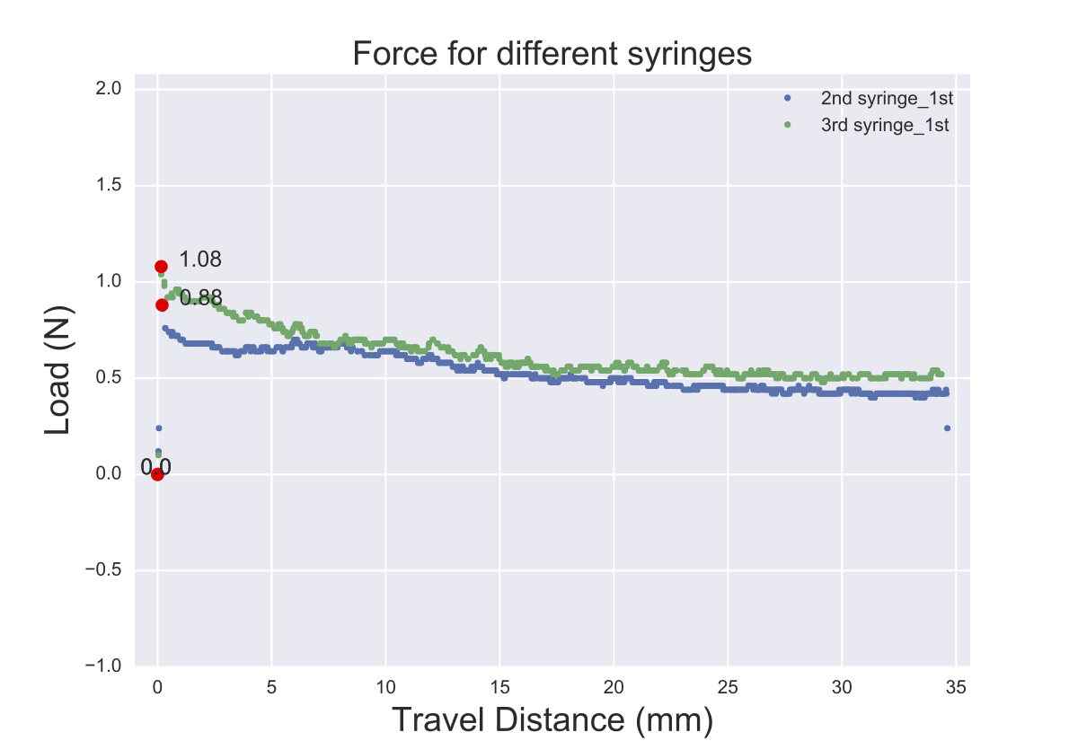
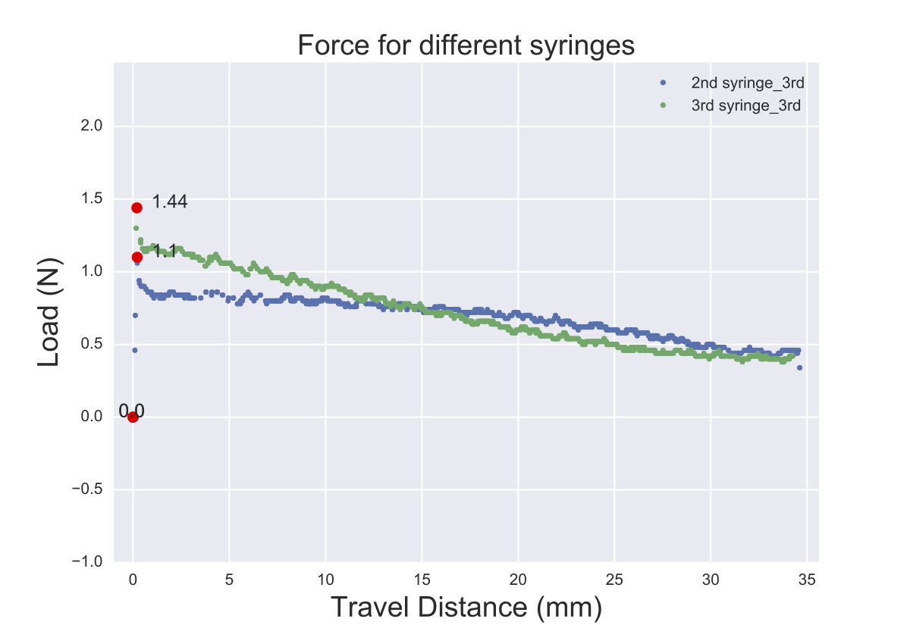

Slide 7
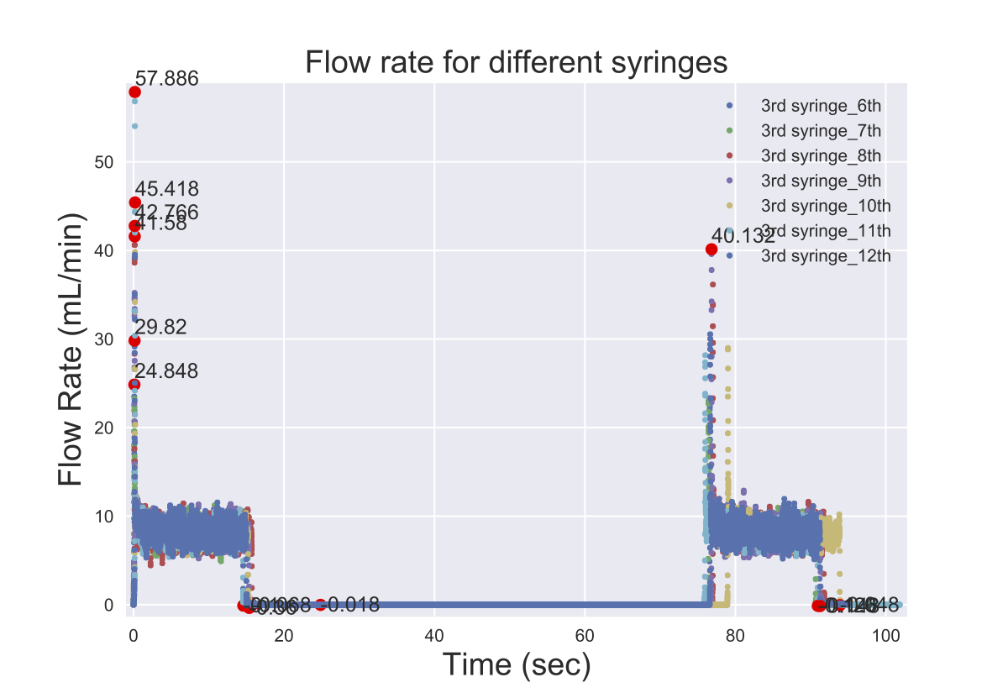
Same syringe (3rd)
7th to 12th are continuous runs

Slide 8
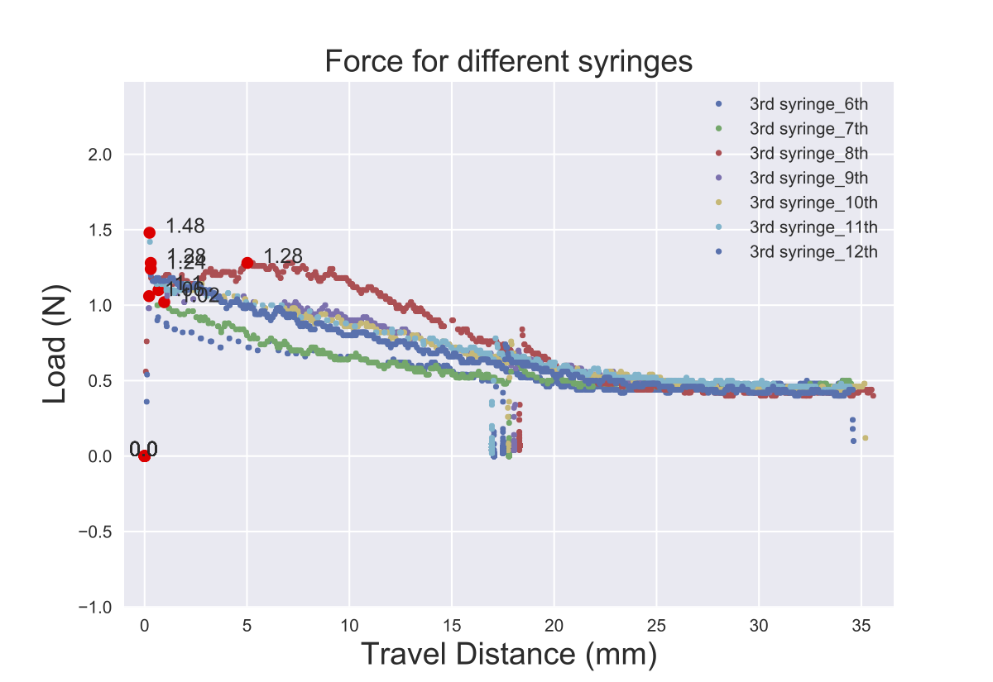
Same syringe (3rd)
7th to 12th are continuous runs

Slide 9
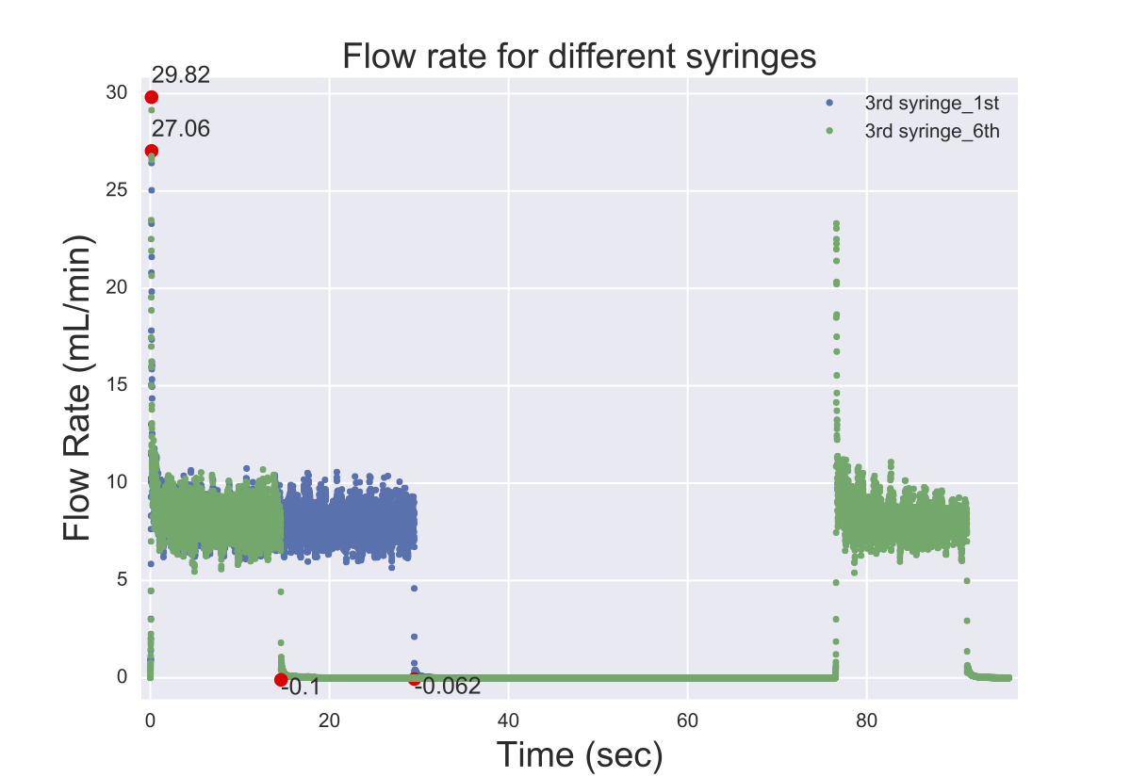
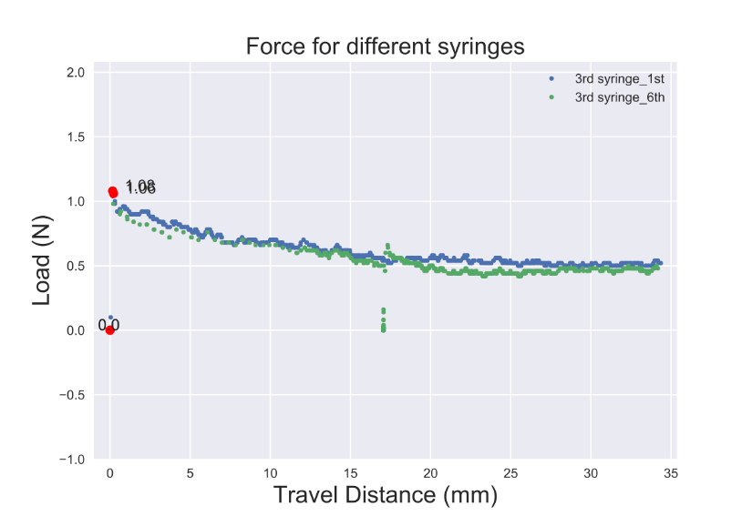

Slide 10
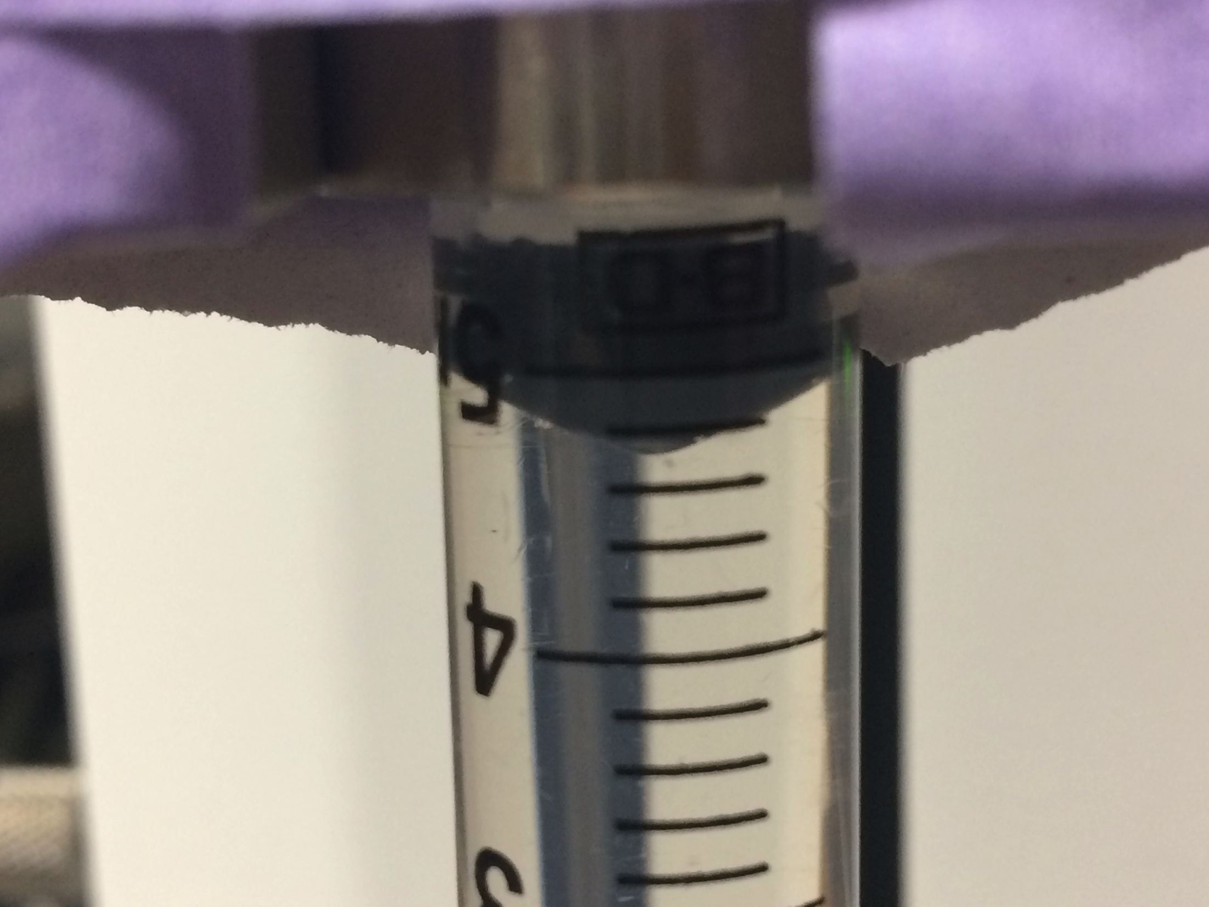
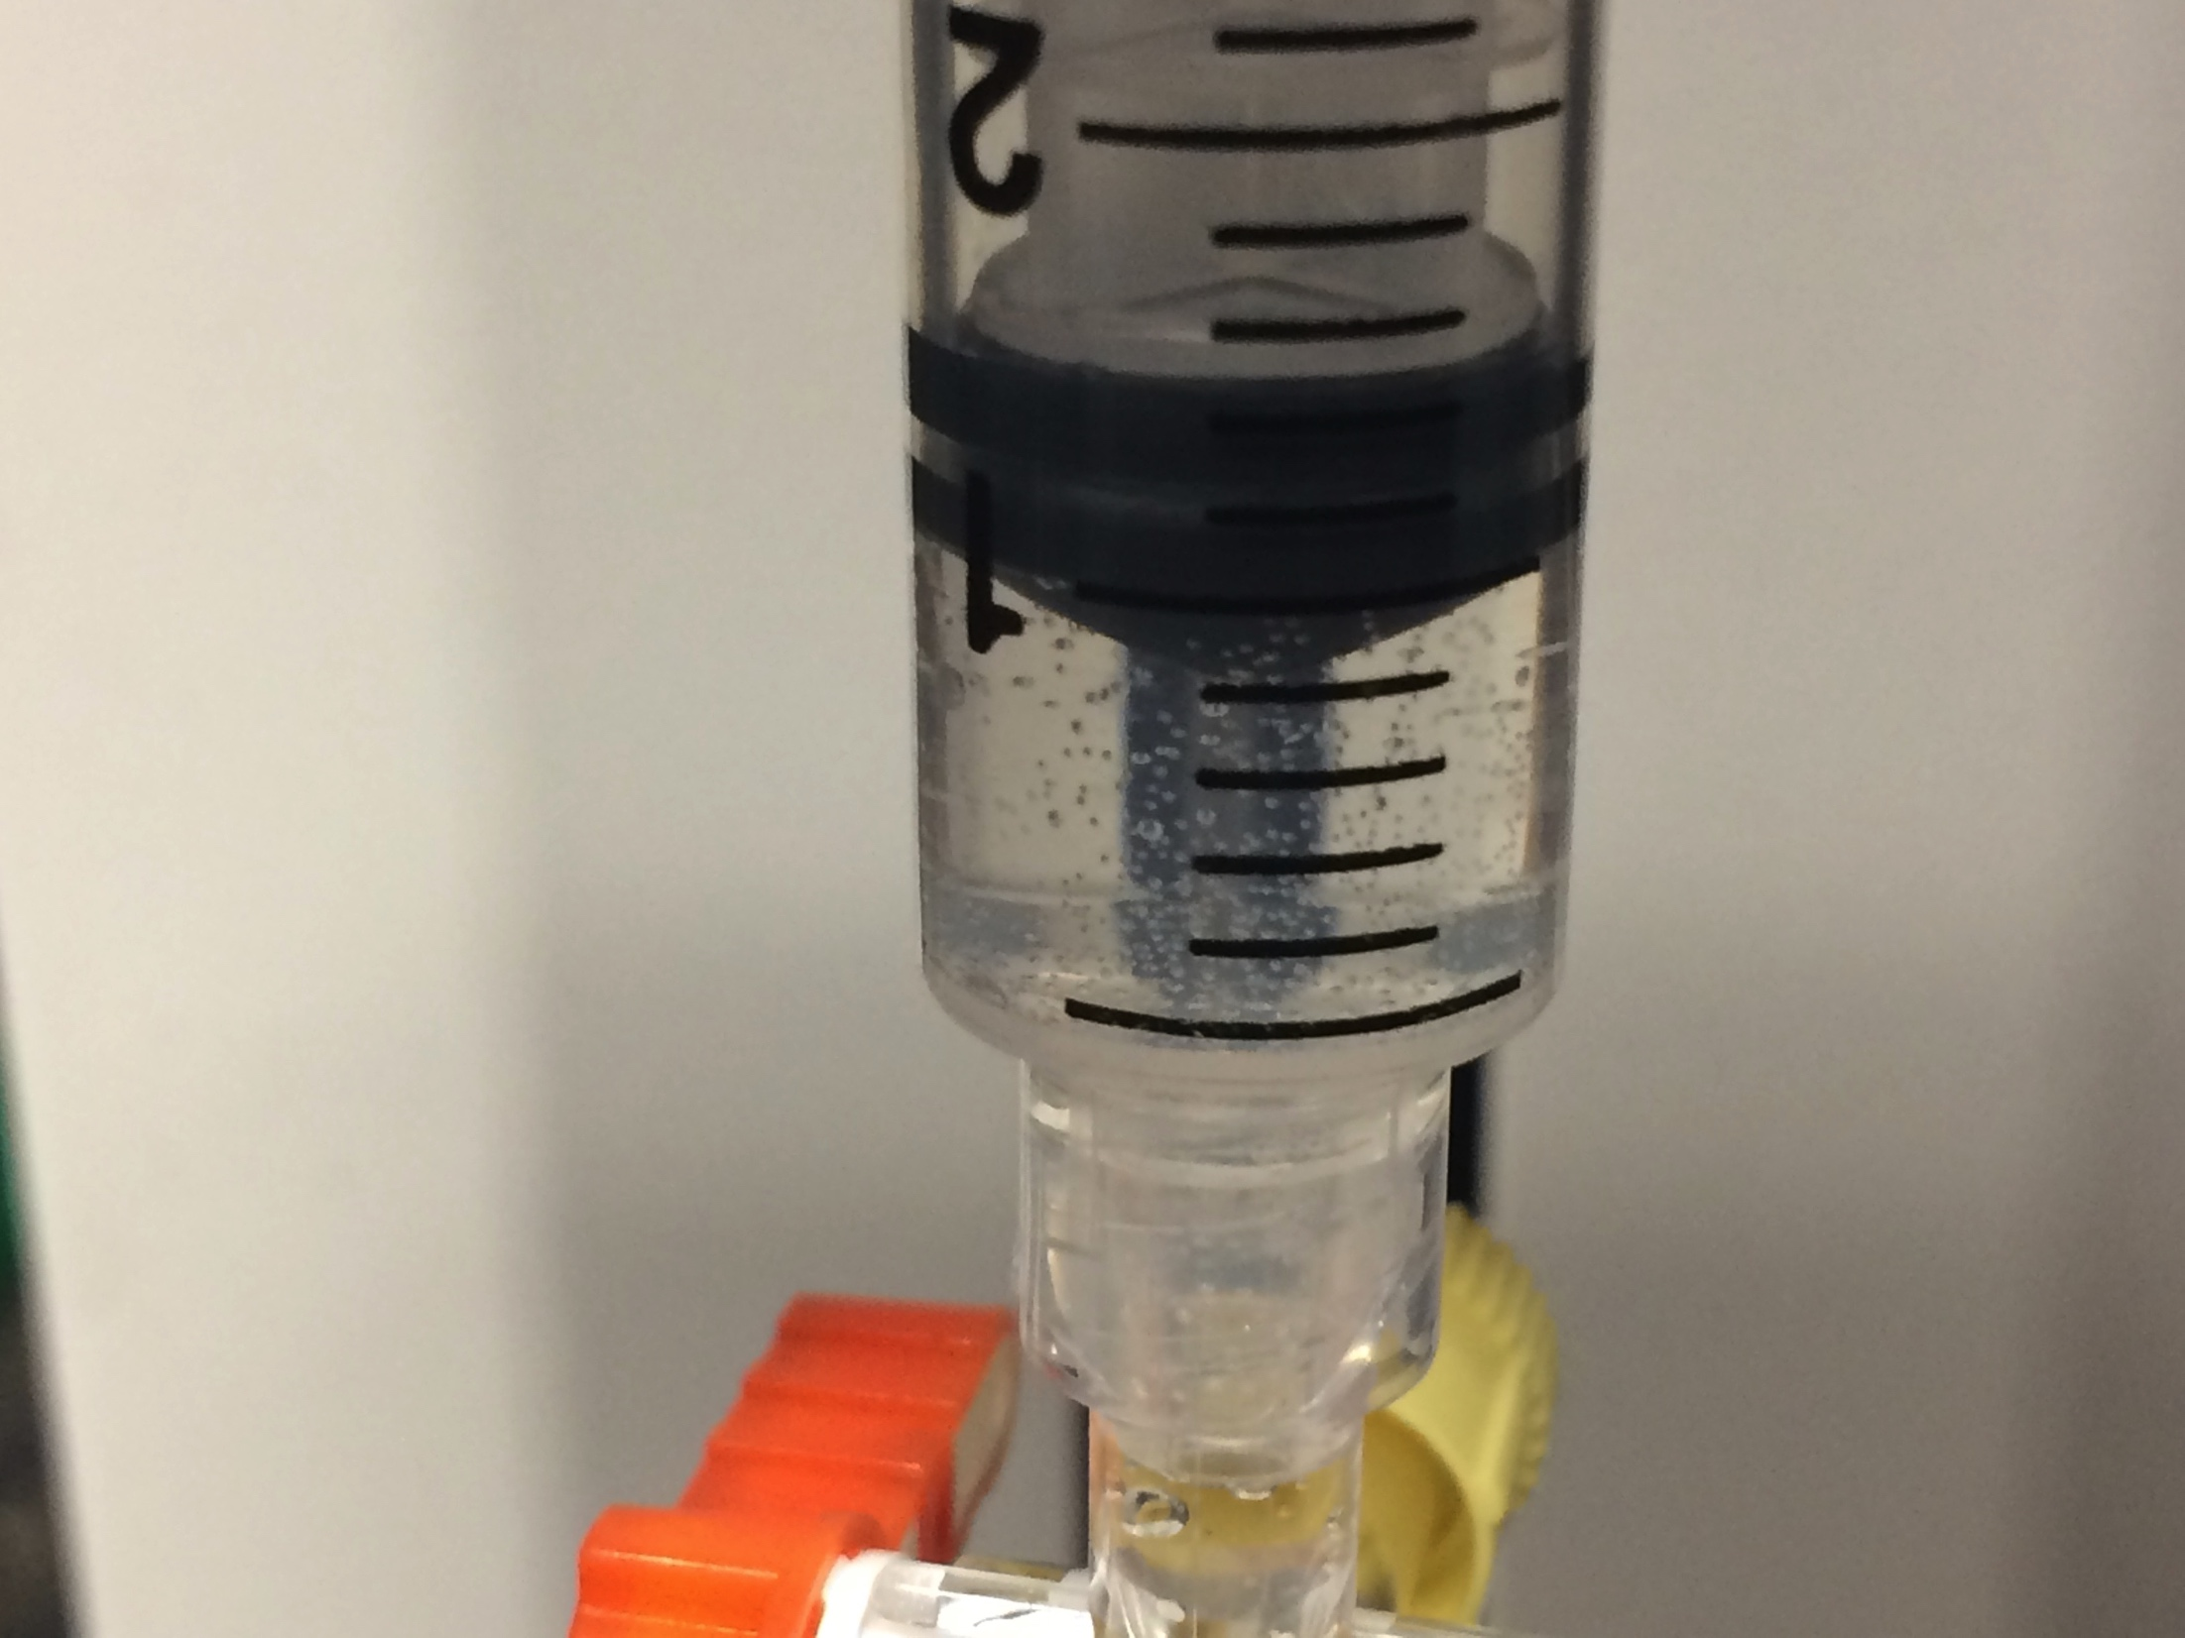
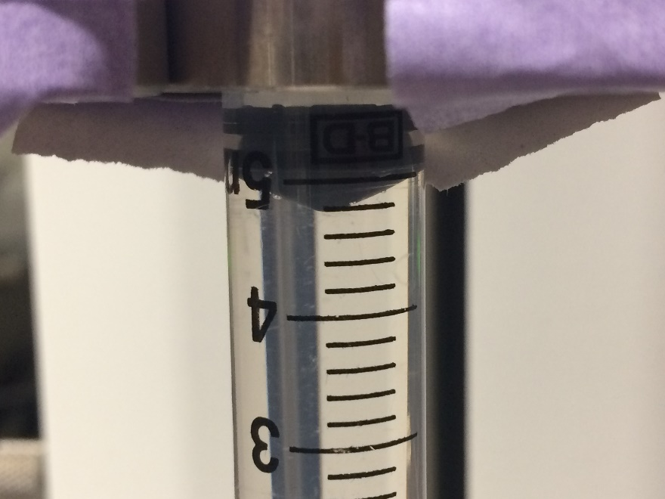
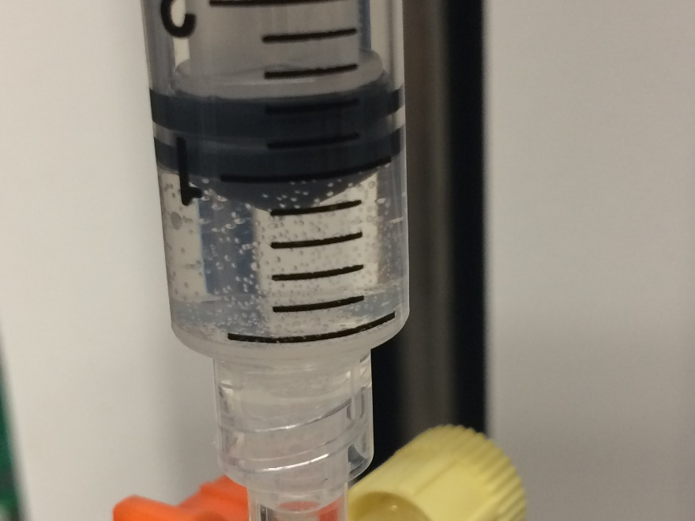
Before 7th run
After 7th run
Before 8th run
After 8th run

