Slide 1
UNISOFT SYSTEM LTD · PRESENTS
TwinMOS Digital Platform
A complete digital transformation: website, content management,
customer engagement and brand protection — in one platform
Prepared for TwinMOS Management
October 2026
253 automated tests passed · 0 security findings · production-ready

Slide 2
Agenda
What we will cover in the next 30 minutes
01
Executive Summary
The platform at a glance and what it delivers
05
Competitive Analysis
How this platform compares to market alternatives
02
Platform Tour
Public website, admin console and the technology
06
Technical Superiority
Architecture, security and quality gates
03
Reaching Customers
Marketing, lead conversion and channel enablement
07
Roadmap & Next Steps
Deployment plan and what happens after launch
04
Customer Service
Support, RMA and the anti-counterfeit advantage

Slide 3
EXECUTIVE SUMMARY
One platform replaces four disconnected systems
28
15
15
253
public website pages
replacing the legacy site
admin modules covering
content, sales & support
customer-facing form types
with SLA-tracked workflows
automated tests
all passing
Before: four disconnected systems
Static website + separate forms inbox + spreadsheet inventory + email-based support — no audit trail, no SLA, no single source of truth.
After: one integrated platform
Every product, page, lead, RMA case, serial and partner managed in one console with full audit trail, role-based access and 2FA.
Built by Unisoft System Ltd · delivered production-ready with verified test evidence

Slide 4
One Platform, Three Surfaces
Website + Admin Console + API sharing a single database
Public Website
Admin Console
REST API
www.twinmos.com
Staff-only CMS
The integration backbone
28 pages: shop, product details, compatibility finder
Anti-counterfeit serial verification
RMA tracker, careers, where-to-buy locator
CDN-fast — no server to patch
15 modules · 5 roles · two-factor auth
Content, products, leads, RMA, partners, media
Every change audit-trailed for 12 months
World-class editing: visual builders + previews
190+ endpoints powering web + admin + partners
Partner portal with gated price files
Bank-grade security: rate limits, validation
Deploy-ready for ERP / CRM integrations
One PostgreSQL database · changes in the admin console appear on the website through an automated content bridge

Slide 5
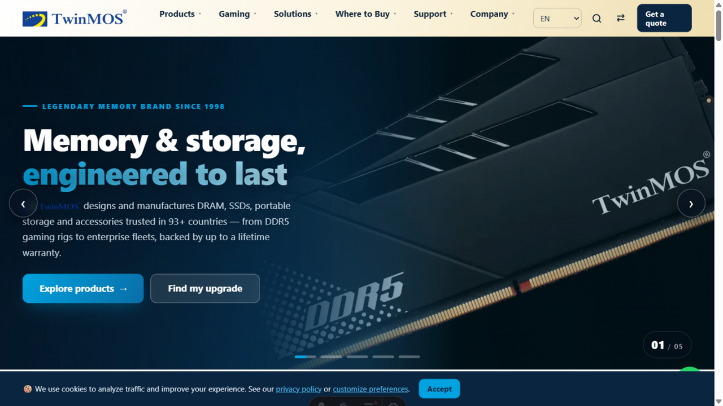
PLATFORM TOUR
A world-class public website
Pixel-perfect design
28 pages faithfully implementing the approved brand
Sub-second page loads
Static-first architecture, CDN-cached worldwide
SEO built-in
Structured data, sitemap, hreflang for 9 languages
Accessible by design
Alt-text compliance tracked across the media library; built to WCAG 2.2 AA

Slide 6
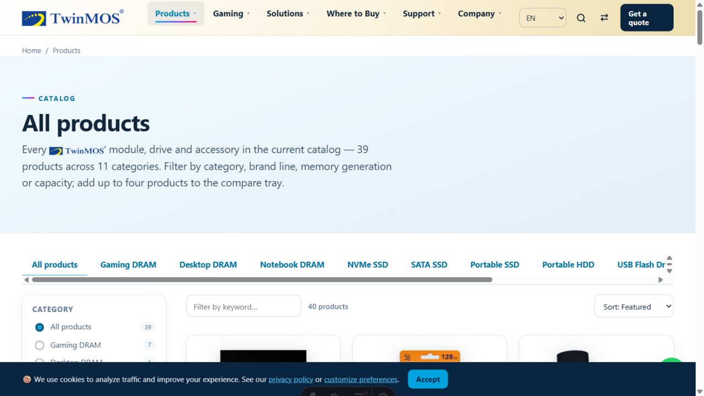
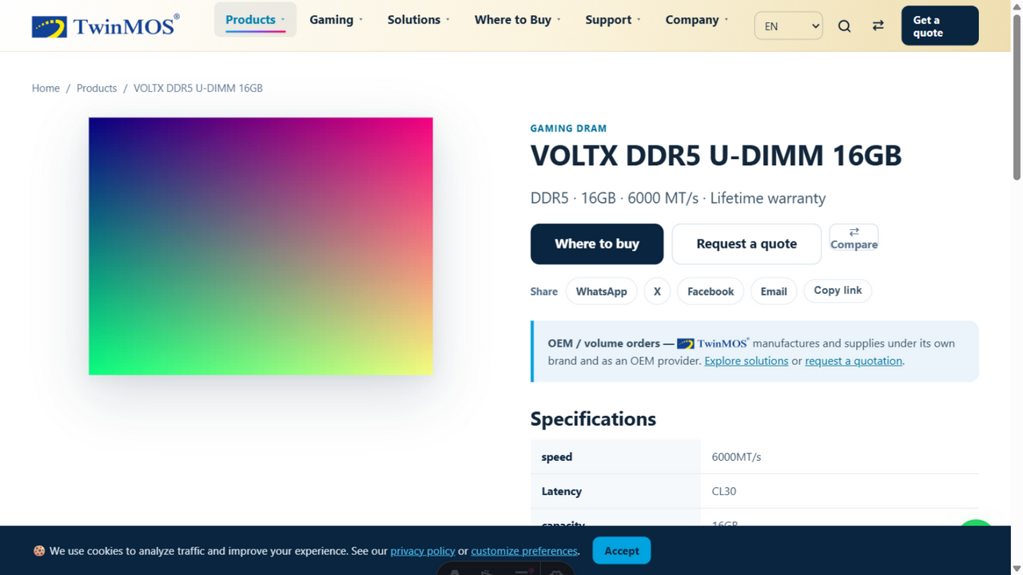
Reaching Customers
A shop that converts
Faceted search
Filter by category, generation, capacity, interface
Rich product pages
Specs, warranty, galleries, datasheets, variants
Compare tool
Side-by-side product comparison
Always current
Product edits in the CMS appear on the site instantly

Slide 7
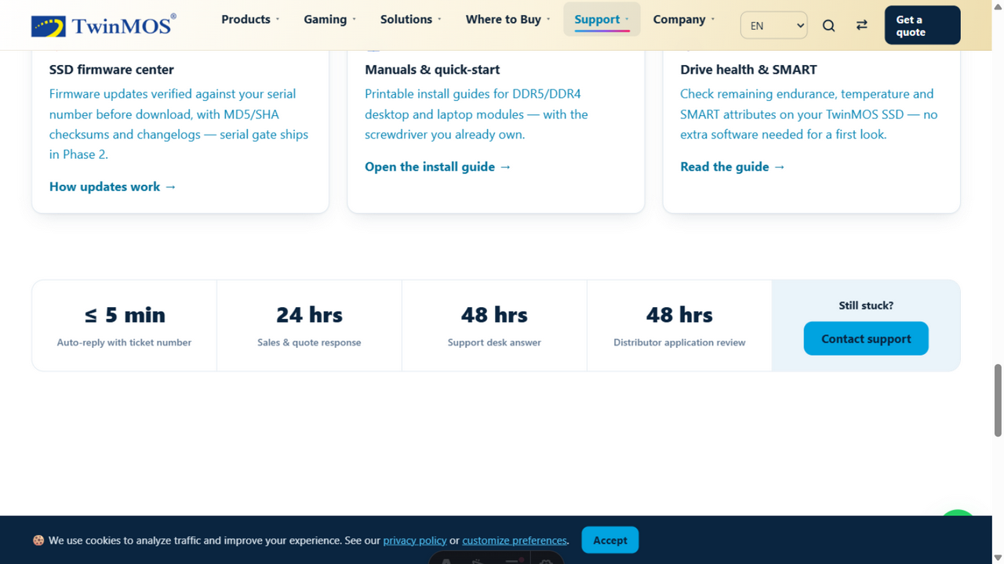
COMPETITIVE ADVANTAGE
Anti-counterfeit serial verification — a first in the industry
Customer-facing verification
Buyers check any TwinMOS serial before purchase — instant genuine / unverified verdict
Factory registry
Every production serial registered; verification history logged with IP and country
Counterfeit detection
Anomaly scan flags serials verified from >5 distinct IP addresses in 24 hours
Warranty protection
RMA cases verify authenticity before any warranty service is approved
Neither Kingston nor Corsair offers a public serial-number lookup: Kingston's verification page is a label-inspection guide only, and Corsair requires a support ticket. An instant registry check is a first among major memory brands — a differentiator TwinMOS can market.

Slide 8
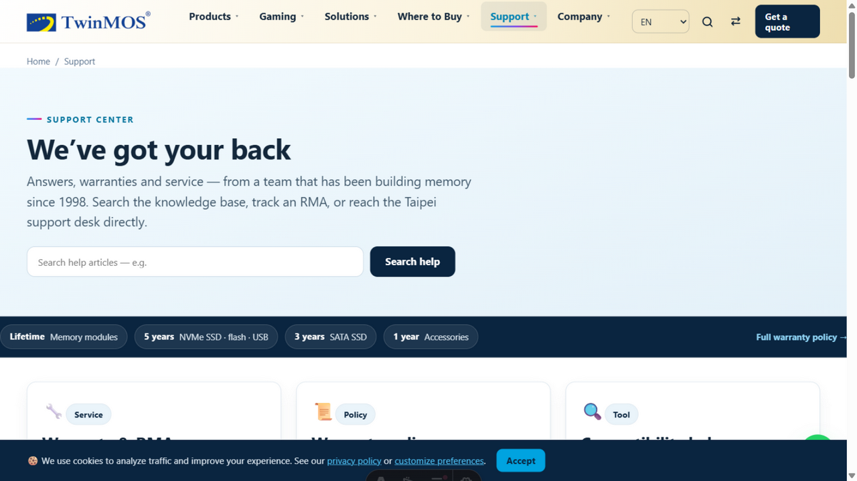
Customer Service Excellence
Support that retains customers
7-state
<1 min
24/7
RMA pipeline with
full case history
to file a support ticket
from any page
self-service
RMA status tracking
Knowledge base
Searchable support articles and FAQ
Live RMA tracker
Customers follow their case through repair
Instant routing
Every form routed to the right team with SLA
Reply from the case
One-click email reply; speed-to-lead tracked

Slide 9
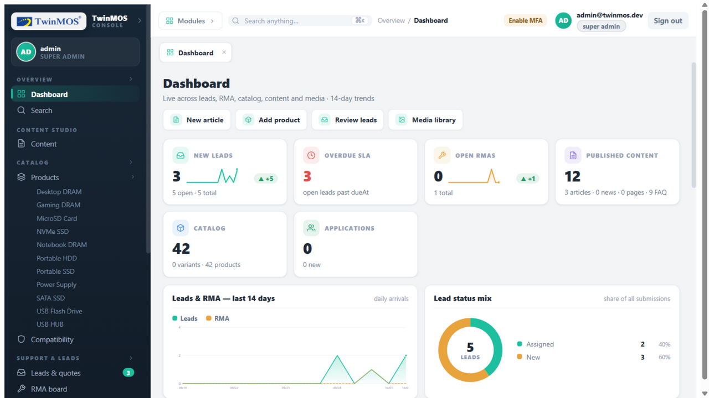
PLATFORM TOUR
The admin console — your team's daily cockpit
15 modules
Content, products, leads, RMA, partners, careers, media, translations, users, audit, settings
Role-based access
5 roles from viewer to super-admin; every action logged
Two-factor auth
TOTP with backup codes; session revocation
Global search
Ctrl+K searches everything — leads, products, content, RMA

Slide 10
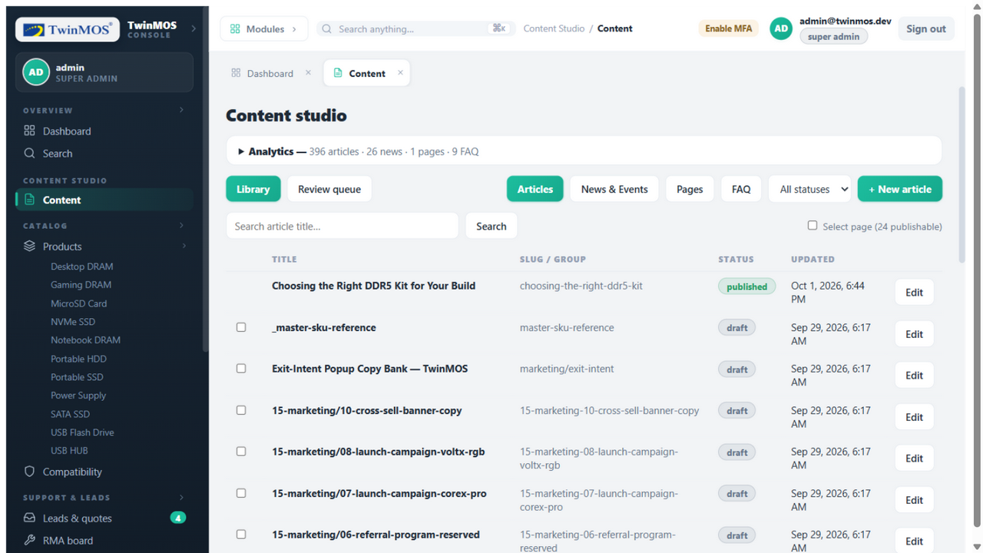
Content Management
Publish in minutes, not days
Visual page builder
13 drag-and-drop block types with live responsive preview
Two-person review
Authors draft; editors approve with visual diff
Full revision history
Every publish snapshots the prior version; one-click rollback
Scheduled publishing
Set a future date; the promoter publishes automatically
Markdown + media
Formatting toolbar with direct media-library image insertion

Slide 11
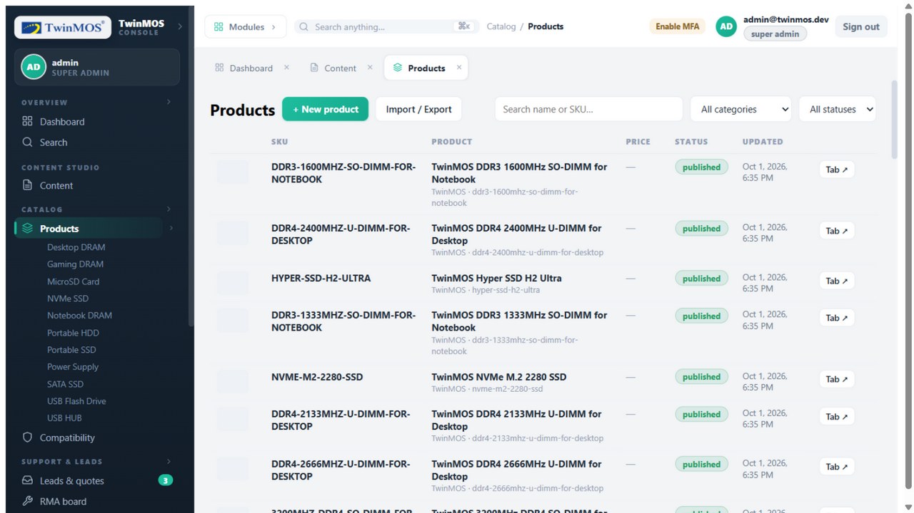
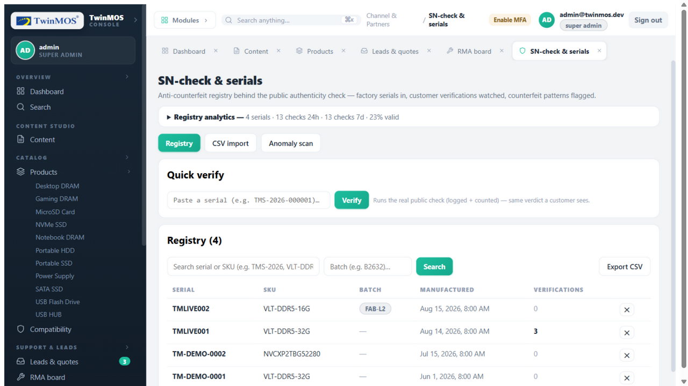
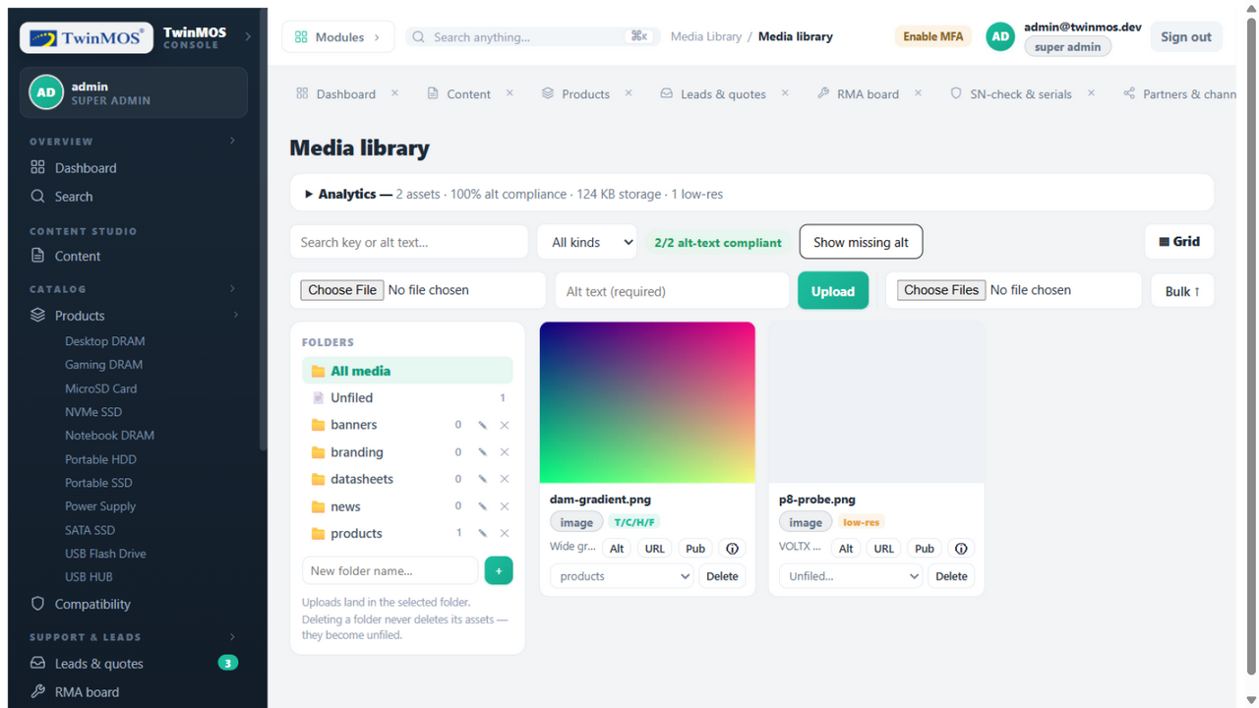
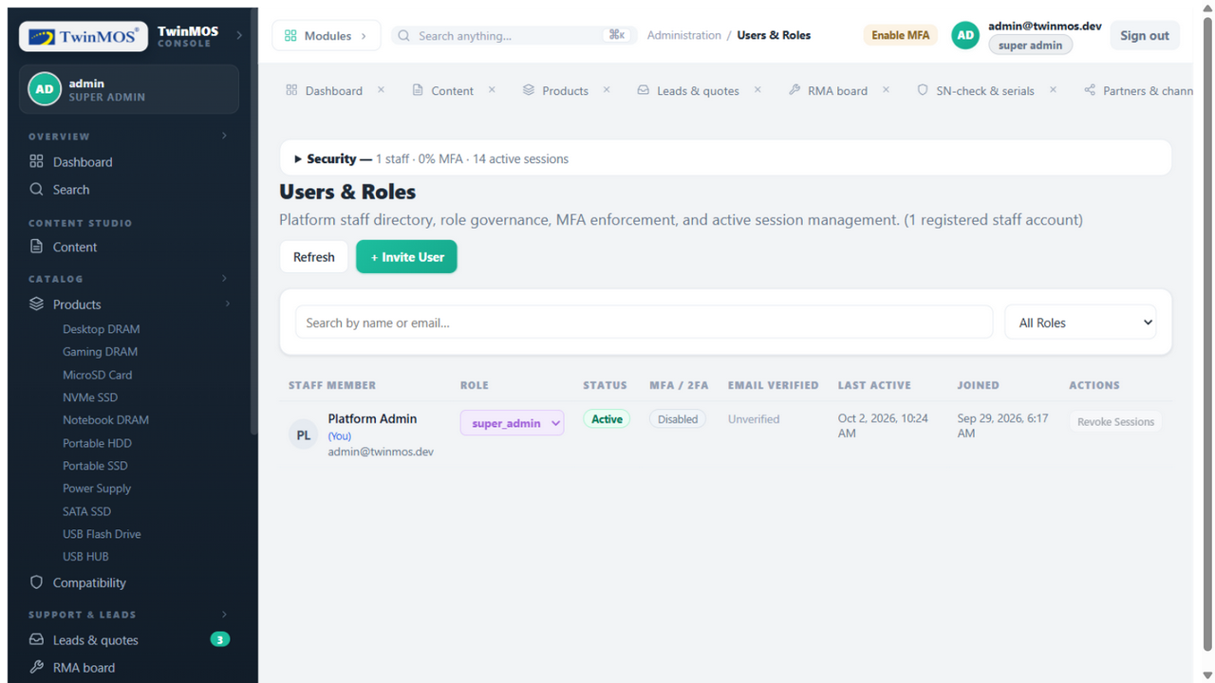
PLATFORM TOUR
Catalogue, serials, media and access — managed in-house
Product Catalogue
Serial Registry
Media Library
Users & Roles
40 products with specs, imagery, variants and SEO fields
The public shop and facets stay in sync automatically
Factory serials imported, verified and tracked
Anomaly scan flags suspected gray-market units
Central assets with folders and usage tracking
Alt-text compliance audited per image
5 roles, two-factor auth, session revocation
Every staff action written to the audit trail

Slide 12
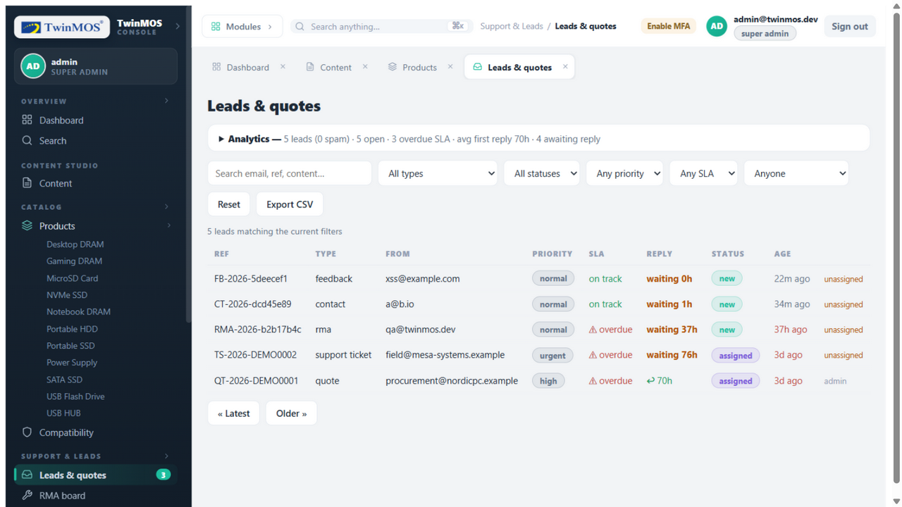
MARKETING & SALES
Every lead answered before it goes cold
Speed-to-lead measured
First-response time tracked on every lead — contacted within 5 minutes, a lead is 21× more likely to qualify than after 30 minutes
SLA enforcement
Per-type response deadlines; overdue leads surface on the dashboard's risk queue
One-click reply
Email the customer directly from the case; the reply is logged and timestamps the first response
Ownership routing
Unassigned queue, per-staff assignment, priority and status filters
Source: Lead Response Management study (Oldroyd · MIT · InsideSales.com)

Slide 13
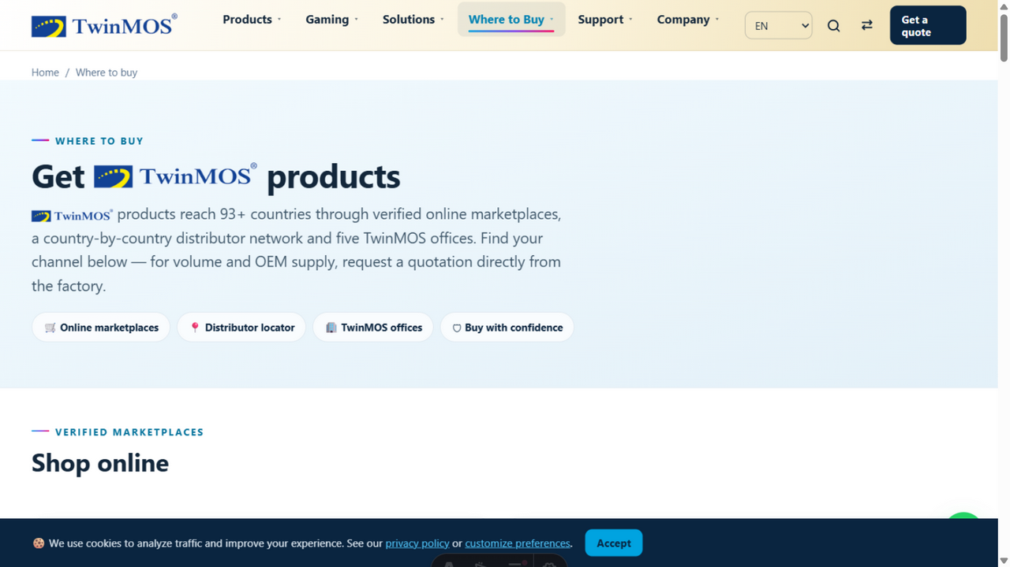
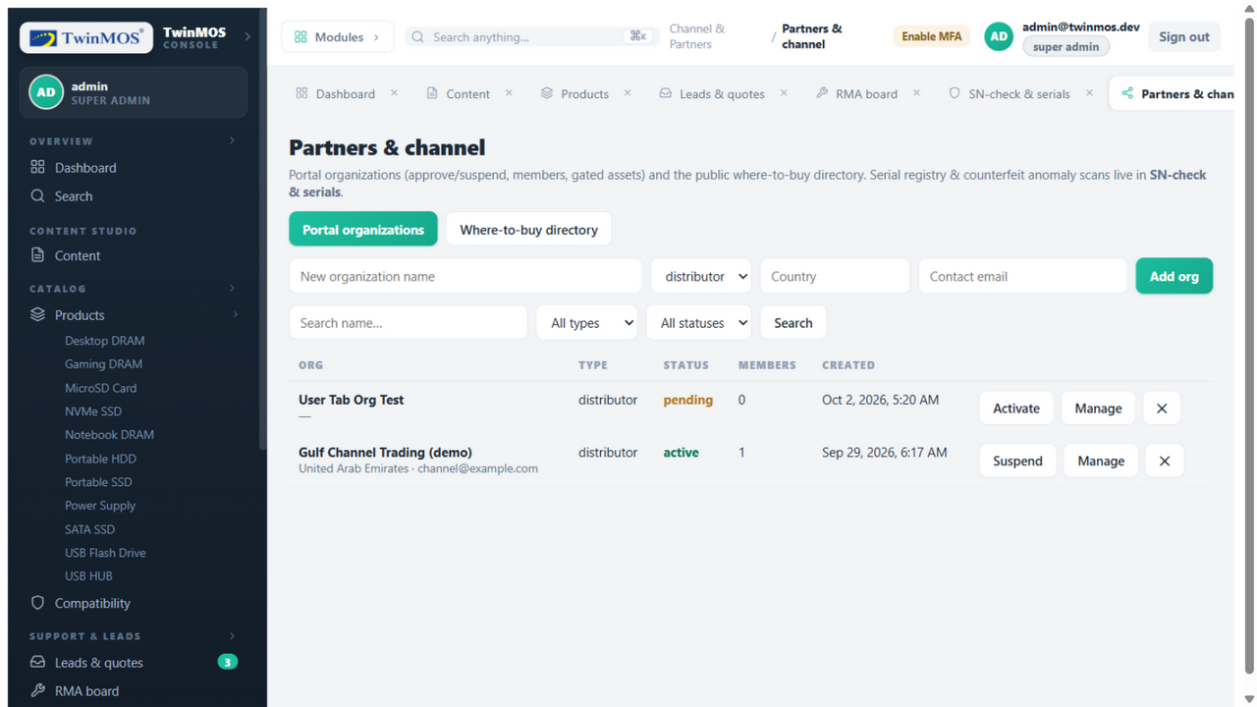
Channel Enablement
The where-to-buy locator — managed from the console
Distributor directory
Country cards with region, status, cities, contacts — instantly live
Partner portal
Gated price files, MDF documents for authorized partners
Verified marketplaces
Official storefronts listed alongside physical channels
CSV import
Batch-update the directory from channel manifests

Slide 14
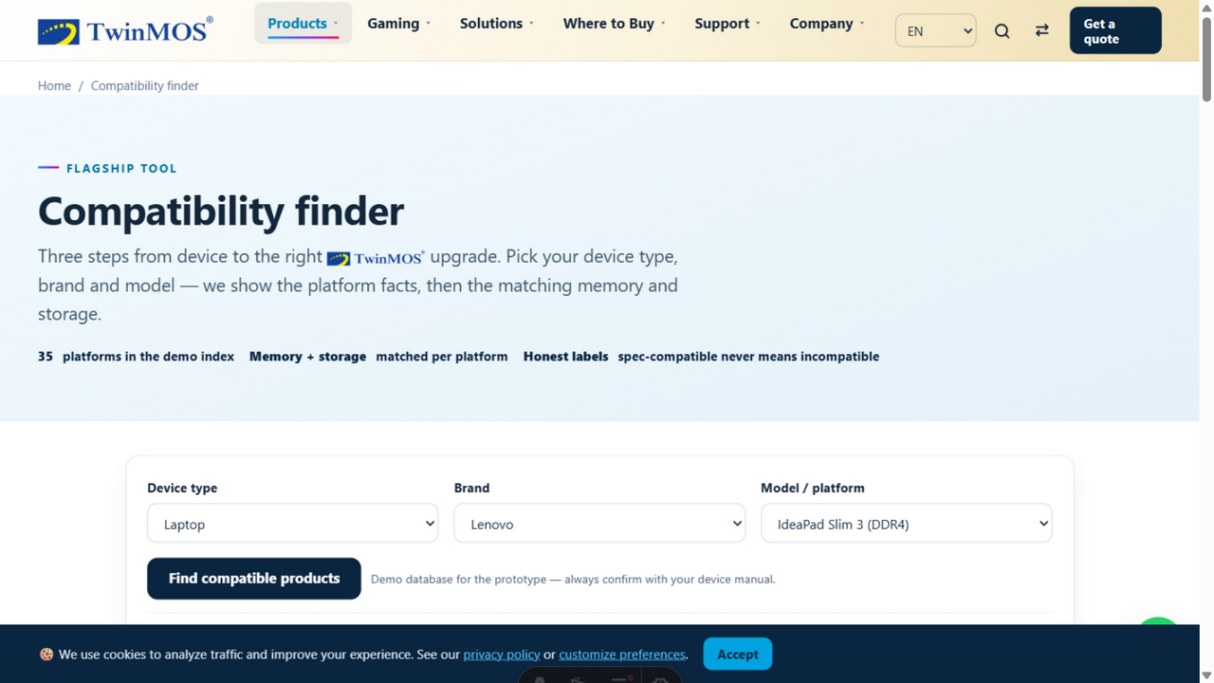
PRE-SALES CONFIDENCE
The compatibility finder removes purchase hesitation
Guided device lookup
Type → brand → model: validated memory guidance in 3 clicks
QVL matrix managed in-house
Max capacity, slot count, speed and SSD upgrade path per device
Recommendations inline
The finder suggests the right product categories per device
Reduces returns
Customers buy the correct module the first time

Slide 15
Competitive Analysis
How the TwinMOS platform compares
Capability | TwinMOS Platform | Kingston / Corsair | Typical agency site
Public serial verification | ✓ Instant registry lookup | Guide page only — no SN lookup | ✗ Not offered
Compatibility finder | ✓ Full QVL, CMS-managed | ✓ Device configurators | ✗ Static page
RMA tracking | ✓ Public 7-state tracker | ✓ Via support portals | ✗ Email only
CMS + shop integration | ✓ One system | ✓ Separate systems | ✗ Developer-needed
Multi-language | ✓ 9 locales, RTL ready | ✓ 16+ languages (Kingston) | ✗ Typically not
Partner portal | ✓ Gated assets, roles | ✓ Login portals | ✗ Not offered
Audit trail & roles | ✓ Every change logged | Not public | ✗ None
Sources: kingston.com product-verification, configurator and support pages; corsair.com warranty and support pages — reviewed October 2026. Agency-site column reflects common market practice.

Slide 16
TECHNICAL SUPERIORITY
An architecture built for scale, speed and security
Sub-second pages
Zero-downtime deploys
Static-first + CDN: the public site needs no server compute; pages are served from the edge worldwide.
Static bundles swap atomically; the API restarts in seconds with systemd auto-recovery.
Edge-served HTML · zero server compute per page
No maintenance windows for content updates
Bank-grade security
Single source of truth
OWASP-equivalent scan: 14 check classes, 0 findings. Rate limiting, 2FA, audit trail, parameter-bound queries only.
One PostgreSQL database behind all three surfaces; no syncing, no drift.
Verified October 2026
Changes flow: console → database → website

Slide 17
Quality Evidence
Not claims — measured, verified, documented
253
automated end-to-end tests
0
security scan findings
26 suites covering auth, MFA, RBAC races, CMS workflow, catalog, leads, RMA, serials, media, security headers
14 OWASP-equivalent check classes · 35 requests · headers, CORS, authz, injection, XSS, rate limits
100%
link & asset integrity
9
languages ready
28 pages crawled · 35 unique link targets · 0 broken links · 0 missing assets · 0 error pages
Locale framework with hreflang alternates and RTL (Arabic) verified
Full evidence trail: phase-evidence documents P1–P7 + forensic audit (Oct 2026), reproducible from the repository.

Slide 18
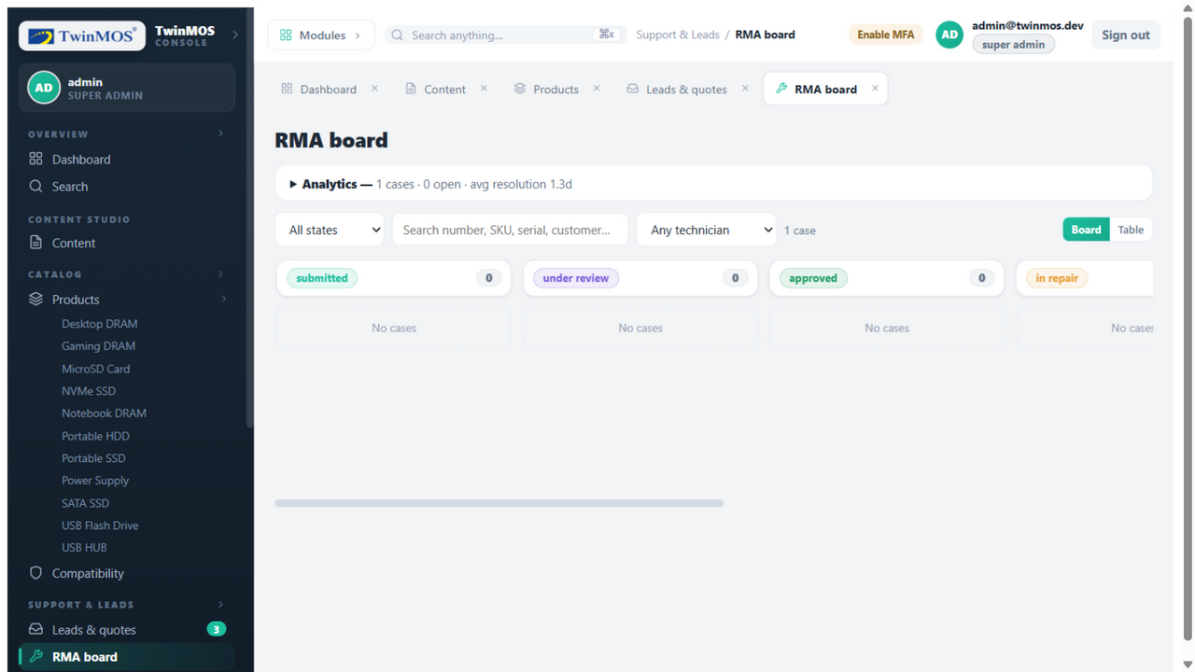
CUSTOMER SERVICE
After-sales operations that scale without headcount
Structured RMA pipeline
7 states from intake to resolution — nothing lives in an inbox
Serial-linked cases
Every case verifies the serial against the factory registry before warranty service
SLA-driven queue
Overdue cases surface first; assignees, priorities and full case history
Customer self-service
The public tracker answers “where is my case?” without a phone call

Slide 19
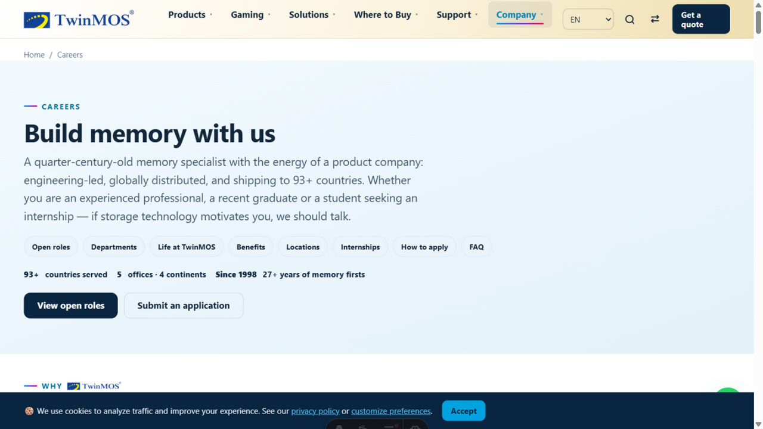
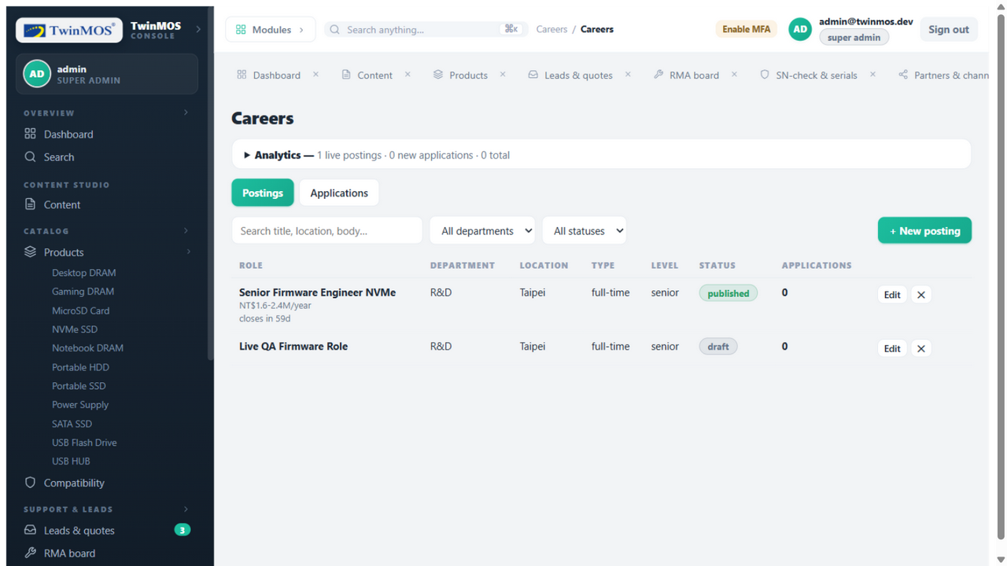
Talent Acquisition
A careers page that recruits while you sleep
Structured listings
Department, location, type and salary band — managed in the console, live instantly
Application pipeline
Applications arrive as leads with résumé attachments and route through the same SLA workflow
Employer brand
Culture, benefits and open roles presented with polished, agency-grade design

Slide 20
MARKET REACH
One platform, nine languages, every customer
English
العربية (RTL)
हिन्दी
Русский
简体中文
Français
Español
Português
Deutsch
Locale framework built-in
Every page emits hreflang alternates — search engines serve the right language automatically
RTL verified
Arabic renders right-to-left correctly, including navigation and forms
Regional channel pages
Where-to-buy and partner directories localised per market from one console
Ready to expand
Adding a tenth language is configuration, not a rebuild

Slide 21
Roadmap & Next Steps
From delivery to market leadership
1
2
3
4
Cloud go-live
Measure & optimise
Amplify marketing
Deepen integrations
Deploy to production using the verified runbook — DNS cutover to the new platform. Effort: days, not weeks.
Enable analytics and search-console instrumentation; baseline conversion on the 15 form types.
Launch the anti-counterfeit verifier as a campaign; syndicate product data to marketplaces and search.
Connect the API to ERP / CRM; expand the partner portal with pricing and MDF workflows.
Ready now
Week 1–2
Week 2–6
Quarter 2
Decision requested today: approve phase 1 — the deployment runbook, secrets checklist and 10-chapter technical manual are already delivered.

Slide 22
Thank You
Let’s take TwinMOS to every customer — on every channel, in every language,
protected by technology no competitor offers today.
28
15
9
253
0
pages
modules
languages
tests
findings
UNISOFT SYSTEM LTD
Prepared for TwinMOS Management · October 2026

