Slide 1
UNISOFT SYSTEMS LIMITED
ULMS
Unisoft Loan Management System — Technical Overview
Bank-grade lending for Bangladesh scheduled banks · Staff web · Borrower app · Field app · Fineract core
16 modules · 162 REST endpoints · 18 migrations
193 Java tests · 44 e2e journeys · 12 runbooks
October 2026

Slide 2
AGENDA
What this deck covers
01
System at a glance
05
Quality gates
KPIs, scope, architecture
311 tests across five suites
02
Technology stack
06
The three apps
Binding stack v3 — every layer
Staff web · borrower · field
03
Modules & functions
07
Deploy · enhance · secure
All 16 backend modules
Environments, extension recipe, controls
04
Regulatory engine
08
Boundaries & roadmap
BRPD 15/2024 · ECL · Basel · AML
What is externally bound, what is next
ULMS v2.0 · October 2026
2

Slide 3
SYSTEM AT A GLANCE
The program in seven numbers
16
162
18
193
44
2
12
backend modules
REST endpoints
Flyway migrations
Java tests (last full)
e2e journeys
mobile apps shipped
ops runbooks
Modular monolith by binding decision — one deployable unit, module boundaries enforced by Spring Modulith. Apache Fineract CE is the immutable loan subledger; ULMS mirrors state for BRPD boards and projections. Build stage complete; bank cutover items follow the RB-11A flip runbook.
ULMS v2.0 · October 2026
3

Slide 4
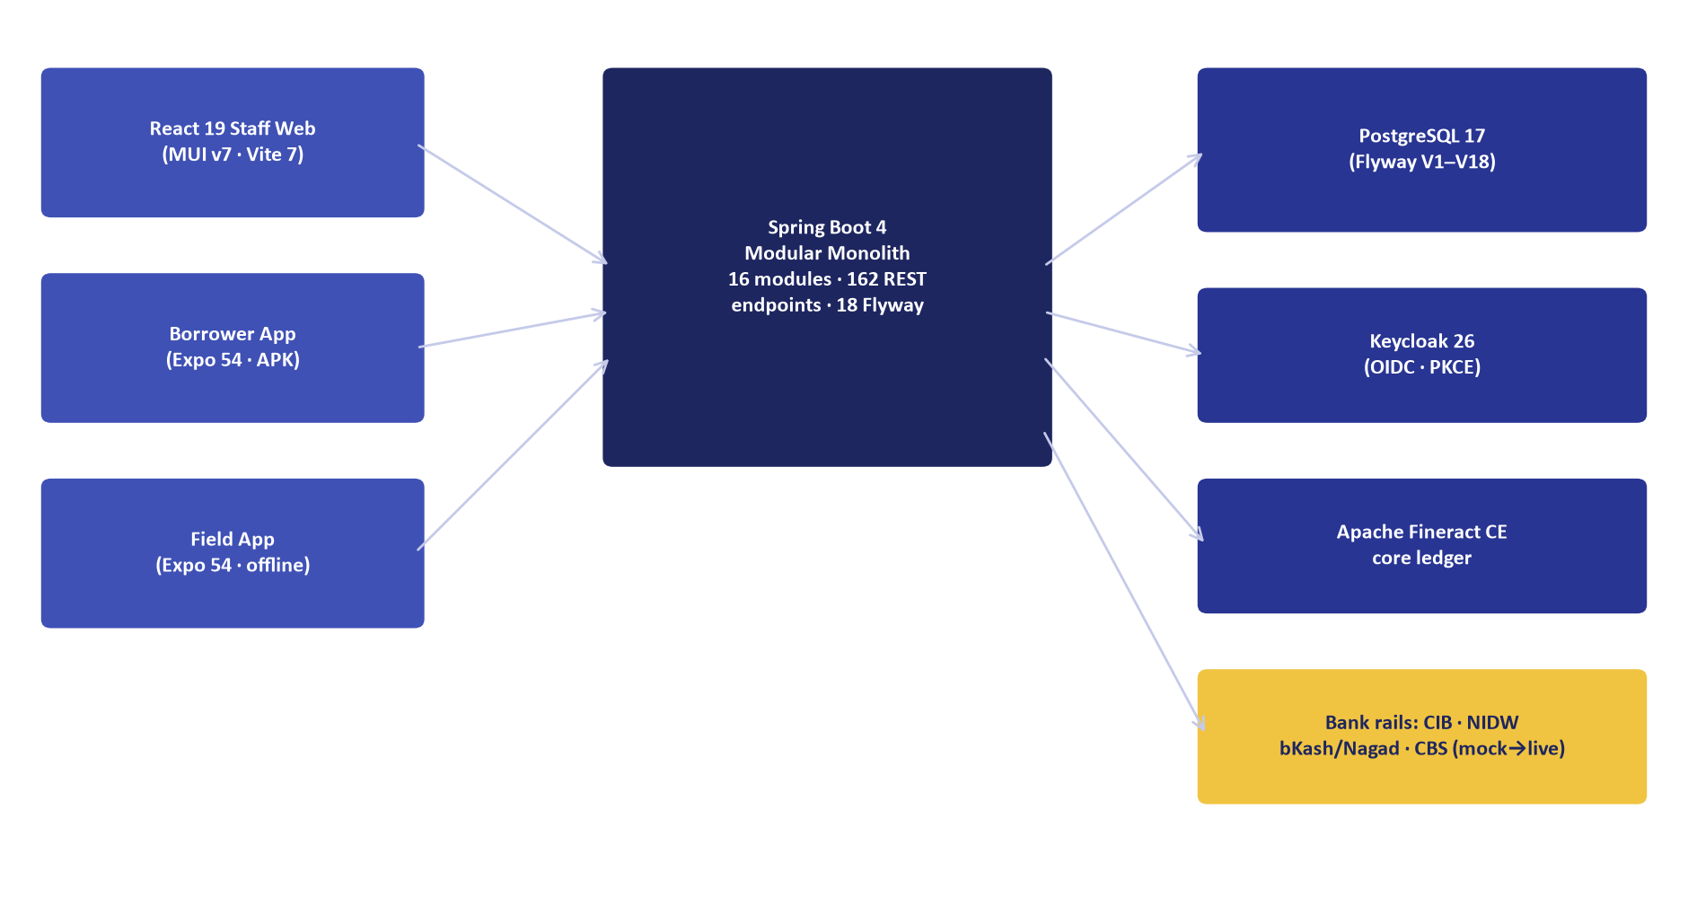
ARCHITECTURE
Three clients · one modular monolith · bank cores
Key decisions
Modular monolith (stack v3) — cycles broken with owned ports
Contract-first mock drives 44 e2e tests without Docker
Live adapters profile-gated (cib-live, rails-live …)
nginx same-origin: /api, /realms (Keycloak), /hooks
Source: component diagram generated from repo structure (SOURCES.md, Marketing/exhibits/E1).
ULMS v2.0 · October 2026
4

Slide 5
TECHNOLOGY STACK
Binding Technology Stack v3 — every layer
Layer | Technology | Notes
Backend | Java 21 · Spring Boot 4 · Gradle 8 | Modular monolith · Spring Modulith
Database | PostgreSQL 17 · Flyway | 18 migrations V1–V18 · JPA validates only
Identity | Keycloak 26 · OIDC + PKCE | Realm ulms · direct-grant MFA login
Staff web | React 19 · MUI v7 · Vite 7 · TS 5.8 | Dynamics-365 shell · bilingual EN/BN
Mobile | Expo 54 · React Native 0.81 | Borrower (signed APK) · field (offline-first)
Core ledger | Apache Fineract CE (pinned SHA) | Loan lifecycle subledger
Ops | Compose → k3s · Helm · Prometheus/Grafana | 6 CI stages · 14 jobs (GitLab)
Contract | OpenAPI 3.0 (redocly-valid) | 140 documented paths
ULMS v2.0 · October 2026
5

Slide 6
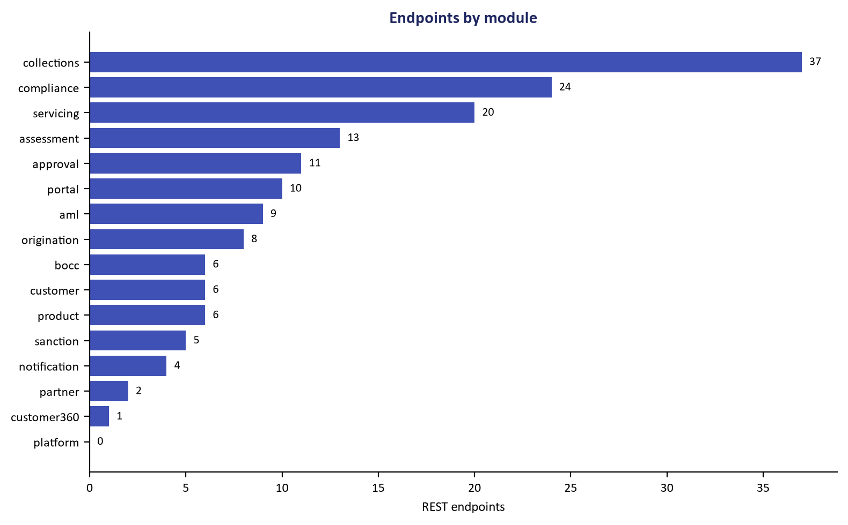
MODULES & FUNCTIONS
16 modules — where the endpoints live
37
24
Collections
Compliance
20
13
Servicing
Assessment
11
10
Approval
Portal
9
8
Counts from the structured repo sweep (SOURCES.md). Collections & compliance dominate by design — delinquency and regulatory reporting are the deepest domains.
AML
Origination
ULMS v2.0 · October 2026
6

Slide 7
WORKFLOW
Credit-to-cash: application to money in seven steps
1
2
3
4
5
6
7
Draft
CIB pull
CPV gate
Ladder
Sanction
Dual-auth
Disburse
Product bounds + DBR ≤50% enforced server-side
Cached 1h · 429 never retried · circuit breaker
Field/branch verification gates the ladder
Amount-derived level · maker-checker at L1
Letter with tokenized acceptance link
Prepare ≠ authorize ≠ release
Fineract posts · ULMS mirror · STR if ≥৳10L
Nightly EOD (23:30 Dhaka) then reclassifies the book: DPD recompute → BRPD stage → provision JV → interest suspense (SS+) → board & IFRS-9 refresh.
Source: workflow trace in code — OriginationService.java, ApprovalService.java, DisbursementService.java, EodBatchService.java.
ULMS v2.0 · October 2026
7

Slide 8
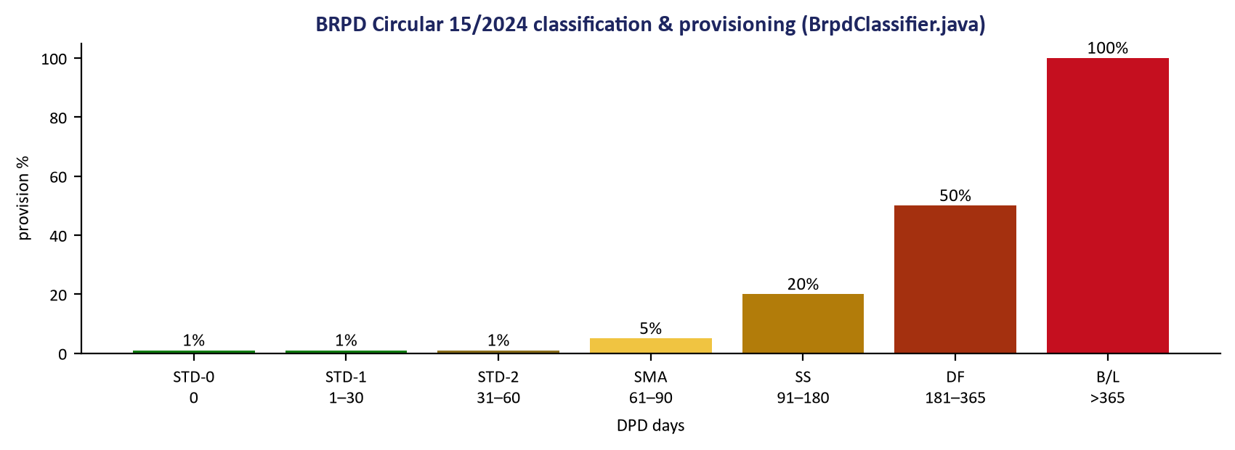
REGULATORY ENGINE
BRPD Circular 15/2024 — classification & provisioning
Also implemented and tested
IFRS-9 ECL staging (EclModel.java)
Basel III CAR + RWA by segment + parallel-run harness
BFIU AML: STR ≥৳20L cash, CTR, goAML XML export
12-return Regcon catalog · WORM packs · maker-checker sign-off
Interest suspense applies from SS onward; ≥EMI payments regularize DPD (demoed live in the borrower app demo mode). Boundaries locked by BrpdBoundaryLockTest — DF ≤365 / B-L >365 move only together.
Source: BrpdClassifier.java, EclModel.java, BaselParallelRunService.java, AmlController.java.
ULMS v2.0 · October 2026
8

Slide 9
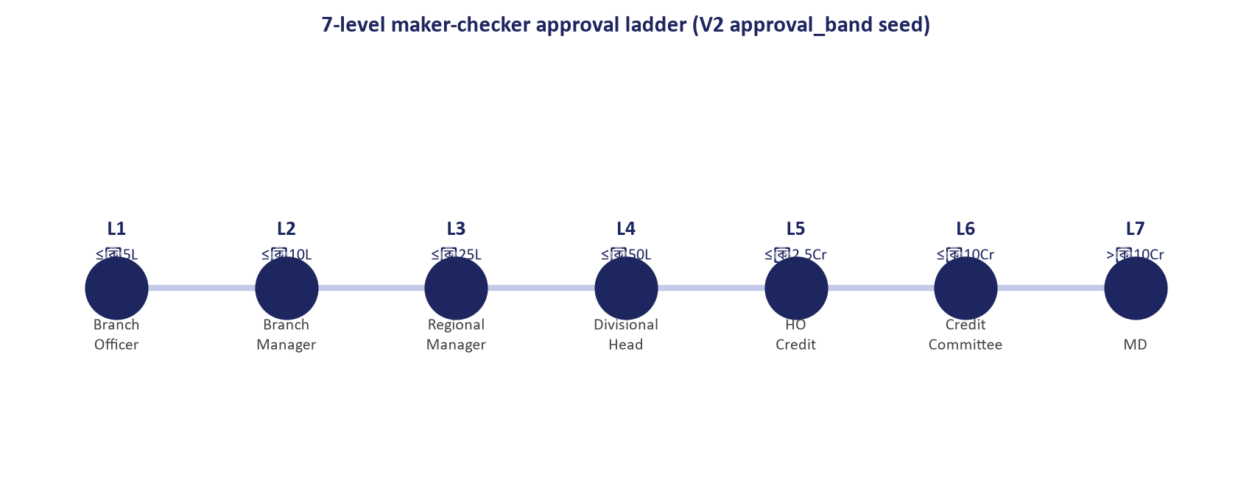
APPROVAL LADDER
Seven levels, configured — not coded
L1 nodes are maker-checker dual; SLA 48h/level with 02:15 nightly auto-escalation. DELEGATE moves a task to a peer (assignee-only gate after); APPROVE_WITH_CONDITIONS records conditions precedent that block disbursement until SATISFIED or WAIVED. Bands live in approval_band (V2 seed) — the bank retunes limits with a data change.
Source: V2__origination_workflow.sql:98-105, SlaService.java, Q1DelegateConditionsTest.java.
ULMS v2.0 · October 2026
9

Slide 10
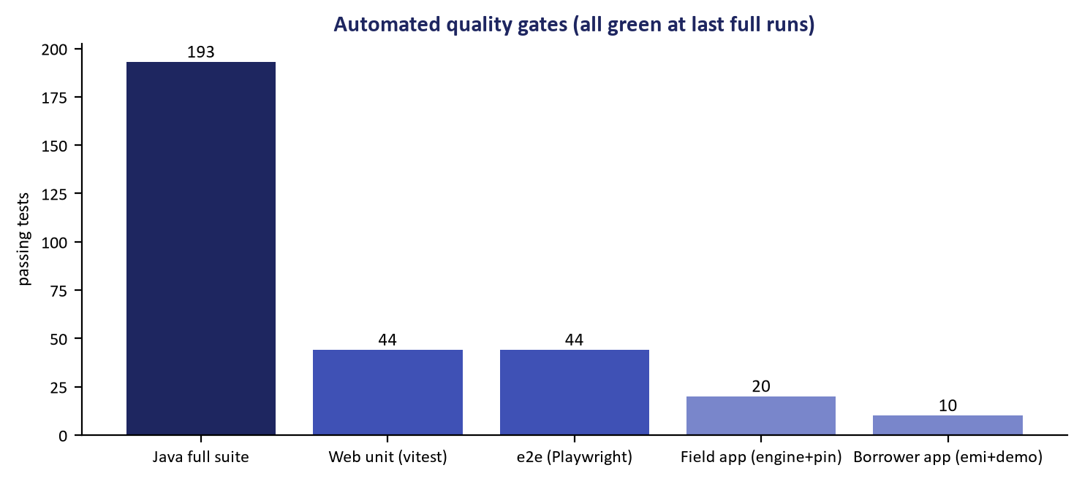
QUALITY GATES
311 passing tests across five suites
Java
193 / 52 suites
Web unit
44
e2e
44
Field app
20
Borrower app
10
Java suites run in Docker (gradle:8-jdk21 + Testcontainers PG17 — CI parity). The e2e suite includes a WCAG 2.1 AA axe gate over 7 surfaces; the build reproduced the release APK byte-identically (deterministic pipeline).
ULMS v2.0 · October 2026
10

Slide 11
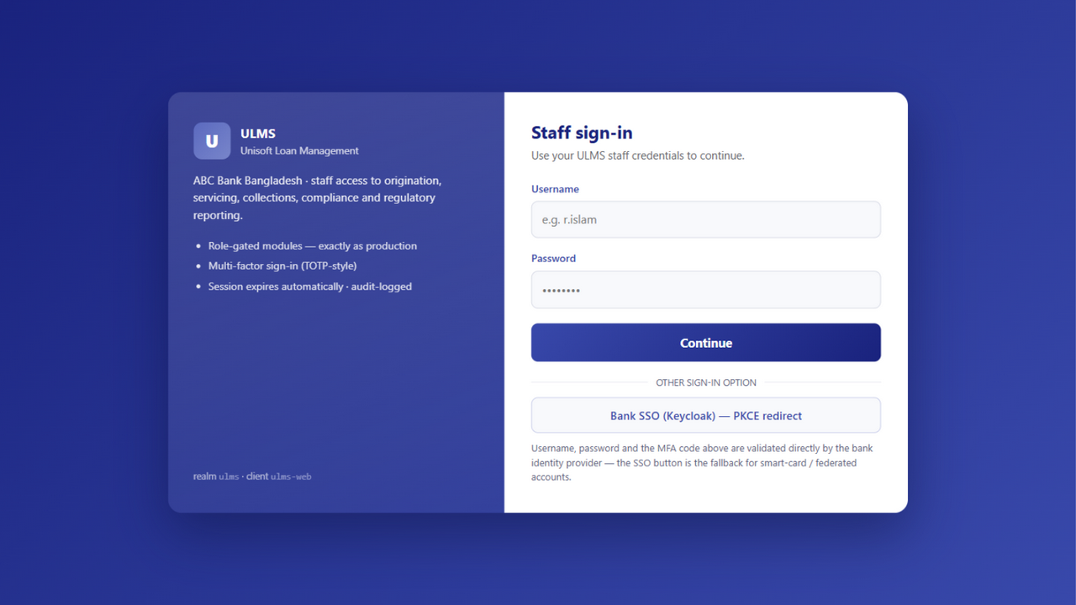
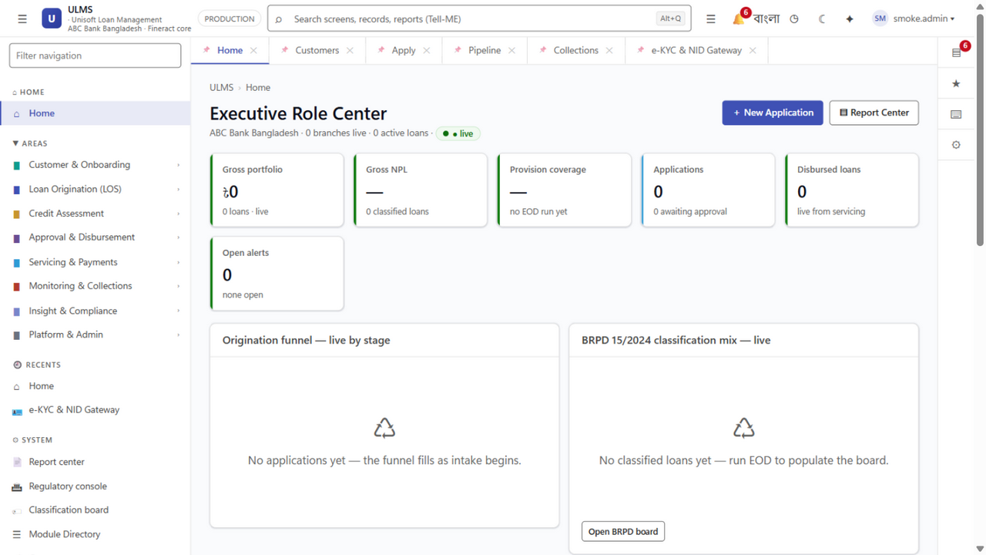
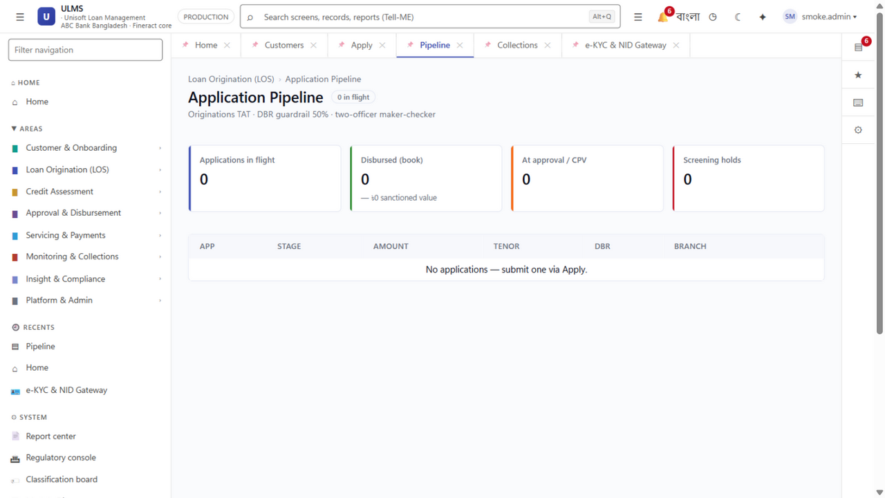
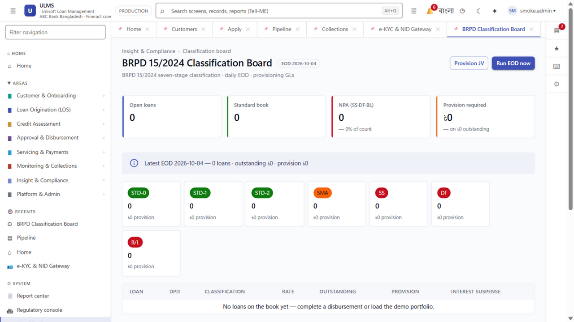
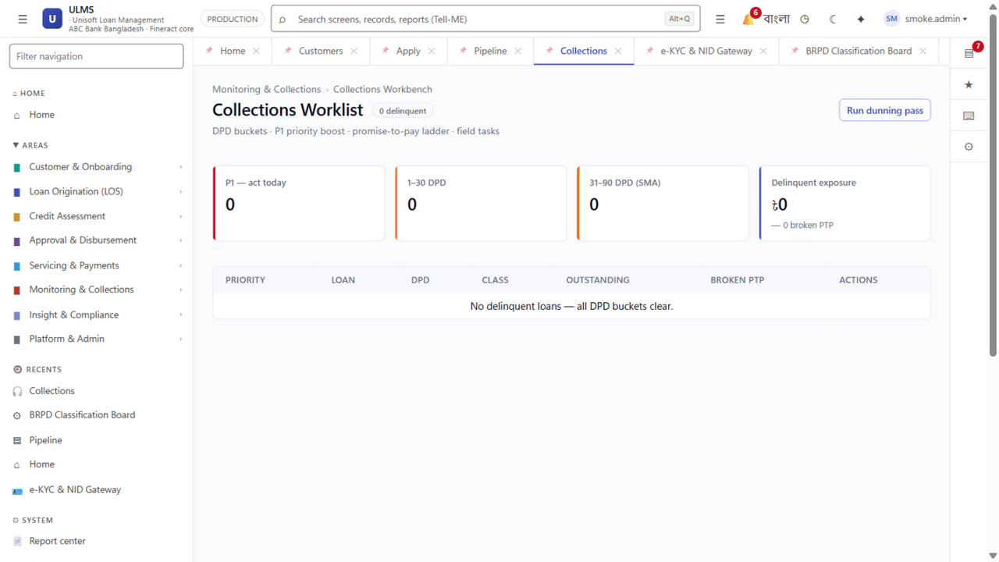
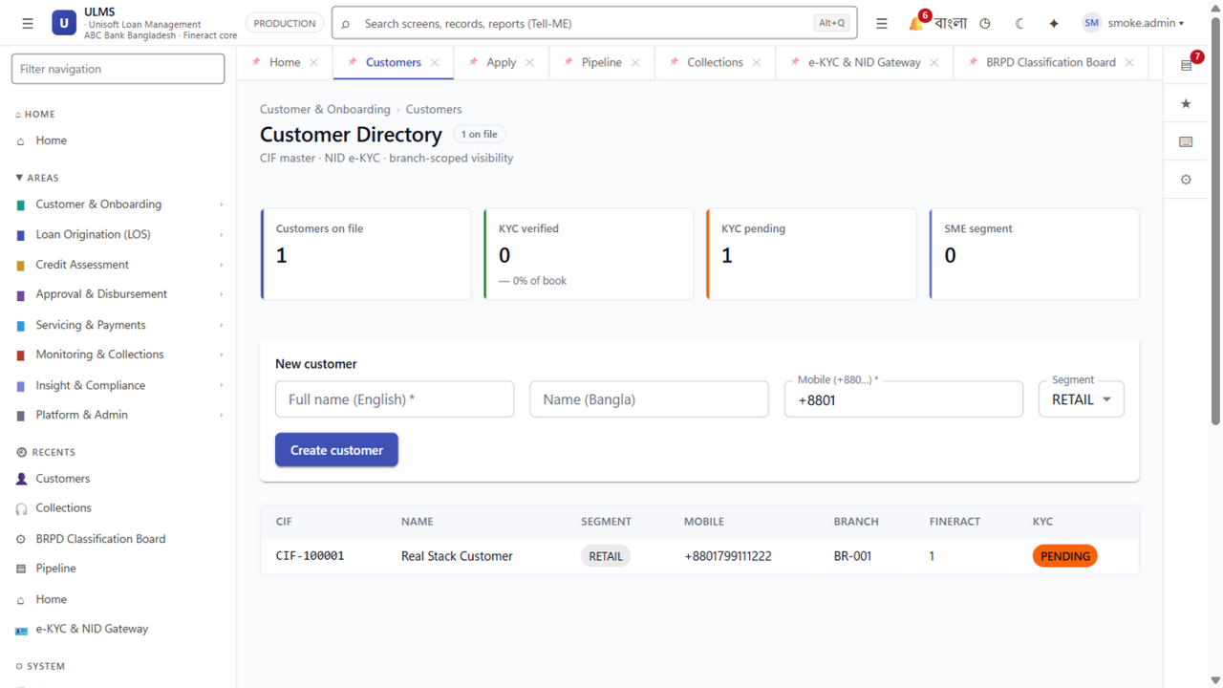
THE THREE APPS · STAFF WEB
Production staff cockpit — real Keycloak session
Sign-in: creds → MFA (Keycloak direct grant)
Home — environment chip reads PRODUCTION
Pipeline — stage chips, DBR, drawer
BRPD classification board
Collections workbench — PTP, dunning
Customer master — branch-scoped
ULMS v2.0 · October 2026
11

Slide 12
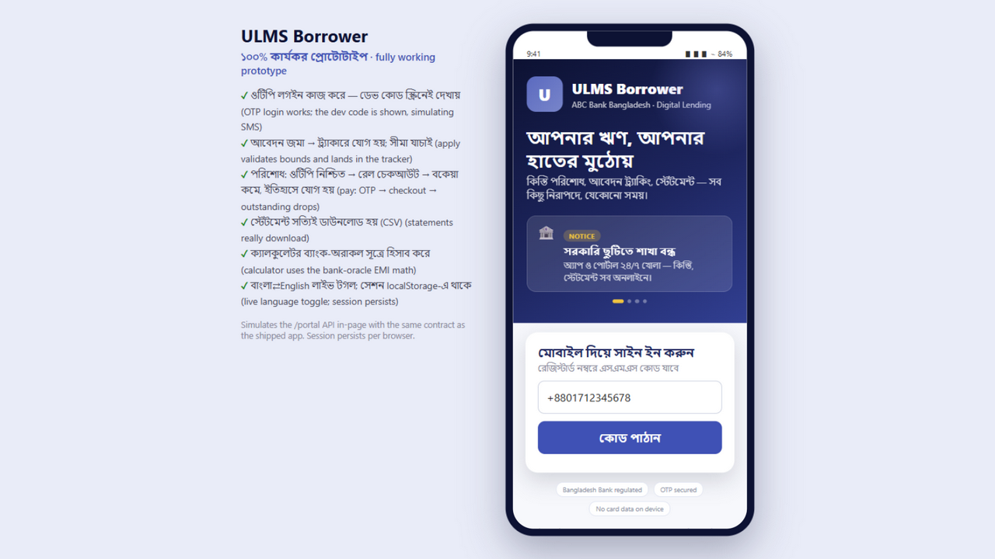
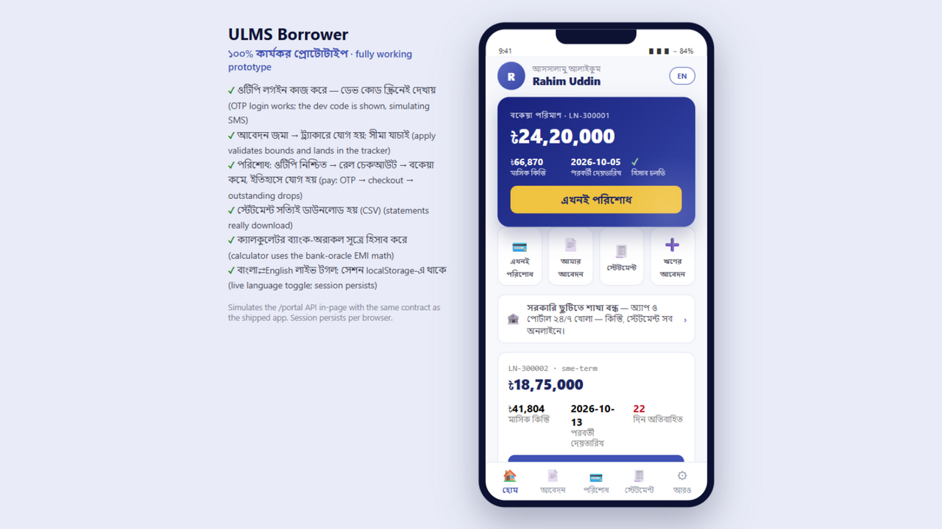
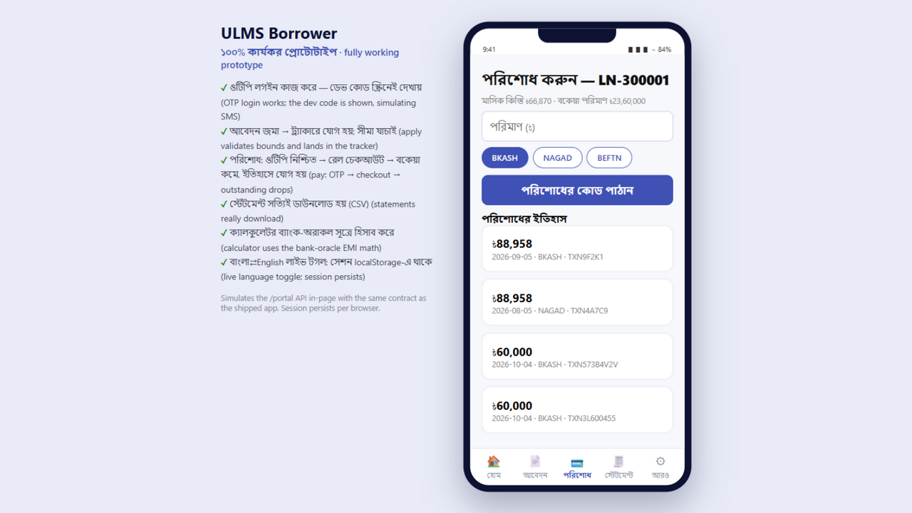
THE THREE APPS · BORROWER MOBILE
Signed Android APK — runs standalone in demo mode
OTP sign-in — code auto-fills (demo simulates SMS)
Home — hero balance card, EMI, DPD, quick actions
Pay — rail chips + OTP confirmation
com.uslbd.ulmsborrower v0.1.0 · minSdk 24 · apksigner v2/v3 verified · arm64 Hermes
No backend set → embedded prototype simulation; set EXPO_PUBLIC_API_BASE → real /portal
iOS: verified Xcode project shipped — IPA needs Mac/EAS per Apple licensing
ULMS v2.0 · October 2026
12

Slide 13
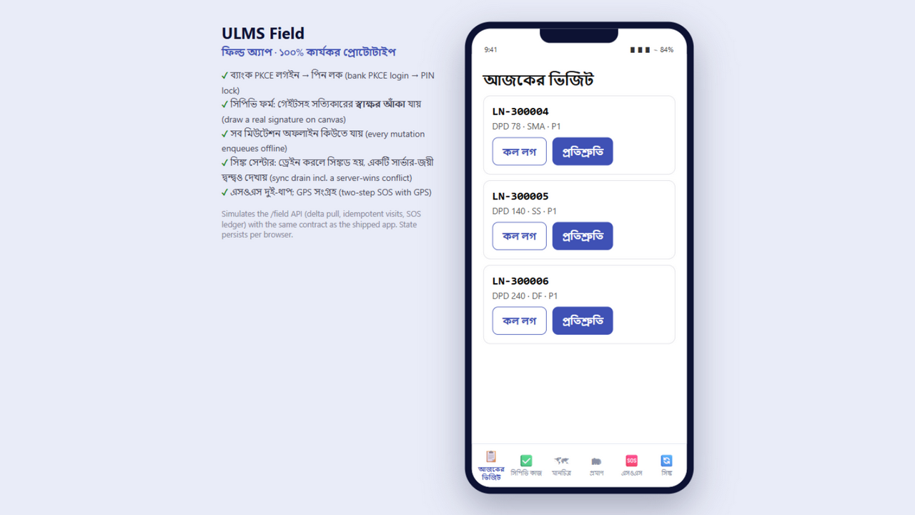
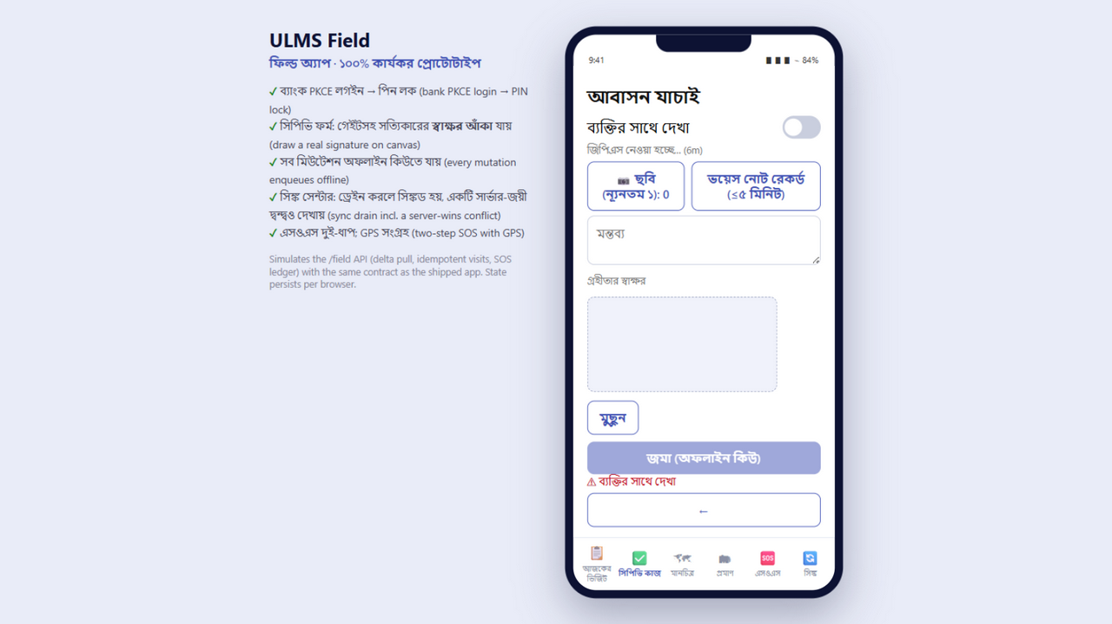
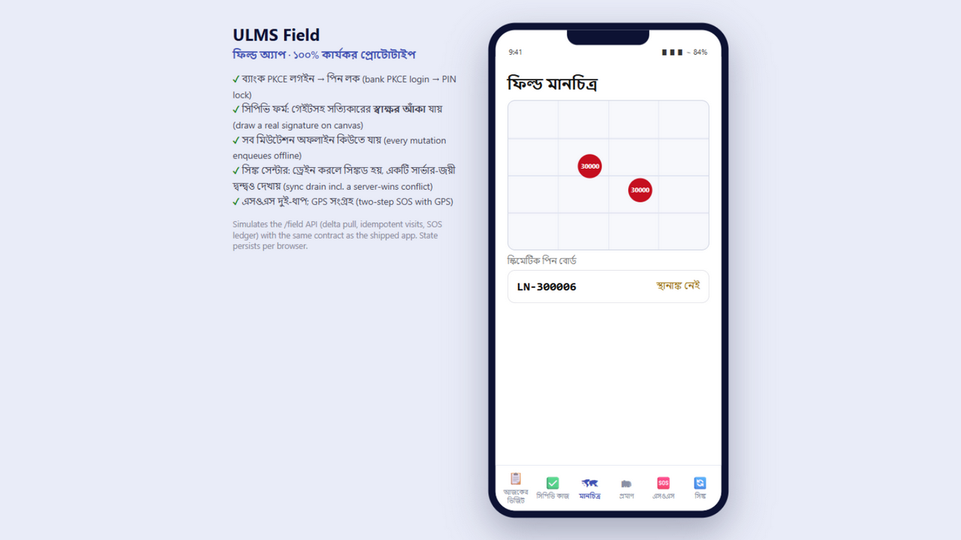
THE THREE APPS · FIELD MOBILE
Offline-first verification — evidence never lost
Bank PKCE sign-in + security notices
CPV form — signature canvas, GPS gate, voice ≤5 min
Field map — borrower task pins
Visits idempotent by clientUuid · task state is server-wins · evidence append-only
App-PIN lock (salted hash) + two-step SOS that never silently drops
Dedicated /field gateway: delta pull with bundleVersion, visits, PTP, SOS + ack desk
ULMS v2.0 · October 2026
13

Slide 14
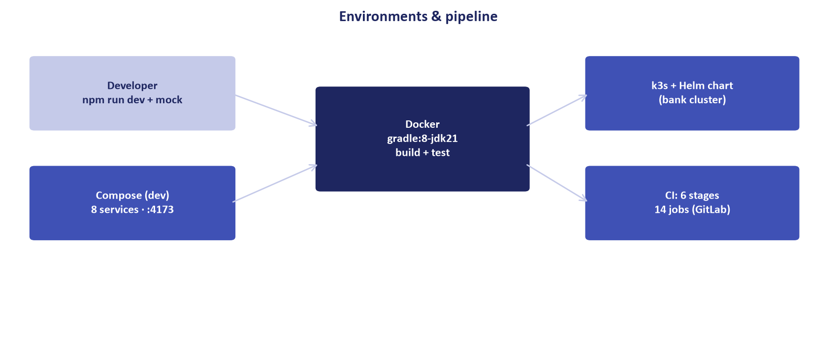
DEPLOYMENT
Three environments, one pipeline
Get running
npm run mock:api && npm run dev # zero-Docker dev
docker compose up -d # 8-service verification
helm upgrade --install ulms deploy/chart/ulms --atomic
10 scheduled jobs (SLA */15 · EOD 23:30 · WORM 02:00 · dunning 06:00 …)
12 runbooks incl. RB-11A flip matrix — mock→bank is values-only
Mobile: build-apk.sh one command → signed APK (byte-identical rebuild proven)
ULMS v2.0 · October 2026
14

Slide 15
SECURITY & COMPLIANCE
Controls a regulator can trace
Identity
Authorization
Dual control
Keycloak OIDC · PKCE · MFA on staff login · SSO secondary
Role gates per endpoint · ladder-level gates · own-CIF portal rows
Maker-checker ladder · triple-gated disbursement · SOS ledger
Audit
Secrets
Regulatory
WORM audit_entry on every mutation · signatures on approvals
Env/Vault only — zero usable literals in the repo (scanned)
BRPD · IFRS-9 · Basel III · BFIU AML (STR/CTR/goAML) · 12 returns
Plus: CSP + nosniff + XFO on the web tier · WCAG axe gate in CI · bilingual incl. Bangla numerals.
ULMS v2.0 · October 2026
15

Slide 16
ENHANCEMENT & EXTENSION
The six-step vertical-slice recipe
1
Entity + Flyway V19+
2
Repository + service
3
Controller + OpenAPI
JPA validates; never generates
Rules + @PreAuthorize + Testcontainers test
redocly must stay valid
4
Mock route
5
Clients + screens
6
Suites green
Contract parity for Docker-free e2e
Web API client · mobile where needed
Touched suites rerun in Docker
Reference slices in repo: collections watchlist + auctions (V17) and the field gateway (V18) each added table → service → controller → spec → mock → screen in one commit series.
ULMS v2.0 · October 2026
16

Slide 17
BOUNDARIES & ROADMAP
Stated plainly — nothing hidden
Externally bound
CIB/NIDW/rail/CBS credentials · clustered Keycloak · bank CI runner · EAS/MDM signing. Mechanism: values-only RB-11A flip.
Deferred by decision
Multi-tenancy (D3) · Islamic Murabaha (phase 4) · outbox→Kafka · websockets. Revisit triggers documented.
UX-contract scope
~120 prototype archetype screens remain badged reference layouts; conversion = the analytics workstream.
Environment
Local Docker Desktop is crash-prone under build load — always-on demo should move to the bank k3s cluster.
ULMS v2.0 · October 2026
17

Slide 18
Build stage: complete.
Deployment execution and bank-bound cutover follow the go-live checklist and the RB-11A flip runbook.
Full technical documentation: ULMS_v2_Technical_Documentation.docx (34 tables, 18 exhibits, provenance map)
Every claim traceable via SOURCES.md — re-verify in minutes
Working prototypes: localhost:8791/prototype (borrower) · /prototype/field (field ops)
Unisoft Systems Limited · October 2026

