Slide 1
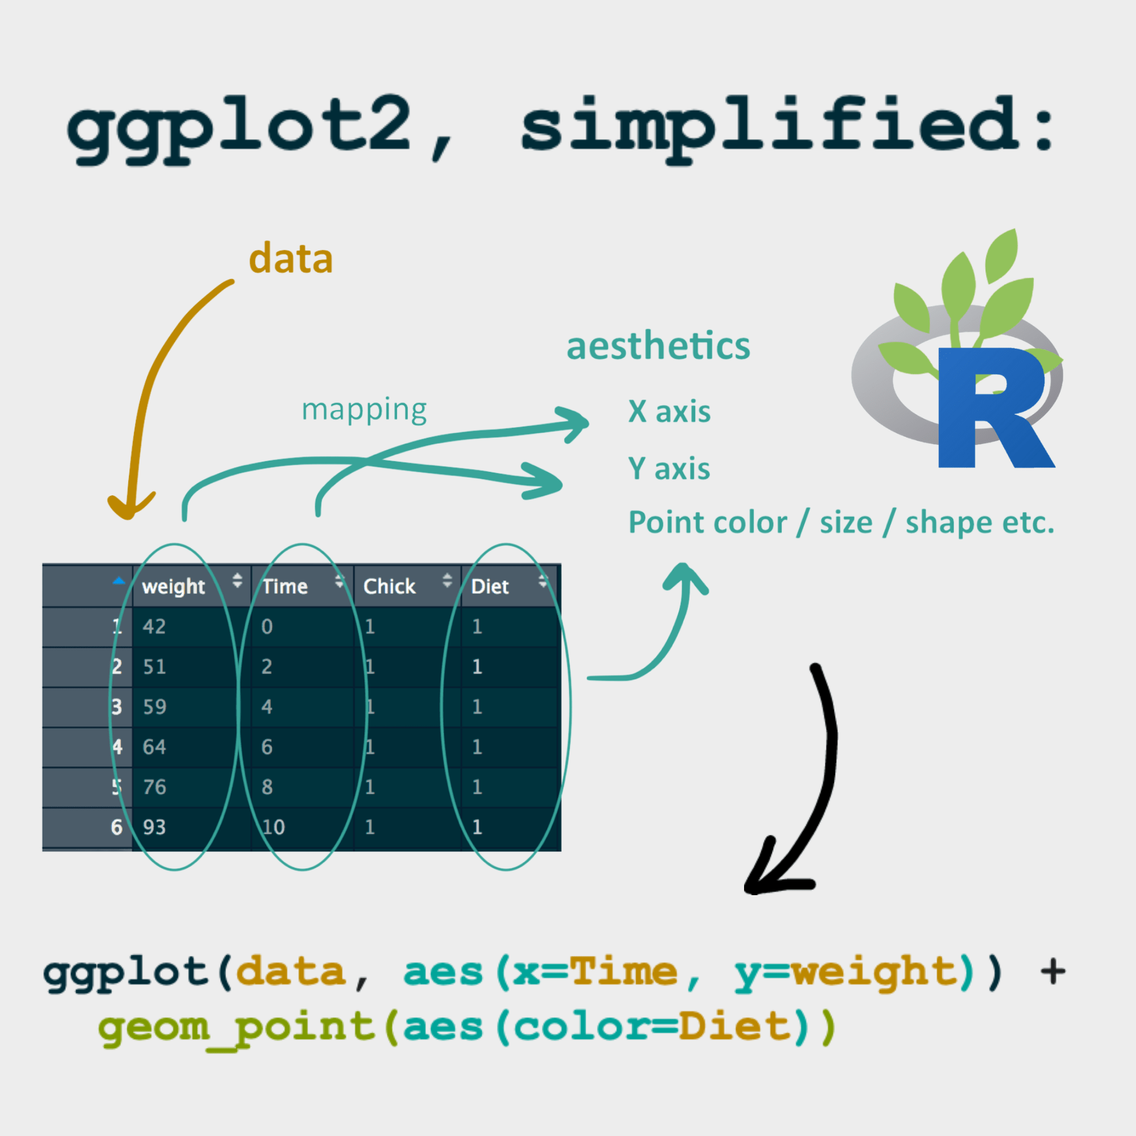
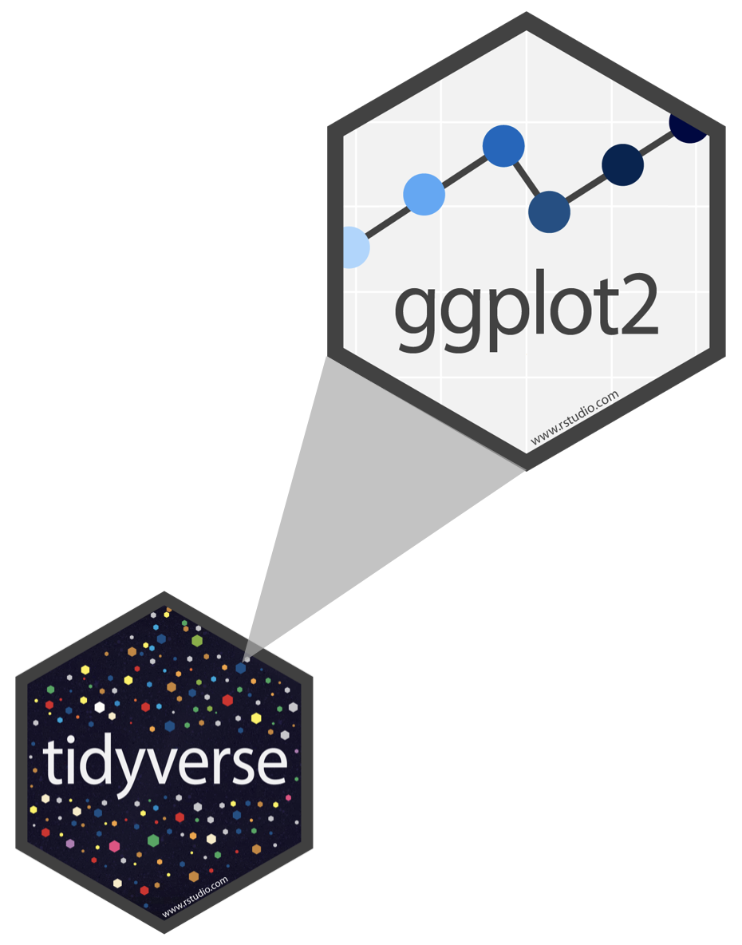
Exploratory Data Analysis: Sociodemographic Patterns and Trends
Harnessing the Power of Exploratory Data Analysis
By Mazafer Ul-Raqib (1622509)
References
Cairo, A. (2013) The Functional Art: An introduction to information graphics and visualization. New Riders.
Dent, B.D. (1999) Cartography: Thematic Map Design. McGraw-Hill.
Few, S. (2009) Now You See It: Simple Visualization Techniques for Quantitative Analysis. Analytics Press.
Heer, J. and Bostock, M. (2010) 'Declarative Language Design for Interactive Visualization', IEEE Transactions on Visualization and Computer Graphics, 16(6), pp. 1149-1156.
Kelleher, C. and Wagener, T. (2018) Ten Guidelines for Effective Data Visualization in Scientific Publications, Environmental Modelling & Software.
Knaflic, C.N. (2015) Storytelling with Data: A Data Visualization Guide for Business Professionals. Wiley.
Tufte, E.R. (2001) The Visual Display of Quantitative Information. Graphics Press.
Wickham, H. (2016) ggplot2: Elegant Graphics for Data Analysis. Springer.

Slide 2

Overview
Our study navigates the socioeconomic terrain through varied data visualizations that dissect the influences of age, income, and education:
3D Scatter Plot: Drawing from Tufte's (2001) quantitative insights, this plot reveals the impact of education on income across age groups.
Bubble Chart & Violin Plot: These visualizations, grounded in Knaflic's (2015) storytelling principles, uncover gender-based economic disparities over time.
Heatmap: Enhanced by Few's (2009) techniques, it lays bare systemic inequities by showing unequal income opportunities across ethnicities, even with similar education levels.
Donut Chart & Stacked Bar Chart: These embrace Cairo's (2013) functional art ethos, displaying marital status distributions alongside intersections with income and gender.
Parallel Coordinates Plot: Clarifies complex socioeconomic relationships, while the Lollipop Chart and Area Plot, informed by Wickham's (2016) layered visualization approach, depict non-linear connections between education and income.
Interactive Histogram Age Distribution: By displaying the age distribution of your dataset, this could serve as an introduction visualisation, providing context.Fundamental understanding of the demographic distribution—a critical component in comprehending socioeconomic dynamics—would be possible with the help of this histogram.
Interactive Boxplot: Distribution of Income according to Education Level After the 3D Scatter Plot of Age, Income, and Education Level, arrange this visualisation. The boxplot will provide a more thorough understanding of how income fluctuates across various educational levels, hence enhancing the scatter plot.It might be interpreted as a thorough examination of one of the features that the scatter plot emphasises.
Interactive Stacked Area Chart: Distribution of Education Levels by Age Group This can be placed in front of the violin plot and bubble chart. The stacked area chart can help to advance the narrative by illustrating how educational attainment changes across different age groups, bringing another level of knowledge to the observed income differences, even though these maps highlight gender-based economic disparities.
However, as Kelleher and Wagener (2018) caution, our dataset has limitations, such as static views and binary gender representations that fall short of capturing the full dynamism of socioeconomic status. These visual narratives, rich in data, are indicative trends, not definitive truths.

Slide 3


Insights, patterns and perspectives
Diverse Sociodemographic Insights Through Interactive Visualizations
Through a succession of interactive visualisations, each presenting a different aspect of the data and enabling viewers to explore into the details of the material given, our examination of socioeconomic patterns takes shape.
Introduction
Data visualisation is essential in the digital age for understanding complex information. Ways that we present and analyse data have been revolutionised by pioneers such as Cairo, Tufte, and Wickham. This paper examines ten interactive visualisations and evaluates how well they represent economic and demographic data. To assess each visualization's communicative effectiveness and conformance to accepted visualisation principles, it is evaluated against the backdrop of influential works in the area.
Visualization 1: Interactive 3D Scatter Plot of Age, Income, and Education Level
A three-dimensional tour of the main socioeconomic factors is provided by this plot. Rotating the perspective allows users to observe how society structure is created by factors such as age, income, and education level, with each data point acting as a beacon indicating a different story inside the greater narrative. Use interactivity to analyse multivariate datasets, keeping in mind Cairo's focus on the practicality of art. According to Tufte, 3D scatter plots with parallel coordinates reveal data complexity without being too overwhelming for the viewer.
Visualization 2: Interactive Bubble Chart of Income vs. Age by Gender
Here, the differences in income between genders in various age groups are highlighted. A dynamic picture of the intersectionality between these variables is given by the size and location of each bubble, which sheds light on the ways in which income paths diverge and converge over the course of a lifetime. Represent Few's ideas of simplicity by employing stacked and bubble bar charts to effectively illustrate relationships between gender and wealth differences.
Visualization 3: Interactive Heatmap of Income Distribution by Ethnicity and Education
This heatmap uses education and ethnicity as its axes to show a colourful array of income distribution. The concentration of income levels is reflected in the colour intensity, creating a striking image of social inequality. Uses a heatmap to depict the distribution of income, a method Dent approves of since it effectively correlates ethnicity and education through a spatial metaphor of data landscapes.
Visualization 4: Interactive Donut Chart - Marital Status Distribution
By dividing the population into marital status categories, the donut chart highlights the patterns and percentages that characterise contemporary social structures. Users can delve further into each section for more specific information thanks to interaction. Kelleher and Wagener defend the donut chart, despite its frequent controversy, for its space-efficient representation of the proportions of marital status.
Visualization 5: Interactive Stacked Bar Chart - Income Distribution by Marital Status and Gender
The stacked bars further break down the income distribution by overlaying marital status and gender to show how these characteristics interact to create various income categories.
Visualization 6: Interactive Histogram - Age Distribution
A detailed look at the demographic profile is provided by an age distribution histogram, which is crucial for comprehending and making plans for the population's present and future needs. In keeping with Knaflic's storytelling with data methodology, the histogram makes age distribution analysis easier to understand while maintaining insight.
Visualization 7: Interactive Parallel Coordinates Plot - Multivariate Analysis
By tracing numerous socioeconomic indicators at once using parallel coordinates, users can uncover intricate correlations and patterns that may be missed in less dynamic representations.
Visualization 8: Interactive Area Plot - Income Distribution Over Age
The area map shows the distribution of income among age groups, highlighting significant phases of economic growth and possible stagnation. It also depicts the lifespan of wages. Area plot, which maps income distribution over age with beauty and precision, pays homage to Wickham's exquisite ggplot2 aesthetics.
Visualization 9: Interactive Boxplot - Income Distribution by Education Level
A statistical representation of the relationship between education level and income distribution can be obtained from a boxplot, where the range and interquartile spread of wages are indicated by boxes and whiskers. Income by education is highlighted with a boxplot, which demonstrates the analytical depth that Heer and Bostock valued and offers quick visual signals to data variation and distribution.
Visualization 10: Interactive Stacked Area Chart - Education Level Distribution by Age Group
The distribution of education levels across age groups is finally broken down in the stacked area chart, which offers insights into the geography of educational attainment throughout time.
The assessed visualisations show a deep regard for the guidelines provided by the cited authors. They provide a deeper understanding and a richer narrative by not only making difficult data easier to interpret but also making it easier to identify patterns and outliers. The ultimate purpose of data visualization—to inform and enlighten—is achieved by the harmonious combination of interactive features and fundamental visualisation principles, which efficiently bridges the gap between data complexity and analytical insight.

Slide 4

Key findings
Following an initial examination of the dataset, the following are some significant conclusions:
Age and Income: There are 27,410 items in the dataset, and their ages range from 0 to 93. About 36 years old is the average age. The average salary for the 21,237 entries in the income data—some of which may be missing—is roughly $27,766, and a large standard deviation suggests that there is a big variance. With a typical income of $18,000, incomes vary from $0 to $720,000.
Marital Status: Of the population, 54.75% are married, 26.36% have never married, 10.24% are divorced, 6.61% are widowed, and 2.05% are separated.
Gender: There is a virtually equal distribution of males and females (51.38% and 48.62%, respectively), which is helpful for performing a gender-based study within the socioeconomic environment.
Ethnicity: White people make up the majority (69.06%), followed by Asian people (12.94%), Black people (11.47%), Hispanic people (3.41%), and other people (3.11%).
Education Level: 39.22% of the persons in the dataset have never completed secondary school. 21.92% of the population is made up of graduates from secondary schools, 21.79% have some higher education (HE), 11.11% have a bachelor's degree, and 5.95% have a master's degree or above.
These distributions offer an insight into the sociodemographic environment that the dataset captures. They show a range of educational backgrounds, nationalities, and marital circumstances. The great variation in salaries and how widely they are distributed point to economic inequalities that interactive visualisations might be used to further investigate.

Slide 5

Narrative and Critique
The Narrative of Data – A Socio-Economic Exploration
The Cartography of Socio-Economics: The wide expanse of socioeconomic data is where our analytical journey begins, analogous to a cartography masterpiece where the boundaries of societal standing are defined by age, money, and education. Our compass serves as the third dimension in an Interactive 3D Scatter Plot, allowing us to visualise Dent's (1999) lessons on cartographic design by projecting light and shadow onto our thematic map through charts and pixels. Cairo (2013) advises us to present data in a way that is not only accurate and understandable but also visually captivating and educational. Our journey takes us across the peaks of wealth and the valleys of poverty, a journey across a social rather than a physical terrain.
Education as the Compass to Prosperity The Interactive Parallel Coordinates Plot in our story reveals the complex relationship between wealth and academic achievement. As a navigational aid, the visualisation shows the trajectory and gradient of an individual's socioeconomic rise, emulating Tufte's (2001) concept of "detailed visualisation of quantities," in which each line winds through the variables and becomes thicker with increasing educational attainment. However, this rise is not straight-line; rather, it fluctuates, mirroring Few's (2009) observations on the visualisation of numerical data and illuminating the complex relationship between social status and education.
The Gender Disparity Narrative A moving story is told through an Interactive Bubble Chart of Income vs Age by Gender. The gender pay gap is a hotly debated topic that is visually represented as a lifespan with peaks and troughs, progression and plateau. The focus placed by Heer and Bostock (2010) on the use of declarative language in visualisation allows us to highlight the significant differences between the economic paths of men and women. With its diverging and convergent trajectories, the chart depicts a history of systemic gender disparity through two distinct stories of income crests.
Ethnicity at the Economic CrossroadsStories of inequality abound in the Interactive Heatmap of Income Distribution, which sits at the intersection of ethnicity and research. Wickham (2016) makes a significant contribution here, since our story is based on his idea of beautiful visualisations for data analysis. The heatmap is more than just a statistical plot; it's a silent conversation about the structural roots of socioeconomic inequality. It illustrates the intersection where education and ethnicity drive economic growth for some and serve as a narrow channel of wealth transfer for others.
The Economic Elevation of Education The Interactive Boxplot of Income Distribution by Education Level, our story's climax, tells the story of individual economic stories shaped by educational attainment through each box and whisker. This data visualisation embodies Cairo's (2013) concept of "functional art," combining practicality and aesthetics to highlight the dual role that education plays in fostering economic development and serving as a safeguard against poverty.
The Silhouettes of Data – Critiquing the Unseen
Even while our investigation of the socioeconomic environment is thorough and analytical, it is not without flaws. The dataset, our principal raconteur, is silent on a number of important issues. Here, Tufte's (2001) warning about misinterpreting data is relevant, as the omissions in our dataset create a long shadow. The broad definitions of race and marital status ignore complex identities, and our study has blind spots due to the lack of indicators for cost of living and geography.
Data storytelling, as Knaflic (2015) incisively notes, is about both the narratives we intentionally create and the ones we unintentionally ignore. We object to the dataset's noteworthy gender approach, which blurs the complex range of gender experiences by reducing a rich tapestry of gender identities to a binary.
Even though they are striking to look at, visualisations like our heatmap only show a portion of the dynamic socioeconomic story. Our data's static nature makes it difficult to monitor changes in income mobility, plot the gender gap's historical evolution, or assess the effects of schooling at different phases of life. Our analysis is more than just a scholarly exercise; it's also a reflective trip into the invisible forces influencing socioeconomic trends, considering the voices that go unheard in our dataset and the untold stories.

Slide 6
Beyond the Surface: Confronting Dataset Limitations in Sociodemographic Analysis
Discover a mosaic of insights by navigating through the sociodemographic information. These insights are interwoven with details about gender, education, marital status, and job hours. But the fabric also contains shadows, places where the data is insufficient to paint a whole picture.
While the visualizations offer profound insights, they are constrained by dataset limitations such as sample size, representativeness, and potential biases. For instance, the income data may not fully capture the economic disparities across different social groups. Additionally, the lack of longitudinal data limits the understanding of trends over time. Such limitations necessitate cautious interpretation and underscore the need for comprehensive and diverse data collection methods.
Variable Scope: While the dataset is rich, several dimensions—like ethnicity and location—are absent. Our analysis's breadth is reduced by this omission, making it more difficult to examine more extensive sociodemographic influences.
Temporal Limitations: The dataset's inability to trace patterns and trends over time or provide evolutionary insights is due to its lack of a temporal dimension, which limits our study to a static picture.
Granularity: Finer features are hidden by the dataset's broad categorizations. The generalised groupings impede the identification of more precise relationships and subtle patterns, particularly in categorical variables.
Handling of Missing Data: Whether by imputation or omission, methods for handling ambiguous or missing data induce biases. These methods have an effect on the accuracy and consistency of the conclusions drawn.
Statistical Robustness: The architecture of the dataset places limitations on the use of specific statistical and methodological techniques, which has an impact on the comprehensiveness and resilience of the analytical results.
As a result, although while the dataset is a useful tool for studying sociodemographic trends, its shortcomings cast a shadow that slightly affects the breadth, depth, and clarity of the stories and insights that can be revealed.

