Slide 1
Trace: Generator, (De)Compress, Reader, Sincronization
Statistics: Get, Print
Parse Parameters:
Multiple Files
Power with Mcpat
OOO Processor:
Pipeline, Branch prediction,
Functional Units, N. Stages
TLB L2
TLB
TLB
TLB L2
Coherence:
MESI or
Directory ?
Prefetcher
D-Cache
I-Cache
Prefetcher
Prefetcher
UCA/NUCA L2
Interconnection: Bandwidth,
Routing, Contention
Prefetcher
UCA/NUCA L3
Memory Controller
Main Memory: Row Buffer

Slide 2
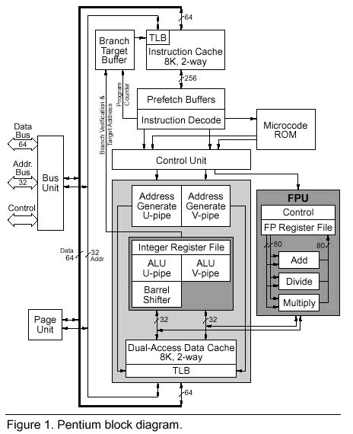

Slide 3
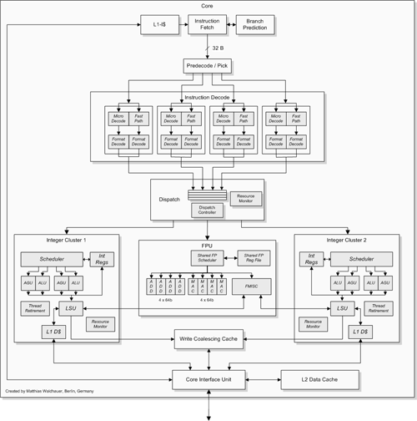

Slide 4
