Slide 1

MECA-H411: Mechanical vibrations
Satellite in microvibrations in orbit
Student:
Maximilien Zarioh
Professors:
Arnaud Deraemaeker
Wout Weijtjens
Thursday, 22 January 2026
Notes:
Bonjour tout ça tout ça

Slide 2
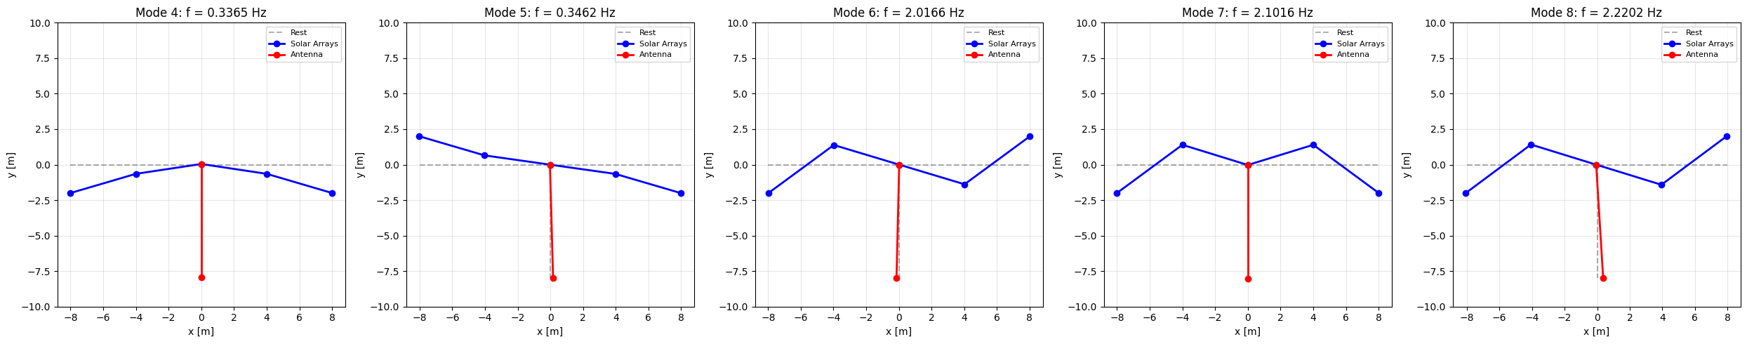
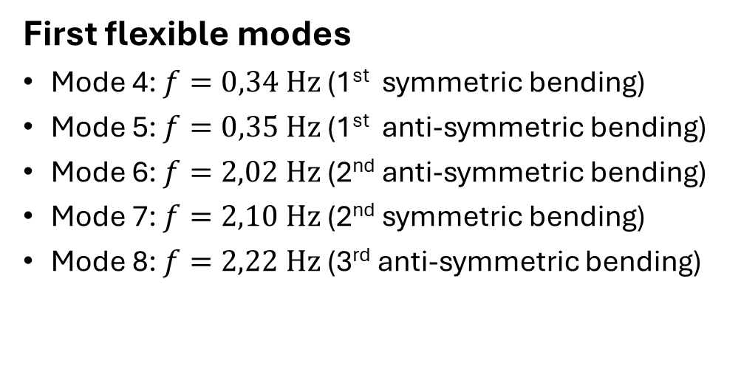
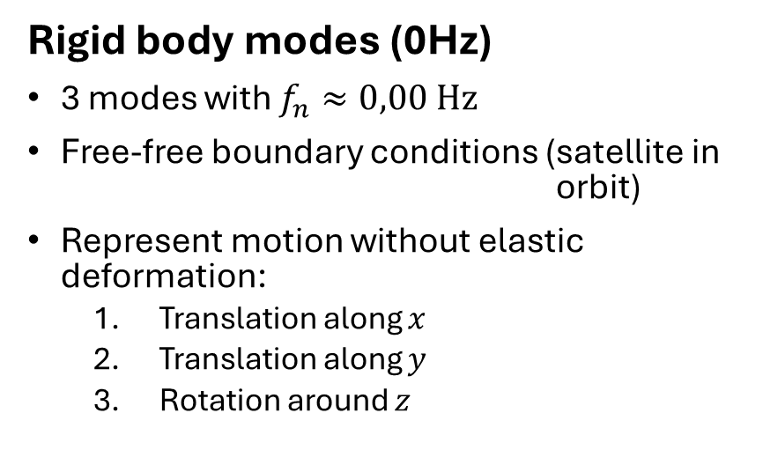
Q1.1 & Q1.2: Modal analysis
Rigid body modes (0Hz)
3 modes with $f_{n}≈0,00 \text{Hz}$
Free-free boundary conditions (satellite in orbit)
Represent motion without elastic deformation:
  Translation along $x$
  Translation along $y$
  Rotation around $z$
First flexible modes
Mode 4: $f=0,34 \text{Hz}$ (1st symmetric bending)
Mode 5: $f=0,35 \text{Hz}$ (1st anti-symmetric bending)
Mode 6: $f=\text{2}\text{,}\text{02 }\text{Hz}$ (2nd anti-symmetric bending)
Mode 7: $f=\text{2}\text{,}\text{10} \text{Hz}$ (2nd symmetric bending)
Mode 8: $f=\text{2}\text{,}\text{22} \text{Hz}$ (3rd anti-symmetric bending)

Slide 3
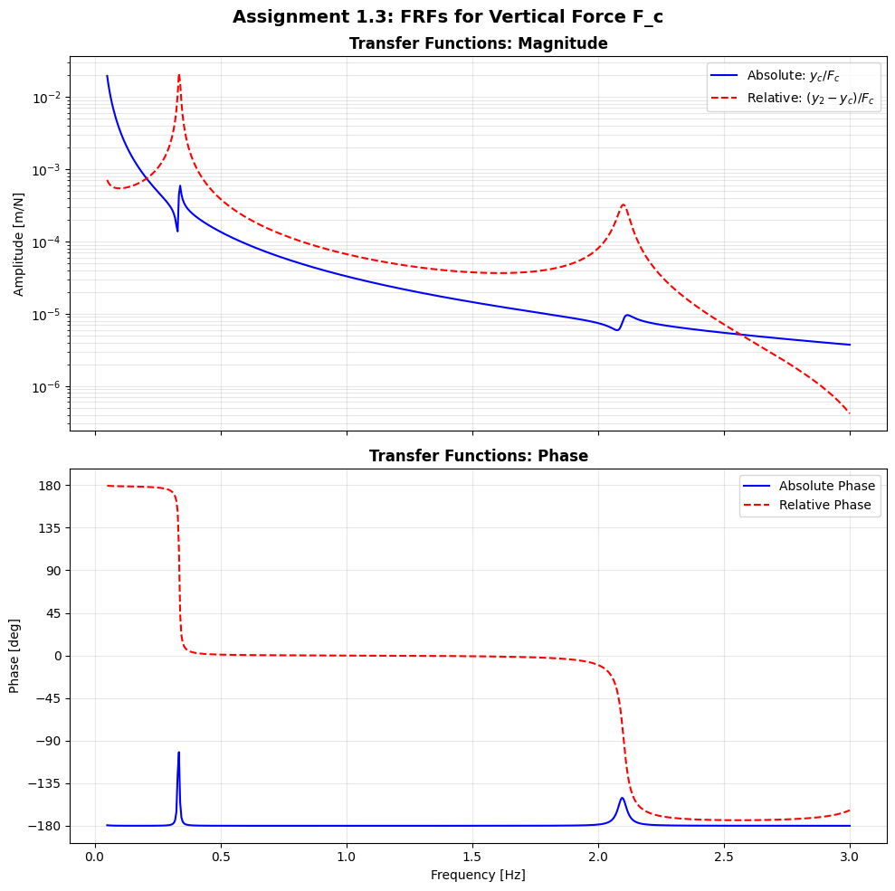
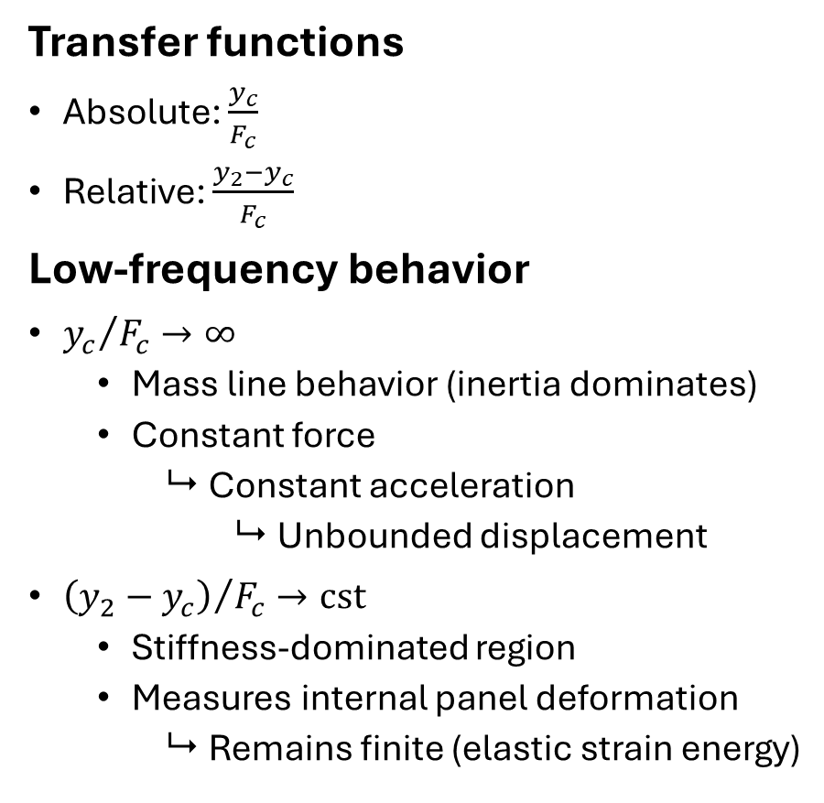
Q1.3: Frequency response, force excitation $F_{c}$
Transfer functions
Absolute: $\frac{y_{c}}{F_{c}}$
Relative: $\frac{y_{2}−y_{c}}{F_{c}}$
Low-frequency behavior
${y_{c}}/{F_{c}}→∞$
  Mass line behavior (inertia dominates)
  Constant force
    Constant acceleration
      Unbounded displacement
${\left(y_{2}−y_{c}\right)}/{F_{c}}→\text{cst}$
  Stiffness-dominated region
  Measures internal panel deformation
    Remains finite (elastic strain energy)

Slide 4
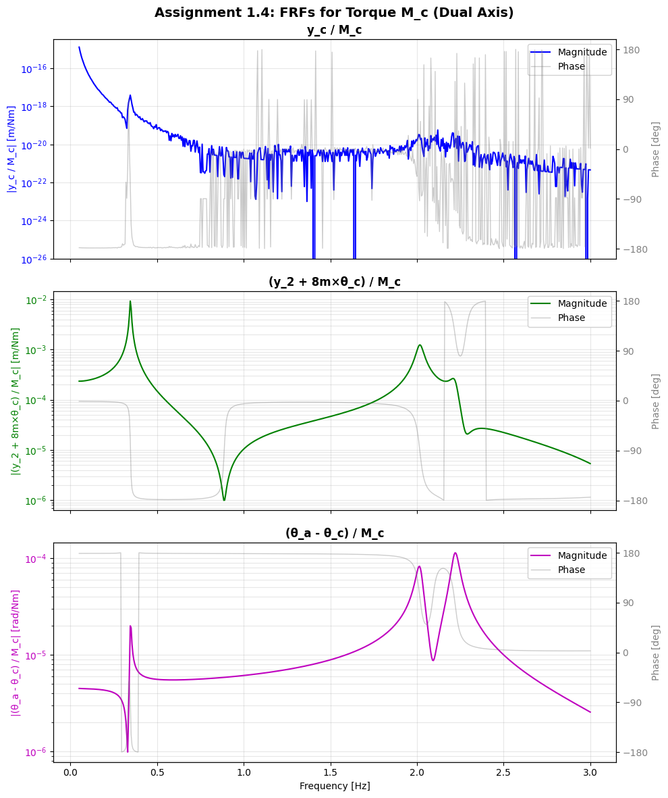
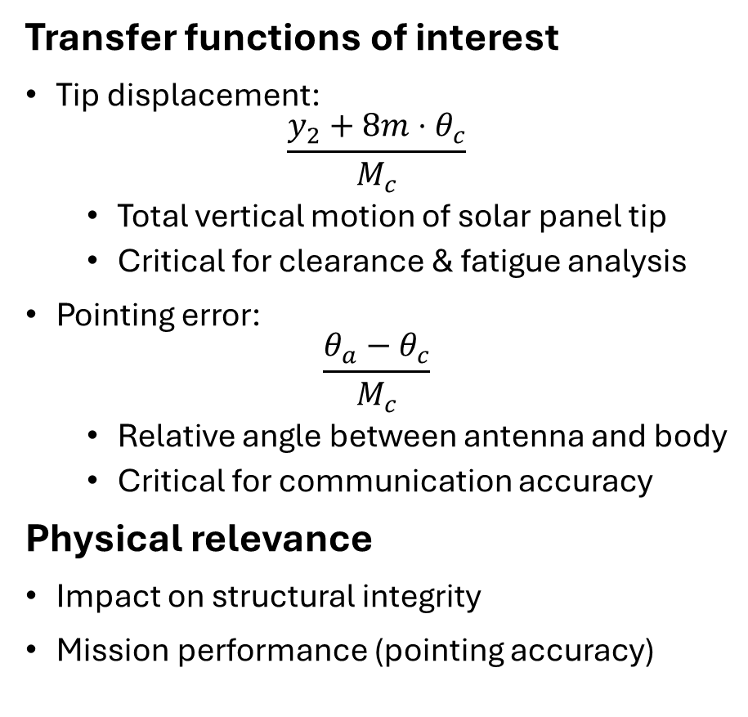
Q1.4: Frequency response, torque excitation $M_{c}$
Transfer functions of interest
Tip displacement:
$$\frac{y_{2}+8m⋅θ_{c}}{M_{c}}$$
  Total vertical motion of solar panel tip
  Critical for clearance & fatigue analysis
Pointing error:
$$\frac{θ_{a}−θ_{c}}{M_{c}}$$
  Relative angle between antenna and body
  Critical for communication accuracy
Physical relevance
Impact on structural integrity
Mission performance (pointing accuracy)

Slide 5
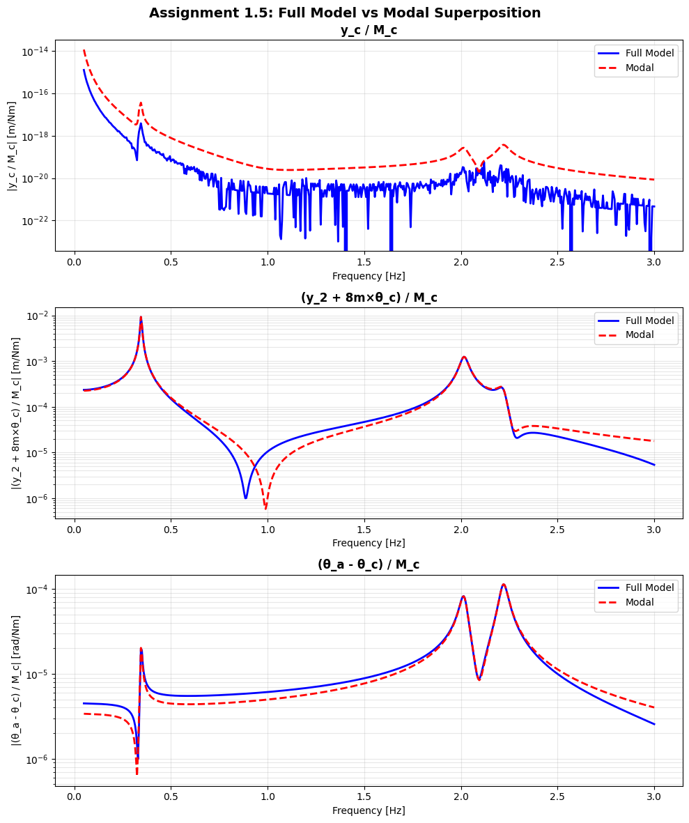
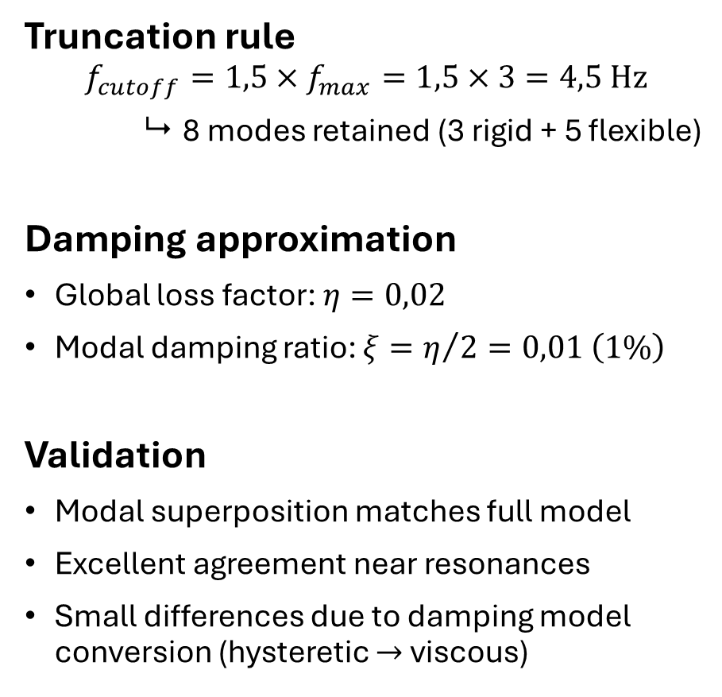
Q1.5: Modal truncation and validation
Truncation rule
$$f_{cutoff}=1,5×f_{max}=1,5×3=4,5 \text{Hz}$$
 8 modes retained (3 rigid + 5 flexible)
Damping approximation
Global loss factor: $η=0,02$
Modal damping ratio: $ξ=η/2=0,01 \left(1\%\right)$
Validation
Modal superposition matches full model
Excellent agreement near resonances
Small differences due to damping model conversion (hysteretic $→$ viscous)

Slide 6
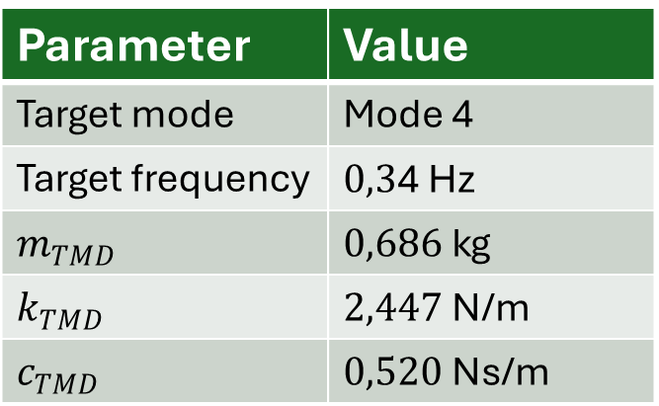
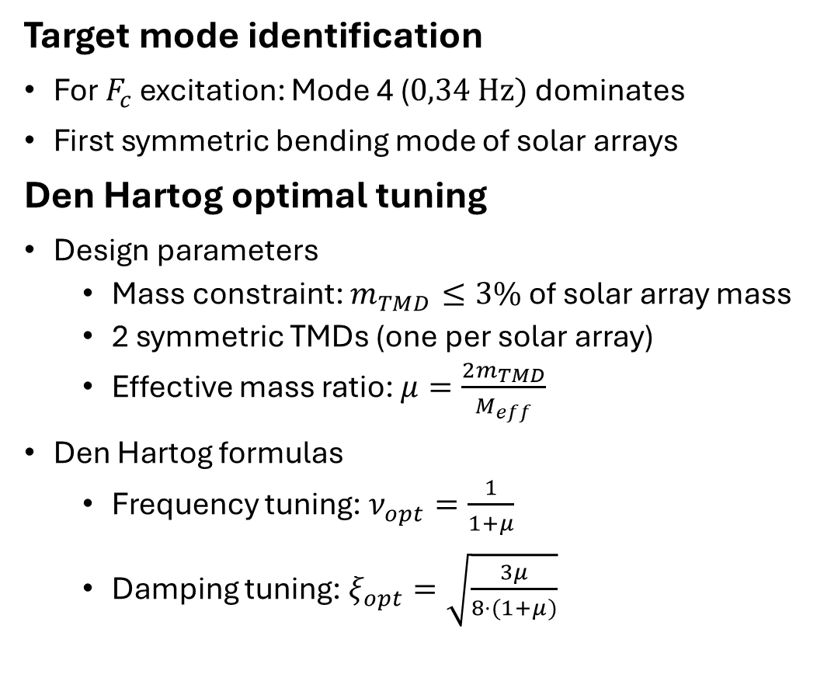
Q2.1 & Q2.2: TMD design strategy
Target mode identification
For $F_{c}$ excitation: Mode 4 ($0,3\text{4} \text{Hz})$dominates
First symmetric bending mode of solar arrays
Den Hartog optimal tuning
Design parameters
  Mass constraint: $m_{TMD}≤3\%$ of solar array mass
  2 symmetric TMDs (one per solar array)
  Effective mass ratio: $μ=\frac{2m_{TMD}}{M_{eff}}$
Den Hartog formulas
  Frequency tuning: $ν_{opt}=\frac{1}{1+μ}$
  Damping tuning: $ξ_{opt}=\sqrt{\frac{3μ}{8⋅(1+μ)}}$
Parameter | Value
Target mode | Mode 4
Target frequency | $0,3\text{4} \text{Hz}$
$m_{TMD}$ | $0,686 \text{kg}$
$k_{TMD}$ | $2,447 \text{N}\text{/}\text{m}$
$c_{TMD}$ | $0,520 \text{Ns}\text{/}\text{m}$
TMD frequency tuned slightly below target to account for mass loading effect

Slide 7
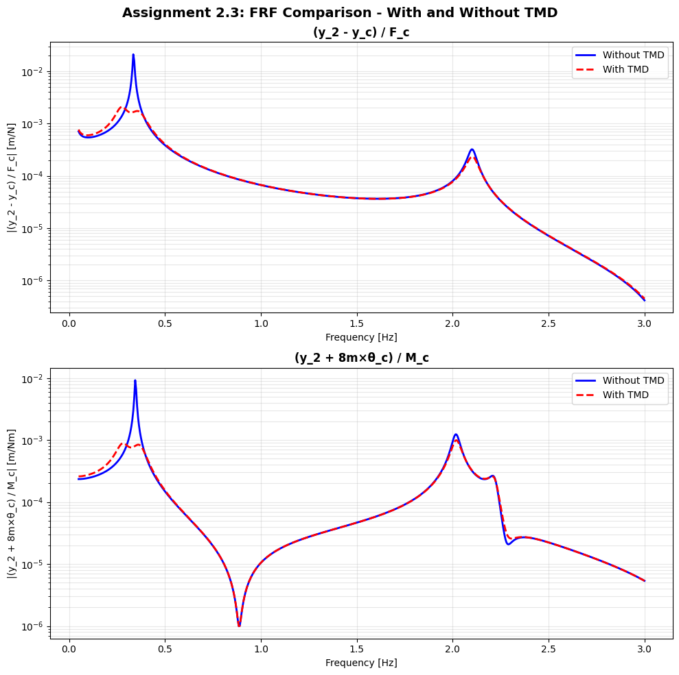
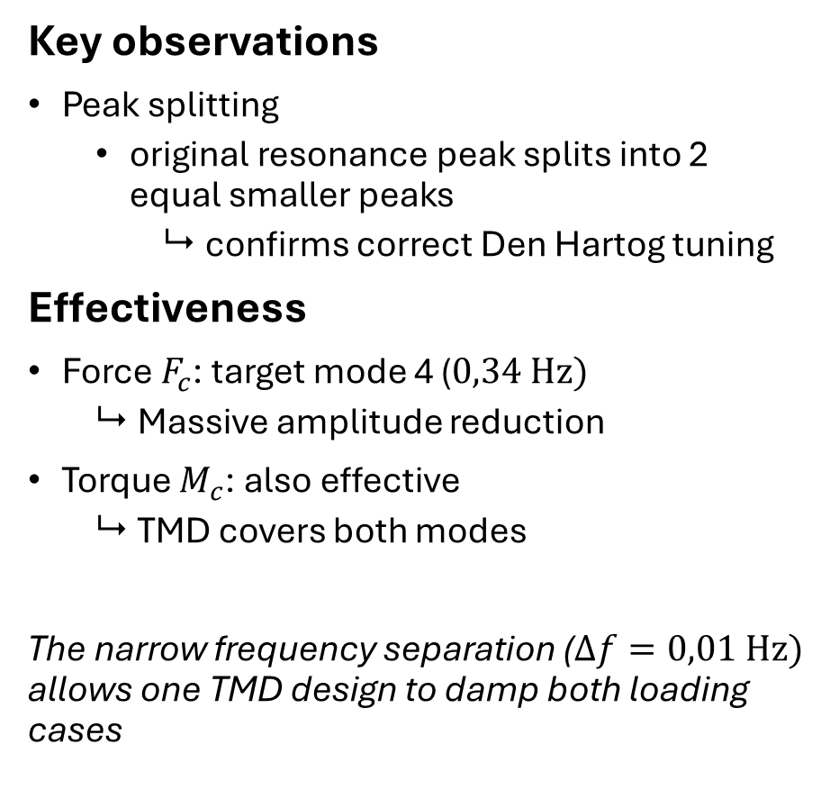
Q2.3: TMD efficiency, frequency domain
Key observations
Peak splitting
  original resonance peak splits into 2 equal smaller peaks
    confirms correct Den Hartog tuning
Effectiveness
Force $F_{c}$: target mode 4 ($0,34 \text{Hz}\text{)}$
  Massive amplitude reduction
Torque $M_{c}$: also effective
  TMD covers both modes
The narrow frequency separation ($Δf=0,01 \text{Hz}\text{)}$ allows one TMD design to damp both loading cases

Slide 8
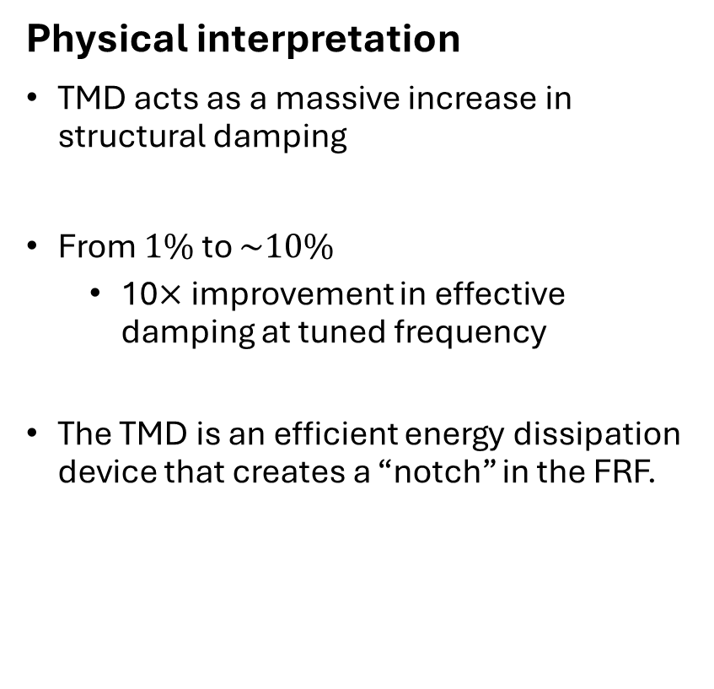
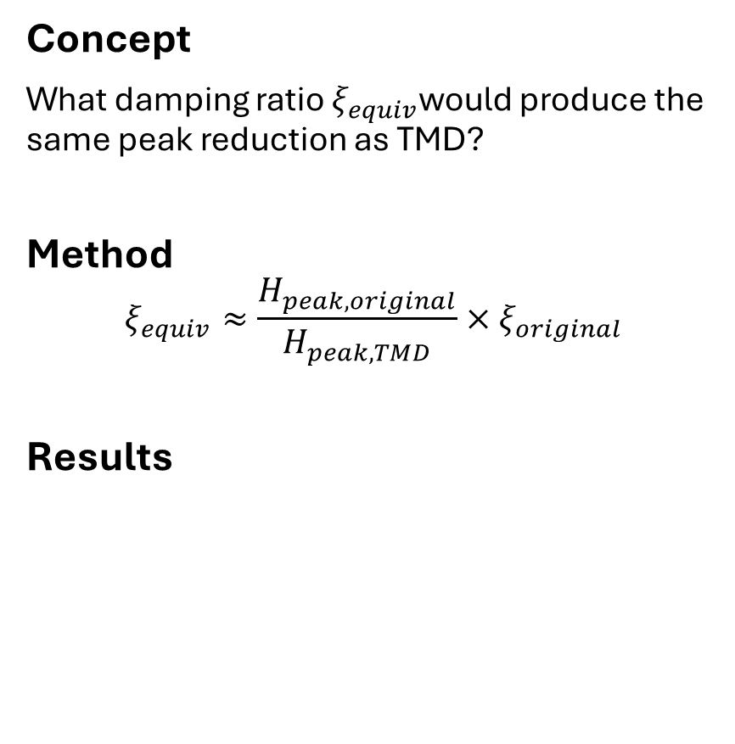
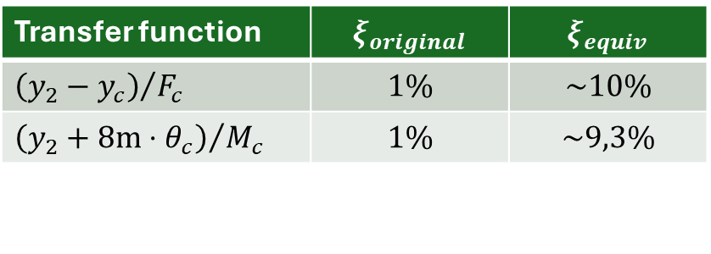
Q2.4: Equivalent damping estimation
Concept
What damping ratio $ξ_{equiv}$would produce the same peak reduction as TMD?
Method
$$ξ_{equiv}≈\frac{H_{peak,original}}{H_{peak,TMD}}×ξ_{original}$$
Results
Physical interpretation
TMD acts as a massive increase in structural damping
From $1\%$ to $\sim 10\%$
  10$×$ improvement in effective damping at tuned frequency
The TMD is an efficient energy dissipation device that creates a “notch” in the FRF.
Transfer function | $$ξ_{original}$$ | $$ξ_{equiv}$$
${\left(y_{2}−y_{c}\right)}/{F_{c}}$ | $$1\%$$ | $$\sim 10\%$$
${\left(y_{2}+8m⋅θ_{c}\right)}/{M_{c}}$ | $$1\%$$ | $$\sim 9,3\%$$

Slide 9
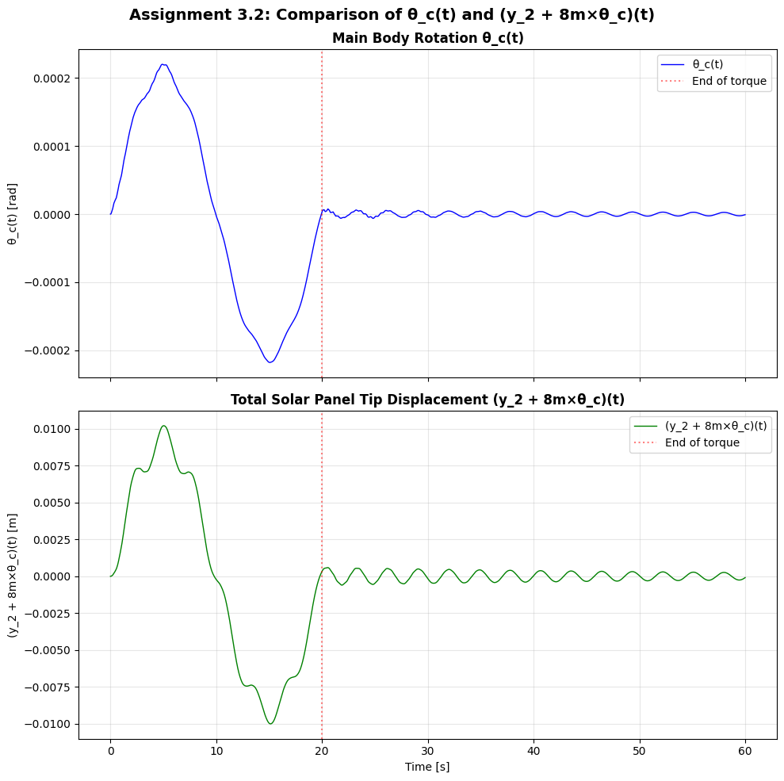
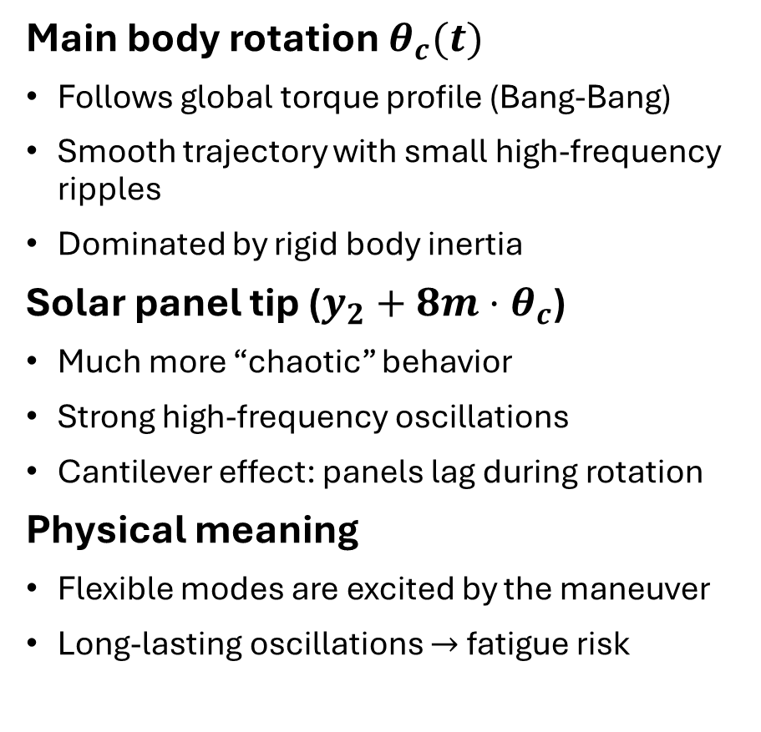
Q3.1 & Q3.2: Time domain analysis, without TMD
Main body rotation $θ_{c}(t)$
Follows global torque profile (Bang-Bang)
Smooth trajectory with small high-frequency ripples
Dominated by rigid body inertia
Solar panel tip ($y_{2}+8m⋅θ_{c}$)
Much more “chaotic” behavior
Strong high-frequency oscillations
Cantilever effect: panels lag during rotation
Physical meaning
Flexible modes are excited by the maneuver
Long-lasting oscillations $→$ fatigue risk

Slide 10
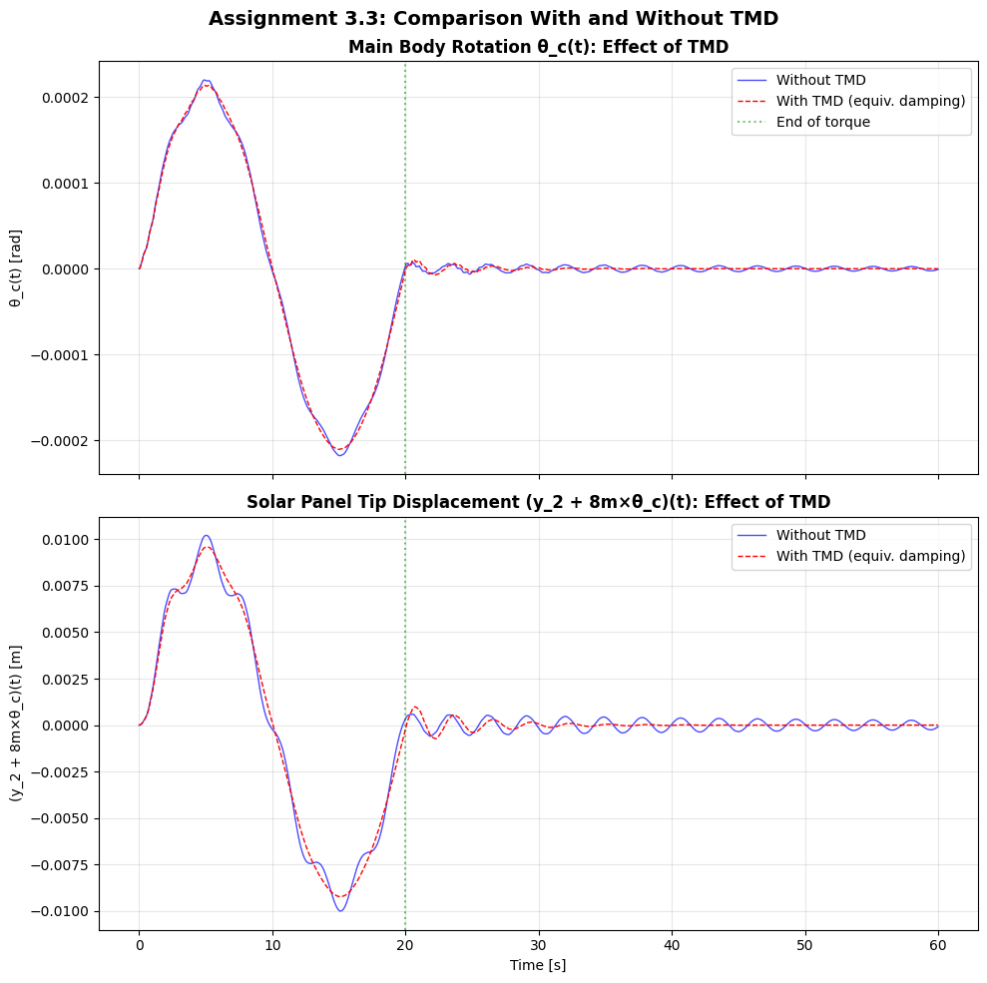
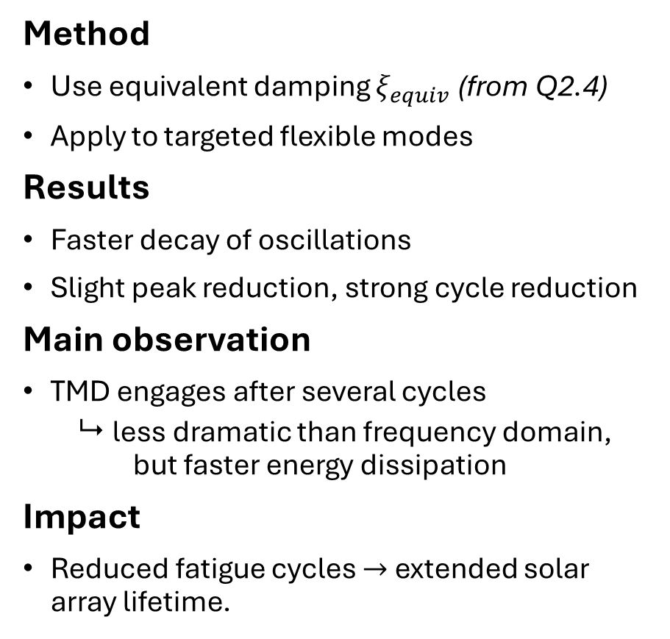
Q3.3: TMD effect in time domain
Method
Use equivalent damping $ξ_{equiv}$ (from Q2.4)
Apply to targeted flexible modes
Results
Faster decay of oscillations
Slight peak reduction, strong cycle reduction
Main observation
TMD engages after several cycles
  less dramatic than frequency domain, but faster energy dissipation
Impact
Reduced fatigue cycles $→$ extended solar array lifetime.

