Slide 1


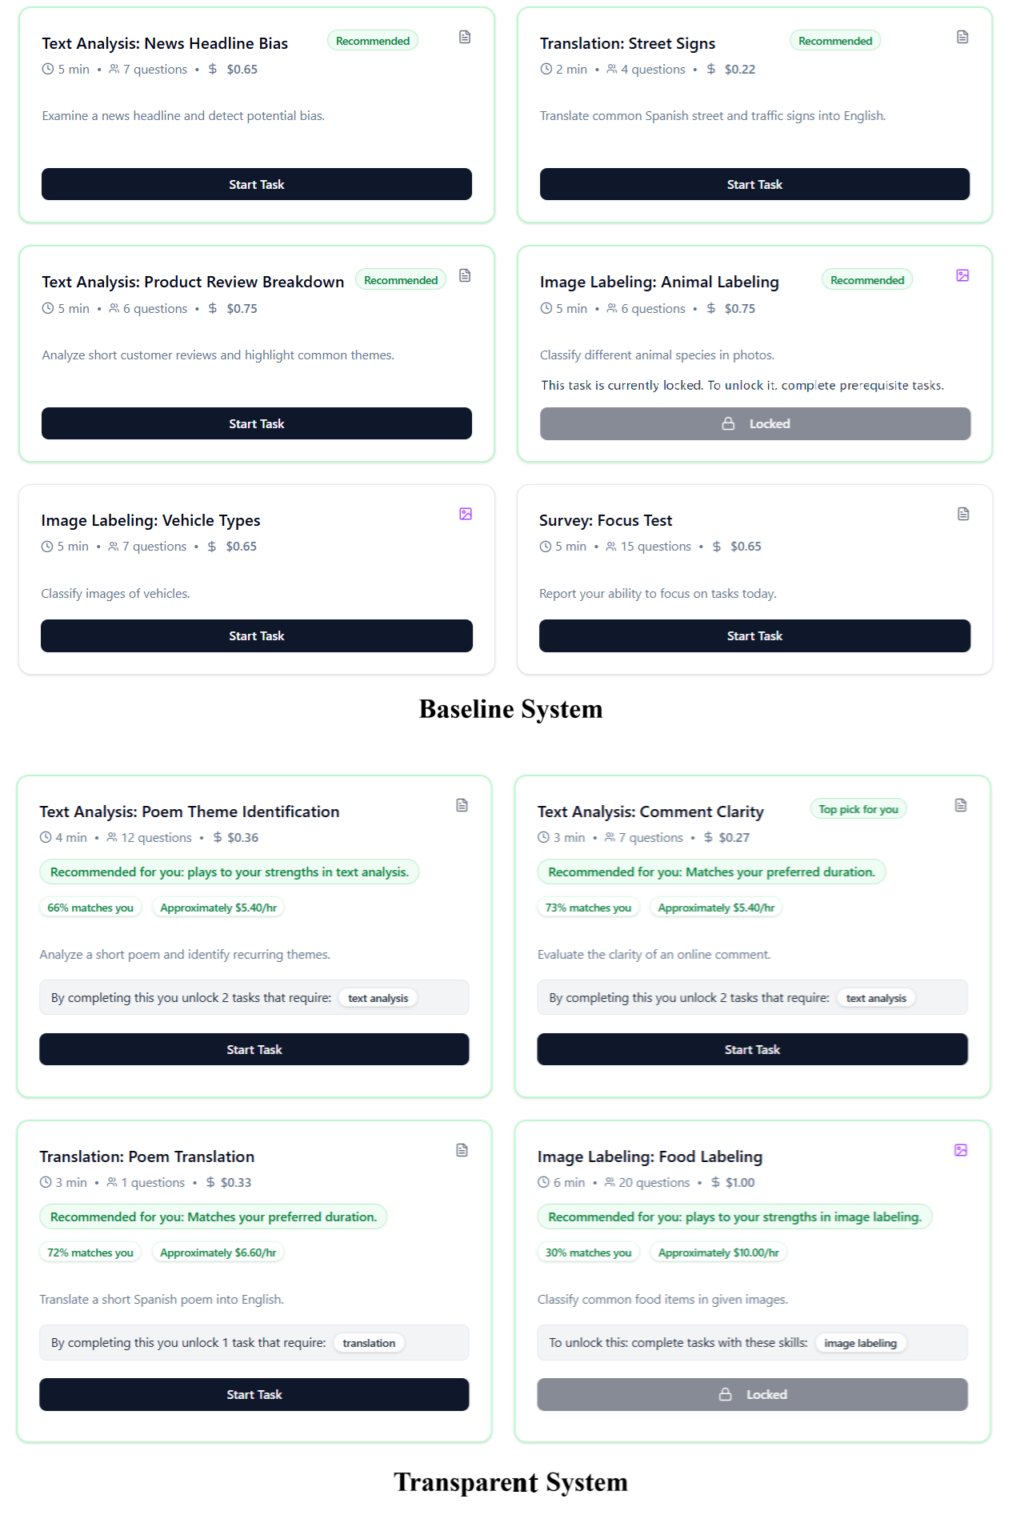
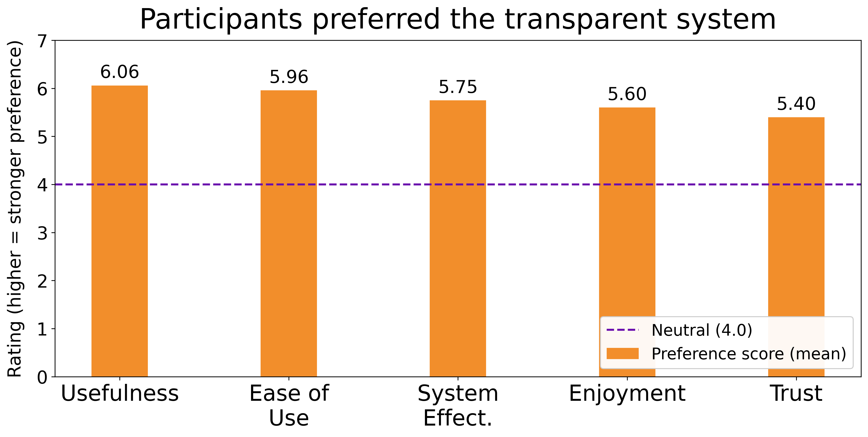
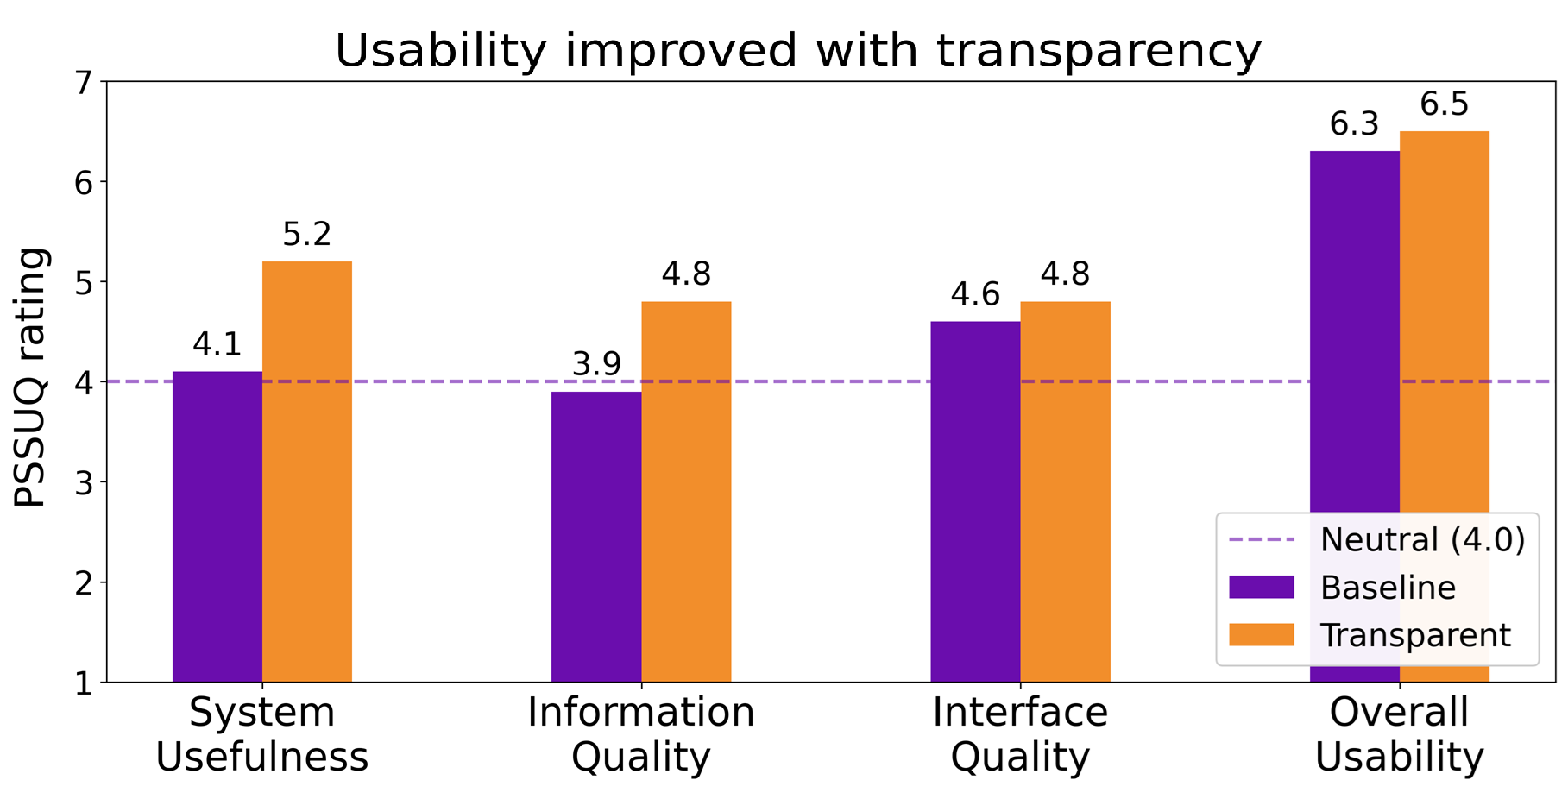
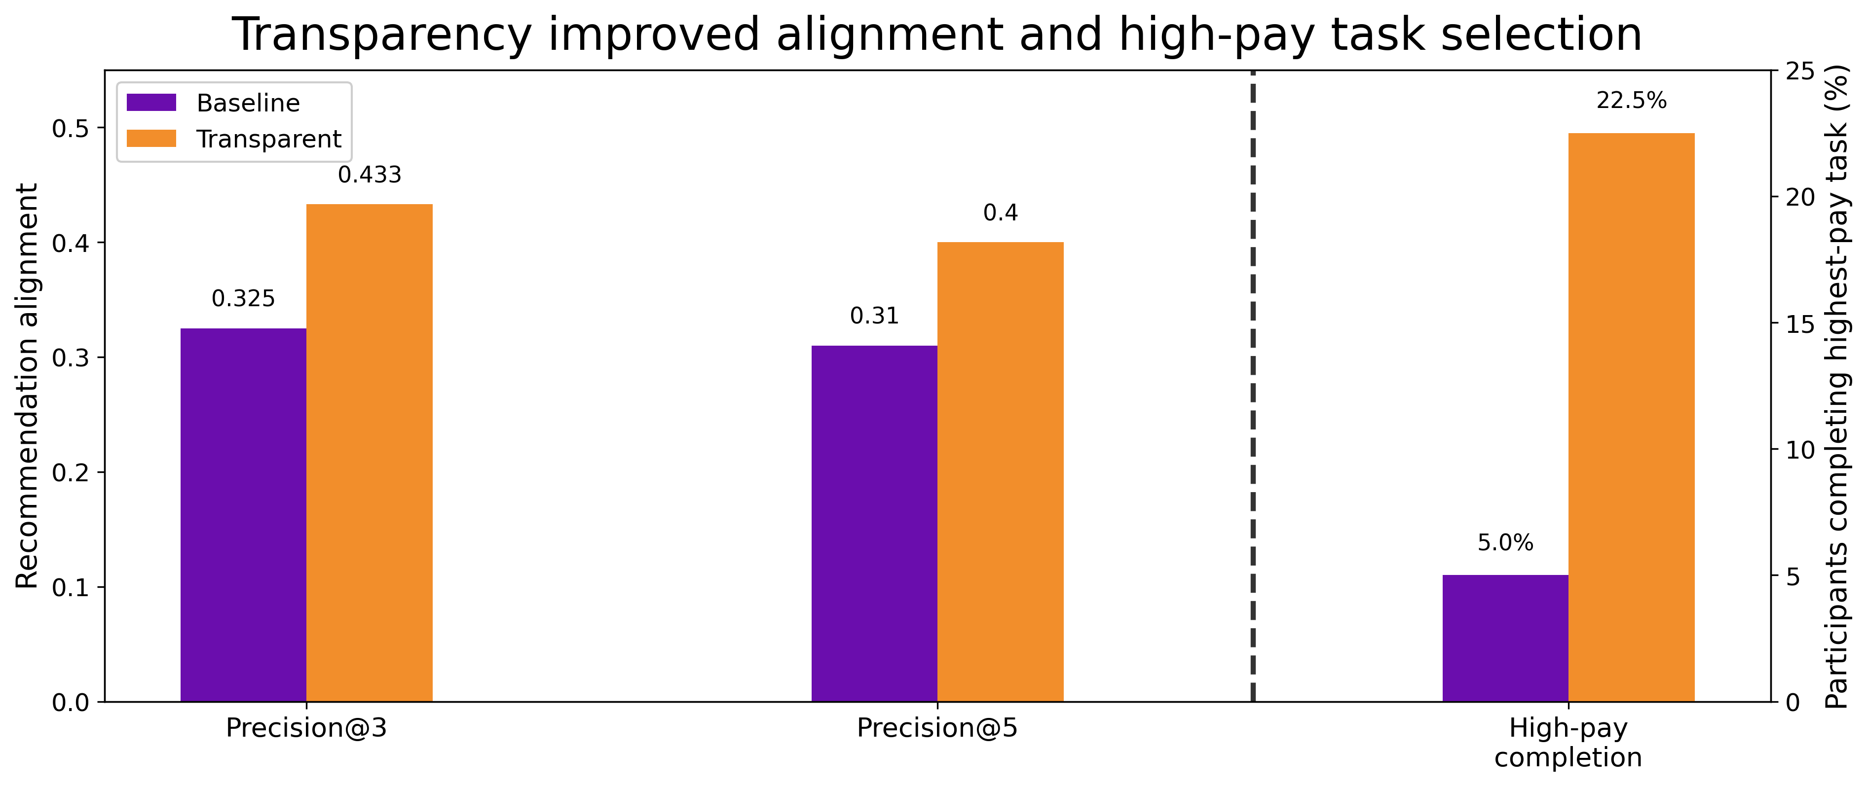
Worker-Centered AI: Transparent Explanations for Trustworthy Task Recommendation in Crowd Work
Fateme Mazdarani, Alberto Campos Hernandez, Carlos Toxtli
School of Computing, Clemson University, Clemson, SC, USA
Motivation
Methodology
Results
Takeaways
Task recommenders on crowd platforms are often opaque.
Workers cannot see why tasks appear.
Workers cannot tell how to unlock better-paying work.
We built a simulated crowd-work platform with micro-tasks and recommendations.
We compared two interfaces with the same recommender: Baseline vs Transparent.
Participants rated the Transparent system significantly better than neutral midpoints on fairness, trust, and empowerment.
Also In direct comparison, participants preferred the Transparent system on all metrics.
Transparency improved workers’ mental model of why tasks are recommended.
Even without changing the algorithm, workers put more trust in recommendations and made more strategic selections.
Research Questions
Design Implications
RQ1. Do transparent task recommendations affect perceived fairness, trust, and empowerment?
RQ2. How does transparency affect usability and interaction quality?
RQ3. How does transparency change engagement and decision behavior?
Transparency should be treated as a core feature of worker-centered AI.
Platforms should:
Show a clear “why this task” rationale.
Make pay and eligibility visible.
Make explanations and recommendations adjustable and optional, to avoid overload.
Transparency also improved System Usefulness and Info Quality
Limitations
Study Design
This study is a proof-of-concept: n = 40, U.S.-based, short-term, low-stakes, and run in a fixed order.
The recommender was a simple, interpretable k-NN model, so results may differ for complex recommenders or real marketplace pressure.
We conducted a within-subjects study, with N=40 (recruited through Prolific).
Participants first selected 3 tasks to build a profile, then completed 3 tasks in each interface with disjoint but comparable tasks.
We collected surveys and interaction logs after each interaction.
Interface Quality remained similar, suggesting the benefits came from better understanding of the system rather than visual redesign.
Behavior analysis shows recommendation alignment improved and completion of the highest-paying recommended task increased x4.5.
Transparent UI added: “why this task,” match score, estimated pay, skill cues, lock/unlock guidance.
Conclusion
Making task recommendation more transparent can improve worker experience and support more strategic choices without changing the underlying algorithm.
Study Flow:
Profile
elicitation
Baseline
system
Transparent
system
Comparison +
Post-Survey

