Slide 1
Digital Image Processing:
Revision

Slide 2
Key Stages in Digital Image Processing
Image Restoration
Morphological Processing
Image Enhancement
Segmentation
Image Acquisition
Object Recognition
Representation & Description
Problem Domain
Colour Image Processing
Image Compression

Slide 3

Key Stages in Digital Image Processing:
Image Aquisition
Image Restoration
Morphological Processing
Image Enhancement
Segmentation
Image Acquisition
Object Recognition
Representation & Description
Problem Domain
Colour Image Processing
Image Compression

Slide 4

Key Stages in Digital Image Processing:
Image Enhancement
Image Restoration
Morphological Processing
Image Enhancement
Segmentation
Image Acquisition
Object Recognition
Representation & Description
Problem Domain
Colour Image Processing
Image Compression

Slide 5
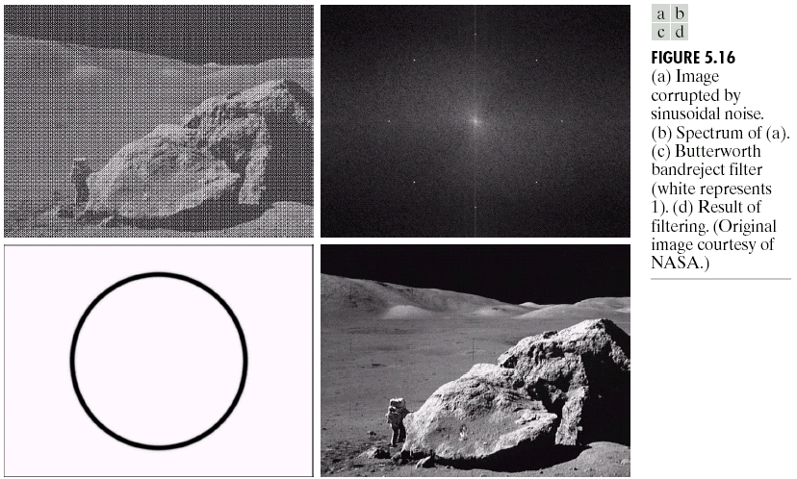
Key Stages in Digital Image Processing:
Image Restoration
Image Restoration
Morphological Processing
Image Enhancement
Segmentation
Image Acquisition
Object Recognition
Representation & Description
Problem Domain
Colour Image Processing
Image Compression

Slide 6
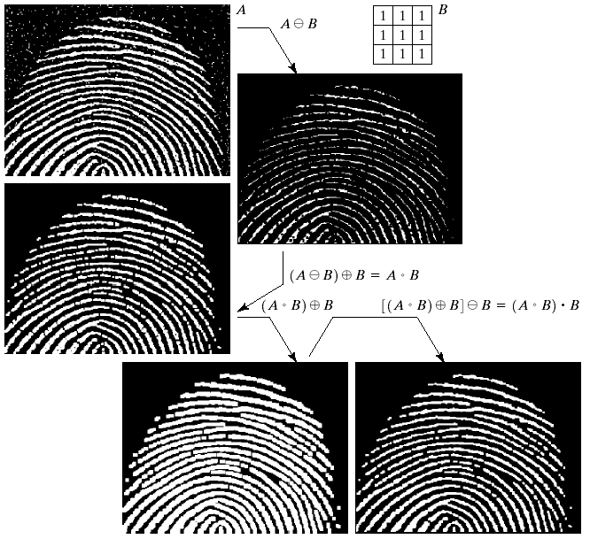
Key Stages in Digital Image Processing:
Morphological Processing
Image Restoration
Morphological Processing
Image Enhancement
Segmentation
Image Acquisition
Object Recognition
Representation & Description
Problem Domain
Colour Image Processing
Image Compression

Slide 7
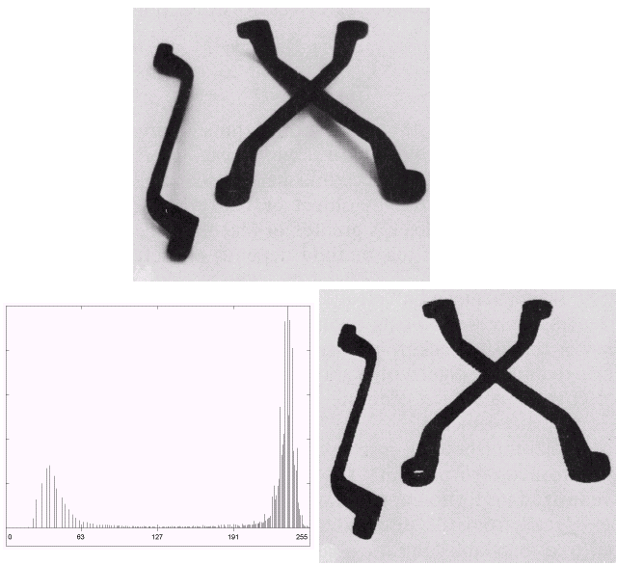
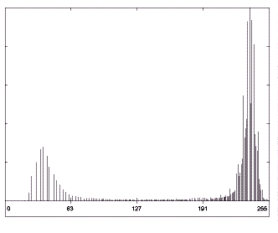
Key Stages in Digital Image Processing:
Segmentation
Image Restoration
Morphological Processing
Image Enhancement
Segmentation
Image Acquisition
Object Recognition
Representation & Description
Problem Domain
Colour Image Processing
Image Compression

Slide 8
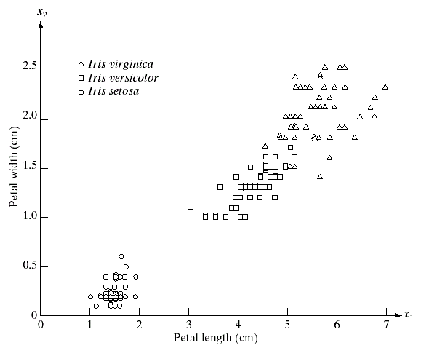
Key Stages in Digital Image Processing:
Object Recognition
Image Restoration
Morphological Processing
Image Enhancement
Segmentation
Image Acquisition
Object Recognition
Representation & Description
Problem Domain
Colour Image Processing
Image Compression

Slide 9
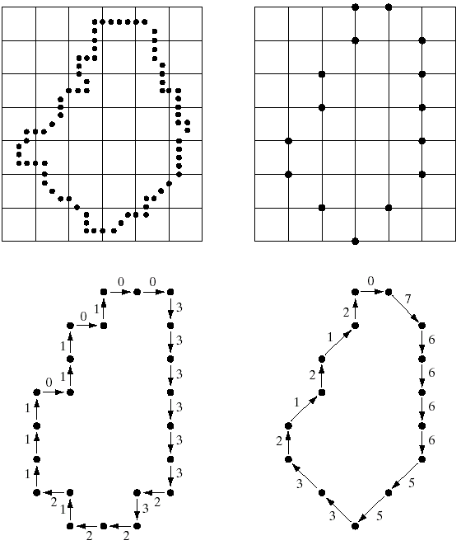
Key Stages in Digital Image Processing:
Representation & Description
Image Restoration
Morphological Processing
Image Enhancement
Segmentation
Image Acquisition
Object Recognition
Representation & Description
Problem Domain
Colour Image Processing
Image Compression

Slide 10
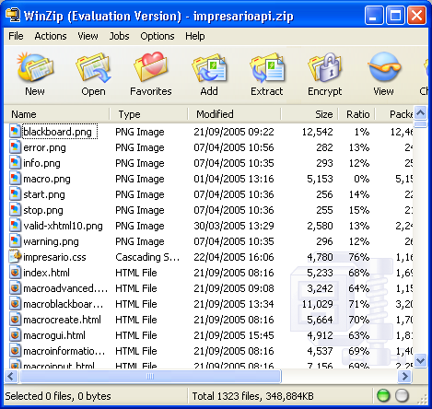
Key Stages in Digital Image Processing:
Image Compression
Image Restoration
Morphological Processing
Image Enhancement
Segmentation
Image Acquisition
Object Recognition
Representation & Description
Problem Domain
Colour Image Processing
Image Compression

Slide 11
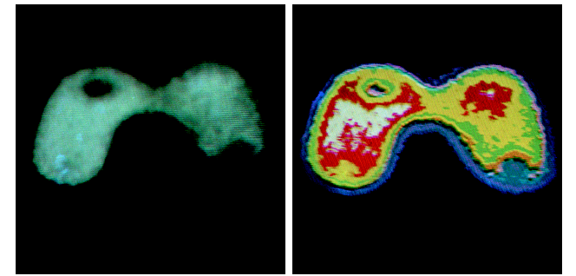
Key Stages in Digital Image Processing:
Colour Image Processing
Image Restoration
Morphological Processing
Image Enhancement
Segmentation
Image Acquisition
Object Recognition
Representation & Description
Problem Domain
Colour Image Processing
Image Compression

Slide 12
ACHTUNG!
THIS IS NOT A LIST OF WHAT IS COMING UP IN YOUR EXAM – DO NOT COMPLAIN!

Slide 13
Introduction to Image Processing
What is a digital image?
What is digital image processing?
History of digital image processing
Digital image processing application areas
Key stages in digital image processing

Slide 14
Digital Image Processing Fundamentals
The human visual system
Light and the electromagnetic spectrum
Image acquisition
Image sampling and quantisation
Spatial and intensity level resolution

Slide 15
Image Enhancement
Enhancement in the spatial and frequency domains
Point processing
  Log transformation
  Power law transformation
Histograms
  What is an image histogram?
  Histogram equalisation

Slide 16
Spatial Filtering
Spatial filtering process
  Can you explain how it works?
Smoothing filters
Problems at image edges during filtering
  Padding and different padding techniques
Difference between correlation and convolution

Slide 17
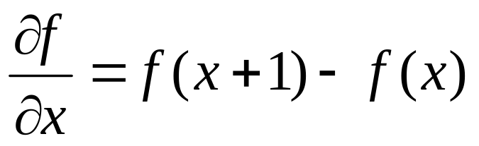
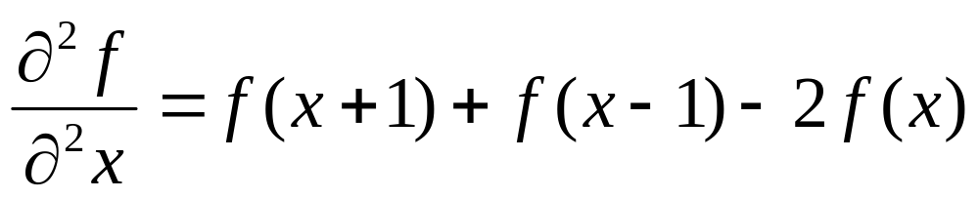
Spatial Filtering (cont…)
Spatial differentiation
  1st derivative
  2nd derivative
Differentiation based filters
How to do sharpening using these filters
0
1
0
-1
-2
-1
-1
0
1
You don’t need to know the maths used to derive these filters
1
-4
1
0
0
0
-2
0
2
0
1
0
1
2
1
-1
0
1
Laplacian
Sobel

Slide 18
Frequency Domain Filtering
The Fourier transform
  Be able to explain the big idea behind it
  You do not need to know the maths for it
  Importance of the inverse Fourier transform
How filtering in the frequency domain works
Low pass filters
  What are they for?
  Ideal low pass filter
  Butterworth low pass filter
  Gaussian low pass filter
You don’t need to know the equations for these, but you must be able to draw them and explain what they do

Slide 19
Frequency Domain Filtering (cont…)
High pass filters
  What are they for?
  Ideal high pass filter
  Butterworth high pass filter
  Gaussian high pass filter
The Fast Fourier Transform and its importance
You don’t need to know the equations for these, but you must be able to draw them and explain what they do

Slide 20
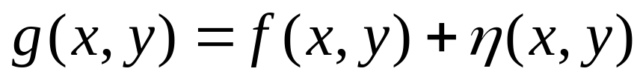
Image Restoration: Noise Removal
Image enhancement vs. image restoration
What is meant by noise removal?
What is meant by a noise model?
  Common noise models
    Gaussian
    Rayleigh
    Erlang
Filtering to remove noise
  Simple mean filter
  Other mean filters
    Exponential
    Uniform
    Impulse (salt & pepper)

Slide 21
Image Restoration: Noise Removal (cont…)
Order statistics filters
  Median filter
  Max and min filter
  Midpoint filter
  Alpha trimmed mean filter
Removing noise in the frequency domain
  Particularly good for removing periodic noise
  Band reject filters
    Ideal band reject filter
    Butterworth band reject filter
    Gaussian band reject filter

Slide 22
Image Segmentation: Thresholding
The segmentation problem
Importance of good thresholding
Problems that can arise with thresholding
The basic global thresholding algorithm
Single value thresholding vs. multiple value thresholding
Basic adaptive thresholding

Slide 23
Morphological Image Processing
Basic morphological concepts and operations
  Hitting, fitting and missing
  Erosion and dilation
  Opening and closing
Morphological algorithms
  Boundary extraction
  Region filling

Slide 24
Your Exam!
Follows the same format as previous years
4 questions in each section, attempt any 3 questions from each section
Read the questions carefully
DO THE PAST PAPERS – available online

Slide 25
Summary
There are two main jobs in image processing
  Enhancement of images for human viewing
  Preparation of images for machine processing
Both of these are hard areas to work in!
We have covered a lot of the first area, and a little of the second
The subject of machine vision is huge, growing and really interesting

