Slide 1



Syscall 劫持2.6
2014.09.23
一些材料来自其他同行，在此感谢

Slide 2
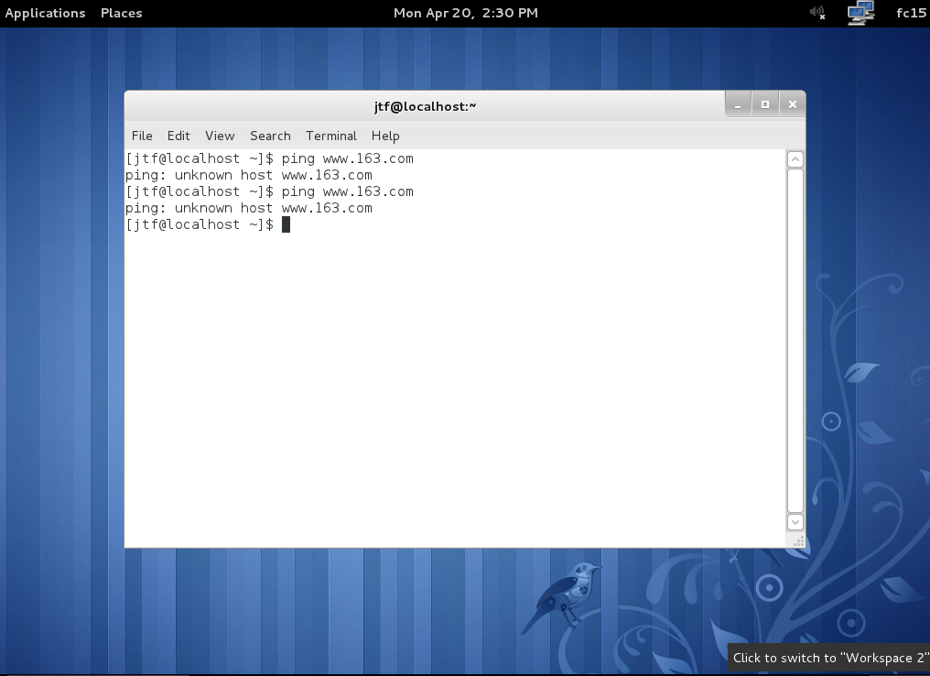
1.普通用户，图形界面是不方便实验的

Slide 3
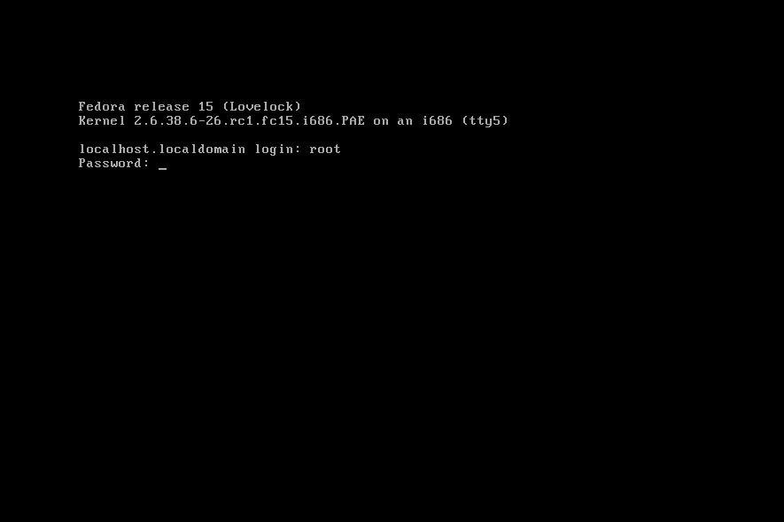
1.ctrl+alt+f5,进入终端模式方便看效果
Notes:
华硕WL-520gC 530

Slide 4
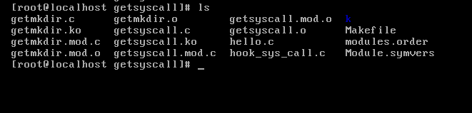
1.ls 查看目录情况

Slide 5
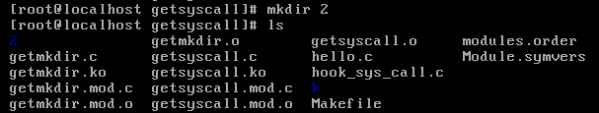
1.mkdir 建立一个目录 ，并查看效果

Slide 6
1.查看准备劫持的系统调用号
系统调用号定义在include/asm/unistd.h
#define __NR_restart_syscall 0
#define __NR_exit 1
#define __NR_fork 2
#define __NR_read 3
#define __NR_write 4
#define __NR_open 5
#define __NR_close 6
#define NR_syscalls 325

Slide 7
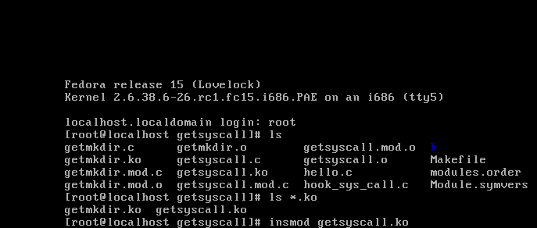
1.insmod getsyscall.ko 取得系统调用表首址并导出

Slide 8
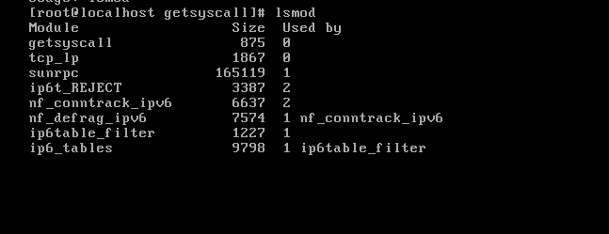
1.lsmod 显示加载情况

Slide 9

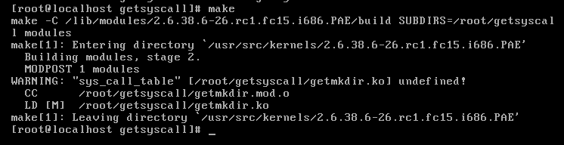
1.编译getmkdir

Slide 10
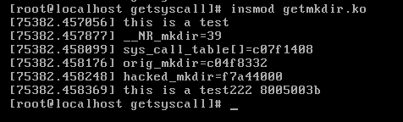
1.insmod getmkdir.ko 劫持系统调用

Slide 11
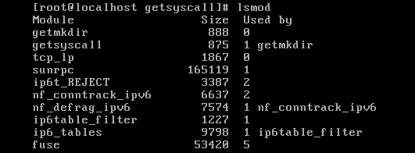
1.lsmod 显示加载情况

Slide 12
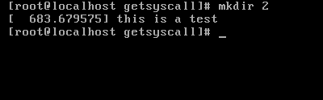
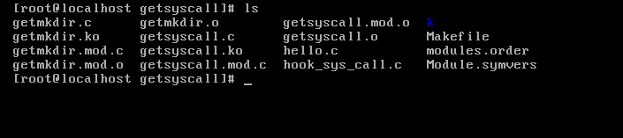
1.再使用mkdir看效果

Slide 13
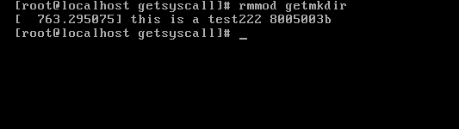
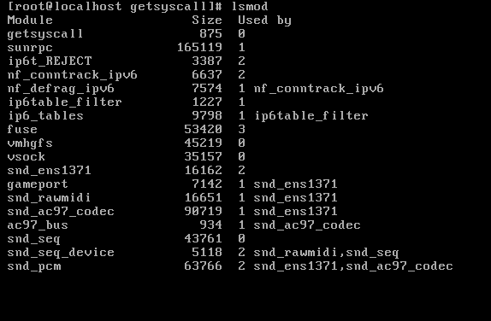
1.卸载getmkdir,并列表显示

Slide 14
1.mkdir 建立一个目录 ，并查看效果

Slide 15
1.getsyscall.c
Notes:
#ifndef __SYSCALL_INCLUDE__
# define __SYSCALL_INCLUDE__
#endif
#ifdef MODVERSIONS
#include <linux/modversions.h>
#endif
#include <linux/module.h>
#include <linux/kernel.h>
MODULE_LICENSE("GPL");
MODULE_AUTHOR("xinhe <xinhe007@163.com>");
MODULE_DESCRIPTION("export the sys_call_table");
#if !defined(symname)
#error symname not defined
#endif
#define CALLOFF 100
unsigned symname; /* #define */
struct {
unsigned short limit;
unsigned int base;
} __attribute__ ((packed)) idtr;
struct {
unsigned short off1;
unsigned short sel;
unsigned char none,
flags;
unsigned short off2;
} __attribute__ ((packed)) * idt;
void set_symbol_addr(unsigned old_value, unsigned new_value)
{
struct module *mod;
struct kernel_symbol *s;
int i;
for (mod = THIS_MODULE, s = mod->syms, i = 0; i < mod->num_syms; ++i, ++s)
if (s->value == old_value)
{
s->value = new_value;
return;
}
/*遍历本模块的符号表，把本模块的一个也叫sys_call_table的符号的地址
设置为系统真正的sys_call_table的实际地址。 */
}
char * findoffset(char *start)
{
char *p;
for (p = start; p < start + CALLOFF; p++)
if (*(p + 0) == '\xff' && *(p + 1) == '\x14' && *(p + 2) == '\x85')
return p;
/*查找ini 80处理函数对sys_call_table的引用*/
return NULL;
}
static int __init init(void)
{
unsigned sys_call_off;
unsigned sct;
char *p;
asm("sidt %0":"=m"(idtr));
idt = (void *) (idtr.base + 8 * 0x80);
sys_call_off = (idt->off2 << 16) | idt->off1;
/*查找int 80的入口地址*/
if ((p = findoffset((char *) sys_call_off)))
{
sct = *(unsigned *) (p + 3);
set_symbol_addr((unsigned) &symname, sct);
}
//EXPORT_SYMBOL(sys_call_table);
return 0;
}
static void __exit fini(void)
{
}
module_init(init);
module_exit(fini);

Slide 16
1.Makefile for getsyscall.c
obj-m :=getsyscall.o
EXTRA_CFLAGS := -Dsymname=sys_call_table
KDIR := /lib/modules/$(shell uname -r)/build
PWD := $(shell pwd)
default:
$(MAKE) -C $(KDIR) SUBDIRS=$(PWD) modules
clean:
$(RM) -rf .*.cmd *.mod.c *.o *.ko .tmp*

Slide 17
1.getmkdir.c
Notes:
#ifndef __GETMKDIR_INCLUDE__
# define __GETMKDIR_INCLUDE__
#endif
#include <linux/module.h>
#include <linux/kernel.h>
#include <linux/init.h>
#include <linux/types.h>
#include <linux/dirent.h>
#include <linux/string.h>
#include <asm/unistd.h>
MODULE_LICENSE("GPL");
MODULE_AUTHOR("xinhe <xinhe007@163.com>");
/*2015-4-21 ok*/
MODULE_DESCRIPTION("export the sys_call_table");
extern void *sys_call_table[];
int (*orig_mkdir)(const char *path);/*指向系统的mkdir*/
long g_oldcr0=0;
/*构造自己的mkdir*/
int hacked_mkdir(const char *path)
{
printk("<1>this is a test\n");
return 0;
}
void setback_cr0(unsigned int val)
{
asm volatile ("movl %%eax, %%cr0": :"a"(val));
}
unsigned int clear_cr0_save()
{
unsigned int cr0 = 0;
unsigned int ret=0,result,input,foo,bar;
//AT&T语法第一个为源操作数，第二个为目的操作数，方向从左到右
asm volatile ("movl %%cr0, %%eax"
: "=a"(cr0)
);
ret = cr0;
/*clear the 20th bit of CR0,*/
cr0 = cr0 &0xfffeffff;
printk("<1>this is a test222 %lx\n",ret);
asm volatile("movl %%eax, %%cr0"::"a"(cr0));
return ret;
}
static int __init init(void)
{
printk("<1>this is a test");
printk("<1>__NR_mkdir=%d\n",__NR_mkdir);
orig_mkdir=(int(*)(void))(sys_call_table[__NR_mkdir]);
//saved=(int(*)(void))(systable[__NR_pedagogictime]);
//systable[__NR_pedagogictime]=(unsigned long)sys_pedagogictime;
printk("<1>sys_call_table[]=%p\n",sys_call_table);
printk("<1>orig_mkdir=%p\n",orig_mkdir);
printk("<1>hacked_mkdir=%p\n",hacked_mkdir);
// g_oldcr0=close_cr();
g_oldcr0=clear_cr0_save();
sys_call_table[__NR_mkdir]=(unsigned long)hacked_mkdir;
/*将sys_call_table的mkdir指向我们自己构造的hacked_mkdir*/
// open_cr(g_oldcr0);
setback_cr0(g_oldcr0);
return 0;
}
static void __exit fini(void)
{
g_oldcr0=clear_cr0_save();
sys_call_table[__NR_mkdir]=orig_mkdir;
setback_cr0(g_oldcr0);
/*做恢复工作*/
}
module_init(init);
module_exit(fini);

Slide 18
1.Makefile for getmkdir.c
obj-m :=getmkdir.o
KDIR := /lib/modules/$(shell uname -r)/build
PWD := $(shell pwd)
default:
$(MAKE) -C $(KDIR) SUBDIRS=$(PWD) modules
clean:
$(RM) -rf .*.cmd *.mod.c *.o *.ko .tmp*

Slide 19

谢谢！

