Slide 1

Project Introduction
Objective:
Building an automatic system for correcting spelling and grammatical errors in Arabic texts.
Two different approaches were used:
- LSTM Model on real data with programmatically added errors.
- Fine-tuning AraBART using LoRA on real data with programmatically added errors.

Slide 2
Model 1 – LSTM
Data:
- Source: Files `train.csv`: 18351 Rows and `valid.csv`: 2294 Rows.
- Original data is grammatically correct.
- Data clean(Remove punctuation,spaces) and
- Random errors (add/remove characters) were programmatically introduced.

Slide 3
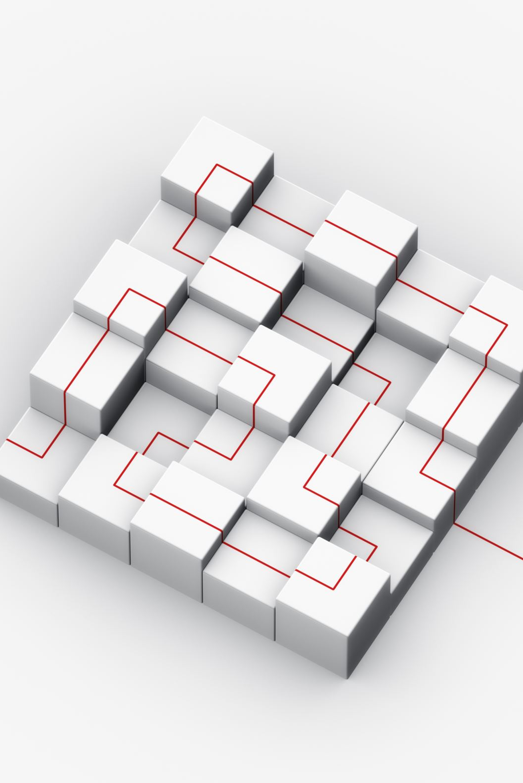
LSTM Model Architecture
Architecture:
- Tokenizer: Word-level
- Embedding Layer: Size 128
- LSTM Layer: Size 128
- Dense Layer with Softmax over the vocabulary
Training Settings:
- Loss: `sparse_categorical_crossentroy`
- Optimizer: Adam
- Batch size: 16
- Epochs: 10

Slide 4
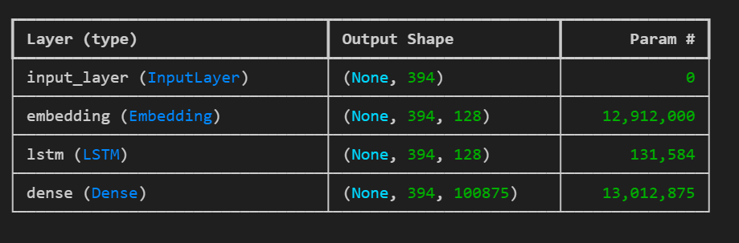
Parameters

Slide 5
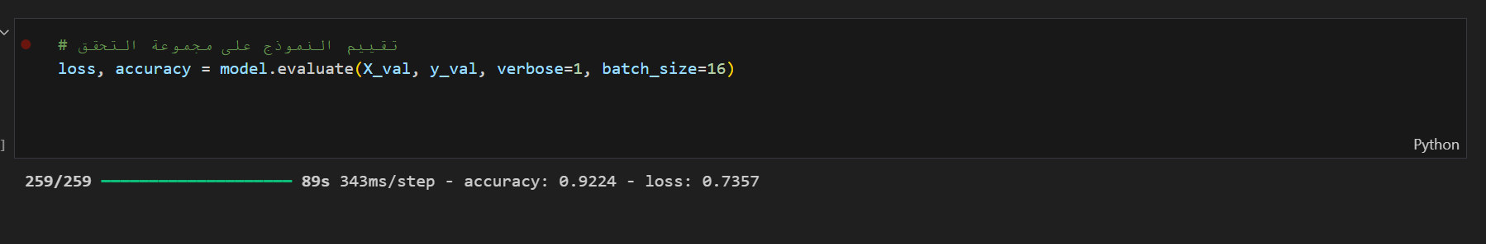
Example of Correction Results
Examples:
Original: العب المصري مثقف.
Corrected: الشعب المصري مثقف.
Original: السد الملك.
Corrected: الأسد الملك

Slide 6
Challenges with LSTM Model
Challenges:
- Modest performance with long and complex sentences
- The model is sensitive to unrealistic randomly generated errors
- need alot more data to perform well

Slide 7
Model 2 – AraBART + LoRA
Data:
- Source: Files `ara_wikipedia_2021_30Ksentences.txt`
Original data is grammatically correct.
- Data clean(Remove punctuation,spaces)
- Random errors (add/remove/swap characters) were programmatically introduced and
splited to
` train_spelling_data.csv`
` validation_spelling_data.csv`
Modifications:
- Used the `CAMeL-Lab/arabart-qalb15-gec-ged-13` model
- Fine-tuning with LoRA to reduce the number of trainable parameters

Slide 8
AraBART Model Architecture
Fine-tuning Technique: LoRA (Low-Rank Adaptation)
LoRA Config:
R:16
Lora_alpha:32
Drpout:0.1
target_modules: ["q_proj", "v_proj"]
Tokenizer: Batch_size:8,Epochs:5

Slide 9
Example of Correction Results
Examples:
Original: هذا الكتاب جمل جدا.
Corrected: هذا الكتاب جيد جدًا.
Original: هيا نلعبو في الحديقه.
Corrected: هيا نلعب في الحديقة.
Original: هوا يحب الكره كثيرن.
Corrected: هو يحب الكرة كثيرًا.

Slide 10
Challenges with AraBART Model
challenges on fine tuning with lora : LoRA needs you to specify which parts of the model to adapt (like q_proj, v_proj). and chosing the wrong parameters like r and alpha can affect the performance
Challenges:
1- challenges on fine tuning without lora : higher memoty consumption compared to LSTM and Risk of Overfitting : Full fine-tuning learns quickly, especially on small datasets.
fine tuning with lora consume less memory
2- challenges on fine tuning with lora : LoRA needs you to specify which parts of the model to adapt (like q_proj, v_proj). and chosing the wrong parameters like r and alpha can affect the performance

