Slide 1

Intelligent Recruiter System.

Slide 2
AGENDA
1.Project idea.
2.Problem Significance.
3.Project Specifications.
4.Time plan.
5.Conclusion.

Slide 3
Problem Significance!

Slide 4
Motivation:
Students need a place to show their full capabilities by interacting with real world problems.
As students, we struggle to know what job market needs before graduating.
Make the recruiting selection process in favor to those who rightly deserve it.
Recruiters are completely dependent on the static profile.
Send notifications to students with ideas about what courses to take.

Slide 5
What is the problem:
Students are not aware of the evolving market needs.
No platform that includes all different fields.
Not all question answering websites provide free access to their information for students.
Most websites focus mainly on the static profile of the student in recruitment.
Recruiters don’t know who is the most qualified for a job or an internship.

Slide 6
Our solution:
A platform that combines several fields together for students.
Combine a question answering platform with a recruitment platform.
Develop a platform that consists of three parts, a search engine, a recommendation, and broker engine.
A dynamic profile is extracted based on Student’s behavior.

Slide 7
Previous solutions:

Slide 8
Stack overflow
Quora
LinkedIn
Advantages:
Uses a wide search engine for Q&A.
Rewarding mechanism.
Users can interact with each others.
Advantages:
Feed page for users.
Different fields.
Users can interact with each others.
Advantages:
A broker engine.
A Job search engine.
Recruiter can contact user.
Disadvantages:
No recommendation engine.
No broker engine.
Manually apply job.
No community.
Disadvantages:
No dynamic profile.
No searching for jobs.
Disadvantages:
No Dynamic Profile for users
Limited search trial.

Slide 9
Project Specifications.

Slide 10
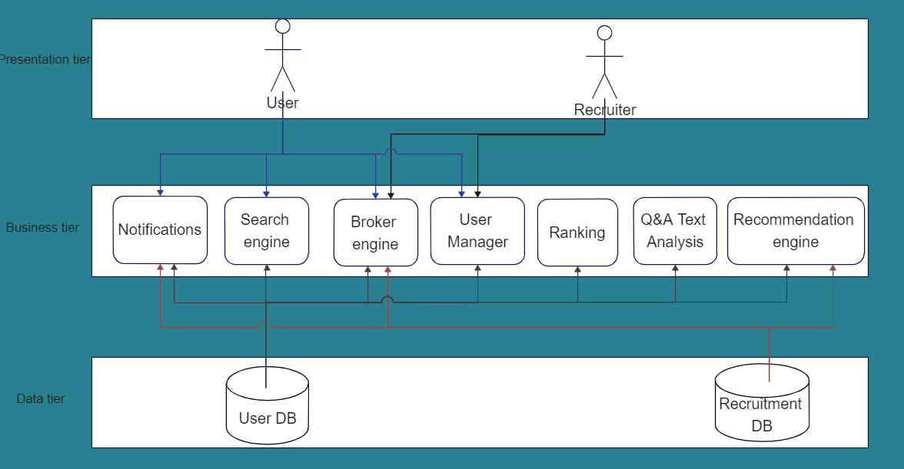

Slide 11
Main components:
Broker engine:
Matchmaking between the jobs’ specifications and student’s skills.
Calculate the cosine similarity.
Return list of matched students with a specific threshold.
Search engine:
Recruiter searches for students by specific skills.
Student searches for jobs by job title, company name or specific skills.
Student searches for questions.

Slide 12
Main components:
Recommendation engine:
Word embedding using TF-IDF technique.
Calculating the similarity between vectors using cosine similarity measurement.
Lob Recommendation :
Recommend the students with jobs that require specific skills closest to a student’s skills.
Skills Recommendation :
Recommend the students with skills to increase their chance at employment.

Slide 13
Main components:
Q & A Text Classification:
Text analysis will be performed on questions and answers so that they are classified into their related topics.
Preprocessing the data.
Vectorizing the data using TF-IDF technique.
Train and test the data using sequential model provided by Keras.
Multi-classification model then used for topics detection.

Slide 14
Main components:
Student Manager:
Static:
All information the student enters when creating the account.
Includes personal information and skills or certificates achieved before making the account.
Dynamic:
Badges earned by students are added to his profile.
Skills gathered by the behavior of the student throughout the activity of the account.

Slide 15
Main components:
Ranking:
The list of students outputted from the broker engine will be ranked.
The list of jobs outputted to a student after making a search for a job with specific skills, titles will be ranked according to such specifications.
Notifications:
Students will receive notifications when job recommendations are sent to them.
Students will receive notifications when skill recommendations are sent to them.
Students will receive notifications when another student interacts with their question or answer (an answer or a like has been added).
Students will receive notifications when they receive a new badge.

Slide 16
Functional Requirements
Student:
Login and registration.
Static profile.
Dynamic profile.
weekly competition.
Adding questions and answers.
Student Interactions.
Student Badges.
Receive Notifications.
Search for jobs
Career tips section.
Recruiter:
Login and registration.
View student profile.
Search by specifications.
New candidate notification.
Admin:
Login.
Add new admin.
Add new competition.
Run recommendation engine.

Slide 17
Non-Functional Requirements
Performance
Scalability
Reliability
Usability
Availability

Slide 18
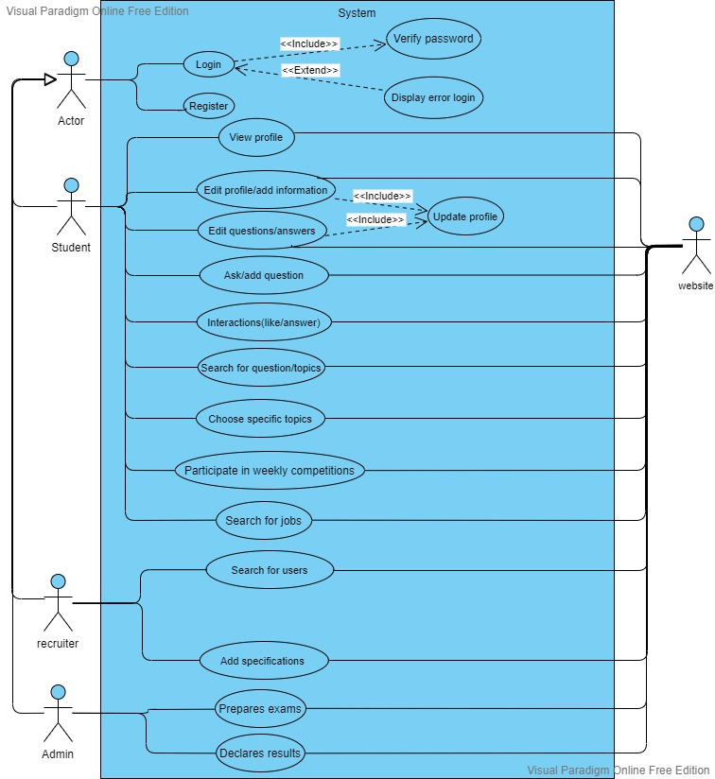
Use case
Diagram:

Slide 19
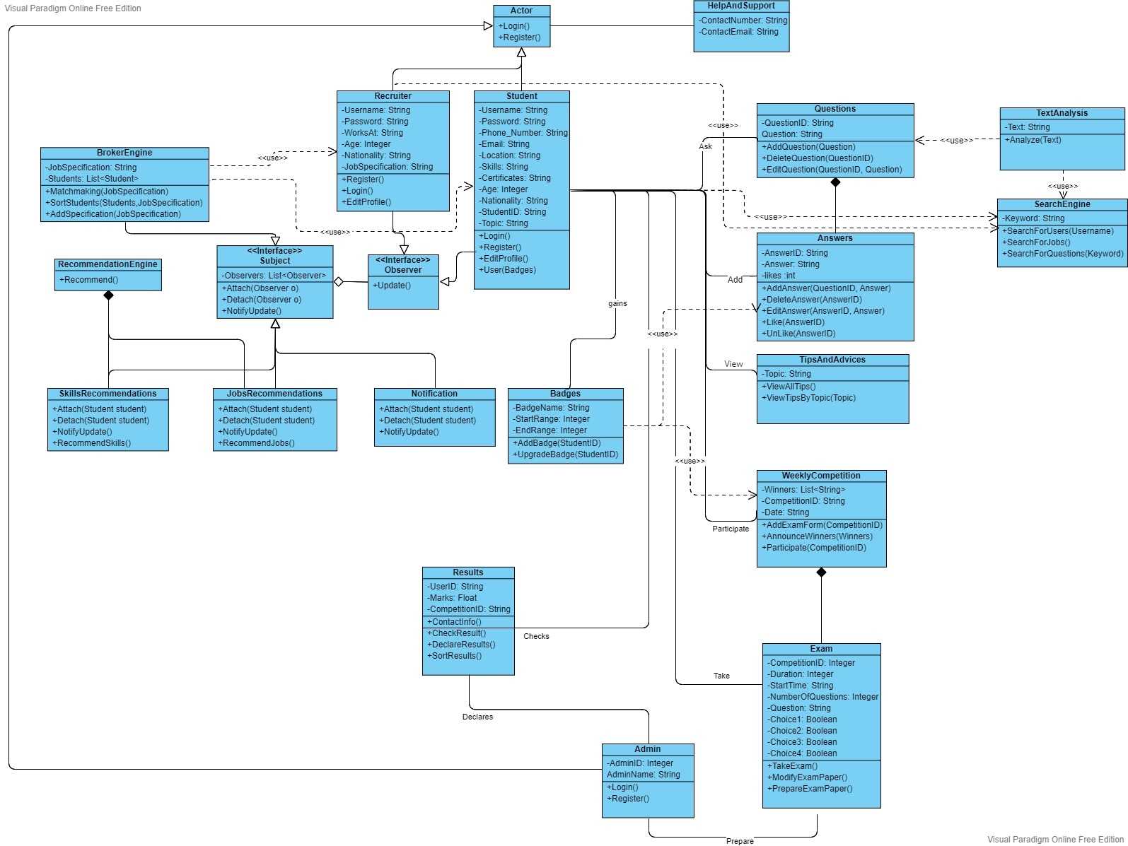
Class Diagram:

Slide 20
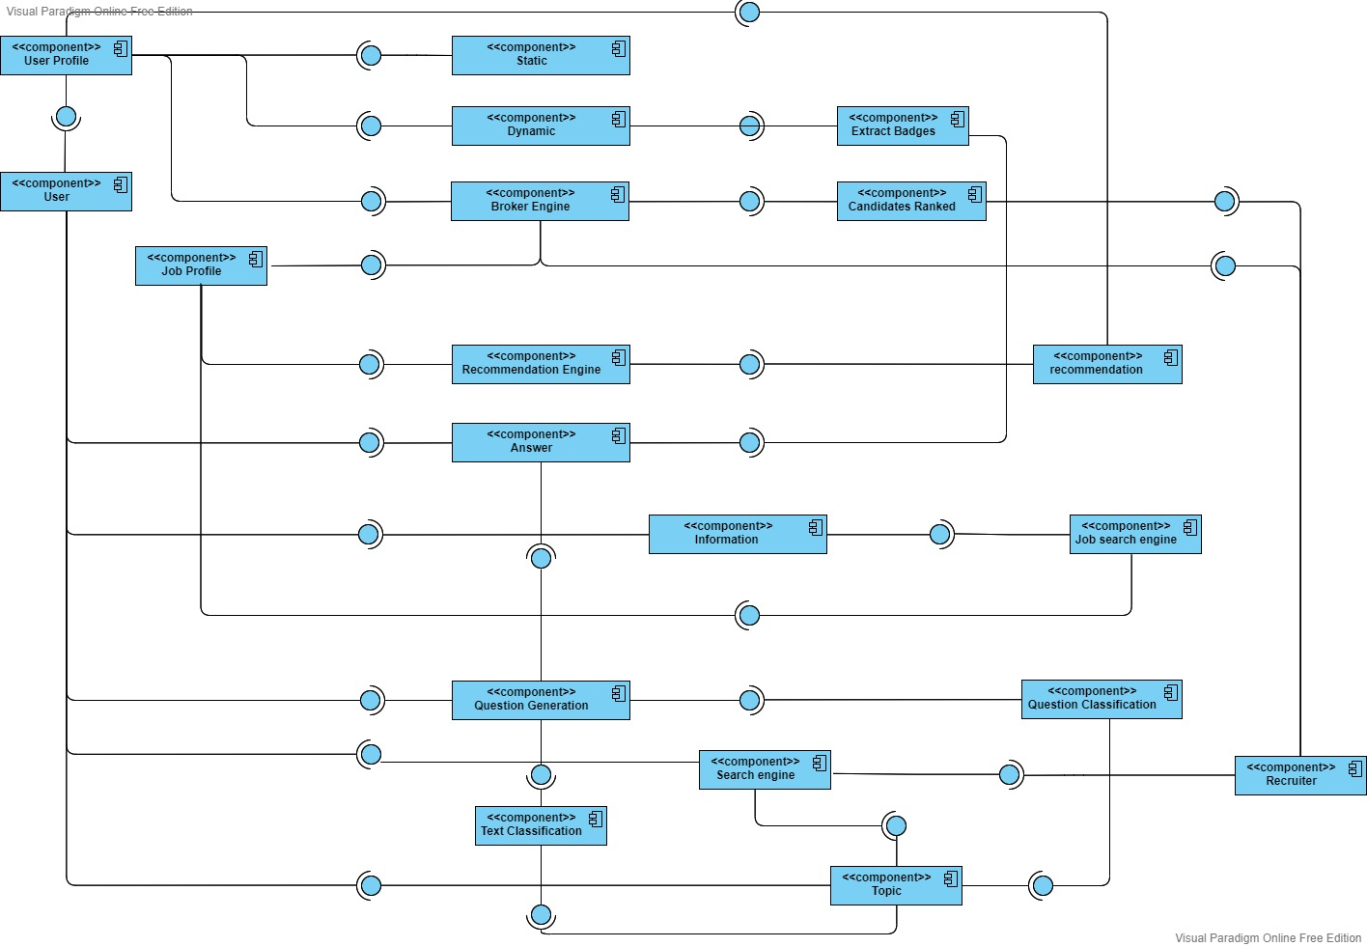
Component Diagram:

Slide 21
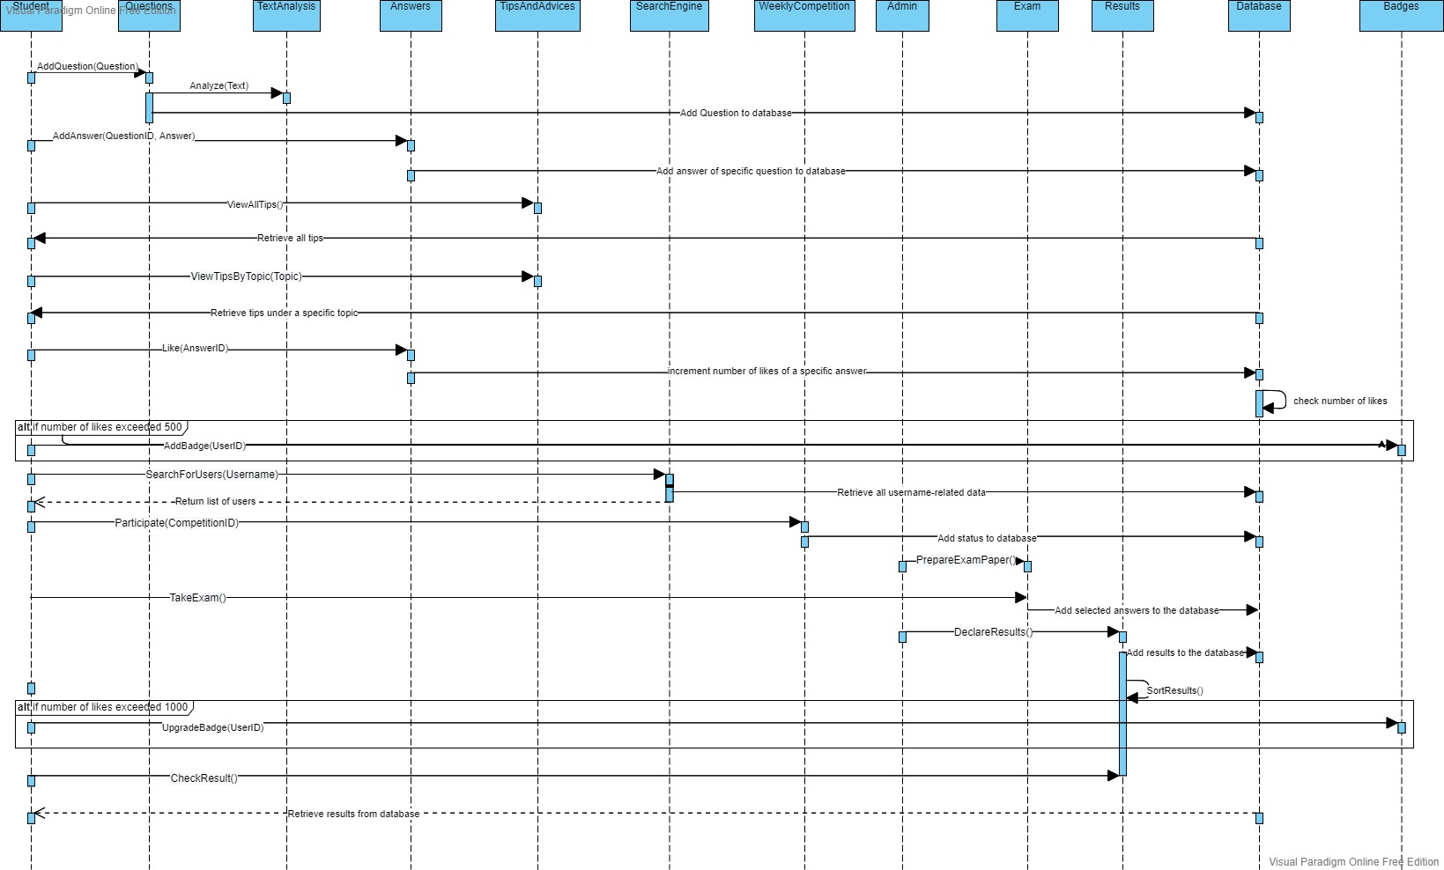
Sequence Diagram 1:

Slide 22
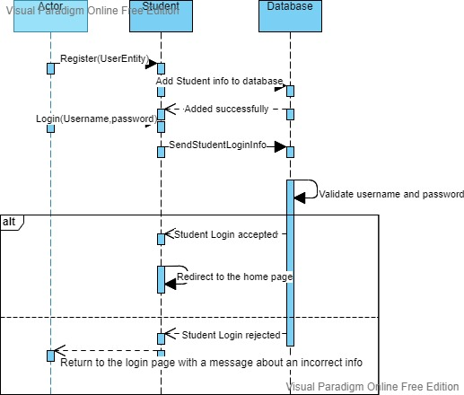
Sequence Diagram 2:

Slide 23
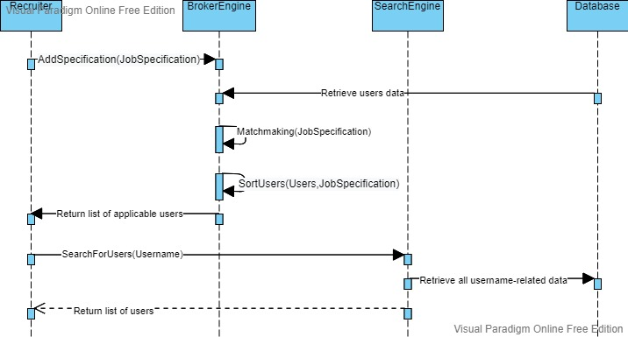
Sequence Diagram 3:

Slide 24
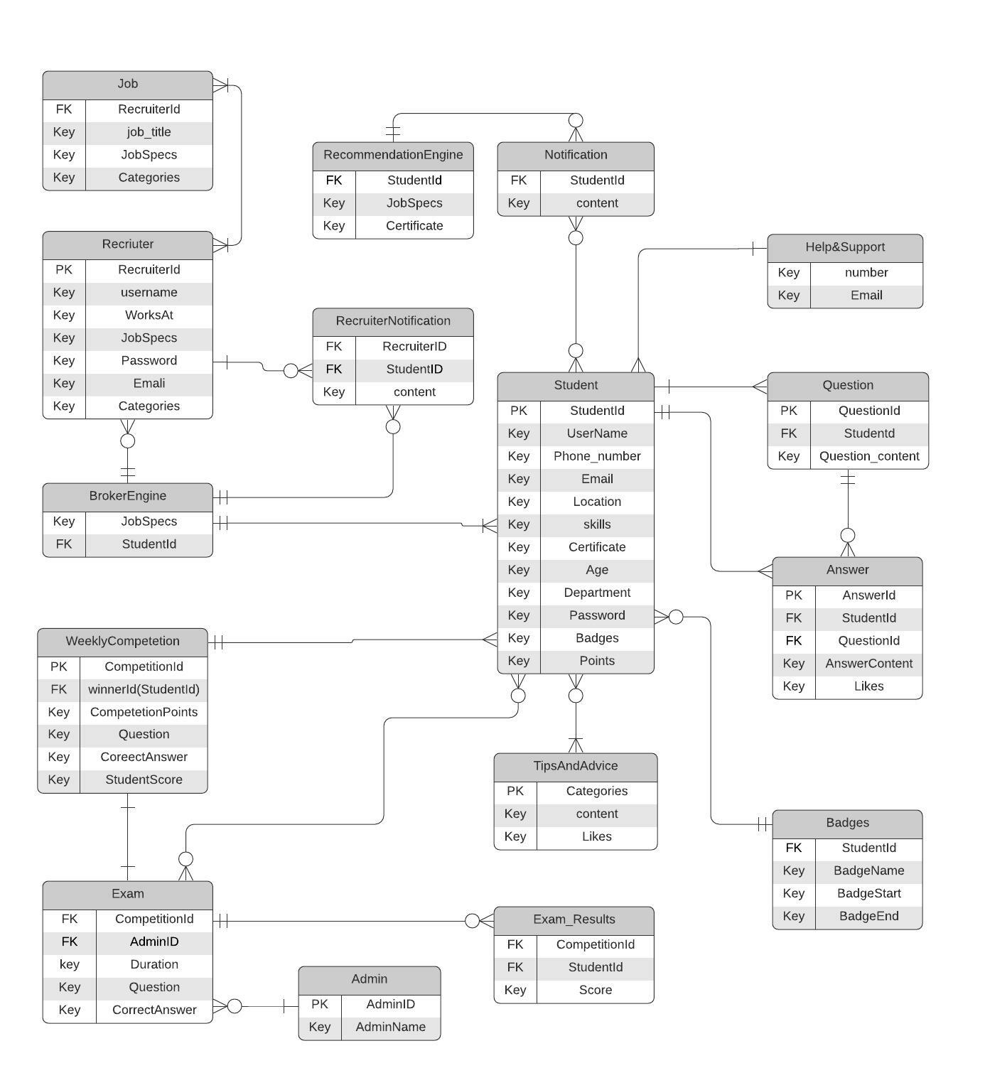
Entity
Relation
Diagram:

Slide 25
System GUI

Slide 27
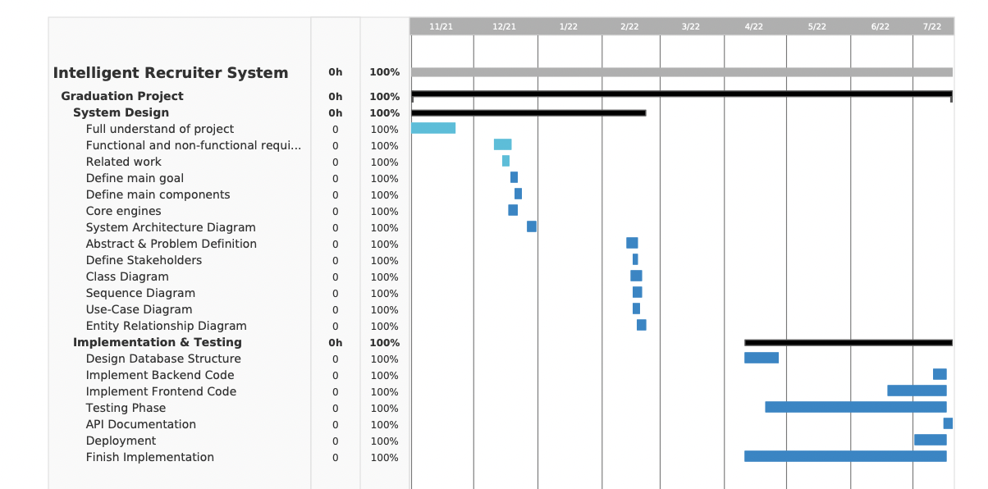
Time plan

Slide 28
CONClUSION
To conclude, The goal of our system is to spread and expand knowledge, to provide a helpful environment for students, to bring together those who have information and those who need it. We also want to provide everyone with the ability to share their knowledge with the rest of the world without restrictions and support an efficient recruitment process.
We look forward to the improvement of students and raising their capabilities in all fields, in addition to making their inclusion in the labor market easier.

Slide 29
Thank You

