Slide 1




$$A$$
$$B$$
$$A$$
$$B$$
$$D$$
$$C$$
$$D$$
$$C$$
map_coloring_solved
map_coloring_unsolved

Slide 2

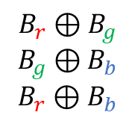


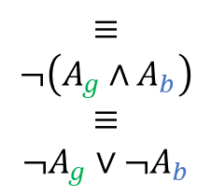



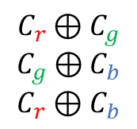




$$A$$
$$B$$
$$C$$
$$D$$
ALO:
$$A_{g}∨A_{b}$$
$${B_{r}∨B}_{g}∨B_{b}$$
$${C_{r}∨C}_{g}∨C_{b}$$
$$D_{g}∨D_{b}$$
AMO:
$$A_{g}⊕A_{b}$$
$$B_{r}⊕B_{g}$$
$$B_{g}⊕B_{b}$$
$$B_{r}⊕B_{b}$$
$$C_{r}⊕C_{g}$$
$$C_{g}⊕C_{b}$$
$$C_{r}⊕C_{b}$$
$$D_{g}⊕D_{b}$$
$$≡$$
$$¬\left(A_{g}∧A_{b}\right)$$
$$≡$$
$$¬A_{g}∨¬A_{b}$$
At-least-once (ALO) + At-most-once (AMO) =
Exactly-once (EO)
Notes:
alo_amo

Slide 3






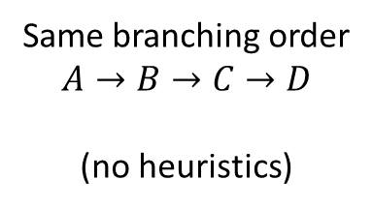



























Same branching order
$$A→B→C→D$$
(no heuristics)
FC
DPLL
$$→$$
$$→$$
$$A$$
$$B$$
$$C$$
$$D$$
$$A_{g}=⊤$$
$$A=$$
$$B_{r}=⊤$$
$$B_{b}=⊤$$
$$A$$
$$B$$
$$C$$
$$D$$
$$C_{b}=⊤$$
$$C_{r}=⊤$$
$$B=$$
$$B=$$
$$\left(D_{g}∨D_{b}\right)∧\left({¬D}_{g}\right)$$
$$∧\left({¬D}_{b}\right)≡□$$
$$D_{b}=⊤$$
$$A$$
$$B$$
$$C$$
$$D$$
$$A$$
$$B$$
$$C$$
$$D$$
$$∅$$
$$C=$$
Backtrack!
Satisfiable
$$C=$$
$$D=∅$$
$$D=$$
Backtrack!
Notes:
direct_fc_vs_dpll

Slide 4

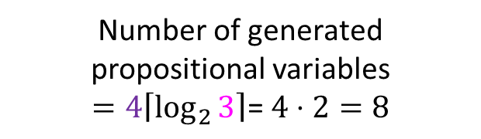

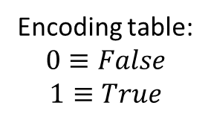

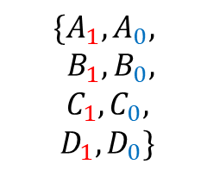


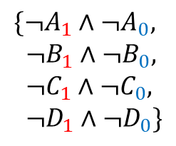

SAT
CSP
Number of generated propositional variables
$$=4\left\lceil \log_{2}{3}\right\rceil \text{= }4⋅2=8$$
Variables:
Variables:$\{A,B,C,D\}$
$$\{A_{1},A_{0},$$
$B_{1},B_{0},$
$C_{1},C_{0},$
$D_{1}, D_{0}\}$
Domain:$\{ , , \}$
Constraints:
$$B$$
Clauses to ensure
no assignment to 11:
$$A$$
$$D$$
Encoding table:
$$0≡False$$
$$1≡True$$
bit 1
bit 0
$$C$$
$\{¬A_{1}∧$ $¬A_{0},$
$¬B_{1}∧$ $¬B_{0},$
$¬C_{1}∧$ $¬C_{0},$
$¬D_{1}∧$ $¬D_{0}\}$
0
0
0
1
1
0
?
1
1
Notes:
log_variables

Slide 5











$$A,D≠$$
bit 1
bit 0
$¬(\left(¬A_{1}∧A_{0}\right)∧(¬D_{1}∧D_{0}$))
0
0
$$A=$$
$$D=$$
0
1
CSP
$$A≠D$$
1
0
$$≡A_{1}∨{¬A}_{0}∨D_{1}∨{¬D}_{0}$$
?
1
1
SAT
$$A,D≠$$
$¬(\left(A_{1}∧¬A_{0}\right)∧(D_{1}∧{¬D}_{0}$))
$$A=$$
$$D=$$
$$≡{¬A}_{1}∨A_{0}∨{¬D}_{1}∨D_{0}$$
Notes:
binary_constraints_log_encoding

Slide 6


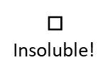

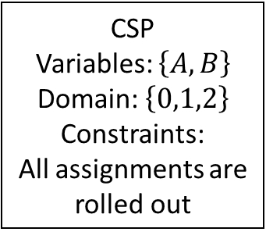

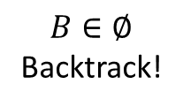





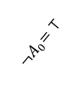

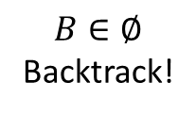





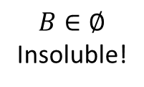


CSP
Variables: $\left\{A,B\right\}$
Domain: $\left\{0,1,2\right\}$
Constraints:
All assignments are rolled out
FC
DPLL
$$A=0$$
$$A=2$$
$$A_{0}=⊤$$
$${¬B}_{1}=⊤$$
$$A=1$$
$$A_{1}=⊤$$
$$B_{1}=⊤$$
$${¬A}_{0}=⊤$$
$${¬B}_{0}=⊤$$
$$□$$
Insoluble!
$$B∈∅$$
Backtrack!
$$B∈∅$$
Insoluble!
$$□$$
$${¬A}_{1}=⊤$$
$$B_{0}=⊤$$
<
$$□$$
$$□$$
3 branches 8 branches
$$□$$
$$□$$
$$□$$
$$B∈∅$$
Backtrack!
$$□$$
For each branch we must backtrack
until the last one
Notes:
log_dominated_by_fc

Slide 7


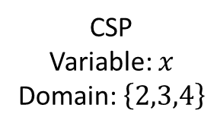


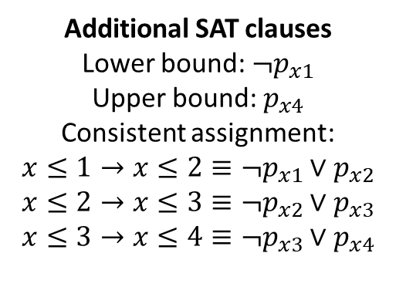







CSP
Variable: $x$
Domain: $\left\{2,3,4\right\}$
Additional SAT clauses
Lower bound: $¬p_{x1}$
Upper bound: $p_{x4}$
Consistent assignment:
$$x≤1→x≤2≡¬p_{x1}∨p_{x2}$$
$$x≤2→x≤3≡¬p_{x2}∨p_{x3}$$
$$x≤3→x≤4≡¬p_{x3}∨p_{x4}$$
$$x$$
$$0$$
$$1$$
$$2$$
$$3$$
$$4$$
$$5$$
$$l\left(x\right) −1$$
$$l\left(x\right)$$
$$u(x)$$
SAT variables:
$$p_{x1},p_{x2},p_{x3},p_{x4}$$
Notes:
order_encoding_variables

