Slide 1

Explore best restaurants place

Slide 2
Introduction
In this project we will try to find a best location for a restaurant. Specifically, this report will be targeted to stakeholders interested in opening an restaurant in new York or Toronto
Since there are lots of restaurants in New York or Toronto
we will try to detect locations that are not already crowded with restaurants. We are also particularly interested in areas with no Italian restaurants in vicinity. We would also prefer locations as close to city center as possible, assuming that first two conditions are met.
We will use our data science powers to generate a few most promising neighborhoods based on this criterion. Advantages of each area will then be clearly expressed so that best possible final location can be chosen by stakeholders

Slide 3
Objectives
Questions that can be asked using the above mentioned datasets
If change idea to build restaurant what we build ?
What places are have best restaurant between new York or Toronto?

Slide 4
Data
For this project we need the following data :
New Delhi Restaurants data that contains list Locality, Restaurant name,Rating along with their latitude and longitude..
Nearby places in each locality of new York city.
Nearby places in each locality of torotno city.
Data source : Fousquare API
Description : By using this api we will get all the venues in each neighborhood.

Slide 5
Approach
Collect the new delhi city data from FourSquare.cm
Using FourSquare API we will find all venues for each neighborhood.
Filter out all venues that are nearby by locality.
Using aggregative rating for each resturant to find the best places.
Visualize the Ranking of neighborhoods using folium library(python)

Slide 6
Results

Slide 7
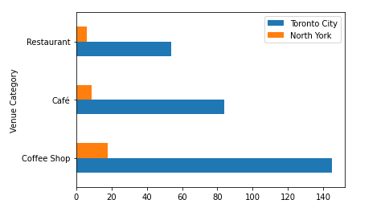

Slide 8
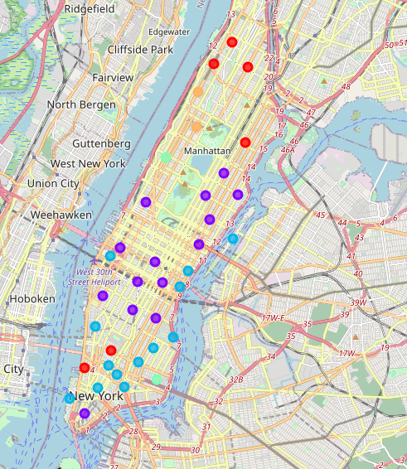
Map :
Clustered restaurant

Slide 9
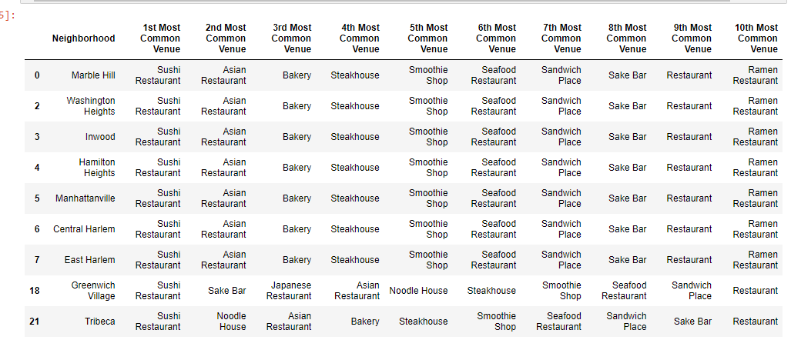
Cluster 1:
It is recommended for venues areas: sushi

Slide 10
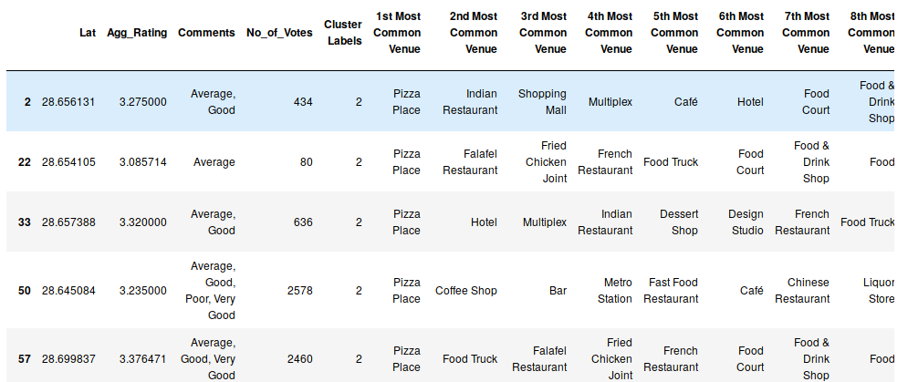
Cluster 2:
It seems like pizza place,

Slide 11
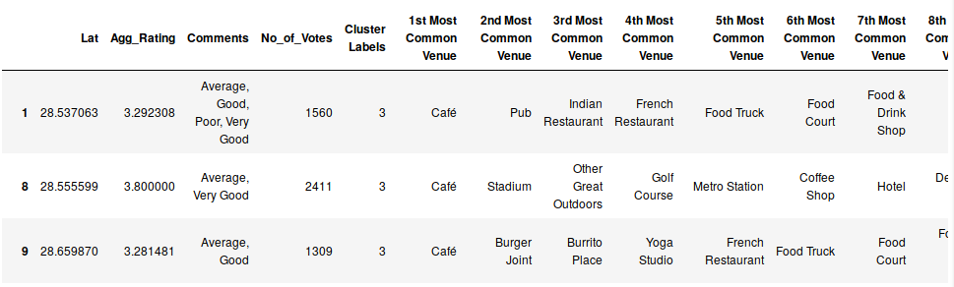
Cluster 5:
It’s most recommended for cafes

Slide 12
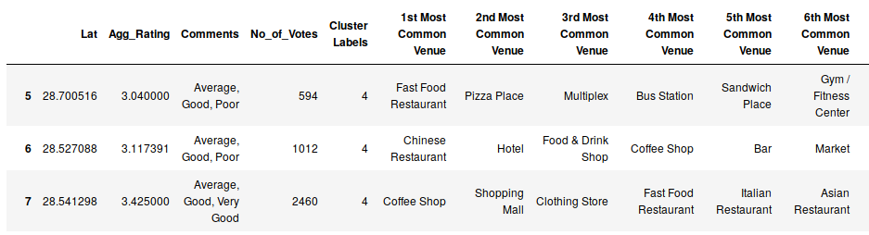
Cluster 5:
Fast food, cafes are the most recommended venues

Slide 13
Conclusion
The Toronto city citizens love drinking coffee more than fast food if business owner builds something else my recommendation is coffee shop

