Slide 1
School Timetable Scheduling Using Genetic Algorithms
Detailed Exploration of Optimization and Constraints

Slide 2
Project Objective
The primary objective is to generate optimal school timetables while meeting the following goals:
- Assign classes to appropriate timeslots, teachers, and rooms.
- Ensure no conflicts in teacher or room schedules
- Maximize resource utilization and minimize idle times.
- Provide a fair and balanced distribution of classes for teachers.

Slide 3
Challenges in Timetabling
1. High Complexity:
- Large number of variables (teachers, rooms, subjects, timeslots)
2. Conflicting Constraints:
- Overlapping schedules for teachers or rooms
3. Dynamic Constraints:
- Last-minute changes like teacher absence or room unavailability
4. Scalability:
- Handling timetables for larger schools with diverse requirements

Slide 4
Key Constraints in School Scheduling
The scheduling problem must consider:
- Teacher Availability: Teachers cannot be scheduled in multiple places simultaneously.
- Room Capacity: Each room should have adequate capacity for the assigned class.
- Subject Requirements: Certain classes may need specialized rooms (e.g., labs).
- Class Schedules: Classes must be assigned without overlapping.
- Break Times: Include sufficient breaks for students and teachers.

Slide 5
Why Use Genetic Algorithms?
Genetic Algorithms (GAs) are well-suited for this problem because they:
- Efficiently explore large solution spaces
- Are flexible in encoding and handling constraints
- Provide near-optimal solutions within reasonable timeframes
- Can adapt to dynamic or additional constraints during execution

Slide 6
Algorithm Design
1. Chromosome Representation:
- Each chromosome represents a timetable (e.g., a list of class-teacher-room assignments).
2. Initialization:
- Randomly generate an initial population of possible schedules.
3. Fitness Function:
-Evaluate solutions based on the number of constraint violations.
- Assign higher fitness scores to feasible solutions.

Slide 7
Handling Constraints
1. Hard Constraints:
- Teacher cannot be in two places simultaneously.
- Room capacity must not be exceeded.
2. Soft Constraints:
- Minimize gaps in teachers' schedules.
- Ensure balanced distribution of classes across timeslots.
Solutions violating hard constraints are penalized in the fitness function.

Slide 8
Workflow of the Solution
1. Problem Definition: Identify inputs (classes, teachers, rooms) and constraints.
2. Initialize Population: Generate random solutions.
3. Evaluate Fitness: Assess solutions based on constraints.
4. Apply GA Operators:
- Selection: Choose the best solutions.
- Crossover: Combine solutions to create new ones.
- Mutation: Introduce variability.
5. Iterate: Repeat until a satisfactory solution is found.

Slide 9
Detailed Results and Analysis
Key Findings:
- Generated timetables meet constraints with minimal violations.
- Optimized resource usage with fewer idle times.
Performance Metrics:
- Average fitness score: Shows improvement across generations.
- Generations required for convergence: Indicates algorithm efficiency.

Slide 10
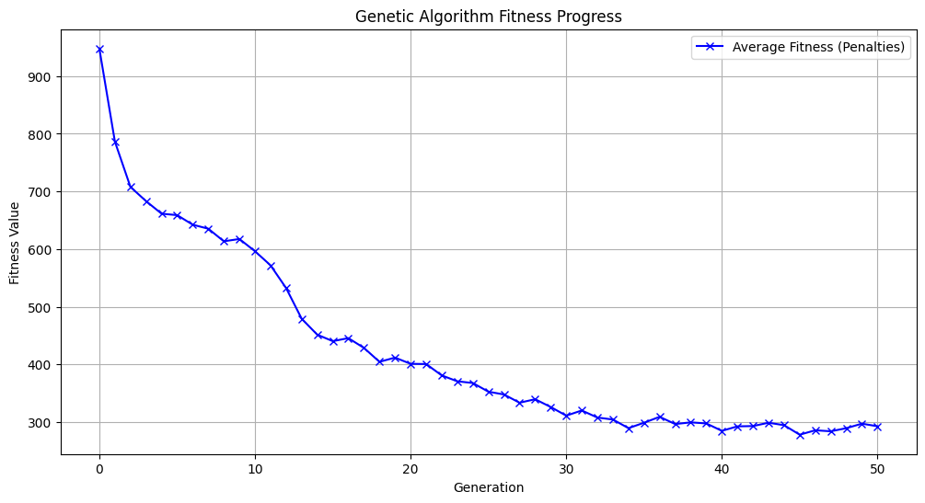
Plot 1

Slide 11
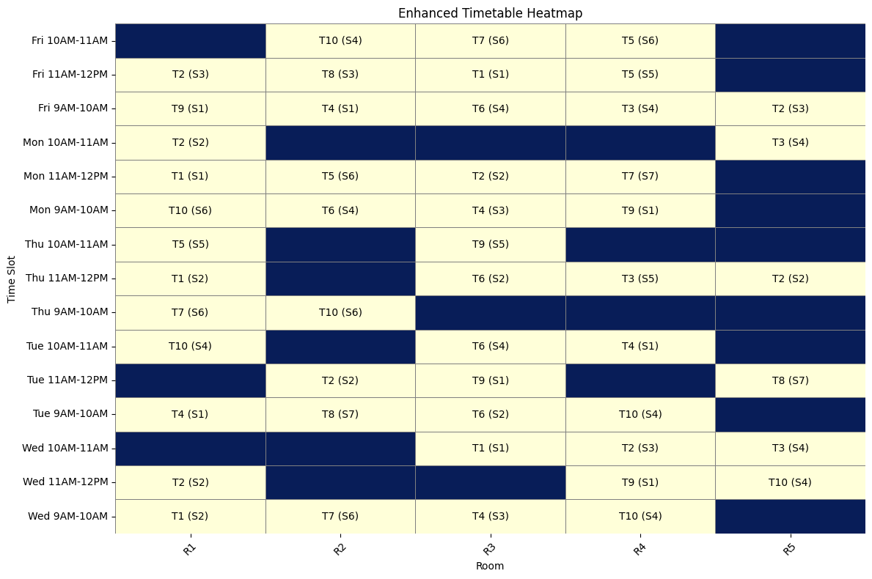
Plot 2

Slide 12
Conclusion and Future Work
Conclusion:
- Genetic Algorithms provide an effective solution for complex scheduling problems.
- The flexibility of GAs ensures adaptability to changing requirements.
Future Work:
- Incorporate machine learning for dynamic constraint adjustment.
- Use parallel computing to handle larger datasets.

