Slide 1
Notion 4ME

Slide 2
Team Members
1-Ehab Ramadan
2-Mazen Mohamed
3-Moustafa Attia
4-Moustafa Ramadan
5-Mohab Yasser
Supervised by: Dr.Dawlat Abd Elaziz
2

Slide 3
Project Description
is an all-in-one workspace where you can write, plan, collaborate and get organized - it allows you to take notes, add tasks, manage projects & more.
Notion provides the building blocks and you can create your own layouts and toolkit to get work done.
3

Slide 4
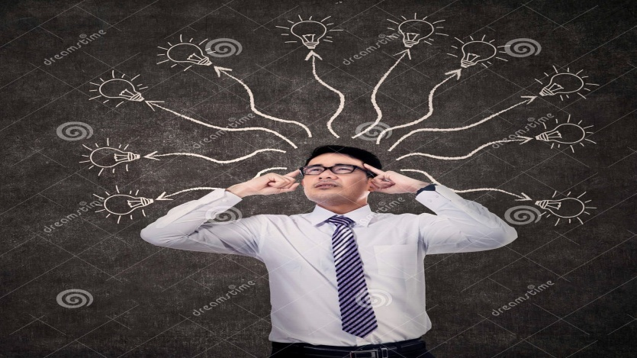

Why Notion
People have many ideas, thoughts and daily plans but they can’t memorize all of those when needed, so it must be saved.
Okay, let’s save our ideas using a paper.
4

Slide 5
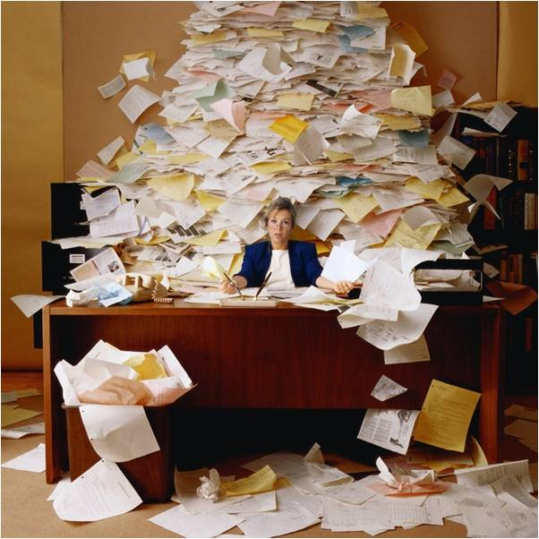
Problems
When we use papers:
With more and more ideas, it will lead us to have a lot of papers.
Another problems happens :
Damaged,
Lost,
Doesn’t provide: images, audios and videos..etc.
5

Slide 6
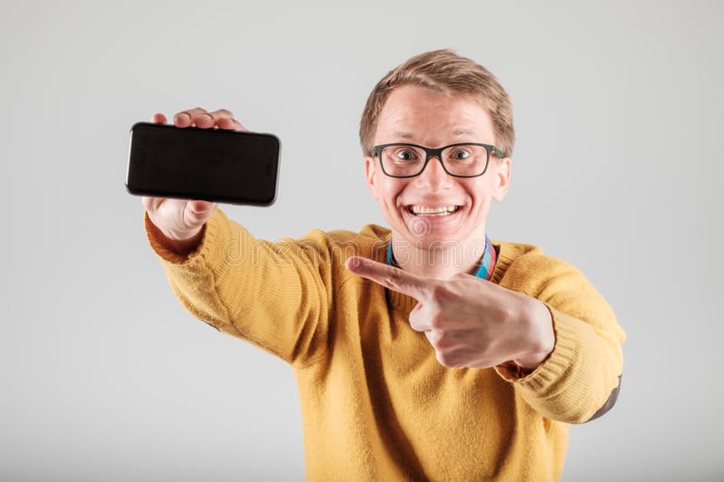
Solution
Solution for the previous problems is to digitize the information . That’s why NOTION 4ME were made for.
6

Slide 7
Notion Disadvantages
Make it more simple.
It is complicated to use.
Limited storage.
Make it free.
7

Slide 8
What’s new?
Finding solutions for Notion’s disadvantages: complicated to use, limited Storage
Pomodoro technique.
Record and insert audio notes.
8

Slide 9
Project Objectives
provide tools to arrange, organize and manage everything in the user's work life and personal life to facilitate them " Life cycle management“.
improve the user's productivity.
providing the building blocks and user can create his own layouts to get more work done.
Allowing teams and individuals to plan their projects, work and goals.
the workspace allows you to write in a beautiful clean space and build your own personal wiki.
more than one can deal with the same workspace.
9

Slide 10
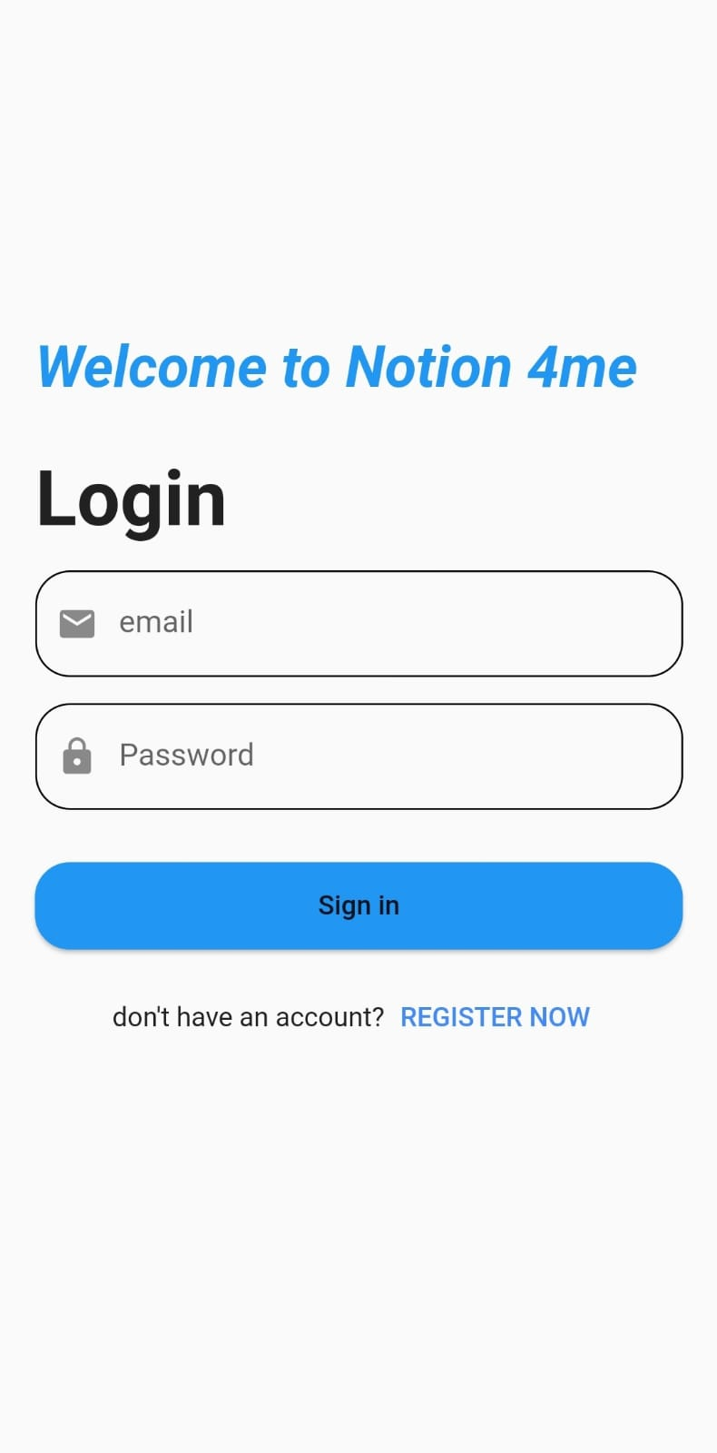
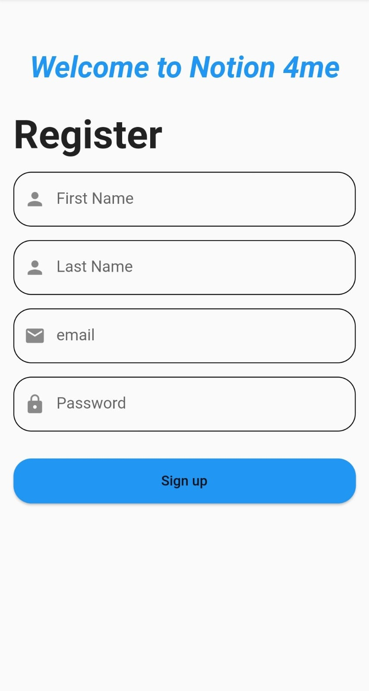
Notion 4Me
Register
Login
10

Slide 11
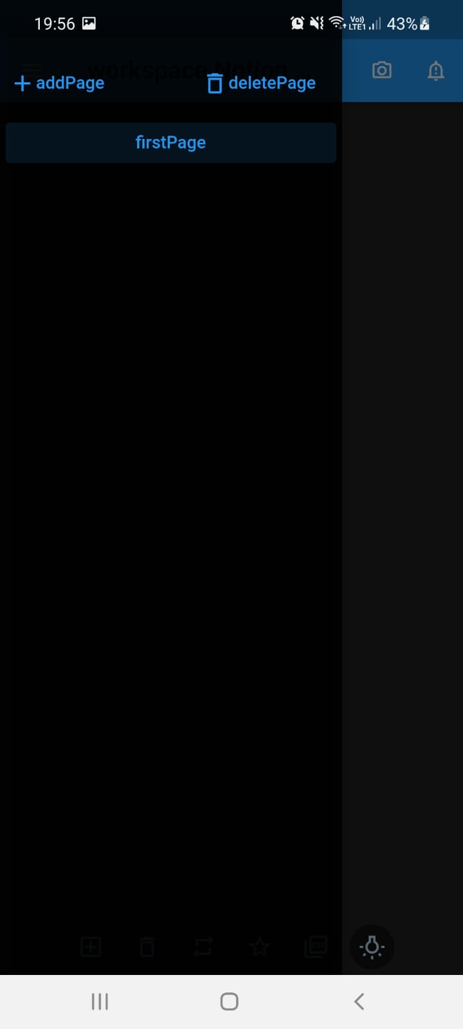
Navigation bar
Contain two buttons: “add page” for adding new page and he can name it as he like and
“delete page” for deleting a particular page.
“first page” is default page if the user don’t add pages.
11

Slide 12
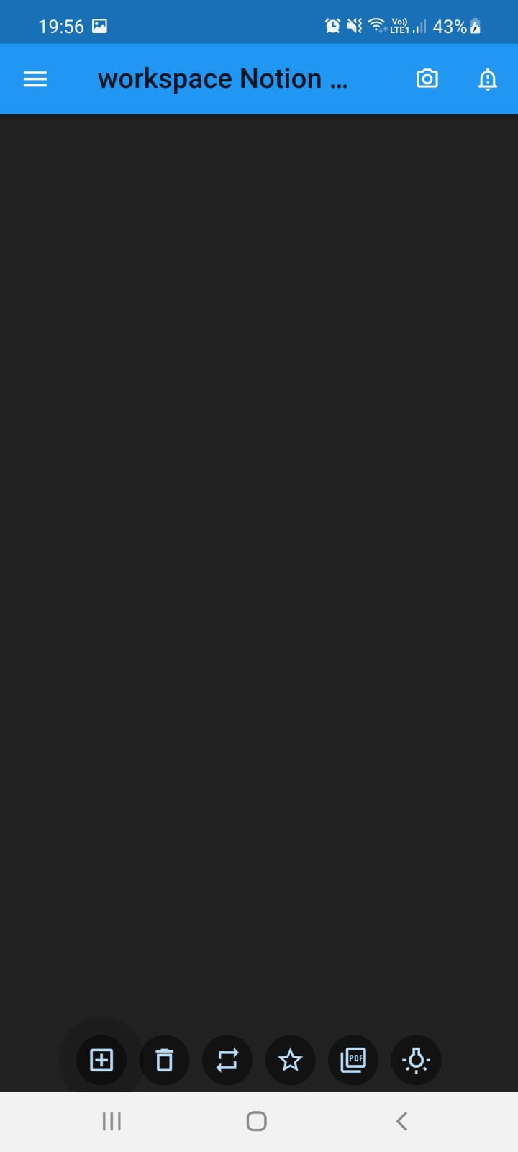
Page
When the user add page this will show to him which contain:
App bar
Button icon “menu” that open the navigation bar.
Default Title
Collection of actions (icon buttons)
collections of icon buttons:
First : add components in the page.
Second: delete component from the page
Third: reversing the indexes of components
Fourth: add favourite pages
Fifth: upload file
Sixth: switch between light mode and dark mode
12

Slide 13
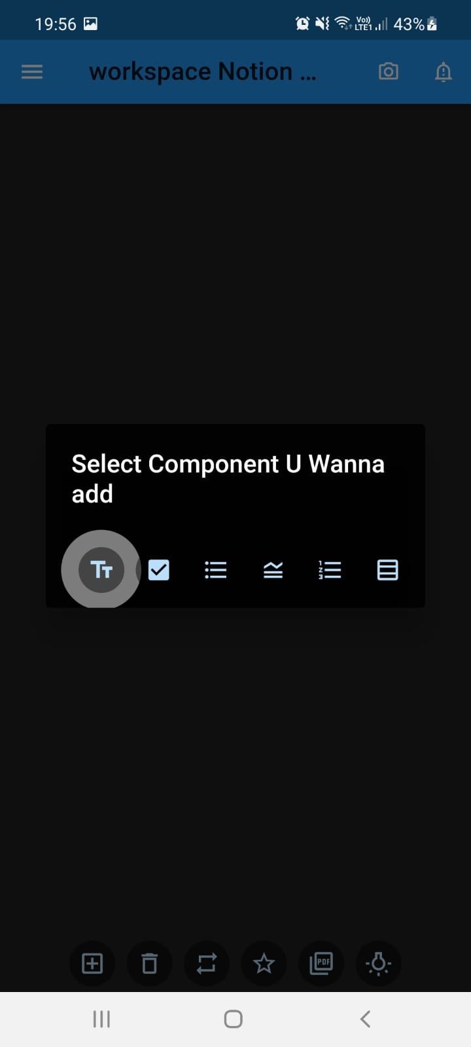
Add component
When the user click on the first button “ add component another collection of icon button will show:
First: to add Text Field
Second: to add Check Box
Third: to add Bulleted List
Fourth: to add Toggle List
Fifth: to add Numbered List
Sixth: to add Table
13

Slide 14
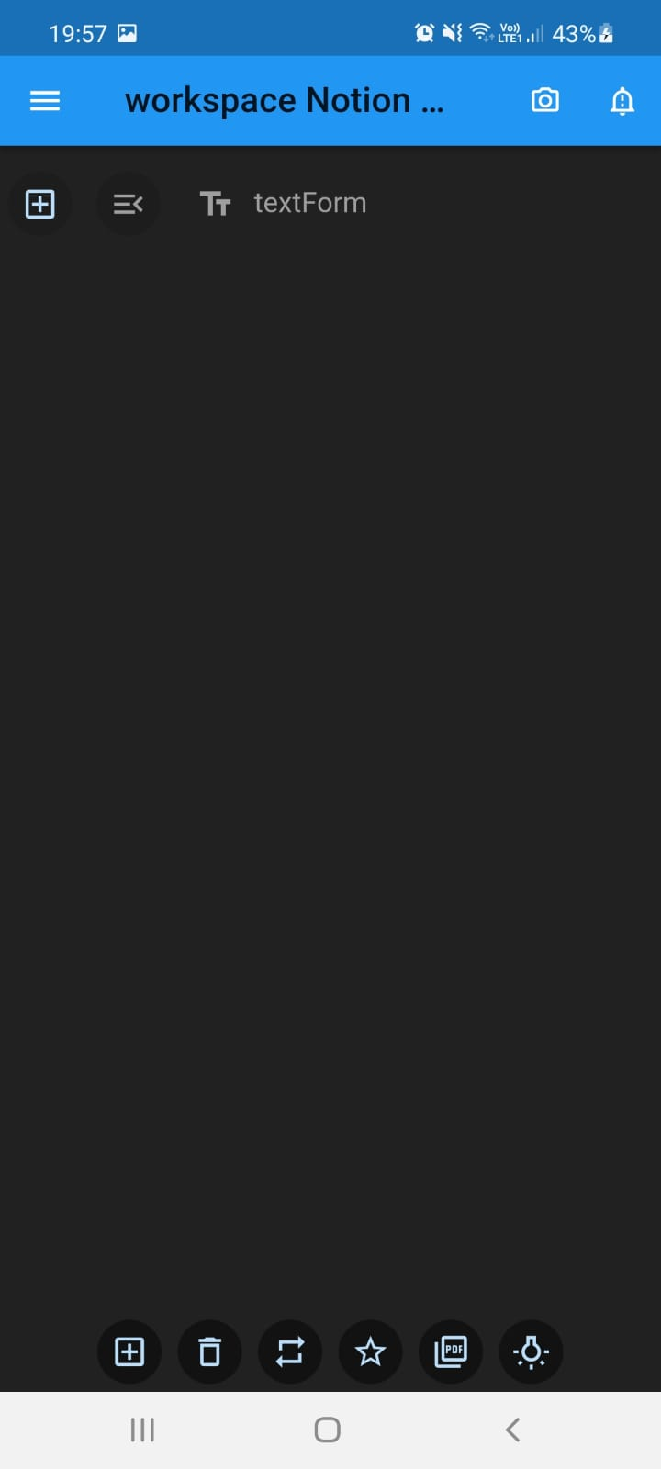
Add component
So when he click in the first button, a Text Field will be added to the page as shown in the following screen And when he click in the second button, a check box will be added to the page and so on..
We can see two more icons buttons in the left of the text:
First : to add component but in index
Second: for the style of the text: font weight, font size, font colour..
14

Slide 15
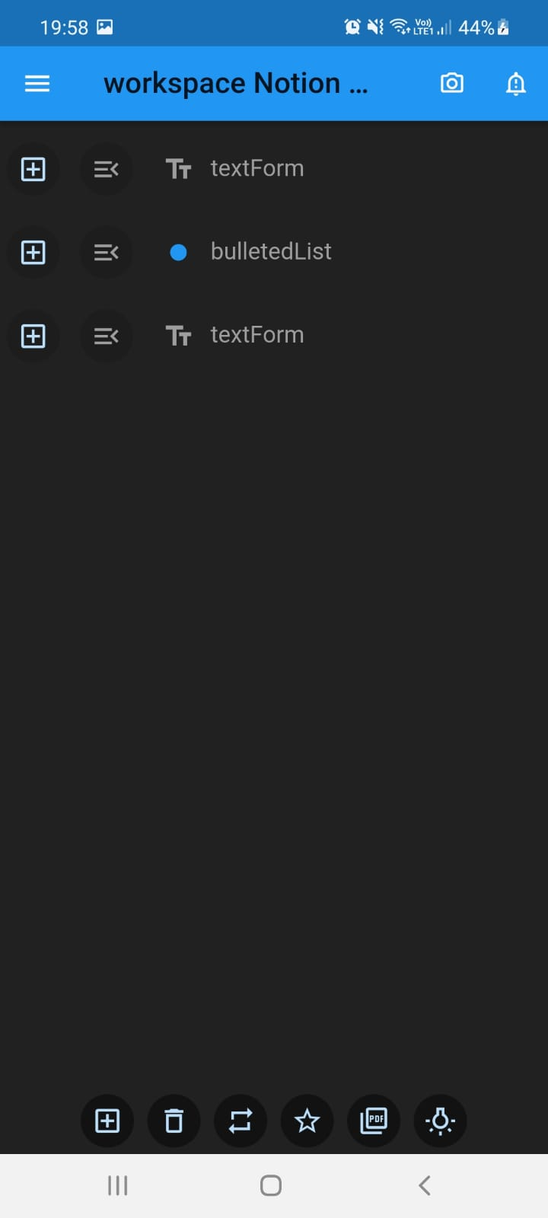
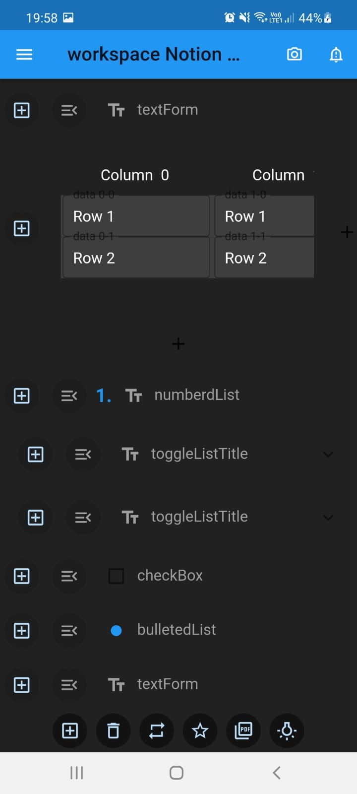
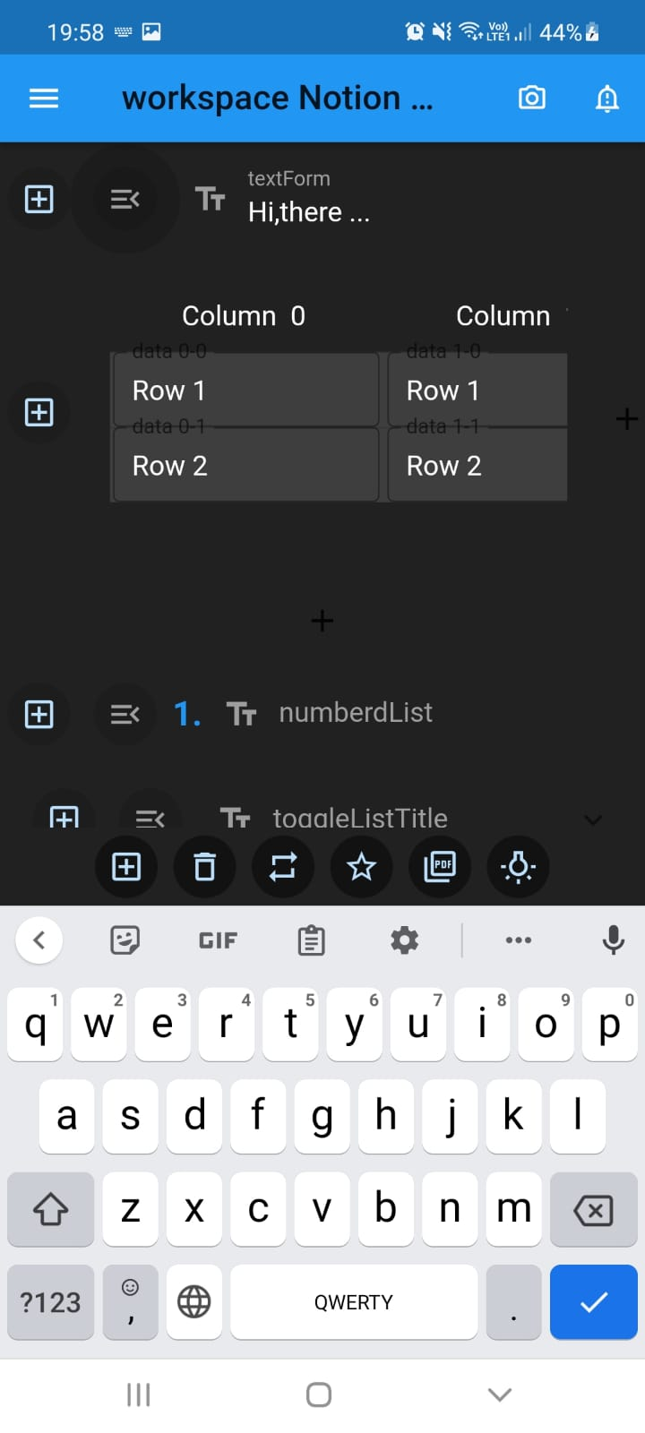
Other screens shows the functionality of all the icon buttons at the end of the page:
15

Slide 16
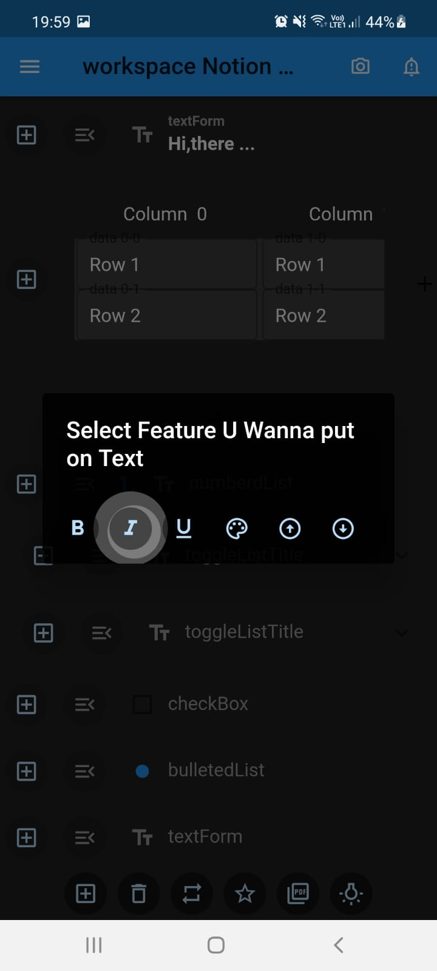
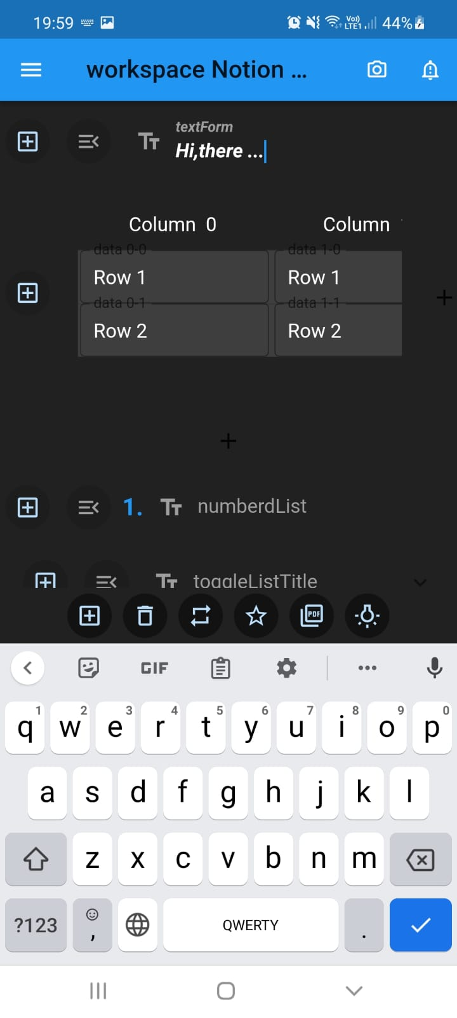
Text Style icon button
First button: to make the text bold
Second button: to make the text italic
Third button: to underline the text
Fourth button: to change the colour of the text
Fifth button: to increase the size of the text
Fifth button: to decrease the size of the text
And for example when he click in the second button as shown in ( Screen 1) the text become italic as shown in (Screen 2).
Screen 1
Screen 2
16

Slide 17
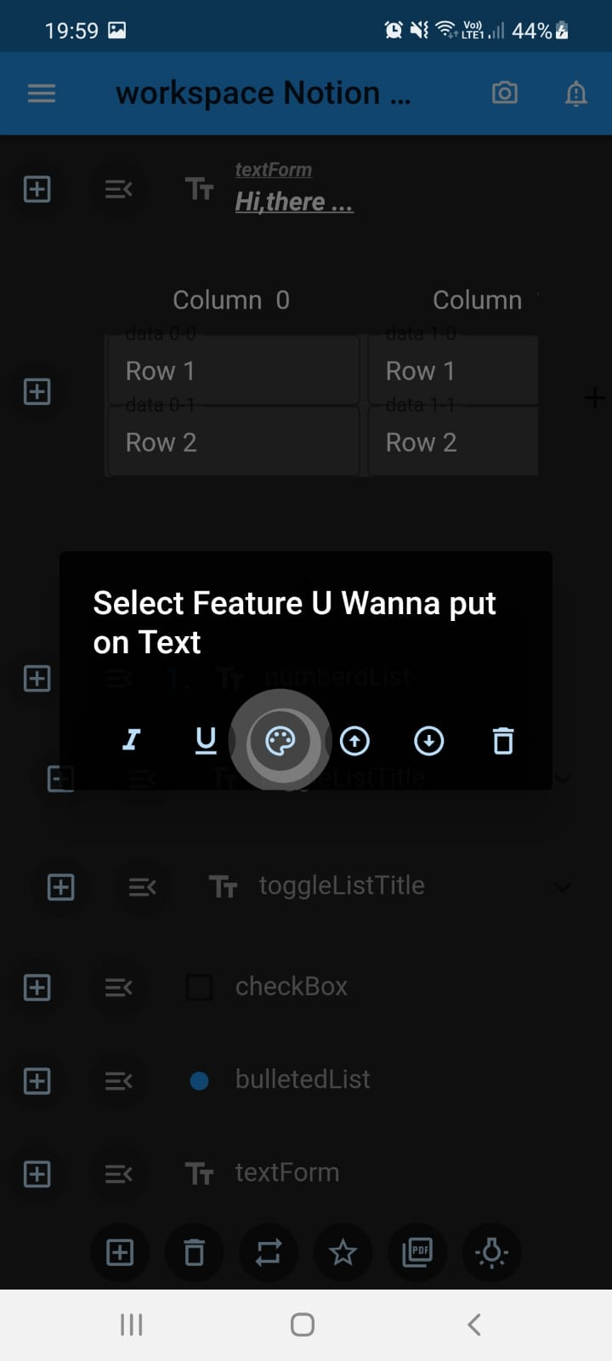

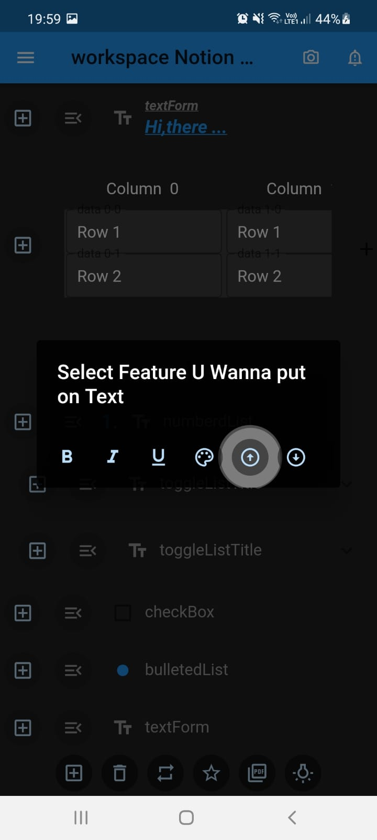
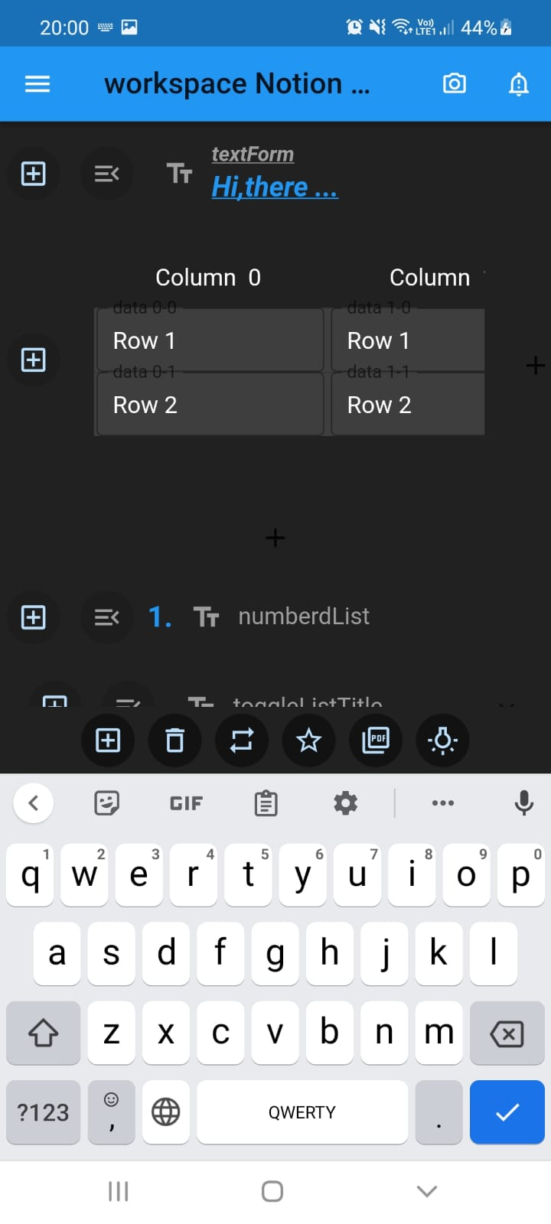
Other screens for text style
17

Slide 18
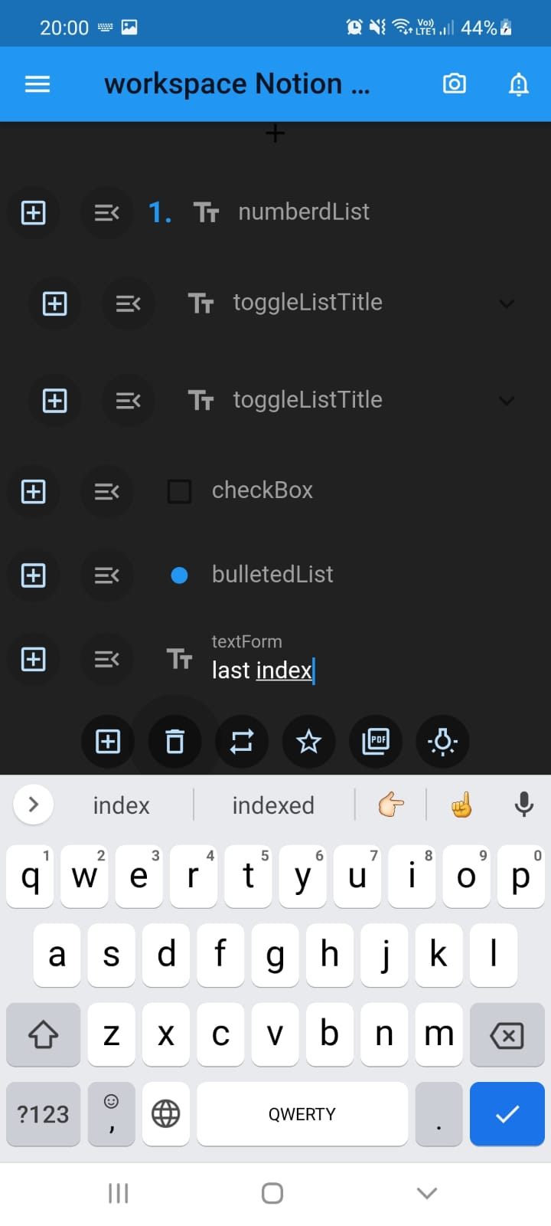
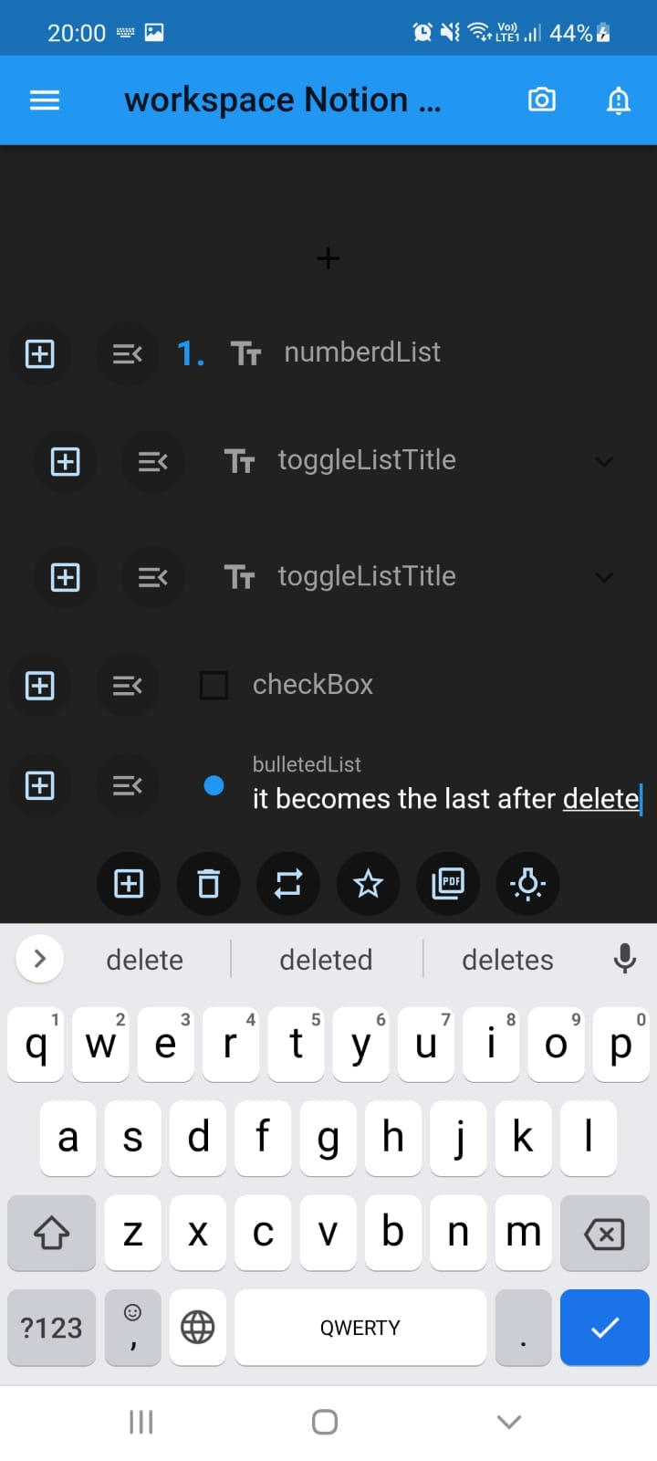
Delete button
Screen 1
Screen 2
When the user want to delete any component say the last one which is Text Field as shown in (Screen 1) he just click in the button delete and then it deleted as shown in (Screen 2).
18

Slide 19
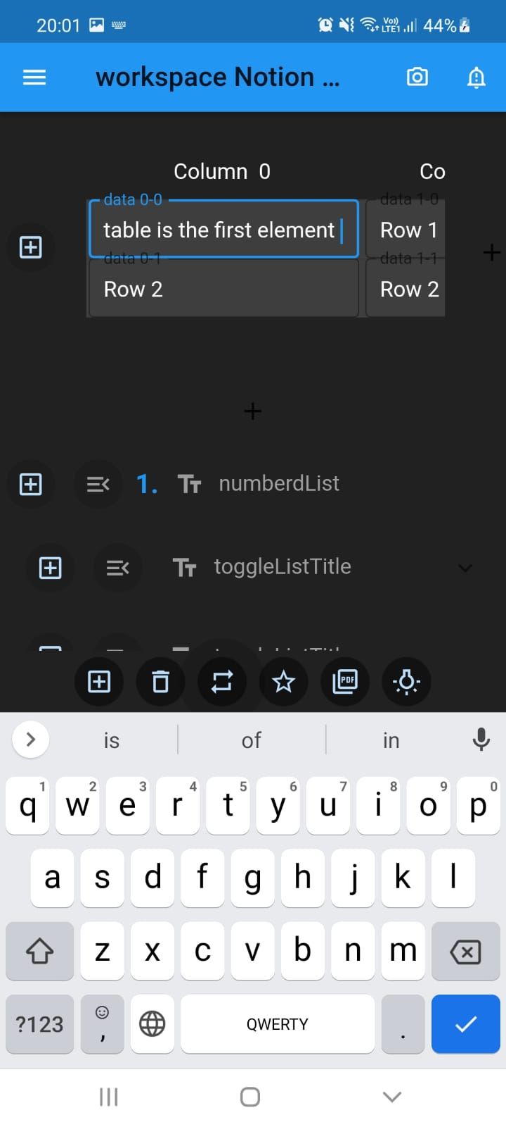
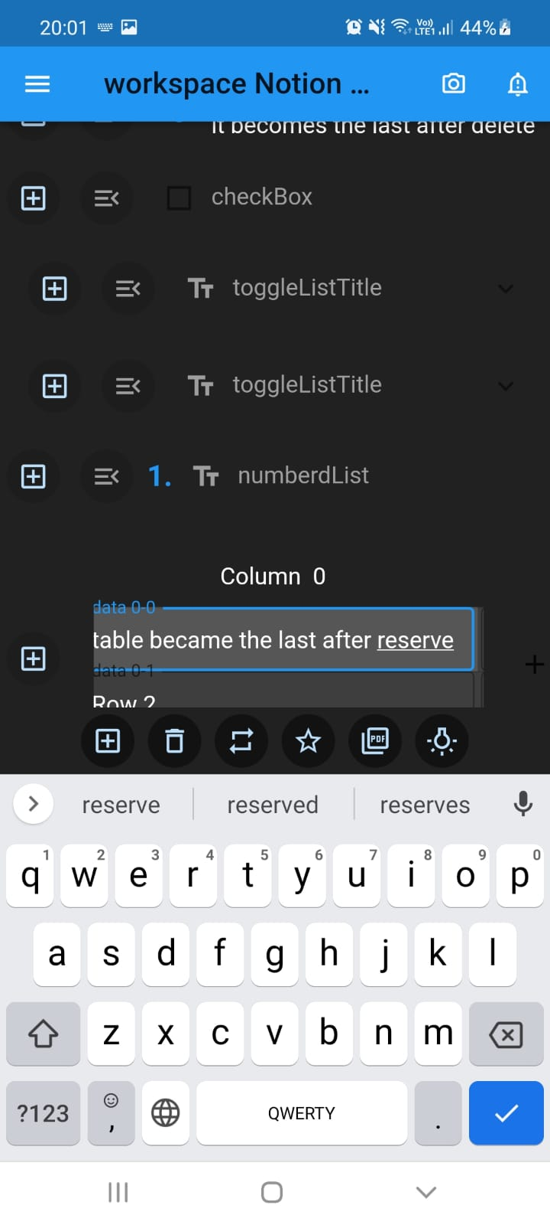
Reverse button
Screen 1
Screen 2
When the user want to reverse all the component as shown in (Screen 1) he just click in the button reverse and then it reversed as shown in (Screen 2).
19

Slide 20
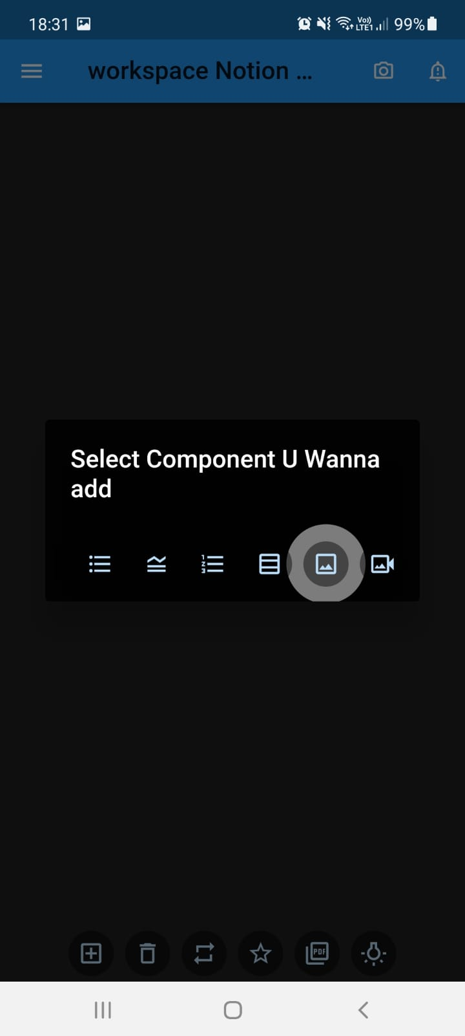
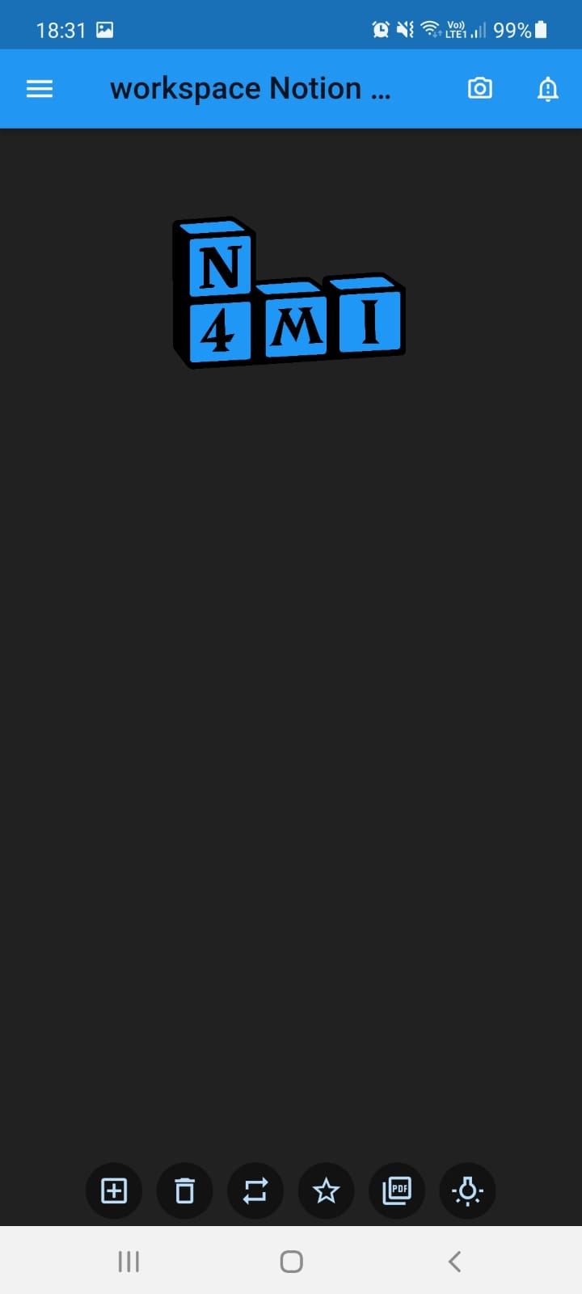
Add Image
Screen 1
Screen 2
When the user want to add Image he click in the button image as shown in (Screen 1) and then pick image from his gallery and then it show in the page as shown in
( Screen 2)
20

Slide 21
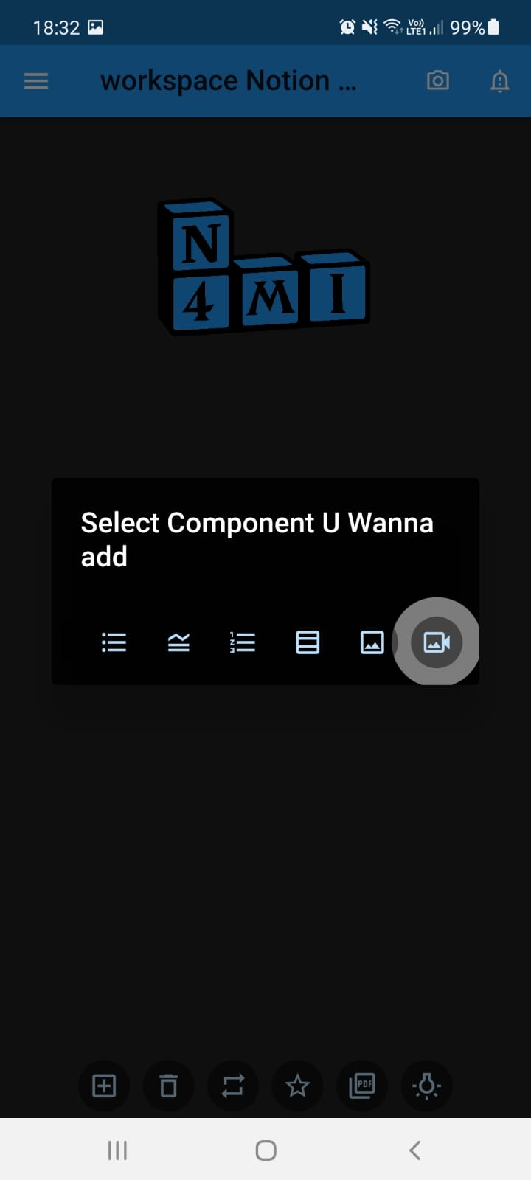
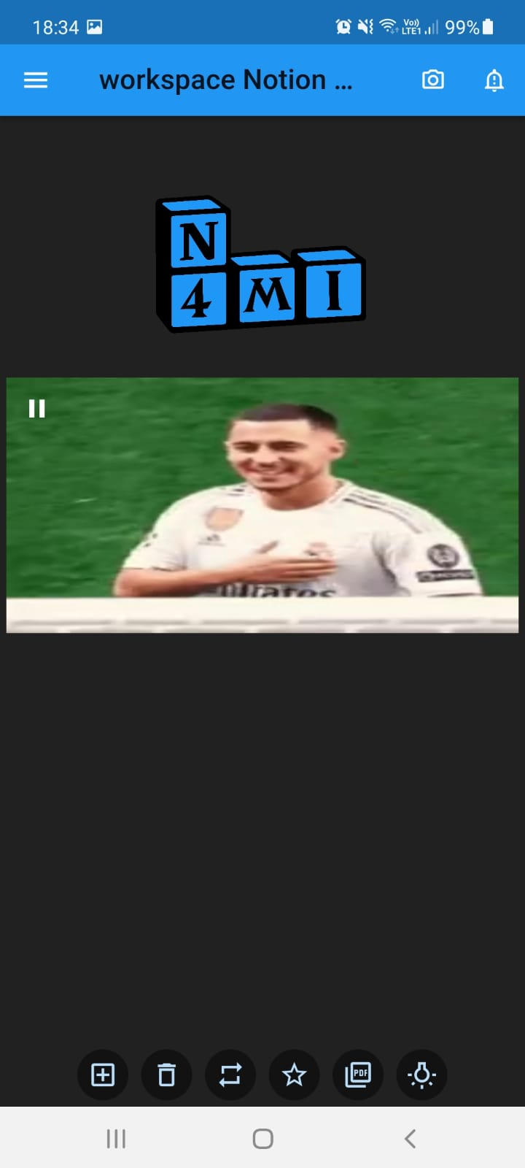
Add Video
Screen 1
Screen 2
When the user want to add image he click in the button image as shown in (Screen 1) and then pick video from his gallery and then it show in the page as shown in
( Screen 2)
21

Slide 22
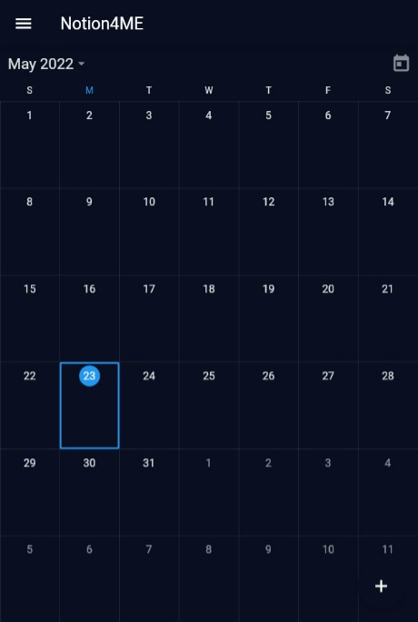
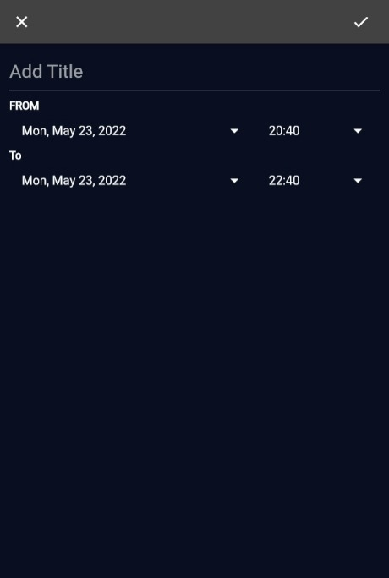
Calendar
Screen 1
Screen 2
When the user want to add calendar he click in calendar and ( Screen 1) will show to him.
When he pick a day and click on it, ( Screen 2 ) will show and he can add title and choose from and to and click on save at the top right.
22

Slide 23
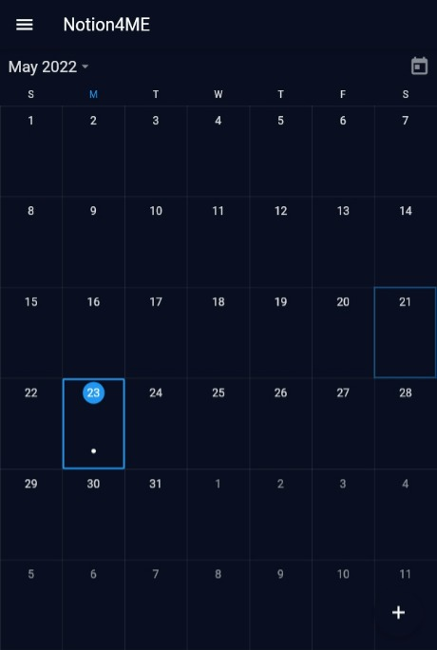
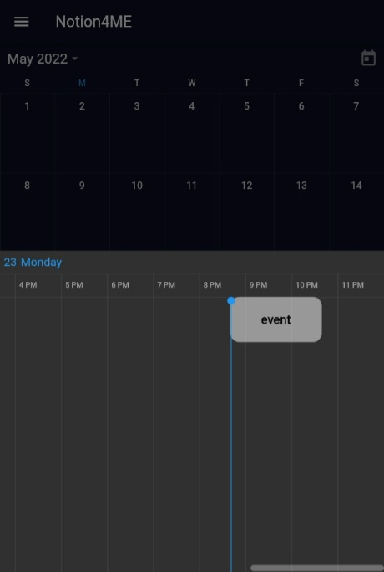
Calendar
Screen 2
Screen 1
Now we can see a dot in the picked day as shown ins ( Screen 1 ), So when the user click on it the
( Screen 2 ) will showed and he can add events.
23

Slide 24
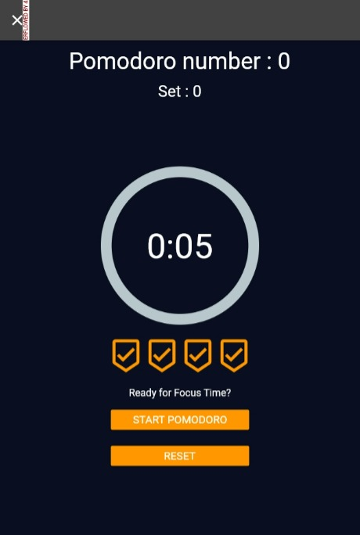
Pomdoro technique
When the user want to focus in particular task for 25 minute he can use our pomodoro by click on it so the Screen show to him which contain:
Pomdoro number as counter
Timer
Two buttons: first to start the pomdoro and the second to reset it
24

Slide 25
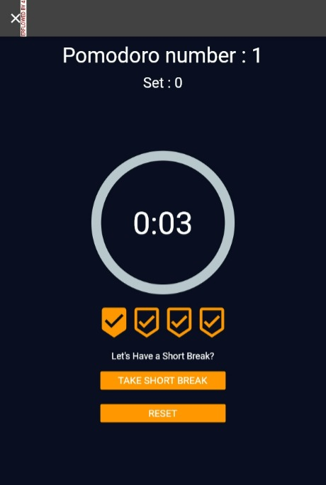
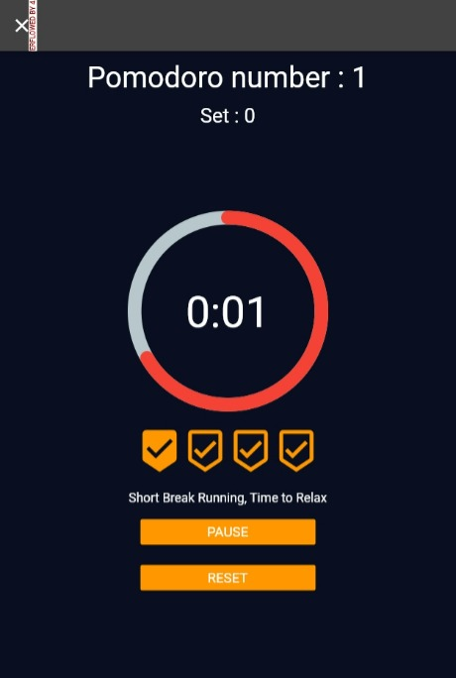
Screen 1
Screen 2
Pomdoro technique
When he clicked in start ( Screen 1) will show and the timer started, and the counter increases
And he also can take short break or rest the timer as shown in ( Screen 1 ) and when he back he can click on pause as shown in ( Screen 2).
25

Slide 26
Authentication
the first screen in our application is the register screen, so everyone must enter name, email and password, and this data will be saved in authentication ( users ) which will create user id for each user.
After registration then Login screen will show to enter his email and password and then we compare the email and password if it correct or not if correct he will enter the main Screen.
If he close the app and open it again the main screen will show ( using shared preference ).
26

Slide 27
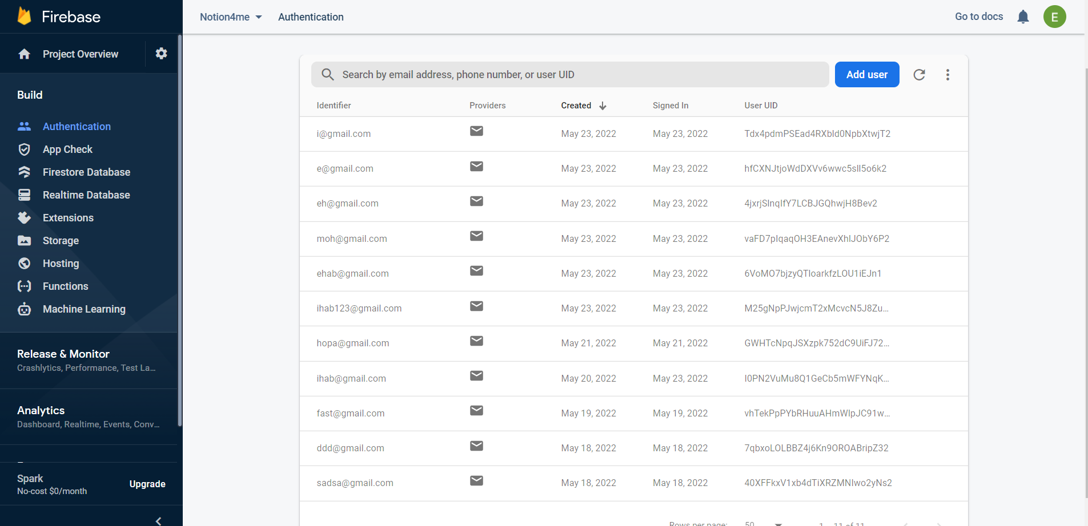
Authentication
27

Slide 28
Firestore Database
So we need when the user reopen the app, his data still there so we use Firebase Database.
We create Collection called users ( which has the all the id from each user that register (authentication) this id called “ documents “ and fields.
Each user has number of pages ( every page has “unique document) and fields.
Each page has many components ( every component has “ unique document “) and fields.
Each component has many texts ( every text has “ unique document ) and fields.
Each text has fields.
28

Slide 29
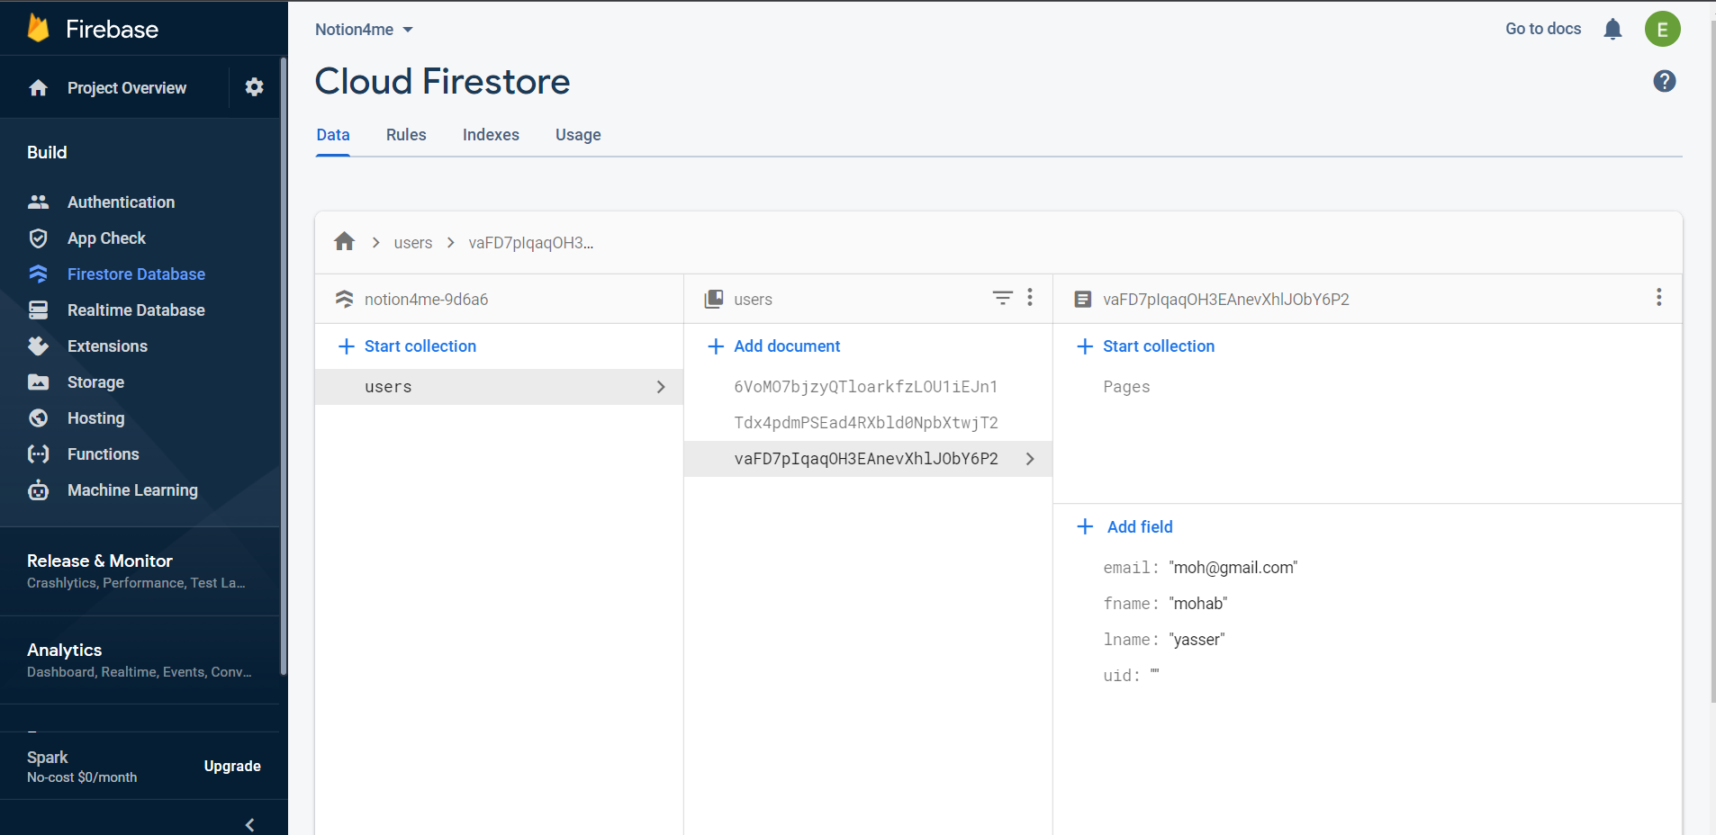
Firestore Database
29

Slide 30
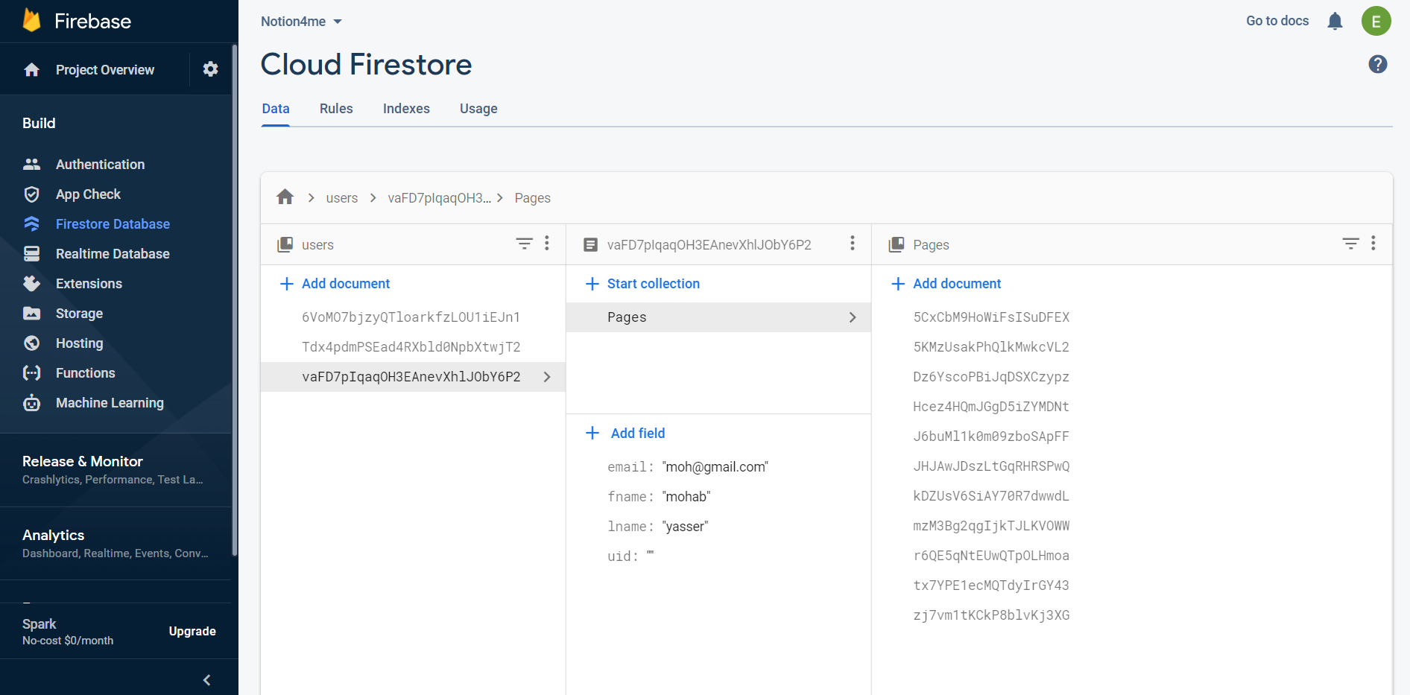
Firestore Database
30

Slide 31
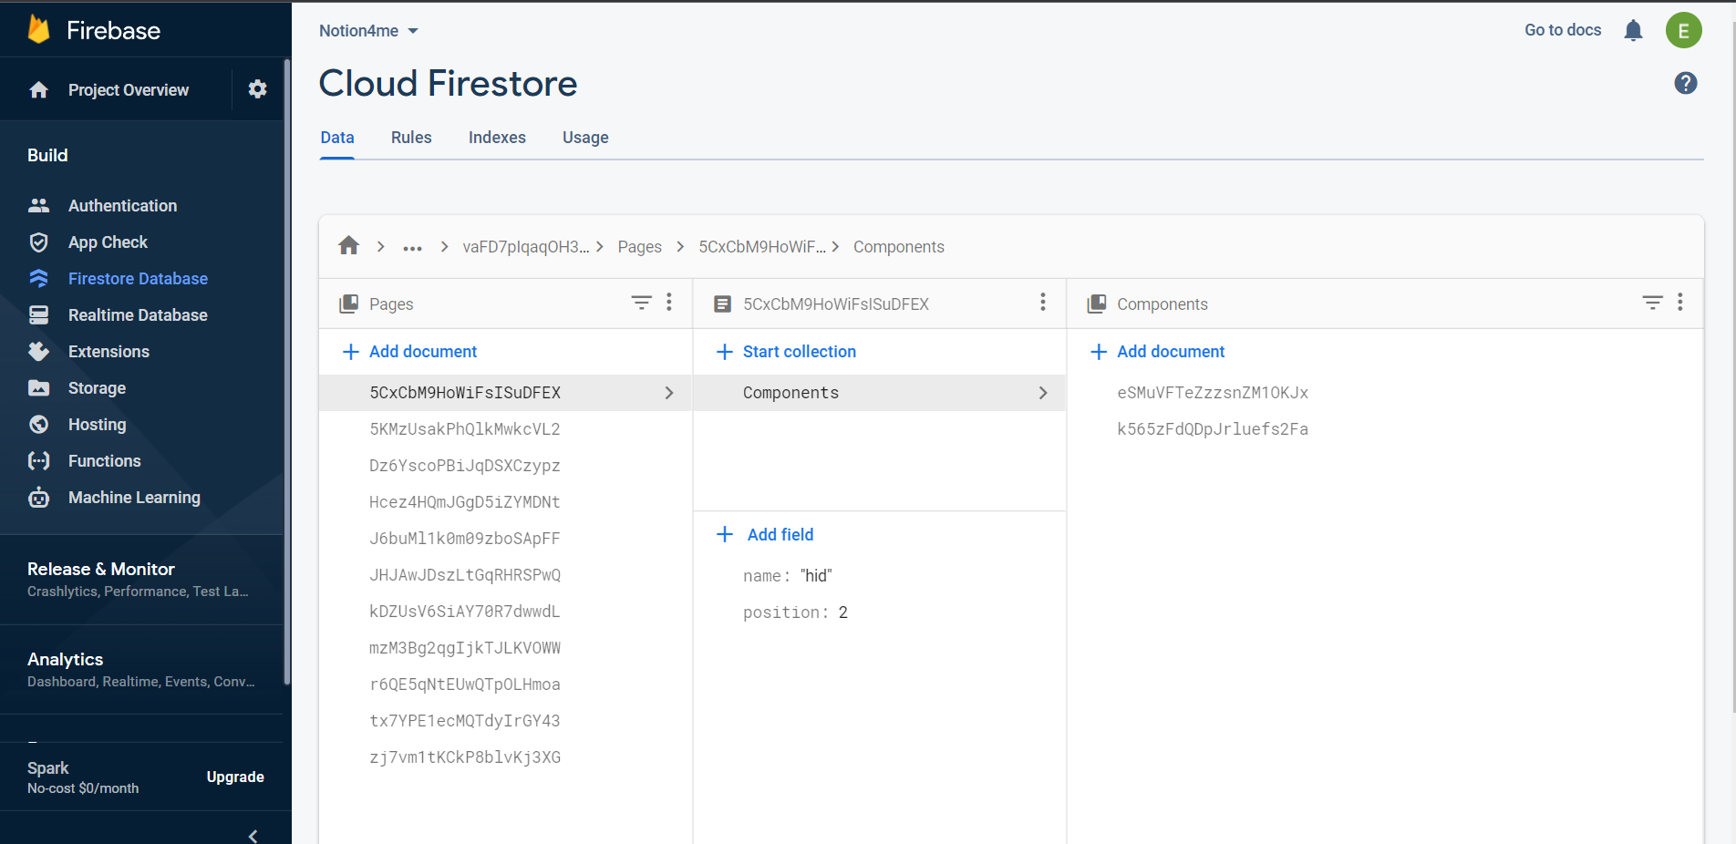
Firestore Database
31

Slide 32
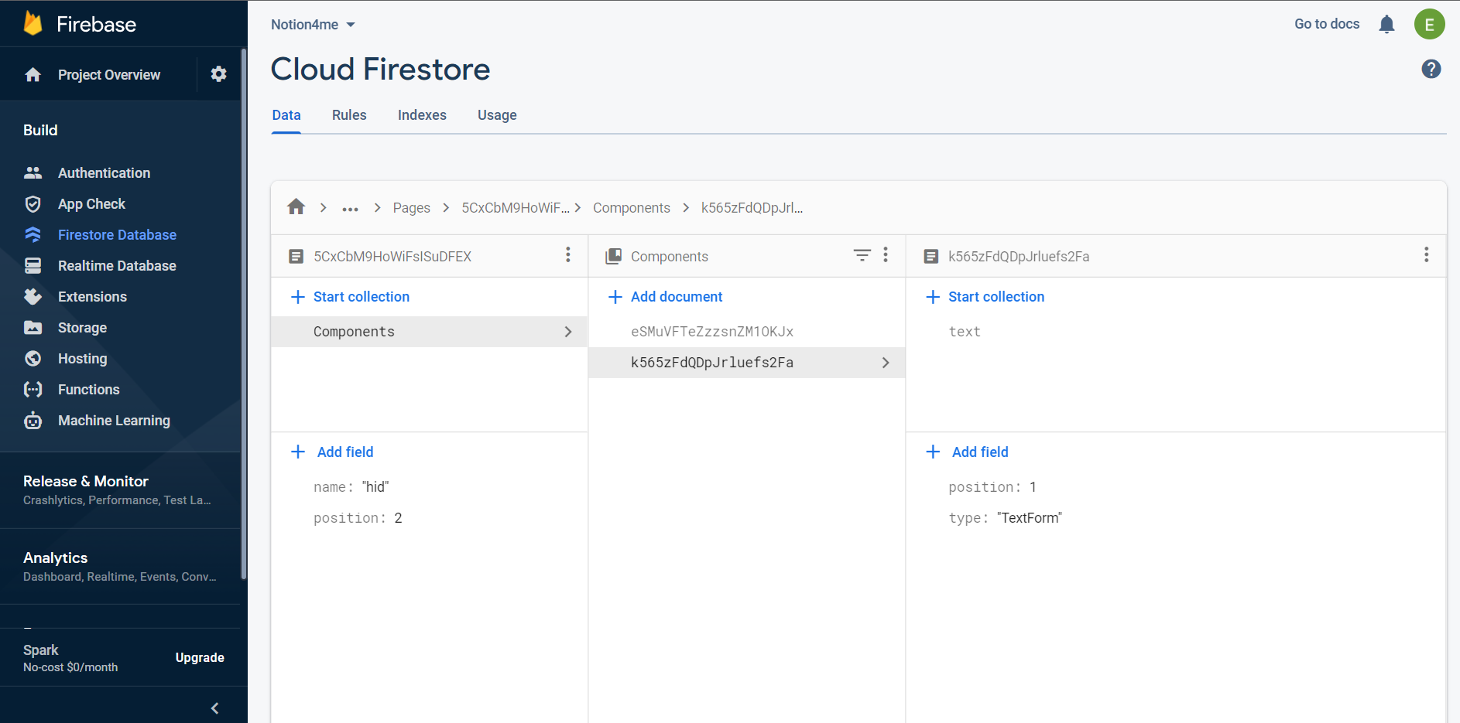
Firestore Database
32

Slide 33
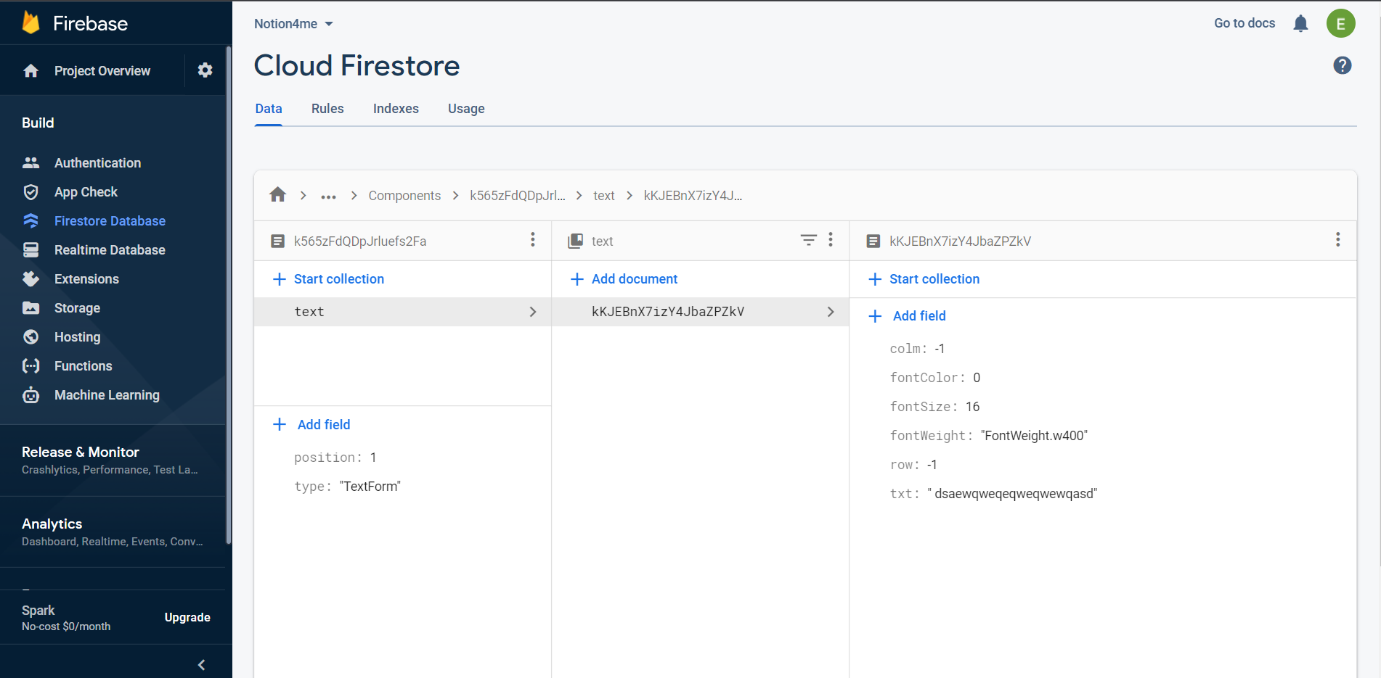
Firestore Database
33

Slide 34
Tools
Flutter and Dart
SqlLite
Firebase: Authentication, cloud Firestore and Storage
34

Slide 35
THANKS!
Any questions?
35

