Slide 1
Real Estate CRM on HubSpot
Lead-to-deal pipeline, automation and data governance
Demo project with sample data | Mazen Mohamed, Operations & CRM Specialist

Slide 2
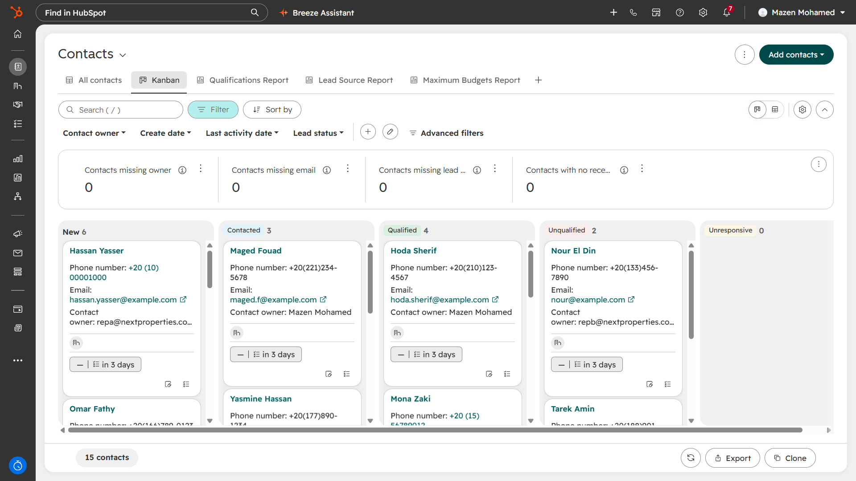
Lead management with built-in data quality
15 sample leads from 5 sources: Website, Facebook, Referral, Walk-in, Portal
Qualification Status: New, Contacted, Qualified, Unqualified, Unresponsive
Kanban view with data-quality cards: missing owner, email and lead source
Every lead gets an owner and a follow-up task automatically
Kanban by qualification status, with data-quality checks on top
Real Estate CRM on HubSpot | Mazen Mohamed | 2

Slide 3
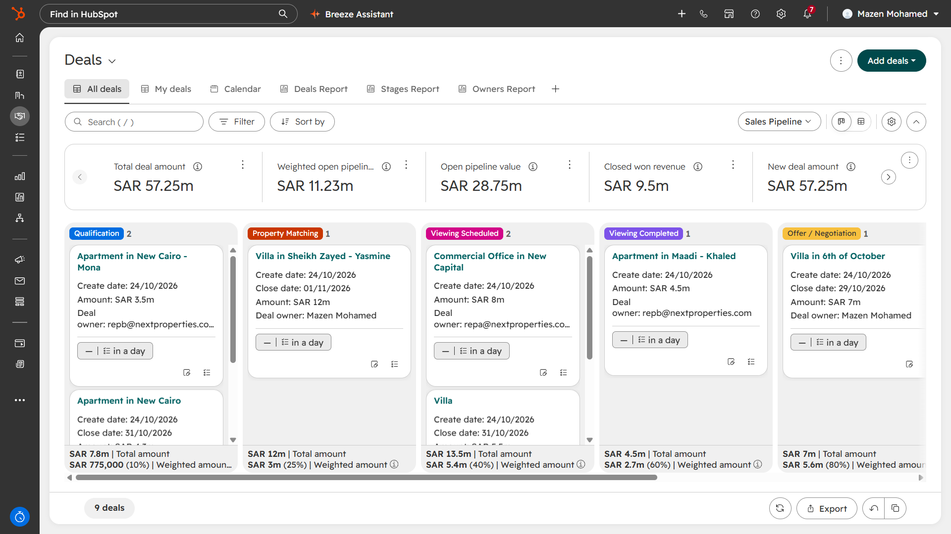
Sales pipeline built for real estate
Stages: Qualification, Property Matching, Viewing Scheduled, Viewing Completed, Offer / Negotiation, Closed
Stage probabilities (10% to 80%) drive a weighted forecast of SAR 11.23m
9 sample deals across Egypt, Saudi Arabia and UAE; entered in local currency and reported in the company currency (SAR)
Viewing stages reflect how property sales actually progress
Deals board with totals and weighted amounts per stage
Real Estate CRM on HubSpot | Mazen Mohamed | 3

Slide 4
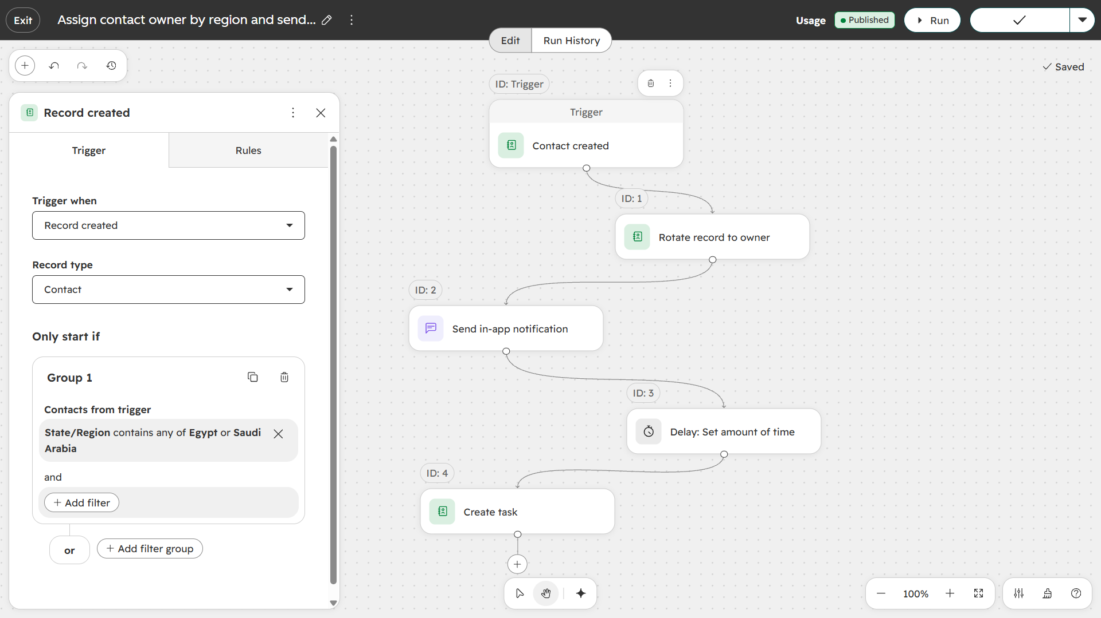
Automation: speed to lead
Trigger: contact created in Egypt or Saudi Arabia
Rotate owner, send in-app notification, wait, create follow-up task
Variants by region (Egypt/Saudi, UAE) and property type (Apartment, Villa)
New deal creates tasks; new owner gets a follow-up task
Result: 23 follow-up tasks, no manual assignment
Owner-assignment workflow by region
Real Estate CRM on HubSpot | Mazen Mohamed | 4

Slide 5
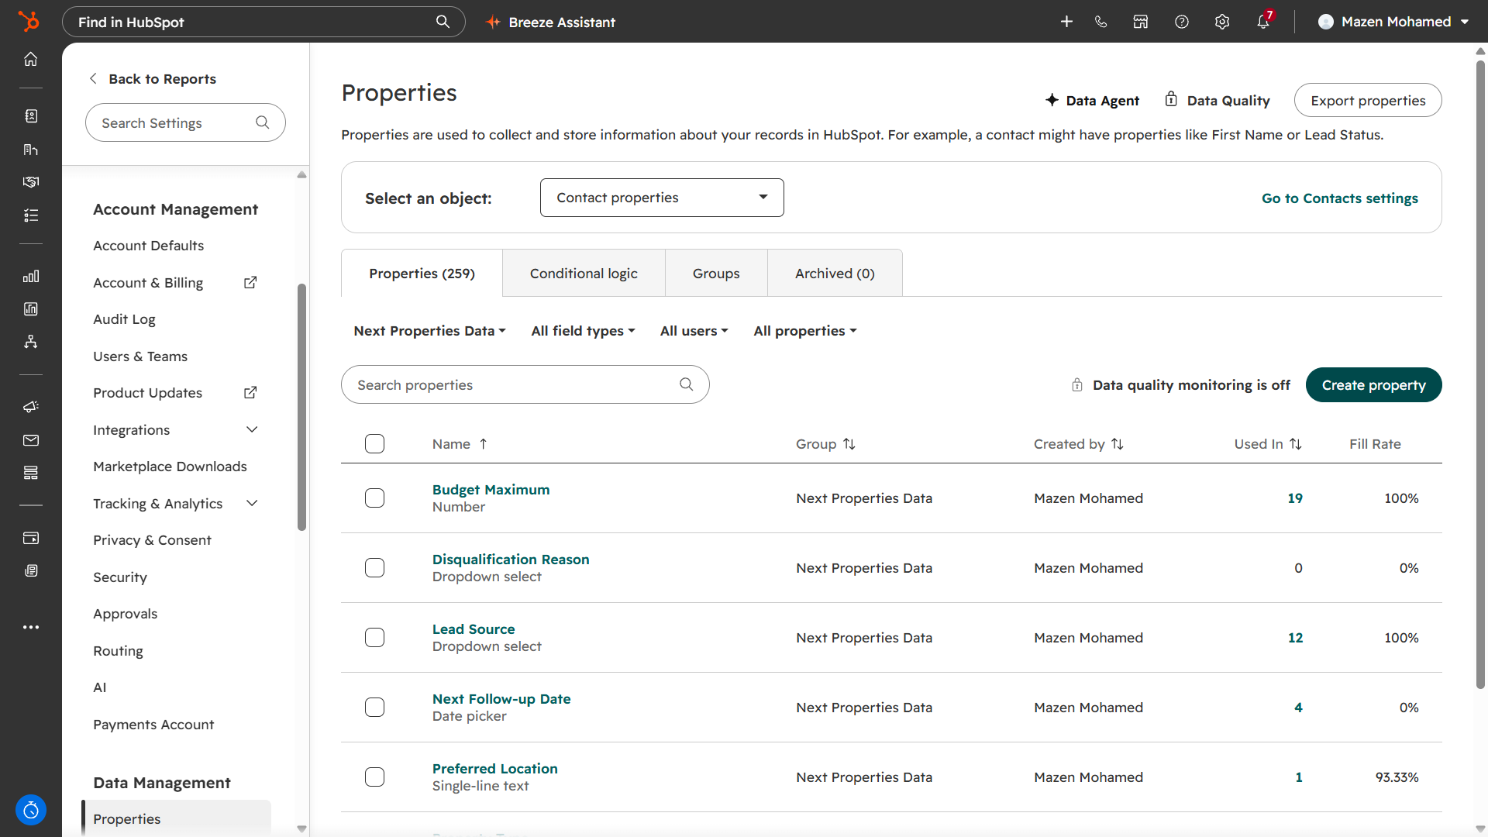
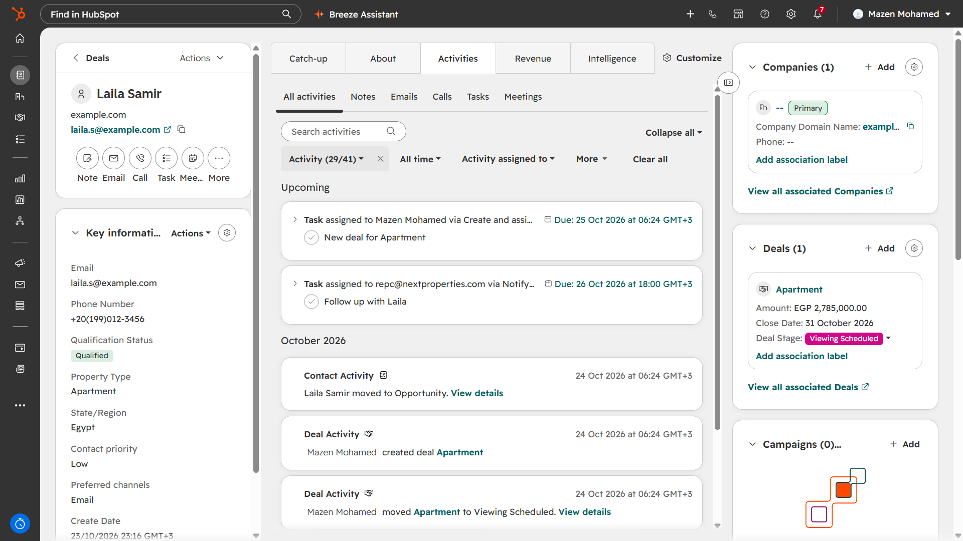
Data model and governance
Custom property group: Budget Maximum, Lead Source, Disqualification Reason, Next Follow-up Date, Preferred Location
Contact record links company, deal and activity timeline; fill rates show which fields need enforcement
Data quality monitoring is a paid feature: first recommendation for production
Real Estate CRM on HubSpot | Mazen Mohamed | 5

Slide 6
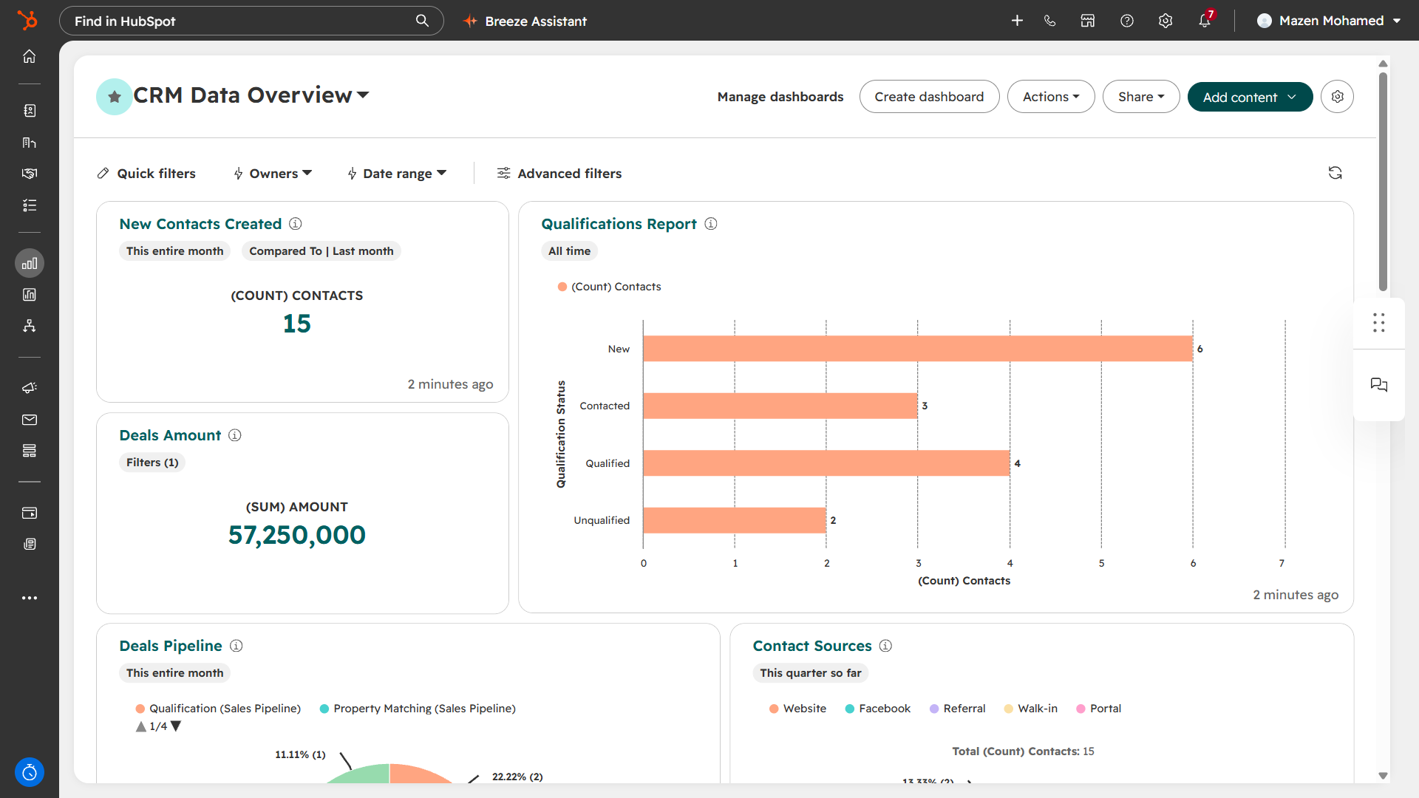
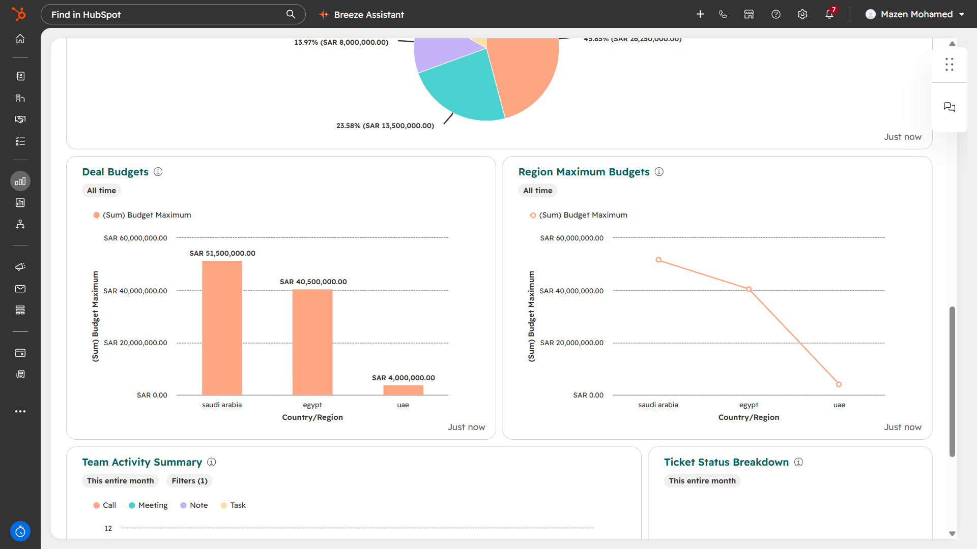
Dashboard: one view for management
Lead qualification report, total deal amount, contact sources and deals by stage and owner
Deal budgets by country and region
Built to answer: where do leads come from, and where do deals get stuck?
Real Estate CRM on HubSpot | Mazen Mohamed | 6

Slide 7
What I would build next
Rebuild the same design in Zoho CRM: Lead to Contact to Deal, Blueprint and Workflow Rules
Speed-to-lead KPI: time to first contact, per owner and per source
Duplicate management and data-quality monitoring (paid tier)
WhatsApp lead capture through an automation platform
Lost-reason reporting to learn why deals close lost
Note: built on a HubSpot account with sample data. It is a learning project, not a production system.
Real Estate CRM on HubSpot | Mazen Mohamed | 7

