Slide 1








Ministry of the Knowledge Economy, Startups and Micro-enterprises
PITCH DECK
INNOVATIVE PROJECT PRESENTATION
NATIONAL COMMITTEE FOR THE LABELING
OF INNOVATIVE PROJECTS, STARTUPS AND INCUBATORS

Slide 2

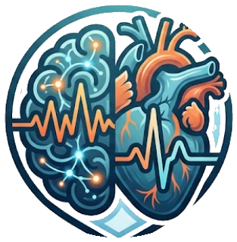
01
GENERAL PRESENTATION
PROJECT TITLE
NeuraCard
PROJECT LOGO
SUBTITLE OR TAGLINE (OPTIONAL)
All of a patient's tests, together in one clear, explainable platform.

Slide 3
01
GENERAL PRESENTATION
CONTACT INFORMATION
Name(s) of the manager(s): Ramoul Mazen
Position: Master's PFE student, Project lead & sole developer
Email: mazen.ramoul@univ-constantine2.dz
Phone number:
Website (optional):
Social media (optional):

Slide 4
02
PROJECT SUMMARY
NeuraCard is a digital health platform that brings a patient's main medical tests (brain MRI, heart ECG, echocardiogram and EEG) together in one place.
Today these tests are read separately, by different specialists, on different systems, so no one sees the full picture when the decision is made. With NeuraCard, a doctor opens a patient, uploads any test, and instantly gets an AI-assisted reading, with a clear explanation of how it was reached, all gathered into one combined report.
The result: simpler, faster and more trustworthy diagnosis, and a platform that can grow toward catching disease earlier by connecting the heart and the brain.

Slide 5
03
THE TEAM
Ramoul Mazen, Master's student in Fundamental Computer Science & Applications, University of Constantine 2. Supervised by Prof. DERDOUR Makhlouf and Prof. TALBI Hichem.
Project lead and sole developer who designed and built the whole platform end to end: the web application, the AI analysis for all four tests, the visual explanations, and the secure online deployment.

Slide 6
04
TARGETED PROBLEM
WHAT IS THE IDENTIFIED PROBLEM?
A patient often needs several tests (MRI, ECG, echocardiogram, EEG), but each is read on its own:
• Different specialists, different systems, different days, with no shared view of the patient.
• The AI tools that could help are scattered, each built for a single test, and rarely leave the lab.
• They act like black boxes that give an answer with no reason, so doctors cannot fully trust them.
So the full picture never comes together at the moment the decision must be made.
Why it matters (WHO):
• Non-communicable diseases cause about 74% of all deaths worldwide.
• Cardiovascular disease, with 17.9 million deaths a year, is the leading cause.
• Cancer, with around 10 million deaths a year, is the second.
Test volumes keep rising every year, while specialists stay scarce.

Slide 7
05
THE PROPOSED SOLUTION
CONCISE AND CLEAR DESCRIPTION OF THE PROPOSED SOLUTION:
NeuraCard is one secure workspace for clinicians:
• Files from hospital machines are converted automatically, ready to use.
• Open a patient, upload any test, and get an instant AI-assisted reading.
• Every result is explained visually: the platform shows what the AI looked at, with an interactive 3D brain and heart.
• All tests are combined into one clear report.
It is honest decision support: the doctor always stays in control; the AI never decides alone.

Slide 8
06
PROTOTYPE PRESENTATION (PRODUCT/SERVICE)
PUT THE LINK TO YOUR PROTOTYPE/SERVICE HERE:
A LINK TO AN EXPLANATORY VIDEO OF 4 MINUTES MAXIMUM FOR HARDWARE PROTOTYPES.
AN APK LINK FOR APPLICATIONS (ANDROID/IOS).
A LINK TO THE PROJECT WEBSITE.

Slide 9
07
PATENTS, TRADEMARKS AND INTELLECTUAL PROPERTY RIGHTS
INTELLECTUAL PROPERTY STATUS
PATENTS FILED OR PENDING
REGISTERED TRADEMARKS OR DESIGNS
COPYRIGHTS OR LICENSES

Slide 10
08
ADDED VALUE
What NeuraCard brings:
• For doctors: one workflow for every test, instant readings, and a single combined report.
• Clear and trustworthy: every result is explained, so doctors see why, not just what.
• For hospitals: faster diagnosis, data kept safely on-site, and a valuable medical data asset.
• For patients: earlier, better-connected care and a clearer, explained result.

Slide 11
09
COMPETITIVE ANALYSIS
Competitive edge
• Most tools today handle only one test (one for ECG, one for heart ultrasound, one for brain scans), plus general hospital imaging and record systems.
• They are useful, but each works alone and offers little explanation.
• NeuraCard is the only platform that brings every test together into one clear, explained picture, and keeps the data inside the hospital.
• Connecting the heart and the brain in one place is something no single-test tool can offer.

Slide 12
10
TARGET MARKET ANALYSIS
Who it is for
• Private diagnostic and radiology centres offering modern, AI-assisted check-ups.
• Public and university hospitals, especially busy cardiology and neurology departments.
• Research centres and medical universities.
• Daily users: cardiologists, neurologists, radiologists, general doctors and a support technician.
• Who benefits most: patients, through earlier, clearer and better-connected care.

Slide 13
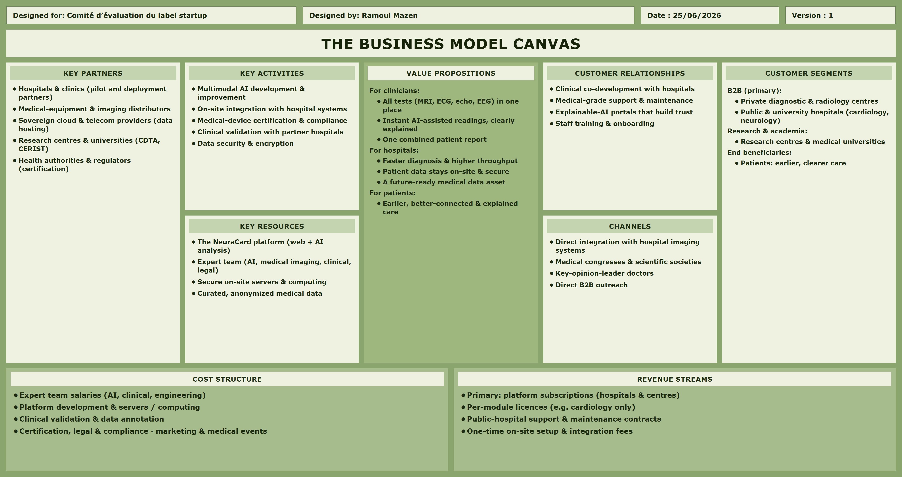
11
BUSINESS MODEL

Slide 14
12
PROJECT ROADMAP AND DEVELOPMENT STRATEGY
Roadmap & growth
• Validate: pilot with a hospital partner and fine-tune the system on local data.
• Certify & deploy: obtain medical-device approval and install the first on-site systems.
• Connect: evolve toward a model that links the heart and the brain to flag disease earlier.
• Scale: add more test types (CT, PET), more hospitals, and reports in Arabic, French & English.
Milestones: a working pilot in the first months, first hospital deployments within a year, and nationwide growth with cross-modal prediction over three years.
What we need: a small expert team (AI, medical-imaging and clinical), secure on-site servers, curated data, and certification support.

Slide 15
THANK YOU

