Slide 1

Arabic AI: Generating Image Captions
Unlocking thepotentialof AItodescribeimagesinArabic,bridging
language barriers in visual understanding.

Slide 2


Project Overview: Building an Arabic Image Captioning System
This presentation details the architecture, development, and performance of our AI-powered Arabic image captioning system.
Seamless Integration
Accurate Descriptions
PracticalApplications
Combines advanced computer
vision with natural language
processing.
Generates relevant and
contextually appropriate Arabic
captions.
From accessibility tools to content
localization, enhancing user
experience.

Slide 3
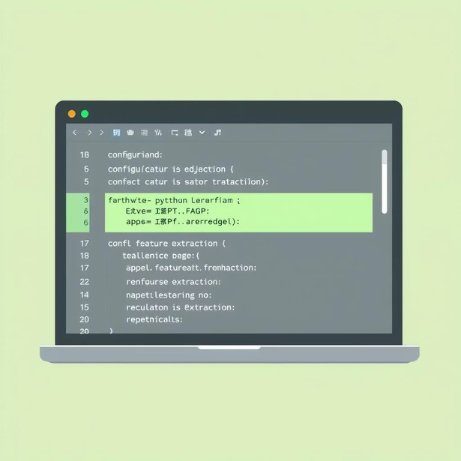
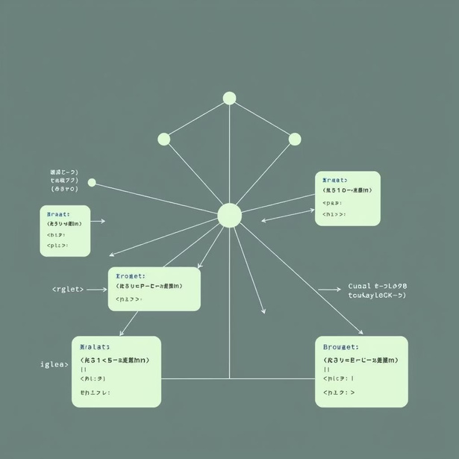
Core Components: Project Code Structure
Our system is built upon a modular codebase, ensuring clarity, maintainability, and efficient development.
config.py
model.py
Central hub for all system parameters, from file paths to model hyperparameters and vocabulary size. This ensures consistent settings across all modules.
extract_features.py
Utilizes pre-trained Convolutional Neural Networks (CNNs) like VGG16 or ResNet to extract essential visual features from images, then stores them for training efficiency.
Defines the complete Encoder-Decoder architecture, integrating a CNN encoder with an LSTM decoder, enhanced by an attention mechanism for improved caption
generation.
train.py
Manages the entire training pipeline, including data loading, iterating through epochs, calculating loss, and saving model checkpoints for future use.

Slide 4

Code Structure (Continued) & Evaluation
Dedicated scripts handle testing, performance evaluation, and provide an interactive graphical user interface.
1
2
test.py
gui.py
Loads the trained model, generates captions for new images, and calculates critical performance metrics like BLEU scores to assess caption quality.
Provides an interactive interface for users to upload images, visualize generated captions, and see real-time results, enhancing user experience and debugging.

Slide 5




Data Foundation: Flickr8k Dataset
TheFlickr8k datasetwaschosenforitsbalancedimagecollectionandcomprehensiveannotations,providing a solid base for
training our model.
This dataset facilitates robust training, enabling the model to learn diverse visual concepts and their corresponding Arabic descriptions.

Slide 6

Feature Extraction: Unlocking Visual Insights
Leveraging powerful CNNs, we convert raw image data into rich, semantic feature vectors for efficient processing.
CNN-Powered
2048-Dimensional Features
Utilized state-of-the-art Convolutional Neural Networks (VGG16/ResNet) for deep feature extraction.
Each image is condensed into a 2048-dimensional
feature vector, capturing its essence.
Optimized Storage
Input Normalization
Extracted features are pre-computed and stored,
significantly accelerating the training phase.
Image inputs were normalized to ensure consistent
data distribution and enhance model stability.

Slide 7
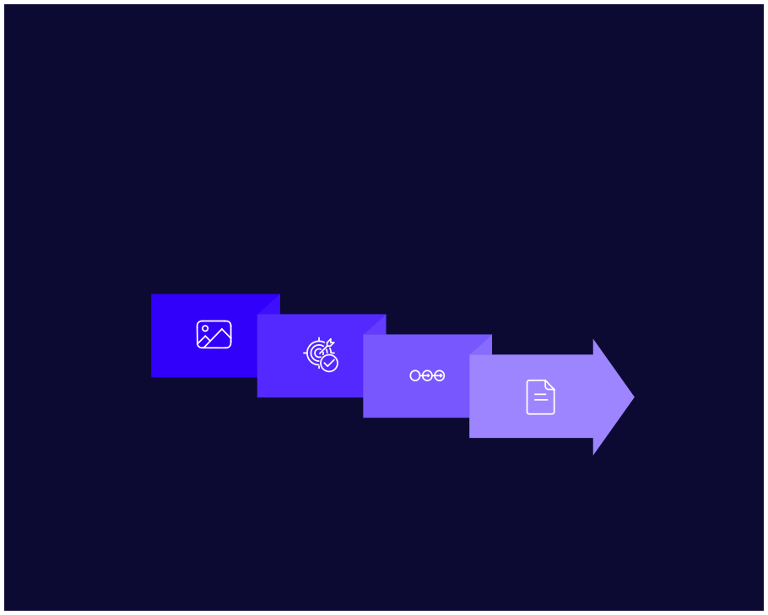
Model Architecture: Encoder-Decoder with Attention
Oursystemcombines a CNNencoderwithanLSTMdecoder,integratinganattentionmechanismtofocusonsalientimage
regions during caption generation.
Attention
Arabic Output
CNN Encoder
LSTM Decoder
This innovative Seq2Seq architecture is specifically designed for generating descriptive Arabic captions.

Slide 8


Training & Testing: Optimizing Performance
Rigorous training and evaluation ensure the model delivers high-quality, accurate Arabic captions.
Key Training Parameters:
GUI for Insight:
Cross-entropy loss function for robust learning. Adam optimizer for efficient weight updates. BLEU score used for quantitative caption evaluation.
Interactive Graphical User Interface (GUI) for real-time visualization.
Facilitates easy testing and demonstration of results.

Slide 9

Training Summary: Performance at 25 Epochs
After25epochs,themodeldemonstratesstrongperformanceinbothtrainingandvalidation,indicatingeffectivelearning and
generalization.
1.5739
1.8202
Final Training Loss
Final Validation Loss
The model achieved a low training loss, indicating successful
learning from the dataset.
The validation loss remained close to training loss,
suggesting good generalization.
71.83%
70.05%
Final Training Accuracy
Final Validation Accuracy
High accuracy on the training set confirms the model's ability
to fit the data.
Solid validation accuracy indicates the model performs well
on unseen data.
These metrics confirm the model's stability and readiness for further deployment and refinement.

Slide 10

Future Directions & Impact
OurArabic imagecaptioningsystemlaysthegroundworkforimpactfulapplications, from enhancing digital accessibility to
enriching multimedia content.
Content Localization
Accessibility
Automating descriptions for global Arabic
audiences.
Providing visual context for visually
impaired Arabic speakers.
Media Indexing
Improving search and organization
of visual content.
Research & Development
Facilitating learning with descriptive
imagery.
A foundation for advanced Arabic NLP
Educational Tools
and CV research.
This project represents a significant step towards more inclusive and intelligent AI experiences for the Arabic-speaking world.

