Slide 1
Objectives, bounds, constraints; minimization and maximization
MODULE 10 · LESSON 1 OF 4 · ≈ 10 MIN
10.1
Module 10: Optimization foundations
Standard form and feasibility
Notes:
Welcome to Module 10, Lesson 1 of the self-paced course Machine Learning Fundamentals for Surrogate-Based Engineering Optimization: Objectives, bounds, constraints; minimization and maximization. This lesson belongs to the module Optimization foundations and takes about 10 minutes. In this lesson: Standard form and feasibility.

Slide 2
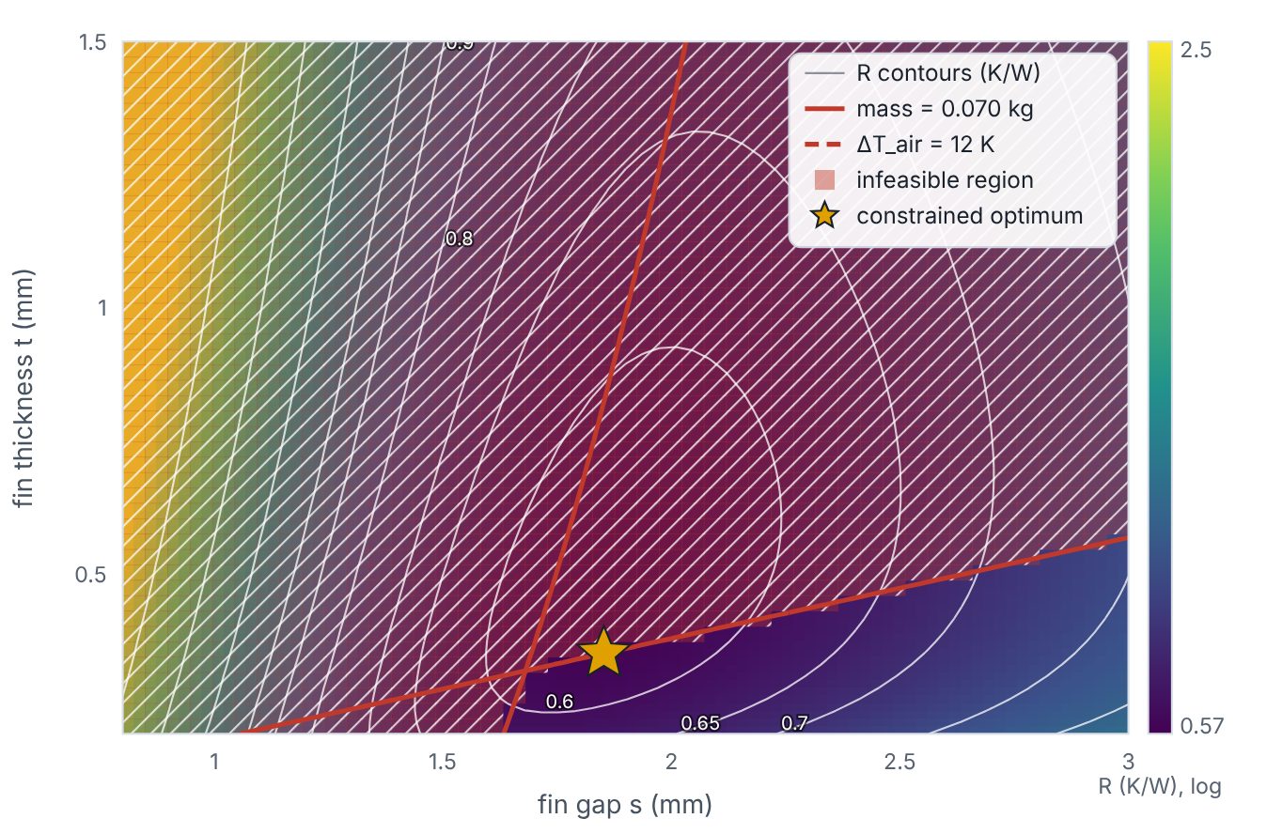

Standard form and feasibility
Lesson 1 · Objectives, bounds, constraints; minimization and maximization · Intuition
Optimizers solve problems in a standard form: minimize an objective subject to inequality constraints g ≤ 0, equality constraints h = 0 and bounds. To maximize efficiency, minimize its negative. A design satisfying every constraint is feasible; the feasible region can be much smaller than the bounded box — in the heat sink only about one-tenth of it.
Objective contours, infeasible regions and the constrained optimum of the heat-sink problem.
Notes:
Standard form and feasibility. Optimizers solve problems in a standard form: minimize an objective subject to inequality constraints g ≤ 0, equality constraints h = 0 and bounds. To maximize efficiency, minimize its negative. A design satisfying every constraint is feasible; the feasible region can be much smaller than the bounded box — in the heat sink only about one-tenth of it. Look at the figure. Objective contours, infeasible regions and the constrained optimum of the heat-sink problem. Map of R with contours, red-shaded infeasible regions bounded by the mass limit (solid red) and air-temperature limit (dashed red), and the constrained optimum star on the mass boundary.

Slide 3

Standard form and feasibility
Lesson 1 · Objectives, bounds, constraints; minimization and maximization · The mathematics
min_{x} f(x) s.t. g_{j}(x) ≤ 0, h_{k}(x) = 0, x_{L} ≤ x ≤ x_{U}; max η(x) ⇔ min [−η(x)]
Penalty approach (used in this page’s demos): minimize f(x) + Σ_{j} c_{j} max(0, g_{j}(x)/g_{j,ref}), with normalized constraints and large weights c_{j}. SciPy’s minimize(method="SLSQP") handles constraints directly.
Notes:
Now the mathematics. min_x f(x) s.t. g_j(x) ≤ 0, h_k(x) = 0, x_L ≤ x ≤ x_U; max η(x) ⇔ min [−η(x)] Penalty approach (used in this page’s demos): minimize f(x) + Σ_j c_j max(0, g_j(x)/g_{j,ref}), with normalized constraints and large weights c_j. SciPy’s minimize(method="SLSQP") handles constraints directly.

Slide 4


Standard form and feasibility
Lesson 1 · Objectives, bounds, constraints; minimization and maximization · In engineering practice
Engineering application
Practical tip
Pump design: maximize efficiency η ⇒ minimize −η, subject to head ≥ required (written as required − head ≤ 0) and NPSH margin constraints. Structural: minimize mass subject to stress − allowable ≤ 0.
Normalize constraints by their limits (e.g., m/0.070 − 1 ≤ 0) so that violations of different units are comparable.
Notes:
Where does this matter in engineering? Pump design: maximize efficiency η ⇒ minimize −η, subject to head ≥ required (written as required − head ≤ 0) and NPSH margin constraints. Structural: minimize mass subject to stress − allowable ≤ 0. A practical tip: Normalize constraints by their limits (e.g., m/0.070 − 1 ≤ 0) so that violations of different units are comparable.

Slide 5

Pause and predict
Lesson 1 · Objectives, bounds, constraints; minimization and maximization · Predict before you look
You want to maximize heat-exchanger effectiveness ε. What do you pass to a minimizer?
Write down your answer, then continue to the next slide.
Notes:
Time to predict. You want to maximize heat-exchanger effectiveness ε. What do you pass to a minimizer? Pause here and commit to an answer before moving on.

Slide 6

What happens, and why
Lesson 1 · Objectives, bounds, constraints; minimization and maximization · Answer
Question: You want to maximize heat-exchanger effectiveness ε. What do you pass to a minimizer?
−ε (or 1 − ε). The optimum design is the same; only the sign of the objective changes.
Notes:
Here is the answer. −ε (or 1 − ε). The optimum design is the same; only the sign of the objective changes.

Slide 7


Standard form and feasibility
Lesson 1 · Objectives, bounds, constraints; minimization and maximization · Common misconception
Misconception
What is actually true
Bounds and constraints are the same thing.
Bounds are simple box limits on variables; constraints are general functions of the design (often expensive responses).
Takeaway Standard form: minimize f subject to g ≤ 0 and bounds; maximize by minimizing the negative.
Notes:
A common misconception is this: Bounds and constraints are the same thing. In fact: Bounds are simple box limits on variables; constraints are general functions of the design (often expensive responses). The takeaway: Standard form: minimize f subject to g ≤ 0 and bounds; maximize by minimizing the negative.

Slide 8
Key takeaways from this lesson
Summary
1
Standard form and feasibility
Standard form: minimize f subject to g ≤ 0 and bounds; maximize by minimizing the negative.
Notes:
To sum up this lesson. Standard form and feasibility: Standard form: minimize f subject to g ≤ 0 and bounds; maximize by minimizing the negative.

Slide 9

Local vs global optima; gradient-based vs derivative-free methods
UP NEXT · LESSON 10.2
Next in Module 10: Lesson 2. Mark this lesson complete in the course before continuing.
Notes:
That completes Lesson 1 of Module 10: Objectives, bounds, constraints; minimization and maximization. Next comes Lesson 2: Local vs global optima; gradient-based vs derivative-free methods.

