Slide 1
Local vs global optima; gradient-based vs derivative-free methods
MODULE 10 · LESSON 2 OF 4 · ≈ 12 MIN
10.2
Module 10: Optimization foundations
Landscapes with more than one valley
Notes:
Welcome to Module 10, Lesson 2 of the self-paced course Machine Learning Fundamentals for Surrogate-Based Engineering Optimization: Local vs global optima; gradient-based vs derivative-free methods. This lesson belongs to the module Optimization foundations and takes about 12 minutes. In this lesson: Landscapes with more than one valley.

Slide 2
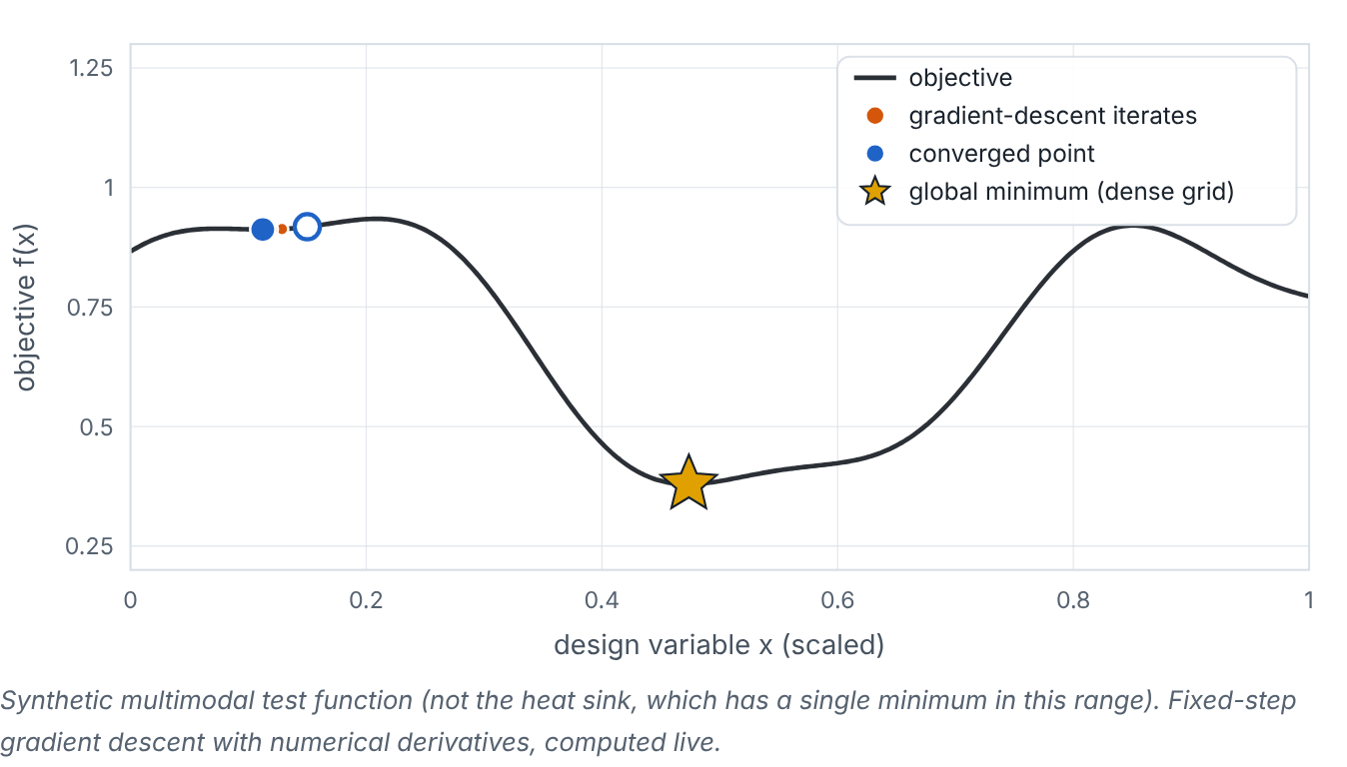

Landscapes with more than one valley
Lesson 2 · Local vs global optima; gradient-based vs derivative-free methods · Intuition
A local minimum is lowest within its neighbourhood; the global minimum is lowest over the whole feasible region. Gradient-based methods (gradient descent, quasi-Newton BFGS, SLSQP) follow slopes efficiently to a nearby local minimum. Derivative-free methods (Nelder–Mead, pattern search, grid/random search, evolutionary algorithms) use only function values; some explore globally but need many evaluations — affordable on a cheap surrogate, unaffordable on CFD.
Gradient descent from different starting points on a synthetic multimodal function. (Interactive in the online course.)
Notes:
Landscapes with more than one valley. A local minimum is lowest within its neighbourhood; the global minimum is lowest over the whole feasible region. Gradient-based methods (gradient descent, quasi-Newton BFGS, SLSQP) follow slopes efficiently to a nearby local minimum. Derivative-free methods (Nelder–Mead, pattern search, grid/random search, evolutionary algorithms) use only function values; some explore globally but need many evaluations — affordable on a cheap surrogate, unaffordable on CFD. Look at the figure. Gradient descent from different starting points on a synthetic multimodal function. A wavy curve with several valleys. Points trace gradient-descent iterates from a chosen start to the nearest valley bottom; a star marks the global minimum found by a dense grid. Some starts reach it; others are trapped in local minima.

Slide 3

Landscapes with more than one valley
Lesson 2 · Local vs global optima; gradient-based vs derivative-free methods · The mathematics
gradient step: x_{k+1} = x_{k} − α ∇f(x_{k})
Symbol | Meaning | Unit
α | step size (learning rate) | units of x² per unit f
∇f | gradient | units of f per unit x
Necessary condition for an interior local minimum: ∇f = 0. At a constrained minimum, the objective gradient is balanced by active-constraint gradients (Karush–Kuhn–Tucker conditions) — no need to compute these by hand here.
Notes:
Now the mathematics. gradient step: x_k_{+1} = x_k − α ∇f(x_k) α is the step size (learning rate), in units of x² per unit f. ∇f is the gradient, in units of f per unit x. Necessary condition for an interior local minimum: ∇f = 0. At a constrained minimum, the objective gradient is balanced by active-constraint gradients (Karush–Kuhn–Tucker conditions) — no need to compute these by hand here.

Slide 4


Landscapes with more than one valley
Lesson 2 · Local vs global optima; gradient-based vs derivative-free methods · In engineering practice
Engineering application
Practical tip
Multi-start strategy: run a local optimizer from many starting points (e.g., an LHS of starts) and keep the best — cheap on a surrogate. This page’s surrogate optimizer uses a dense grid followed by Nelder–Mead refinement from the best few grid points.
Never claim global optimality from a single local run. Say “best design found” and describe the search (multi-start, grid, budget).
Notes:
Where does this matter in engineering? Multi-start strategy: run a local optimizer from many starting points (e.g., an LHS of starts) and keep the best — cheap on a surrogate. This page’s surrogate optimizer uses a dense grid followed by Nelder–Mead refinement from the best few grid points. A practical tip: Never claim global optimality from a single local run. Say “best design found” and describe the search (multi-start, grid, budget).

Slide 5

Pause and predict
Lesson 2 · Local vs global optima; gradient-based vs derivative-free methods · Predict before you look
On a smooth surrogate with one valley, which is more efficient: Nelder–Mead or BFGS with analytic gradients?
Write down your answer, then continue to the next slide.
Notes:
Time to predict. On a smooth surrogate with one valley, which is more efficient: Nelder–Mead or BFGS with analytic gradients? Pause here and commit to an answer before moving on.

Slide 6

What happens, and why
Lesson 2 · Local vs global optima; gradient-based vs derivative-free methods · Answer
Question: On a smooth surrogate with one valley, which is more efficient: Nelder–Mead or BFGS with analytic gradients?
BFGS with gradients typically converges in far fewer evaluations on smooth problems. Derivative-free methods shine when gradients are unavailable or the function is noisy or non-smooth.
Notes:
Here is the answer. BFGS with gradients typically converges in far fewer evaluations on smooth problems. Derivative-free methods shine when gradients are unavailable or the function is noisy or non-smooth.

Slide 7


Landscapes with more than one valley
Lesson 2 · Local vs global optima; gradient-based vs derivative-free methods · Common misconception
Misconception
What is actually true
A converged optimizer has found the global optimum.
Convergence means a local stopping criterion was met. Without global search or problem structure (e.g., convexity), global optimality is not established.
Takeaway Gradient methods: fast, local. Derivative-free/global methods: more robust, more evaluations — fine on surrogates.
Notes:
A common misconception is this: A converged optimizer has found the global optimum. In fact: Convergence means a local stopping criterion was met. Without global search or problem structure (e.g., convexity), global optimality is not established. The takeaway: Gradient methods: fast, local. Derivative-free/global methods: more robust, more evaluations — fine on surrogates.

Slide 8
Key takeaways from this lesson
Summary
1
Landscapes with more than one valley
Gradient methods: fast, local. Derivative-free/global methods: more robust, more evaluations — fine on surrogates.
Notes:
To sum up this lesson. Landscapes with more than one valley: Gradient methods: fast, local. Derivative-free/global methods: more robust, more evaluations — fine on surrogates.

Slide 9

Multi-objective optimization and Pareto fronts
UP NEXT · LESSON 10.3
Next in Module 10: Lesson 3. Mark this lesson complete in the course before continuing.
Notes:
That completes Lesson 2 of Module 10: Local vs global optima; gradient-based vs derivative-free methods. Next comes Lesson 3: Multi-objective optimization and Pareto fronts.

