Slide 1
Multi-objective optimization and Pareto fronts
MODULE 10 · LESSON 3 OF 4 · ≈ 10 MIN
10.3
Module 10: Optimization foundations
When two goals conflict
Notes:
Welcome to Module 10, Lesson 3 of the self-paced course Machine Learning Fundamentals for Surrogate-Based Engineering Optimization: Multi-objective optimization and Pareto fronts. This lesson belongs to the module Optimization foundations and takes about 10 minutes. In this lesson: When two goals conflict.

Slide 2
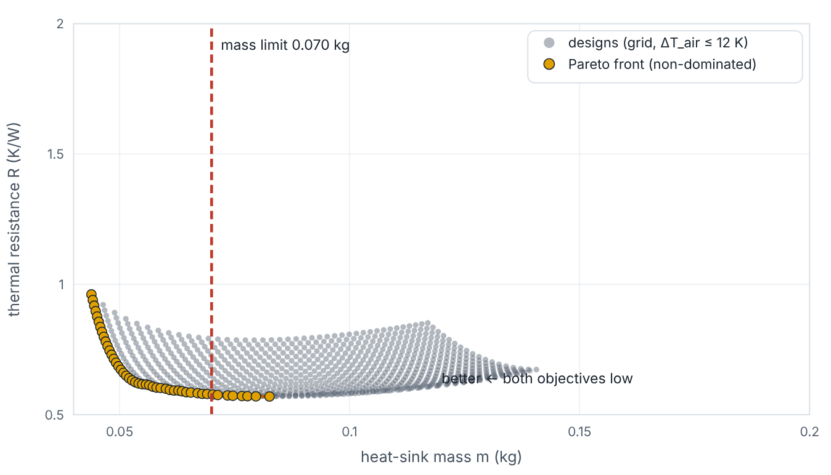

When two goals conflict
Lesson 3 · Multi-objective optimization and Pareto fronts · Intuition
Often two objectives compete: lower thermal resistance versus lower mass. A design is Pareto-optimal (non-dominated) if no other design is at least as good in both objectives and strictly better in one. The set of such designs is the Pareto front — the menu of best trade-offs from which an engineer chooses.
Heat-sink designs (grey) and the Pareto front of mass vs thermal resistance (gold); dashed line at the 0.070 kg mass limit.
Notes:
When two goals conflict. Often two objectives compete: lower thermal resistance versus lower mass. A design is Pareto-optimal (non-dominated) if no other design is at least as good in both objectives and strictly better in one. The set of such designs is the Pareto front — the menu of best trade-offs from which an engineer chooses. Look at the figure. Heat-sink designs (grey) and the Pareto front of mass vs thermal resistance (gold); dashed line at the 0.070 kg mass limit. Scatter of designs with mass on the x-axis and R on the y-axis. The lower-left boundary of the cloud is highlighted in gold as the Pareto front: lighter designs have higher R. A vertical dashed line marks 0.070 kg; the constrained single-objective optimum is where the front meets this line.

Slide 3

When two goals conflict
Lesson 3 · Multi-objective optimization and Pareto fronts · The mathematics
xª dominates x^{b} ⇔ f_{i}(xª) ≤ f_{i}(x^{b}) ∀i and f_{i}(xª) < f_{i}(x^{b}) for some i
Scalarizations: weighted sum min w₁f₁ + w₂f₂ (misses non-convex parts of fronts), or ε-constraint min f₁ s.t. f₂ ≤ ε — our mass-limited problem is exactly one ε-constraint point.
Notes:
Now the mathematics. x^a dominates x^b ⇔ f_i(x^a) ≤ f_i(x^b) ∀i and f_i(x^a) < f_i(x^b) for some i Scalarizations: weighted sum min w_1f_1 + w_2f_2 (misses non-convex parts of fronts), or ε-constraint min f_1 s.t. f_2 ≤ ε — our mass-limited problem is exactly one ε-constraint point.

Slide 4


When two goals conflict
Lesson 3 · Multi-objective optimization and Pareto fronts · In engineering practice
Engineering application
Practical tip
Machining: surface roughness vs material removal rate. Structures: mass vs deflection. Fluid machinery: efficiency vs operating range. Each needs a trade-off decision informed by the front, not a single “optimum”.
Plot the front with the constraint limits overlaid; decision-makers understand trade-offs better from the picture than from a single number.
Notes:
Where does this matter in engineering? Machining: surface roughness vs material removal rate. Structures: mass vs deflection. Fluid machinery: efficiency vs operating range. Each needs a trade-off decision informed by the front, not a single “optimum”. A practical tip: Plot the front with the constraint limits overlaid; decision-makers understand trade-offs better from the picture than from a single number.

Slide 5

Pause and predict
Lesson 3 · Multi-objective optimization and Pareto fronts · Predict before you look
Design A: m = 0.06 kg, R = 0.62 K/W. Design B: m = 0.07 kg, R = 0.60 K/W. Does either dominate?
Write down your answer, then continue to the next slide.
Notes:
Time to predict. Design A: m = 0.06 kg, R = 0.62 K/W. Design B: m = 0.07 kg, R = 0.60 K/W. Does either dominate? Pause here and commit to an answer before moving on.

Slide 6

What happens, and why
Lesson 3 · Multi-objective optimization and Pareto fronts · Answer
Question: Design A: m = 0.06 kg, R = 0.62 K/W. Design B: m = 0.07 kg, R = 0.60 K/W. Does either dominate?
No — A is lighter, B has lower R. Both can be Pareto-optimal; the choice depends on priorities.
Notes:
Here is the answer. No — A is lighter, B has lower R. Both can be Pareto-optimal; the choice depends on priorities.

Slide 7


When two goals conflict
Lesson 3 · Multi-objective optimization and Pareto fronts · Common misconception
Misconception
What is actually true
Multi-objective optimization gives one best design.
It gives a set of trade-offs. Choosing among them needs engineering judgement or extra criteria.
Takeaway Pareto front = non-dominated trade-offs; single-objective optima are points on it.
Notes:
A common misconception is this: Multi-objective optimization gives one best design. In fact: It gives a set of trade-offs. Choosing among them needs engineering judgement or extra criteria. The takeaway: Pareto front = non-dominated trade-offs; single-objective optima are points on it.

Slide 8
Key takeaways from this lesson
Summary
1
When two goals conflict
Pareto front = non-dominated trade-offs; single-objective optima are points on it.
Notes:
To sum up this lesson. When two goals conflict: Pareto front = non-dominated trade-offs; single-objective optima are points on it.

Slide 9

Optimizing a surrogate is not finding the true optimum
UP NEXT · LESSON 10.4
Next in Module 10: Lesson 4. Mark this lesson complete in the course before continuing.
Notes:
That completes Lesson 3 of Module 10: Multi-objective optimization and Pareto fronts. Next comes Lesson 4: Optimizing a surrogate is not finding the true optimum.

