Slide 1
Optimizing a surrogate is not finding the true optimum
MODULE 10 · LESSON 4 OF 4 · ≈ 8 MIN
10.4
Module 10: Optimization foundations
Two different minima
Notes:
Welcome to Module 10, Lesson 4 of the self-paced course Machine Learning Fundamentals for Surrogate-Based Engineering Optimization: Optimizing a surrogate is not finding the true optimum. This lesson belongs to the module Optimization foundations and takes about 8 minutes. In this lesson: Two different minima.

Slide 2
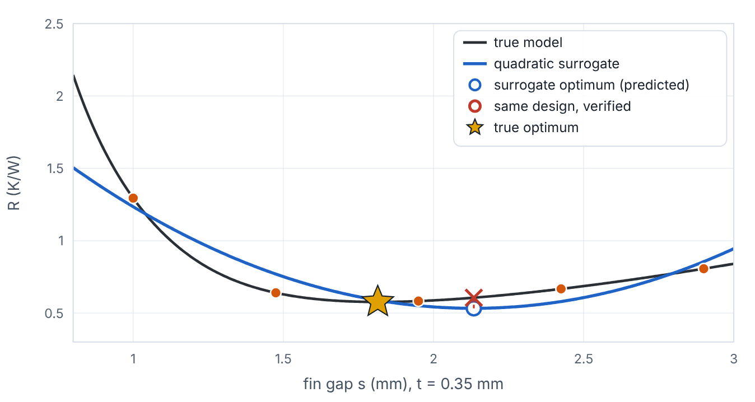

Two different minima
Lesson 4 · Optimizing a surrogate is not finding the true optimum · Intuition
An optimizer applied to a surrogate finds the minimum of the surrogate. If the surrogate is wrong near that point, the true performance there can be worse than predicted, and the true optimum may lie elsewhere. Only original-model evaluation tells you which.
A quadratic surrogate’s optimum (hollow) versus its verified value (red ×) and the true optimum (star) on a heat-sink slice. (Interactive in the online course.)
Notes:
Two different minima. An optimizer applied to a surrogate finds the minimum of the surrogate. If the surrogate is wrong near that point, the true performance there can be worse than predicted, and the true optimum may lie elsewhere. Only original-model evaluation tells you which. Look at the figure. A quadratic surrogate’s optimum (hollow) versus its verified value (red ×) and the true optimum (star) on a heat-sink slice. Plot of true R versus fin gap at t = 0.35 mm and a quadratic surrogate from a few samples. The surrogate minimum is marked; a vertical red segment connects its predicted value to the verified true value at the same design; a star marks the true minimum. Increasing samples moves the surrogate minimum closer.

Slide 3

Two different minima
Lesson 4 · Optimizing a surrogate is not finding the true optimum · The mathematics
x̂* = arg min f̂(x), prediction error at candidate: f̂(x̂*) − f(x̂*), optimality gap: f(x̂*) − f(x*)
Because the optimizer specifically seeks low predictions, f̂(x̂*) tends to be optimistic (biased low for minimization) — a selection effect.
Notes:
Now the mathematics. x̂* = arg min f̂(x), prediction error at candidate: f̂(x̂*) − f(x̂*), optimality gap: f(x̂*) − f(x*) Because the optimizer specifically seeks low predictions, f̂(x̂*) tends to be optimistic (biased low for minimization) — a selection effect.

Slide 4


Two different minima
Lesson 4 · Optimizing a surrogate is not finding the true optimum · In engineering practice
Engineering application
Practical tip
In the heat sink the true constrained optimum is known only because the model is cheap — in practice you never know f(x*); you know only verified values at the designs you evaluated.
Report predicted and verified objective and constraint values side by side for every candidate.
Notes:
Where does this matter in engineering? In the heat sink the true constrained optimum is known only because the model is cheap — in practice you never know f(x*); you know only verified values at the designs you evaluated. A practical tip: Report predicted and verified objective and constraint values side by side for every candidate.

Slide 5

Pause and predict
Lesson 4 · Optimizing a surrogate is not finding the true optimum · Predict before you look
Why is the predicted value at the surrogate optimum more likely to be too low than too high?
Write down your answer, then continue to the next slide.
Notes:
Time to predict. Why is the predicted value at the surrogate optimum more likely to be too low than too high? Pause here and commit to an answer before moving on.

Slide 6

What happens, and why
Lesson 4 · Optimizing a surrogate is not finding the true optimum · Answer
Question: Why is the predicted value at the surrogate optimum more likely to be too low than too high?
The optimizer searches for the lowest prediction; points where the surrogate happens to under-predict are favoured, so errors at the chosen point skew optimistic.
Notes:
Here is the answer. The optimizer searches for the lowest prediction; points where the surrogate happens to under-predict are favoured, so errors at the chosen point skew optimistic.

Slide 7


Two different minima
Lesson 4 · Optimizing a surrogate is not finding the true optimum · Common misconception
Misconception
What is actually true
If the surrogate optimum is feasible according to the surrogate, it is feasible.
Constraint surrogates have errors too; verify feasibility with the original model.
Takeaway Surrogate optimum ≠ true optimum; predictions at the optimum are optimistic; verify.
Notes:
A common misconception is this: If the surrogate optimum is feasible according to the surrogate, it is feasible. In fact: Constraint surrogates have errors too; verify feasibility with the original model. The takeaway: Surrogate optimum ≠ true optimum; predictions at the optimum are optimistic; verify.

Slide 8
Key takeaways from this lesson
Summary
1
Two different minima
Surrogate optimum ≠ true optimum; predictions at the optimum are optimistic; verify.
Notes:
To sum up this lesson. Two different minima: Surrogate optimum ≠ true optimum; predictions at the optimum are optimistic; verify.

Slide 9

The loop: fit, optimize, verify, update
UP NEXT · LESSON 11.1
That completes Module 10. Before moving on, review the Module 10 flashcards and take its quiz in the course (pass mark 70%). Next: Module 11, Surrogate-based optimization.
Notes:
That completes Lesson 4 of Module 10: Optimizing a surrogate is not finding the true optimum. This was the last lesson of the module, so review the flashcards and take the Module 10 quiz in the course. Next comes Module 11, Surrogate-based optimization, starting with The loop: fit, optimize, verify, update.

