Slide 1
The loop: fit, optimize, verify, update
MODULE 11 · LESSON 1 OF 3 · ≈ 14 MIN
11.1
Module 11: Surrogate-based optimization
Running surrogate-based optimization
Notes:
Welcome to Module 11, Lesson 1 of the self-paced course Machine Learning Fundamentals for Surrogate-Based Engineering Optimization: The loop: fit, optimize, verify, update. This lesson belongs to the module Surrogate-based optimization and takes about 14 minutes. In this lesson: Running surrogate-based optimization.

Slide 2

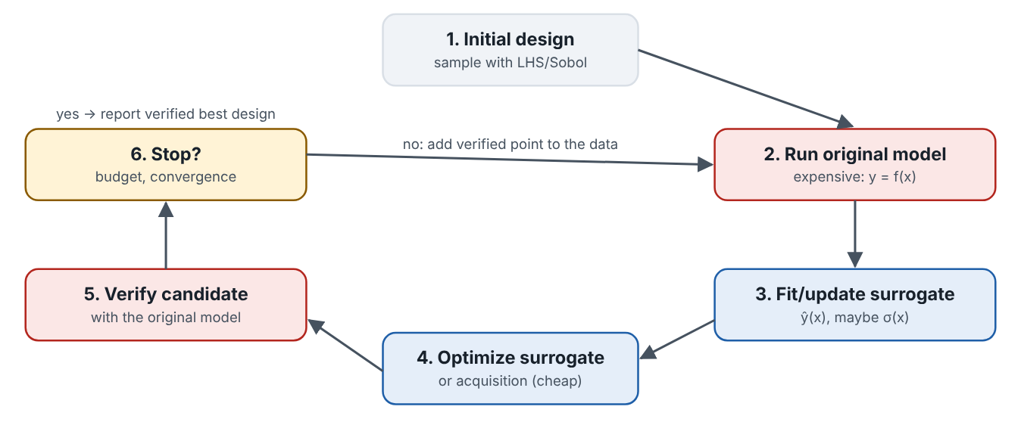
Running surrogate-based optimization
Lesson 1 · The loop: fit, optimize, verify, update · Intuition
Start with a space-filling sample. Fit surrogates for the expensive responses (here log₁₀R and log₁₀ΔT_{air}); compute cheap responses (mass) exactly. Optimize the surrogate problem. Evaluate the candidate with the original model. Add it to the data and refit. Each iteration teaches the surrogate most where it matters — near promising designs.
The SBO loop.
Notes:
Running surrogate-based optimization. Start with a space-filling sample. Fit surrogates for the expensive responses (here log₁₀R and log₁₀ΔT_{air}); compute cheap responses (mass) exactly. Optimize the surrogate problem. Evaluate the candidate with the original model. Add it to the data and refit. Each iteration teaches the surrogate most where it matters — near promising designs. Look at the figure. The SBO loop. Cycle diagram of initial design, original-model runs, surrogate fitting, surrogate optimization, verification and stopping decision.

Slide 3
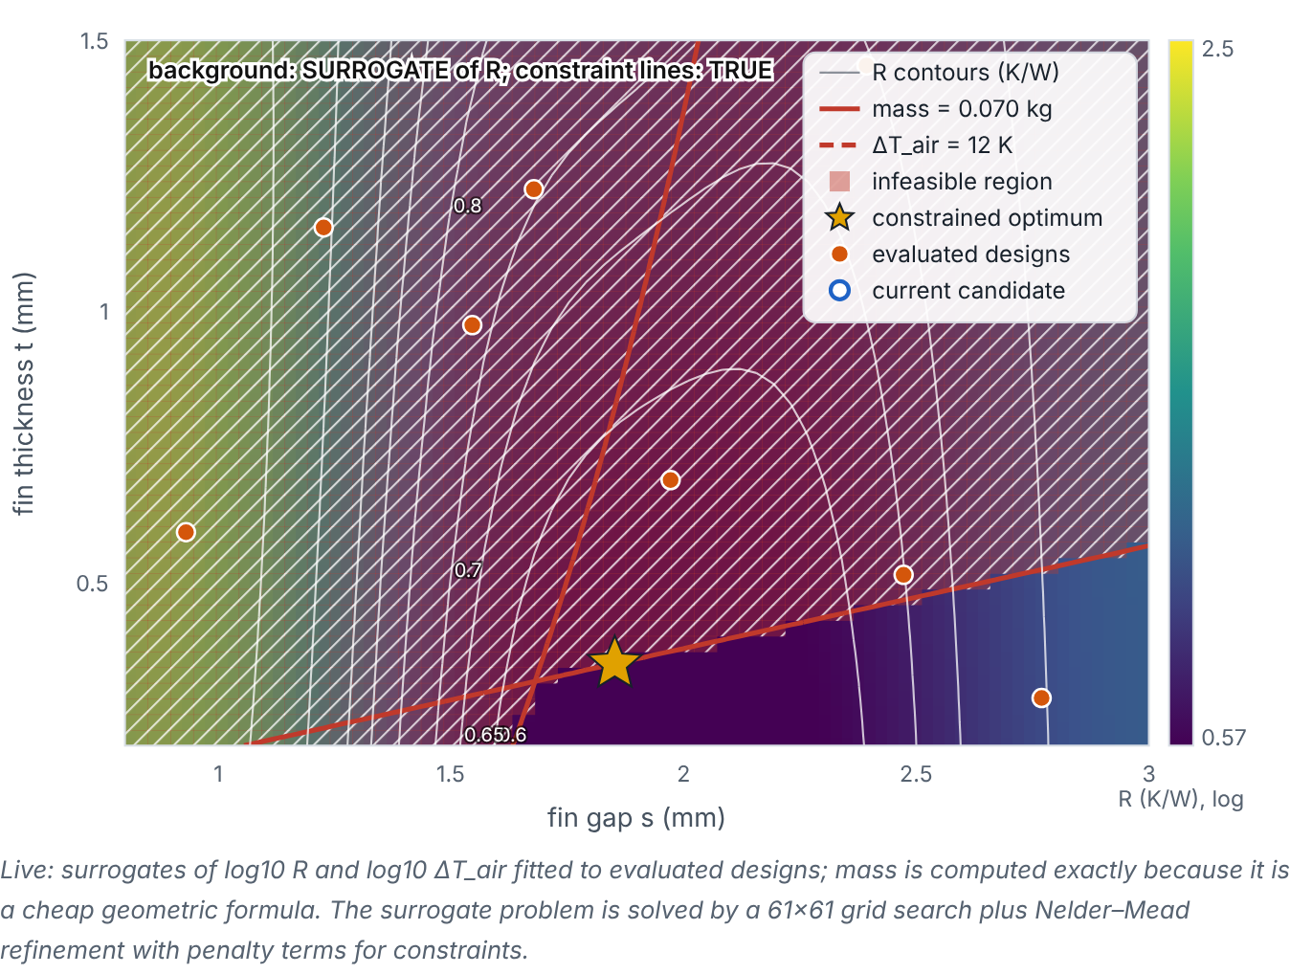
Running surrogate-based optimization
Lesson 1 · The loop: fit, optimize, verify, update · Figure
Choose surrogate type and initial sample size; press ① to optimize the surrogate and ② to verify and add the point. A table records predicted vs verified values. (Interactive in the online course.)
Notes:
Here is another view. Choose surrogate type and initial sample size; press ① to optimize the surrogate and ② to verify and add the point. A table records predicted vs verified values. Map of the surrogate prediction of R with true constraint lines and the true optimum star. Evaluated designs are orange dots; the current candidate is a hollow circle. A table logs each iteration: design, predicted and verified R, predicted and verified air-temperature rise, mass and feasibility.

Slide 4

Running surrogate-based optimization
Lesson 1 · The loop: fit, optimize, verify, update · The mathematics
Iteration k:
x_{k} = arg min_{x ∈ box} R̂_{k}(x) s.t. m(x) ≤ 0.070, T̂_{k}(x) ≤ 12; then evaluate R(x_{k}), ΔT_{air}(x_{k})
Keep a table of: iteration, evaluations used, design, predicted and verified objective, predicted and verified constraints, feasibility. The best verified feasible design is the result.
Notes:
Now the mathematics. Iteration k: x_k = arg min_x_{ ∈ box} R̂_k(x) s.t. m(x) ≤ 0.070, T̂_k(x) ≤ 12; then evaluate R(x_k), ΔT_{air}(x_k) Keep a table of: iteration, evaluations used, design, predicted and verified objective, predicted and verified constraints, feasibility. The best verified feasible design is the result.

Slide 5


Running surrogate-based optimization
Lesson 1 · The loop: fit, optimize, verify, update · In engineering practice
Engineering application
Practical tip
Typical observation in the demo: with 8 initial LHS points, the first candidate’s predicted R differs from the verified value by a few thousandths to a few hundredths of a K/W; after about 3–5 updates the best verified design typically lies on the mass boundary within 1% of R* (author’s check: within 0.5% after 5 updates for 8 of 8 seeds). Results depend on the seed — try several.
Do not re-evaluate a design already in the data; with a deterministic model it adds nothing. If the optimizer proposes one, explore elsewhere.
Notes:
Where does this matter in engineering? Typical observation in the demo: with 8 initial LHS points, the first candidate’s predicted R differs from the verified value by a few thousandths to a few hundredths of a K/W; after about 3–5 updates the best verified design typically lies on the mass boundary within 1% of R* (author’s check: within 0.5% after 5 updates for 8 of 8 seeds). Results depend on the seed — try several. A practical tip: Do not re-evaluate a design already in the data; with a deterministic model it adds nothing. If the optimizer proposes one, explore elsewhere.

Slide 6

Pause and predict
Lesson 1 · The loop: fit, optimize, verify, update · Predict before you look
After adding a verified candidate and refitting, should the next candidate be identical to the last one?
Write down your answer, then continue to the next slide.
Notes:
Time to predict. After adding a verified candidate and refitting, should the next candidate be identical to the last one? Pause here and commit to an answer before moving on.

Slide 7

What happens, and why
Lesson 1 · The loop: fit, optimize, verify, update · Answer
Question: After adding a verified candidate and refitting, should the next candidate be identical to the last one?
Usually not: the new data point changes the surrogate locally. If the optimizer keeps returning the same point, the surrogate is already exact there — a sign of convergence (or a need to explore elsewhere).
Notes:
Here is the answer. Usually not: the new data point changes the surrogate locally. If the optimizer keeps returning the same point, the surrogate is already exact there — a sign of convergence (or a need to explore elsewhere).

Slide 8


Running surrogate-based optimization
Lesson 1 · The loop: fit, optimize, verify, update · Common misconception
Misconception
What is actually true
One surrogate fit followed by one optimization is enough.
A one-shot approach relies entirely on initial accuracy near the optimum. Sequential updates concentrate accuracy where it matters.
Takeaway Fit → optimize → verify → update; the best verified feasible design is the answer.
Notes:
A common misconception is this: One surrogate fit followed by one optimization is enough. In fact: A one-shot approach relies entirely on initial accuracy near the optimum. Sequential updates concentrate accuracy where it matters. The takeaway: Fit → optimize → verify → update; the best verified feasible design is the answer.

Slide 9
Key takeaways from this lesson
Summary
1
Running surrogate-based optimization
Fit → optimize → verify → update; the best verified feasible design is the answer.
Notes:
To sum up this lesson. Running surrogate-based optimization: Fit → optimize → verify → update; the best verified feasible design is the answer.

Slide 10

Constraint surrogates and optimizer exploitation
UP NEXT · LESSON 11.2
Next in Module 11: Lesson 2. Mark this lesson complete in the course before continuing.
Notes:
That completes Lesson 1 of Module 11: The loop: fit, optimize, verify, update. Next comes Lesson 2: Constraint surrogates and optimizer exploitation.

