Slide 1
Constraint surrogates and optimizer exploitation
MODULE 11 · LESSON 2 OF 3 · ≈ 11 MIN
11.2
Module 11: Surrogate-based optimization
When the optimizer finds the surrogate’s mistakes
Notes:
Welcome to Module 11, Lesson 2 of the self-paced course Machine Learning Fundamentals for Surrogate-Based Engineering Optimization: Constraint surrogates and optimizer exploitation. This lesson belongs to the module Surrogate-based optimization and takes about 11 minutes. In this lesson: When the optimizer finds the surrogate’s mistakes.

Slide 2
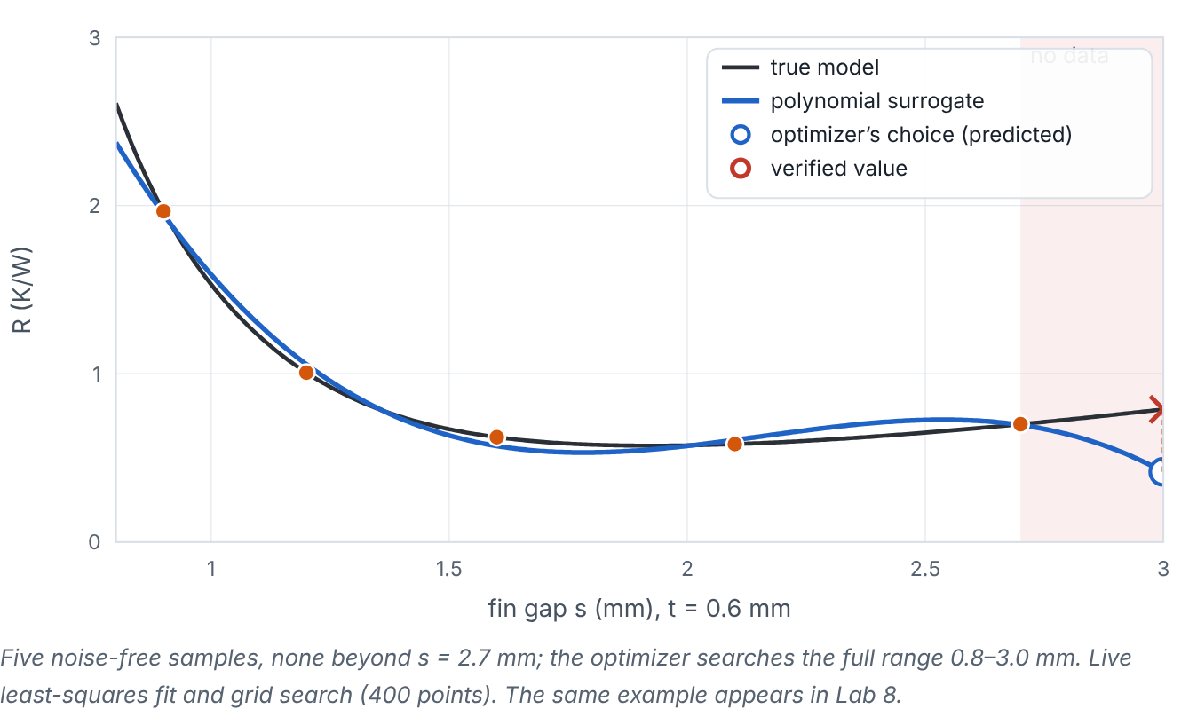

When the optimizer finds the surrogate’s mistakes
Lesson 2 · Constraint surrogates and optimizer exploitation · Intuition
An optimizer is a relentless searcher for the lowest predicted value. If the surrogate has a spurious dip — from overfitting, an outlier, or extrapolation — the optimizer will find and exploit it. The same applies to constraint surrogates: an under-predicted constraint makes an infeasible design look feasible.
A cubic fitted to five samples dives beyond the last sample; the optimizer picks that unsampled edge. (Interactive in the online course.)
Notes:
When the optimizer finds the surrogate’s mistakes. An optimizer is a relentless searcher for the lowest predicted value. If the surrogate has a spurious dip — from overfitting, an outlier, or extrapolation — the optimizer will find and exploit it. The same applies to constraint surrogates: an under-predicted constraint makes an infeasible design look feasible. Look at the figure. A cubic fitted to five samples dives beyond the last sample; the optimizer picks that unsampled edge. Plot of true R versus fin gap with five samples between 0.9 and 2.7 mm and a cubic surrogate. Beyond 2.7 mm (shaded, no data) the cubic falls steeply; the optimizer chooses s = 3.0 mm with a predicted R near 0.42 K/W, while the verified value (red ×) is about 0.79 K/W.

Slide 3

When the optimizer finds the surrogate’s mistakes
Lesson 2 · Constraint surrogates and optimizer exploitation · The mathematics
Safeguards:
Prefer smooth, validated surrogates; avoid excessive flexibility with few points.
Constrain the optimizer to the sampled region or a trust region around the best verified design.
Use a constraint margin: require ĝ(x) + k·σ_{g}(x) ≤ 0 (with a GP), or a fixed safety margin.
Always verify candidates; add them to the data.
Notes:
Now the mathematics. Safeguards: • Prefer smooth, validated surrogates; avoid excessive flexibility with few points.
• Constrain the optimizer to the sampled region or a trust region around the best verified design.
• Use a constraint margin: require ĝ(x) + k·σ_g(x) ≤ 0 (with a GP), or a fixed safety margin.
• Always verify candidates; add them to the data.

Slide 4


When the optimizer finds the surrogate’s mistakes
Lesson 2 · Constraint surrogates and optimizer exploitation · In engineering practice
Engineering application
Practical tip
Heat sink: ΔT_{air} rises steeply at small gaps. If its surrogate under-predicts there, the optimizer may pick an infeasible small-gap design. Mass is computed exactly, so it cannot be exploited — a strong argument for computing cheap responses exactly.
Plot candidates on the error/uncertainty map; candidates in high-uncertainty regions deserve scepticism (or deliberate exploration, Module 12).
Notes:
Where does this matter in engineering? Heat sink: ΔT_{air} rises steeply at small gaps. If its surrogate under-predicts there, the optimizer may pick an infeasible small-gap design. Mass is computed exactly, so it cannot be exploited — a strong argument for computing cheap responses exactly. A practical tip: Plot candidates on the error/uncertainty map; candidates in high-uncertainty regions deserve scepticism (or deliberate exploration, Module 12).

Slide 5

Pause and predict
Lesson 2 · Constraint surrogates and optimizer exploitation · Predict before you look
The optimizer’s candidate lies right at a corner of the bounds where there are no samples, with a remarkably low predicted R. What should you suspect?
Write down your answer, then continue to the next slide.
Notes:
Time to predict. The optimizer’s candidate lies right at a corner of the bounds where there are no samples, with a remarkably low predicted R. What should you suspect? Pause here and commit to an answer before moving on.

Slide 6

What happens, and why
Lesson 2 · Constraint surrogates and optimizer exploitation · Answer
Question: The optimizer’s candidate lies right at a corner of the bounds where there are no samples, with a remarkably low predicted R. What should you suspect?
Exploitation of extrapolation error. Verify, and consider a trust region or more samples near that corner.
Notes:
Here is the answer. Exploitation of extrapolation error. Verify, and consider a trust region or more samples near that corner.

Slide 7


When the optimizer finds the surrogate’s mistakes
Lesson 2 · Constraint surrogates and optimizer exploitation · Common misconception
Misconception
What is actually true
A better optimizer will fix bad surrogate predictions.
A better optimizer finds surrogate errors more effectively. Fix the surrogate (data, model, margins), not the optimizer.
Takeaway Optimizers exploit surrogate errors; use smooth models, margins, trust regions and verification.
Notes:
A common misconception is this: A better optimizer will fix bad surrogate predictions. In fact: A better optimizer finds surrogate errors more effectively. Fix the surrogate (data, model, margins), not the optimizer. The takeaway: Optimizers exploit surrogate errors; use smooth models, margins, trust regions and verification.

Slide 8
Key takeaways from this lesson
Summary
1
When the optimizer finds the surrogate’s mistakes
Optimizers exploit surrogate errors; use smooth models, margins, trust regions and verification.
Notes:
To sum up this lesson. When the optimizer finds the surrogate’s mistakes: Optimizers exploit surrogate errors; use smooth models, margins, trust regions and verification.

Slide 9

Stopping criteria and fair comparisons
UP NEXT · LESSON 11.3
Next in Module 11: Lesson 3. Mark this lesson complete in the course before continuing.
Notes:
That completes Lesson 2 of Module 11: Constraint surrogates and optimizer exploitation. Next comes Lesson 3: Stopping criteria and fair comparisons.

