Slide 1
Stopping criteria and fair comparisons
MODULE 11 · LESSON 3 OF 3 · ≈ 10 MIN
11.3
Module 11: Surrogate-based optimization
When to stop, and how to compare methods honestly
Notes:
Welcome to Module 11, Lesson 3 of the self-paced course Machine Learning Fundamentals for Surrogate-Based Engineering Optimization: Stopping criteria and fair comparisons. This lesson belongs to the module Surrogate-based optimization and takes about 10 minutes. In this lesson: When to stop, and how to compare methods honestly.

Slide 2
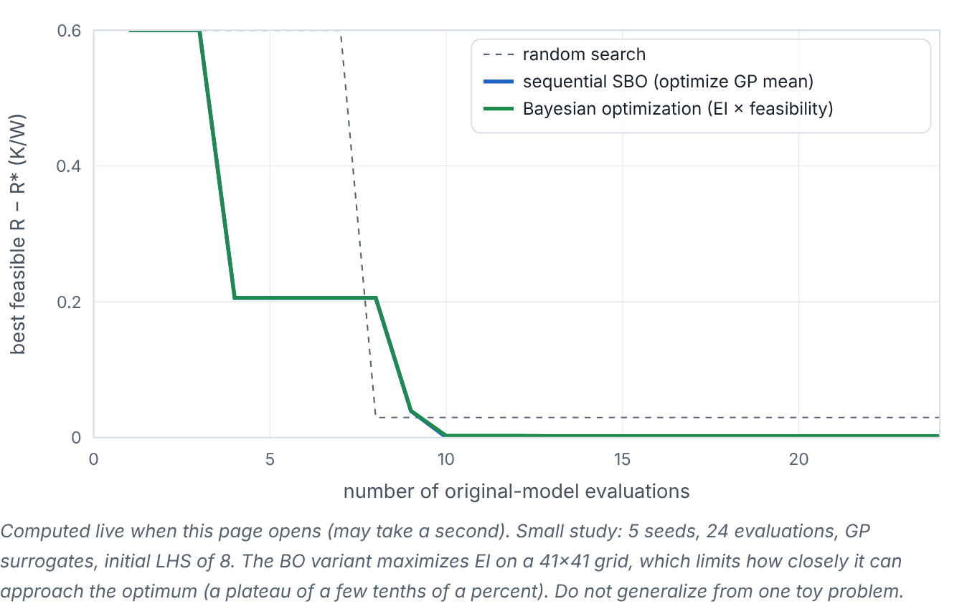

When to stop, and how to compare methods honestly
Lesson 3 · Stopping criteria and fair comparisons · Intuition
Stop when the evaluation budget is used, when verified improvement over several iterations is negligible, or when candidates repeat. To compare methods (random search, one-shot surrogate, sequential SBO, Bayesian optimization), plot the best verified feasible objective versus the number of original-model evaluations, averaged over several seeds — never compare by iterations or by predicted values.
Computed live: median gap to the reference optimum versus original-model evaluations for random search, sequential SBO and Bayesian optimization (5 seeds each).
Notes:
When to stop, and how to compare methods honestly. Stop when the evaluation budget is used, when verified improvement over several iterations is negligible, or when candidates repeat. To compare methods (random search, one-shot surrogate, sequential SBO, Bayesian optimization), plot the best verified feasible objective versus the number of original-model evaluations, averaged over several seeds — never compare by iterations or by predicted values. Look at the figure. Computed live: median gap to the reference optimum versus original-model evaluations for random search, sequential SBO and Bayesian optimization (5 seeds each). Three descending curves of best feasible R minus R* versus number of evaluations. Random search improves slowly; sequential SBO and BO drop quickly after the initial 8 samples. Differences between SBO and BO are small on this smooth problem.

Slide 3

When to stop, and how to compare methods honestly
Lesson 3 · Stopping criteria and fair comparisons · The mathematics
stop if k ≥ B or (f_{best}^{(k−w)} − f_{best}^{(k)})/(|f_{best}^{(k)}|) < ε
Symbol | Meaning | Unit
B | budget of original-model evaluations | count
w | window of recent iterations | count
ε | relative improvement tolerance, e.g. 0.001 | —
Fair comparison: same total original-model evaluations (including initial samples), same initial design where applicable, several seeds, report median and spread, and include computational cost of fitting if it is not negligible.
Notes:
Now the mathematics. stop if k ≥ B or (f_{best}^(^k^−^w^) − f_{best}^(^k^))/(|f_{best}^(^k^)|) < ε B is the budget of original-model evaluations, in count. w is the window of recent iterations, in count. ε is the relative improvement tolerance, e.g. 0.001. Fair comparison: same total original-model evaluations (including initial samples), same initial design where applicable, several seeds, report median and spread, and include computational cost of fitting if it is not negligible.

Slide 4


When to stop, and how to compare methods honestly
Lesson 3 · Stopping criteria and fair comparisons · In engineering practice
Engineering application
Practical tip
In CFD-based studies the cost is dominated by simulations, so “evaluations” is the right x-axis. If a surrogate method takes hours of fitting time per iteration (e.g., large neural networks), that cost must be reported too.
Include random search with the same budget as a baseline. If your method does not beat it clearly, reconsider.
Notes:
Where does this matter in engineering? In CFD-based studies the cost is dominated by simulations, so “evaluations” is the right x-axis. If a surrogate method takes hours of fitting time per iteration (e.g., large neural networks), that cost must be reported too. A practical tip: Include random search with the same budget as a baseline. If your method does not beat it clearly, reconsider.

Slide 5

Pause and predict
Lesson 3 · Stopping criteria and fair comparisons · Predict before you look
Method A reaches its best design after 5 iterations of 4 evaluations each; method B after 12 iterations of 1 evaluation each. Which used fewer original-model evaluations?
Write down your answer, then continue to the next slide.
Notes:
Time to predict. Method A reaches its best design after 5 iterations of 4 evaluations each; method B after 12 iterations of 1 evaluation each. Which used fewer original-model evaluations? Pause here and commit to an answer before moving on.

Slide 6

What happens, and why
Lesson 3 · Stopping criteria and fair comparisons · Answer
Question: Method A reaches its best design after 5 iterations of 4 evaluations each; method B after 12 iterations of 1 evaluation each. Which used fewer original-model evaluations?
B: 12 evaluations vs A’s 20. Compare by evaluations, not iterations.
Notes:
Here is the answer. B: 12 evaluations vs A’s 20. Compare by evaluations, not iterations.

Slide 7


When to stop, and how to compare methods honestly
Lesson 3 · Stopping criteria and fair comparisons · Common misconception
Misconception
What is actually true
Comparing best predicted values is fine because the surrogate is accurate.
Only verified values are evidence; predicted values are biased optimistic at optima.
Takeaway Stop on budget or stagnation; compare by verified best value vs original-model evaluations over several seeds.
Notes:
A common misconception is this: Comparing best predicted values is fine because the surrogate is accurate. In fact: Only verified values are evidence; predicted values are biased optimistic at optima. The takeaway: Stop on budget or stagnation; compare by verified best value vs original-model evaluations over several seeds.

Slide 8
Key takeaways from this lesson
Summary
1
When to stop, and how to compare methods honestly
Stop on budget or stagnation; compare by verified best value vs original-model evaluations over several seeds.
Notes:
To sum up this lesson. When to stop, and how to compare methods honestly: Stop on budget or stagnation; compare by verified best value vs original-model evaluations over several seeds.

Slide 9

Exploration versus exploitation
UP NEXT · LESSON 12.1
That completes Module 11. Before moving on, review the Module 11 flashcards and take its quiz in the course (pass mark 70%). Next: Module 12, Sequential learning and Bayesian optimization.
Notes:
That completes Lesson 3 of Module 11: Stopping criteria and fair comparisons. This was the last lesson of the module, so review the flashcards and take the Module 11 quiz in the course. Next comes Module 12, Sequential learning and Bayesian optimization, starting with Exploration versus exploitation.

