Slide 1
Exploration versus exploitation
MODULE 12 · LESSON 1 OF 3 · ≈ 9 MIN
12.1
Module 12: Sequential learning and Bayesian optimization
Sample where it looks good, or where you know little?
Notes:
Welcome to Module 12, Lesson 1 of the self-paced course Machine Learning Fundamentals for Surrogate-Based Engineering Optimization: Exploration versus exploitation. This lesson belongs to the module Sequential learning and Bayesian optimization and takes about 9 minutes. In this lesson: Sample where it looks good, or where you know little?.

Slide 2
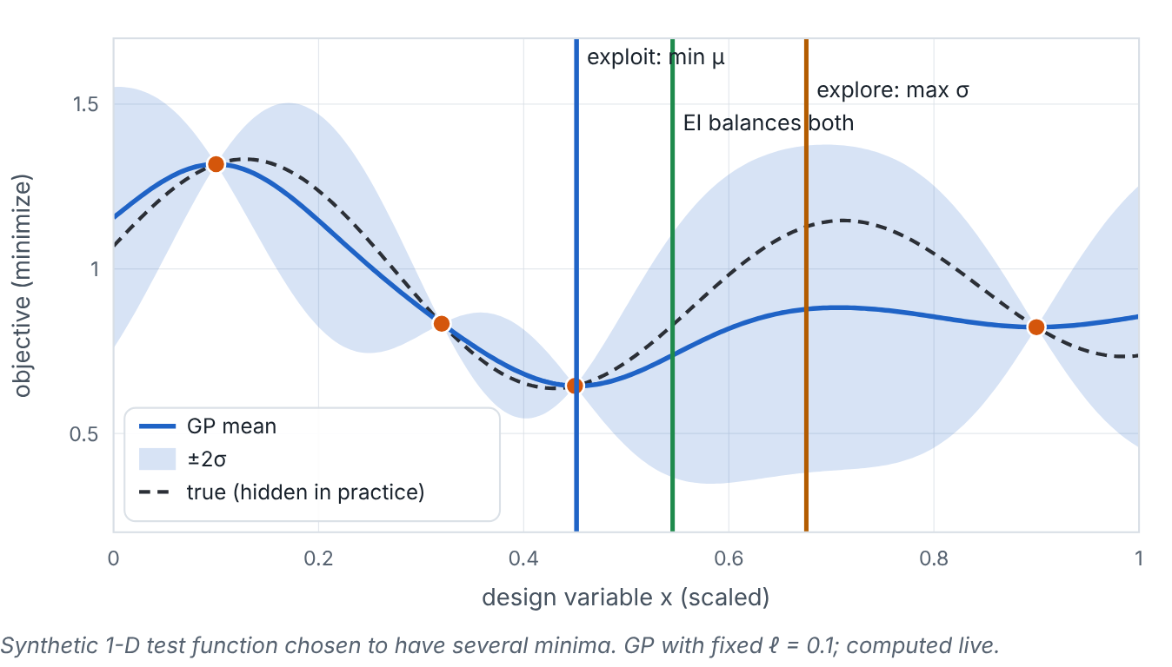

Sample where it looks good, or where you know little?
Lesson 1 · Exploration versus exploitation · Intuition
Exploitation: sample where the surrogate predicts the best value (lowest μ). Exploration: sample where uncertainty σ is highest, to learn. Pure exploitation can get stuck refining a local valley; pure exploration wastes evaluations on regions that are clearly poor. Good strategies balance both.
A GP fitted to four samples of a synthetic multimodal function: the pure-exploitation, pure-exploration and expected-improvement choices differ.
Notes:
Sample where it looks good, or where you know little?. Exploitation: sample where the surrogate predicts the best value (lowest μ). Exploration: sample where uncertainty σ is highest, to learn. Pure exploitation can get stuck refining a local valley; pure exploration wastes evaluations on regions that are clearly poor. Good strategies balance both. Look at the figure. A GP fitted to four samples of a synthetic multimodal function: the pure-exploitation, pure-exploration and expected-improvement choices differ. GP mean and band over a 1-D design variable. Three vertical lines: “exploit: min μ” near the best observed sample, “explore: max σ” in the largest gap, and “EI balances both” at an intermediate location.

Slide 3

Sample where it looks good, or where you know little?
Lesson 1 · Exploration versus exploitation · The mathematics
Lower confidence bound (for minimization) makes the trade-off explicit:
LCB(x) = μ(x) − κ σ(x), next sample = arg min LCB
Symbol | Meaning | Unit
κ | exploration weight: 0 = pure exploitation; large = mostly exploration | —
Notes:
Now the mathematics. Lower confidence bound (for minimization) makes the trade-off explicit: LCB(x) = μ(x) − κ σ(x), next sample = arg min LCB κ is the exploration weight: 0 = pure exploitation; large = mostly exploration.

Slide 4


Sample where it looks good, or where you know little?
Lesson 1 · Exploration versus exploitation · In engineering practice
Engineering application
Practical tip
In a turbomachinery study with 40 CFD runs, early iterations benefit from exploration (find the right region), later ones from exploitation (refine the best design).
If successive candidates cluster tightly while large regions remain unexplored, increase exploration (κ, or ξ in EI).
Notes:
Where does this matter in engineering? In a turbomachinery study with 40 CFD runs, early iterations benefit from exploration (find the right region), later ones from exploitation (refine the best design). A practical tip: If successive candidates cluster tightly while large regions remain unexplored, increase exploration (κ, or ξ in EI).

Slide 5

Pause and predict
Lesson 1 · Exploration versus exploitation · Predict before you look
With κ = 0, which point does LCB select?
Write down your answer, then continue to the next slide.
Notes:
Time to predict. With κ = 0, which point does LCB select? Pause here and commit to an answer before moving on.

Slide 6

What happens, and why
Lesson 1 · Exploration versus exploitation · Answer
Question: With κ = 0, which point does LCB select?
The minimum of the GP mean — pure exploitation.
Notes:
Here is the answer. The minimum of the GP mean — pure exploitation.

Slide 7


Sample where it looks good, or where you know little?
Lesson 1 · Exploration versus exploitation · Common misconception
Misconception
What is actually true
Exploration wastes evaluations.
Without it, the search can miss a better region entirely; exploration is an investment.
Takeaway Exploit (low μ) vs explore (high σ); acquisition functions balance them.
Notes:
A common misconception is this: Exploration wastes evaluations. In fact: Without it, the search can miss a better region entirely; exploration is an investment. The takeaway: Exploit (low μ) vs explore (high σ); acquisition functions balance them.

Slide 8
Key takeaways from this lesson
Summary
1
Sample where it looks good, or where you know little?
Exploit (low μ) vs explore (high σ); acquisition functions balance them.
Notes:
To sum up this lesson. Sample where it looks good, or where you know little?: Exploit (low μ) vs explore (high σ); acquisition functions balance them.

Slide 9

Acquisition functions and expected improvement
UP NEXT · LESSON 12.2
Next in Module 12: Lesson 2. Mark this lesson complete in the course before continuing.
Notes:
That completes Lesson 1 of Module 12: Exploration versus exploitation. Next comes Lesson 2: Acquisition functions and expected improvement.

