Slide 1
Acquisition functions and expected improvement
MODULE 12 · LESSON 2 OF 3 · ≈ 14 MIN
12.2
Module 12: Sequential learning and Bayesian optimization
Expected improvement for minimization
Notes:
Welcome to Module 12, Lesson 2 of the self-paced course Machine Learning Fundamentals for Surrogate-Based Engineering Optimization: Acquisition functions and expected improvement. This lesson belongs to the module Sequential learning and Bayesian optimization and takes about 14 minutes. In this lesson: Expected improvement for minimization.

Slide 2
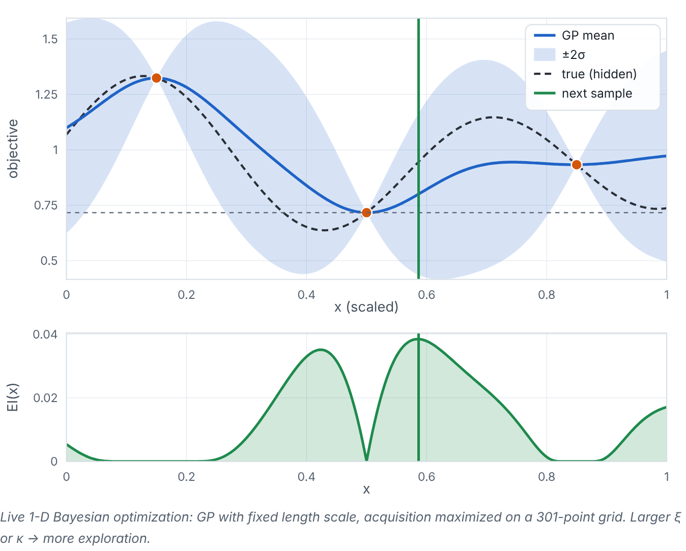

Expected improvement for minimization
Lesson 2 · Acquisition functions and expected improvement · Intuition
Let f_{best} be the best (lowest) value observed so far. At each candidate x, the GP says the unknown value is roughly normal with mean μ and standard deviation σ. Expected improvement (EI) is the average amount by which it would beat f_{best}, counting “no improvement” as zero. EI is large where μ is low (exploitation) or σ is large (exploration).
Interactive Bayesian optimization in 1-D: the GP (top), the acquisition function (bottom) and the next sample (green line). Adjust ξ or switch to LCB, then press “Evaluate next point”. (Interactive in the online course.)
Notes:
Expected improvement for minimization. Let f_{best} be the best (lowest) value observed so far. At each candidate x, the GP says the unknown value is roughly normal with mean μ and standard deviation σ. Expected improvement (EI) is the average amount by which it would beat f_{best}, counting “no improvement” as zero. EI is large where μ is low (exploitation) or σ is large (exploration). Look at the figure. Interactive Bayesian optimization in 1-D: the GP (top), the acquisition function (bottom) and the next sample (green line). Adjust ξ or switch to LCB, then press “Evaluate next point”. Top: GP mean, band, hidden true function and samples, with a horizontal line at the best observed value and a green vertical line at the next sample. Bottom: the EI curve, zero at existing samples and peaking at the chosen point. Increasing ξ shifts the peak toward unexplored regions.

Slide 3

Expected improvement for minimization
Lesson 2 · Acquisition functions and expected improvement · The mathematics (1/2)
For a candidate x, the GP says the unknown value is Y ~ N(μ, σ²). With an optional margin ξ ≥ 0, define the improvement random variable I_{ξ} = max(f_{best} − Y − ξ, 0) and EI = E[I_{ξ}]:
EI(x) = (f_{best} − μ − ξ) Φ(z) + σ φ(z), z = (f_{best} − μ − ξ)/(σ), for σ > 0
EI(x) = max(f_{best} − μ − ξ, 0) for σ = 0 (then Y = μ with certainty, so I_{ξ} is deterministic)
Notes:
Now the mathematics. For a candidate x, the GP says the unknown value is Y ~ N(μ, σ²). With an optional margin ξ ≥ 0, define the improvement random variable I_ξ = max(f_{best} − Y − ξ, 0) and EI = E[I_ξ]: EI(x) = (f_{best} − μ − ξ) Φ(z) + σ φ(z), z = (f_{best} − μ − ξ)/(σ), for σ > 0 EI(x) = max(f_{best} − μ − ξ, 0) for σ = 0 (then Y = μ with certainty, so I_ξ is deterministic)

Slide 4
Expected improvement for minimization
Lesson 2 · Acquisition functions and expected improvement · The mathematics (2/2)
Symbol | Meaning | Unit
Φ, φ | standard normal CDF and PDF | —
ξ ≥ 0 | optional margin: larger ξ demands bigger improvement → more exploration | units of f
z | standardized improvement | —
σ = 0 must be handled separately: the formula divides by σ. With σ = 0 the outcome is certain, so the improvement is deterministic. At an existing noise-free sample μ = y_{i} ≥ f_{best}, hence EI = 0 — BO never re-samples a known point. In code, treat σ below a tiny threshold as zero.
Notes:
Continuing. Φ, φ is the standard normal CDF and PDF. ξ ≥ 0 is the optional margin: larger ξ demands bigger improvement → more exploration, in units of f. z is the standardized improvement. σ = 0 must be handled separately: the formula divides by σ. With σ = 0 the outcome is certain, so the improvement is deterministic. At an existing noise-free sample μ = y_i ≥ f_{best}, hence EI = 0 — BO never re-samples a known point. In code, treat σ below a tiny threshold as zero.

Slide 5


Expected improvement for minimization
Lesson 2 · Acquisition functions and expected improvement · In engineering practice
Engineering application
Practical tip
Heat-sink slice option in the demo: EI quickly concentrates samples around the minimum near s ≈ 1.9 mm. Synthetic multimodal option: with ξ = 0 EI may refine a local valley; with ξ ≈ 0.05 it explores other valleys first. (Fitting to log₁₀R in Lab 9 means EI is computed on the log scale.)
Maximize EI with a multi-start or dense grid: EI is often flat (near zero) over large regions with narrow peaks.
Notes:
Where does this matter in engineering? Heat-sink slice option in the demo: EI quickly concentrates samples around the minimum near s ≈ 1.9 mm. Synthetic multimodal option: with ξ = 0 EI may refine a local valley; with ξ ≈ 0.05 it explores other valleys first. (Fitting to log₁₀R in Lab 9 means EI is computed on the log scale.) A practical tip: Maximize EI with a multi-start or dense grid: EI is often flat (near zero) over large regions with narrow peaks.

Slide 6

Pause and predict
Lesson 2 · Acquisition functions and expected improvement · Predict before you look
At a candidate, μ = 0.60, σ = 0.05, f_best = 0.62, ξ = 0. Is EI larger or smaller than 0.02?
Write down your answer, then continue to the next slide.
Notes:
Time to predict. At a candidate, μ = 0.60, σ = 0.05, f_best = 0.62, ξ = 0. Is EI larger or smaller than 0.02? Pause here and commit to an answer before moving on.

Slide 7

What happens, and why
Lesson 2 · Acquisition functions and expected improvement · Answer
Question: At a candidate, μ = 0.60, σ = 0.05, f_best = 0.62, ξ = 0. Is EI larger or smaller than 0.02?
Larger. The deterministic part alone gives 0.02·Φ(0.4) ≈ 0.0131; adding σφ(0.4) = 0.05 × 0.368 ≈ 0.0184 gives EI ≈ 0.0315 — uncertainty adds expected upside.
Notes:
Here is the answer. Larger. The deterministic part alone gives 0.02·Φ(0.4) ≈ 0.0131; adding σφ(0.4) = 0.05 × 0.368 ≈ 0.0184 gives EI ≈ 0.0315 — uncertainty adds expected upside.

Slide 8


Expected improvement for minimization
Lesson 2 · Acquisition functions and expected improvement · Common misconception
Misconception
What is actually true
EI is the probability of improvement.
Probability of improvement (PI) is Φ(z); EI weights by how much improvement, which usually explores better.
Takeaway EI = (f_best − μ − ξ)Φ(z) + σφ(z); handle σ = 0 as max(f_best − μ − ξ, 0).
Notes:
A common misconception is this: EI is the probability of improvement. In fact: Probability of improvement (PI) is Φ(z); EI weights by how much improvement, which usually explores better. The takeaway: EI = (f_best − μ − ξ)Φ(z) + σφ(z); handle σ = 0 as max(f_best − μ − ξ, 0).

Slide 9
Key takeaways from this lesson
Summary
1
Expected improvement for minimization
EI = (f_best − μ − ξ)Φ(z) + σφ(z); handle σ = 0 as max(f_best − μ − ξ, 0).
Notes:
To sum up this lesson. Expected improvement for minimization: EI = (f_best − μ − ξ)Φ(z) + σφ(z); handle σ = 0 as max(f_best − μ − ξ, 0).

Slide 10

Noise, batches, constraints — and the assumptions behind BO
UP NEXT · LESSON 12.3
Next in Module 12: Lesson 3. Mark this lesson complete in the course before continuing.
Notes:
That completes Lesson 2 of Module 12: Acquisition functions and expected improvement. Next comes Lesson 3: Noise, batches, constraints — and the assumptions behind BO.

